Slide 1
Visual-Weld v7.5

Slide 2
Outline
What is Visual-Weld?
Model Building
Welding Advisor
Weld Utilities
Heat Treatment Advisor
Post Processing & Report Generation
Tools & Customization
Discussions

Slide 3
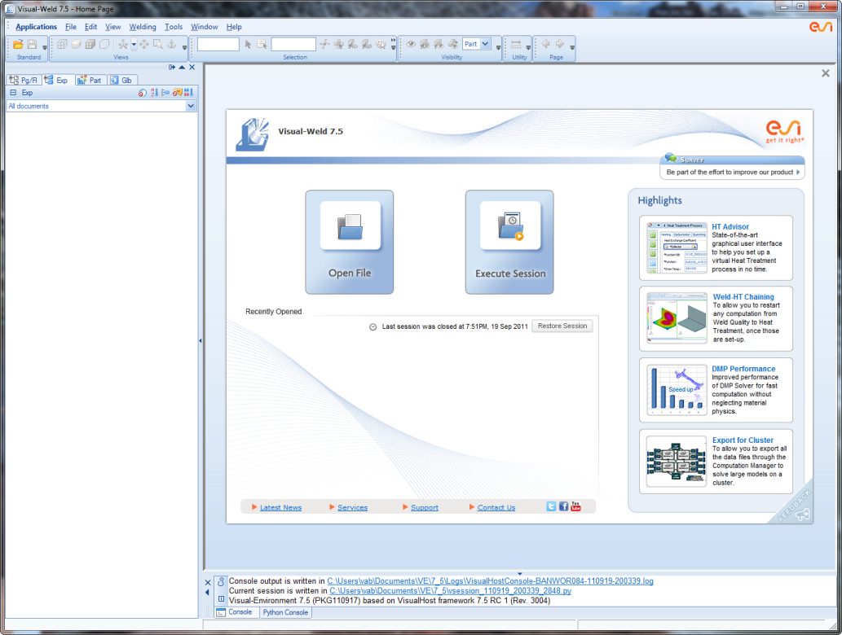
What is Visual-Weld?
Visual-Weld is the new-generation easy to use welding & Heat Treatment simulation tool developed in Visual-Environment which encompasses the complete workflow for a realistic simulation based design. It offers the full set of welding engineering methodologies needed by designers, process planners and manufacturing practitioners. Visual-Weld coupled with Visual-Mesh and Visual-Viewer covers all the activities of a Welding Engineer starting from interfacing to CAD formats, CAD cleanup, meshing, model set-up, post processing using one single data model.

Slide 4
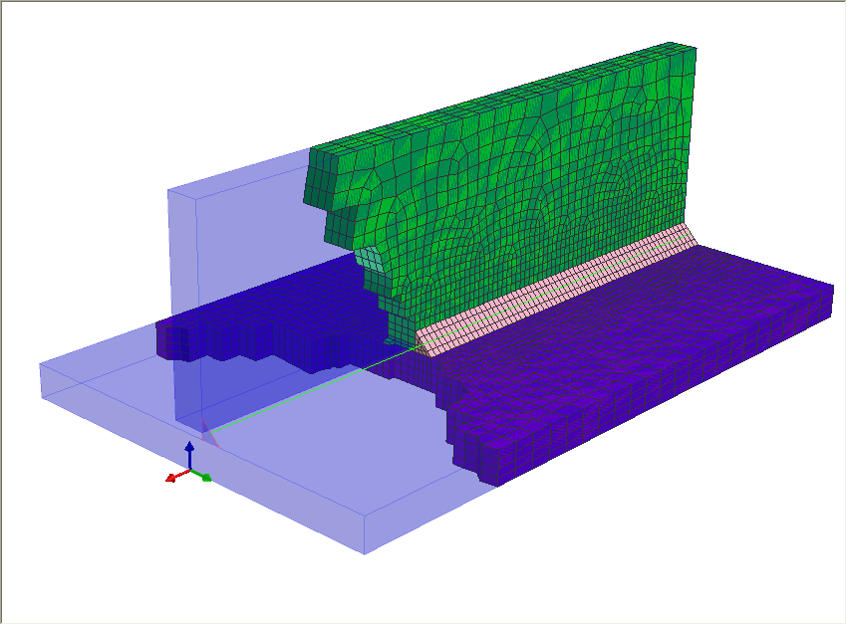
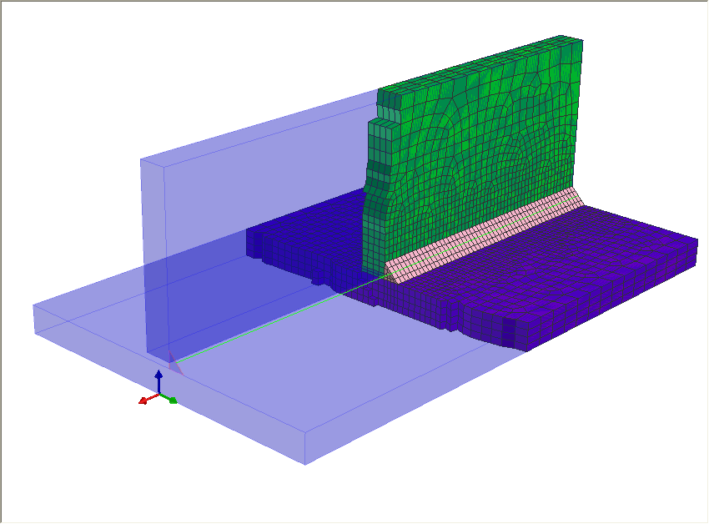
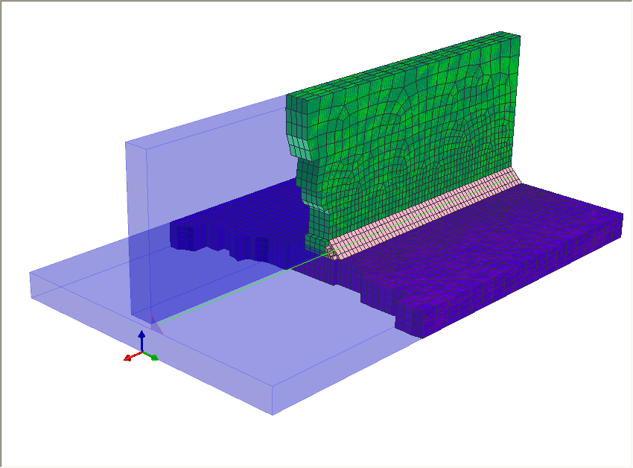
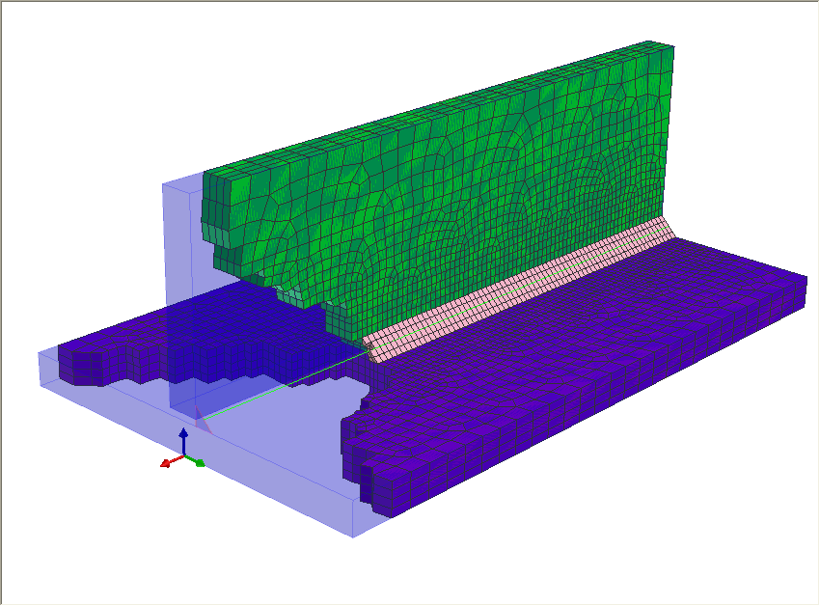
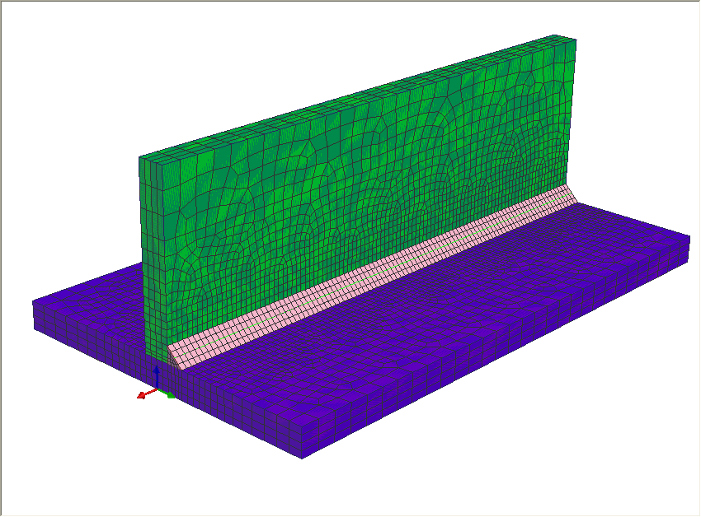
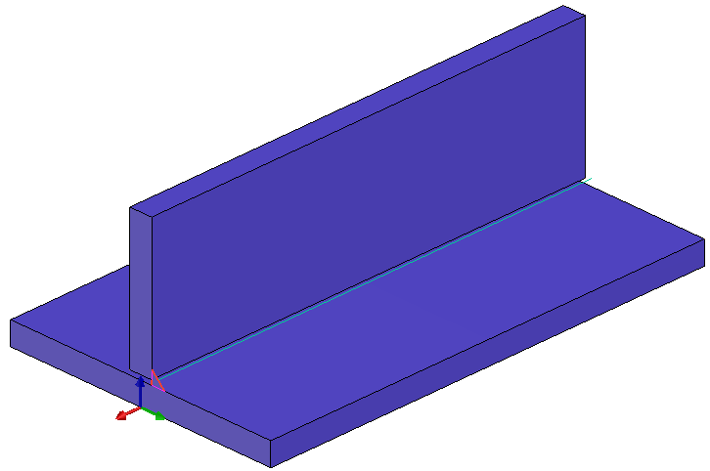
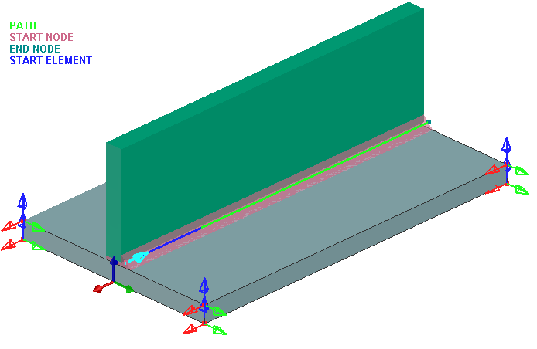
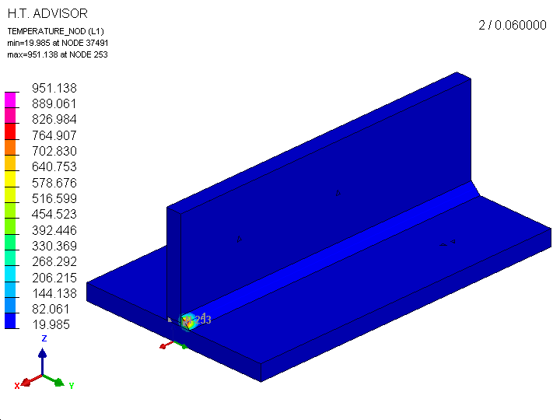
Work flow
CAD DATA
T-JOINT.iges
Visual-Mesh
MESH DATA
T-JOINT.vdb
CAD
MESH
Visual-Weld
MESH
WELD Definition
Visual-Viewer (Weld)
Results
T-JOINT.fbd
or *.dsy,*.erf
MESH & WELD DATA
T-JOINT.vdb
SYSWELD
Solve
Results

Slide 5
File types
Converted Result Files
*.fdb – Out of a file type TIT converted hoops result file (Stresses, Strains
5
1
Meshing
File Types
Welding
*.vdb - Visual Mesh file with all mesh data
*.ASC – Sysweld File with all FEM data
*.Dat files
Result Files
*.TIT – Sysweld result files in a binary format (DISP (nodes), FORCES (GP), etc.
4
2
Project definition
Solver Command File
*.prj – Project file generated with a Sysweld Advisor or an Excel tool
*.DAT – Files with solver commands generated out of a project file
3

Slide 6
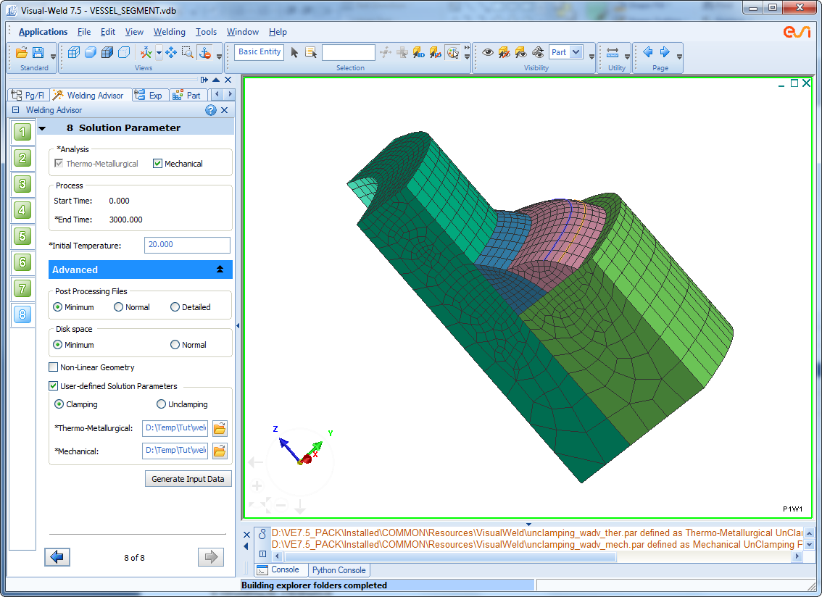

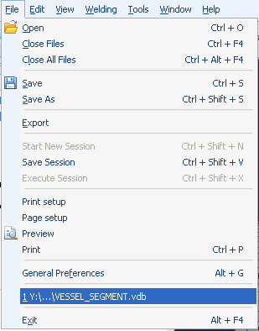
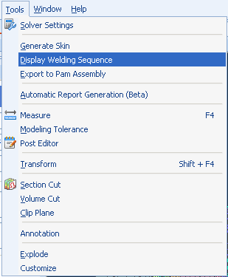
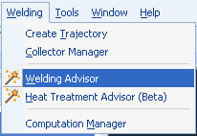
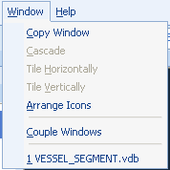
Graphical User Interface
Access various functions to thematic menu system
Easy accessible tool bars
Explorer Window, where you can visualize and manipulate the model objects tree
Model Window area, where models are displayed in one or several windows.
Console Window, where system messages are displayed.
Context Bar , where in user can switch to different context to Build, Define or Visualize results

Slide 7

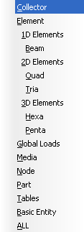

Entity Selector
The Entity Selector toolbar allows you to select and modify several entities at one time, using different methods.
ID input
List Selection
Graphical pick
Advanced selection
Many more…

Slide 8
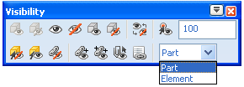

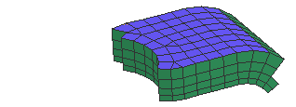


Display Control
  Fast display control
    Show selected, all, unselected
    Hide selected, all, unselected
    Reverse visibility
    Show / Mask part or element contain in a circle of 10 mm radius (in the example)
  View and Display mode tool bars

Slide 9
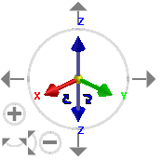
View Manipulator (Compass)
View Manipulator (Compass)
  Interactive view manipulator to reduce mouse movement and better model handling.
    2D Rotation
    Horizontal/Vertical Translation
    Horizontal/Vertical Rotation
    Axis Translation
    Axis Rotation
    View Orientation
    Mirror View and
    Zoom
  Options to Control the view manipulations

Slide 10
Outline
What is Visual-Weld?
Model Building
Welding Advisor
Weld Utilities
Heat Treatment Advisor
Post Processing & Report Generation
Tools & Customization
Discussions

Slide 11
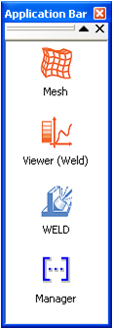
Model Building
Start with Visual–Mesh preprocessor, in order to create geometry, mesh and groups, from scratch or starting from geometry data exported from external CAD systems
Visual-Mesh
CAD DATA
T-JOINT.iges
CAD
MESH
MESH DATA
T-JOINT.vdb

Slide 12
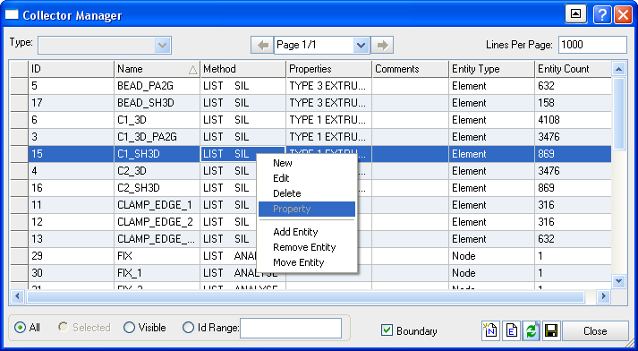
Model Building
Collector Manager
Collector Manager is an versatile utility that allows users to manage collectors. It allows you to create, edit, delete and visualize collectors which are very important in any welding simulation

Slide 13
Model Building
Collector Manager
Some of key features are listed below.
  Options to list collectors page wise and choose lines per page for easy listing.
  Filtering option based on Ids.
  Option to display model in boundary mode for easy visualization of collectors.
  Option to list all or only visible collectors.
  Options to add, remove and move entities from collectors.
  Provision to sort columns by clicking on column header.
  Editable name field.
  ‘Save’ option to save all the information in .csv format

Slide 14
Outline
What is Visual-Weld?
Model Building
Welding Advisor
Weld Utilities
Heat Treatment Advisor
Post Processing & Report Generation
Tools & Customization
Discussions

Slide 15
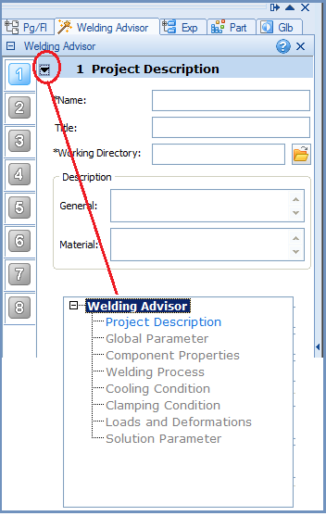
Welding Advisor
Welding Advisor
Project Description
Global Parameters
Material Properties
Heat Treatment Process
Cooling Condition
Clamping Conditions
Loads & Deformations
  An easy-to-use guided work-flow based interface requiring minimum input; Define and solve weld problems; Set-up Single-Pass and Multi-Pass Welding simulations
Solution Parameters

Slide 16
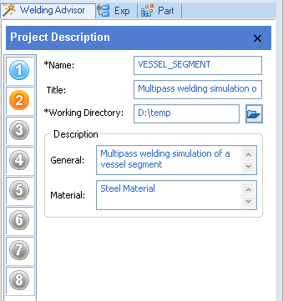
Welding Advisor
Project Description
Welding Advisor
Project Description
Global Parameters
Component Properties
Welding Process
Cooling Condition
Clamping Conditions
Loads & Deformations
  Define project name and working directory with other basic information for project identification;
  Project name will be used for all created files and they will be stored in the working directory
Solution Parameters

Slide 17
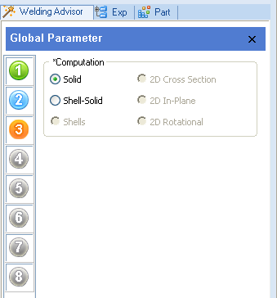
Welding Advisor
Global Parameters
Welding Advisor
Project Description
Global Parameters
Component Properties
Welding Process
Cooling Condition
Clamping Conditions
Loads & Deformations
    Set the computation option to be used for the project;
    Default computation option is selected automatically based on the loaded mesh;
Solution Parameters

Slide 18
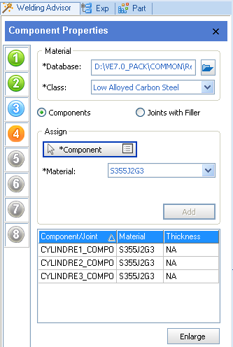
Welding Advisor
Component Properties
Welding Advisor
Project Description
Process Definition
Component Properties
Welding Process
Cooling Condition
Clamping Conditions
Loads & Deformations
    Assign materials to all components and/or filler material defining the weld problem. You can select Parts and/or Collectors for components process type.
Solution Parameters

Slide 19
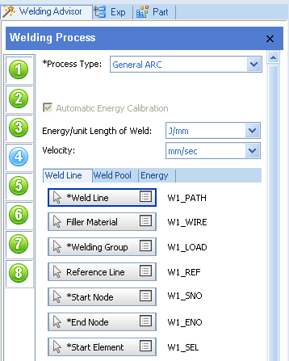
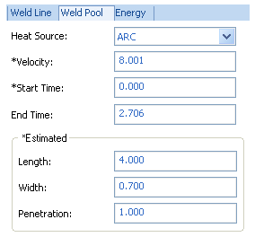
Welding Advisor
Welding Process
Welding Advisor
Project Description
Process Definition
Material Properties
Welding Process
Cooling Condition
Clamping Conditions
Loads & Deformations
    Define all required trajectories;
    Choose different process types either pre defined or user defined;
    Define all properties for heat source with diving.
Solution Parameters

Slide 20
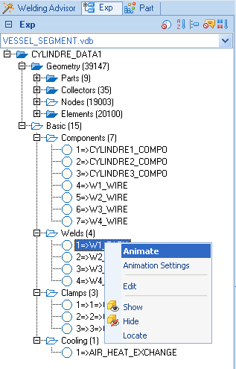
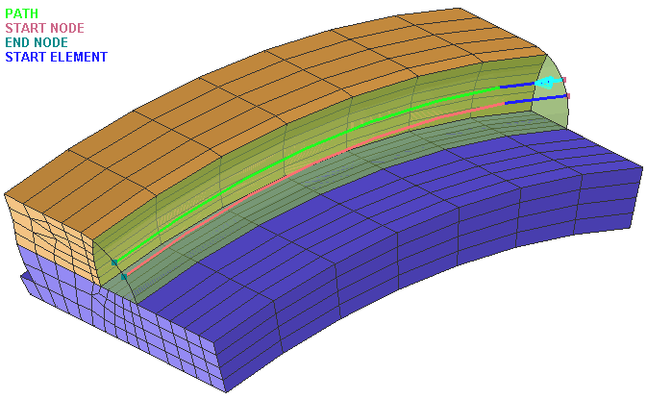
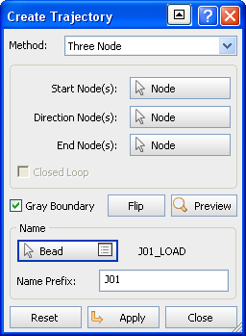
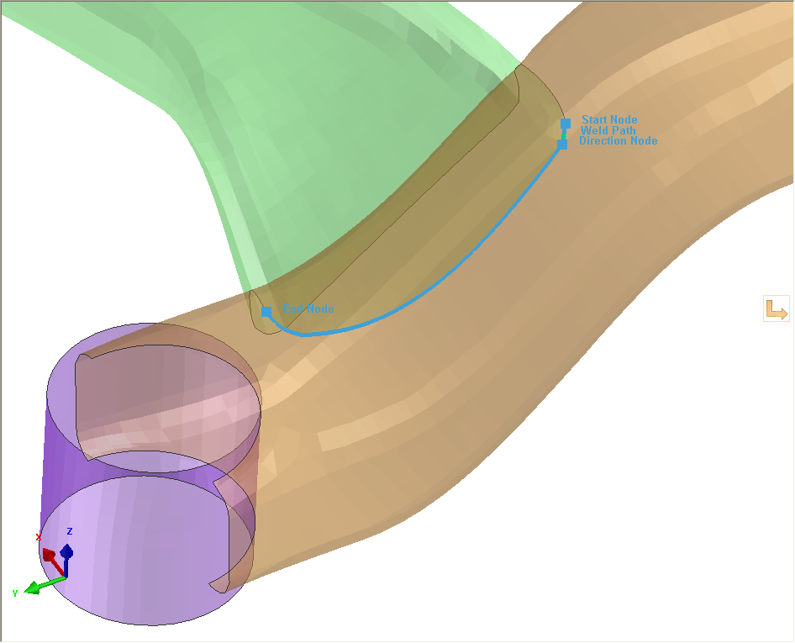
Welding Advisor
Welding Process - Automatic Weld Trajectory
Welding Advisor
Project Description
Process Definition
WELD LINE
Material Properties
Welding Process
Cooling Condition
Clamping Condition
Loads & Deformations
Solution Parameters
    Create Weld trajectories automatically;
    Directly edit entities or visualize them in explorer

Slide 21
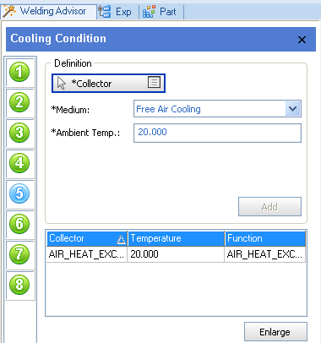
Welding Advisor
Cooling Condition
Welding Advisor
Project Description
Process Definition
Component Properties
Welding Process
Cooling Condition
Clamping Condition
Loads & Deformations
    Define heat exchange condition;
    Choose from Free cooling and/or Forced cooling
Solution Parameters

Slide 22
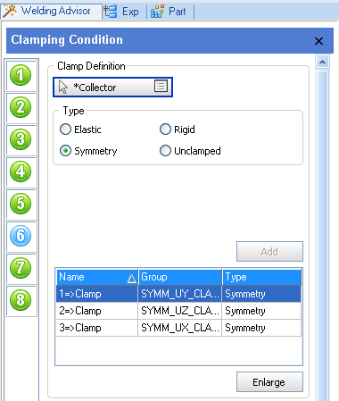
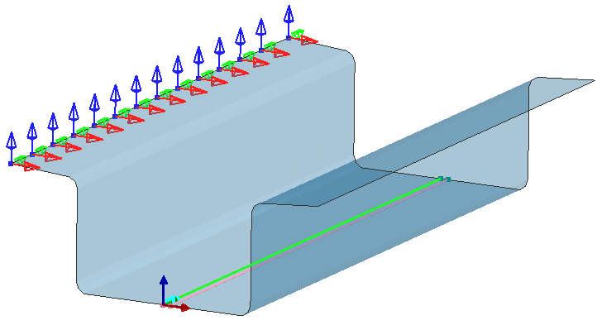
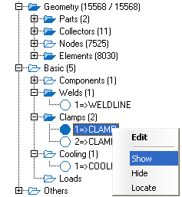
Welding Advisor
Clamping Condition
Welding Advisor
Project Description
Process Definition
Component Properties
Welding Process
Cooling Condition
Clamping Condition
Loads & Deformations
    Define all Clamps required for complete welding -
      Elastic, Rigid, Symmetry, Unclamped;
    Define clamping condition using the clamps defined;
    Directly Visualize and edit entities in explorer
Solution Parameters

Slide 23
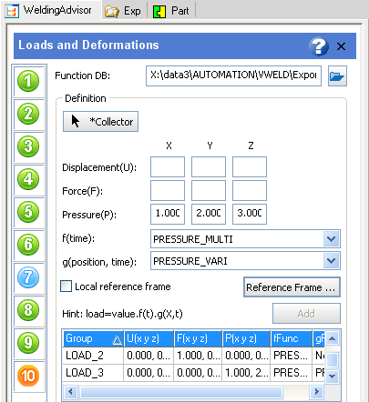

Welding Advisor
Loads & Deformations
Welding Advisor
Project Description
Process Definition
Material Properties
Heat Treatment Process
Cooling Condition
Clamping Condition
Loads & Deformations
    Define all loads and/or deformations;
      Displacements, Force, Pressure;
    Define loading conditions using the loads defined.
Solution Parameters

Slide 24
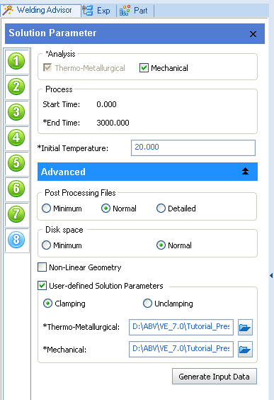
Welding Advisor
Solution Parameters
Welding Advisor
Project Description
Process Definition
Component Properties
Welding Process
MESH & WELD DATA
T-JOINT.vdb
Cooling Condition
Clamping Condition
Loads & Deformations
    Solve Set various solver parameters;
    Generate the input data;
Solution Parameters

Slide 25
Outline
What is Visual-Weld?
Model Building
Welding Advisor
Weld Utilities
Heat Treatment Advisor
Post Processing & Report Generation
Tools & Customization
Discussions

Slide 26
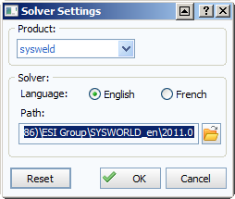
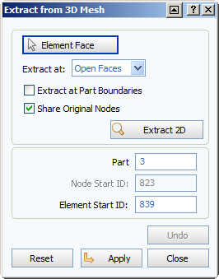
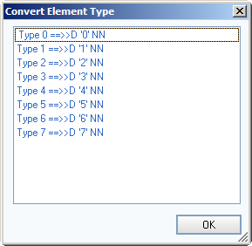
Weld Utilities
Skin Generation and Element
Weld Utilities
Basic Utilities
Welding Sequence Visualization
Job Submission
Export to Pam Assembly

Slide 27
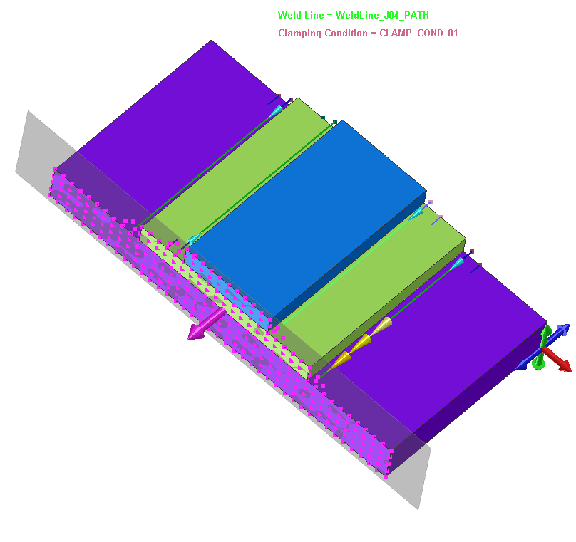






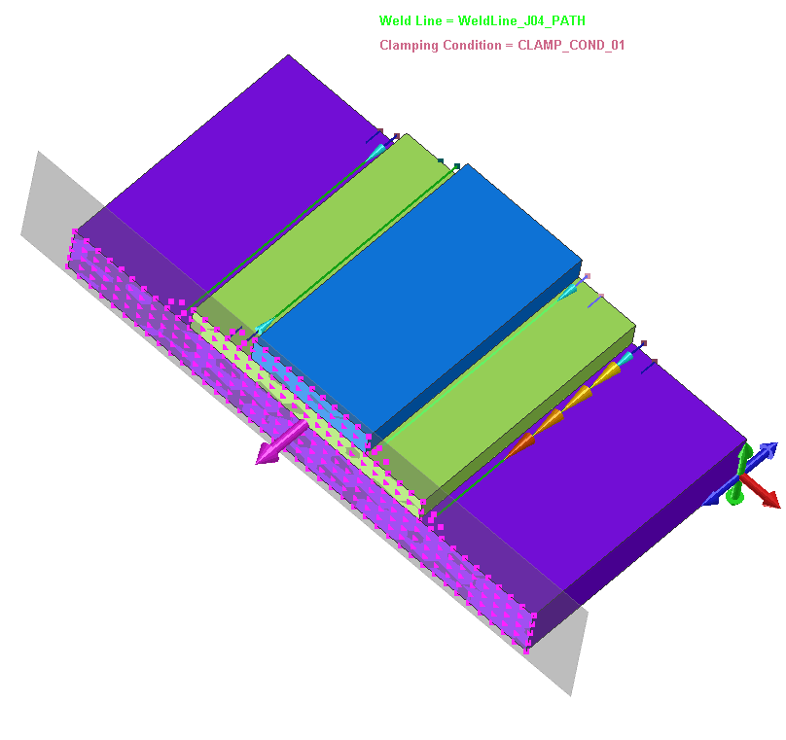
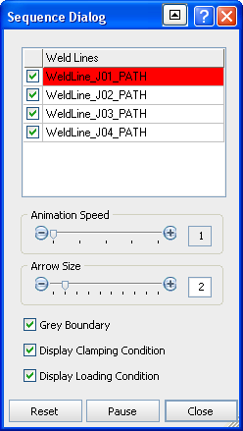
Weld Utilities
Welding Sequence Visualization
Weld Utilities
Basic Utilities
Welding Sequence Visualization
Job Submission
Export to Pam Assembly

Slide 28
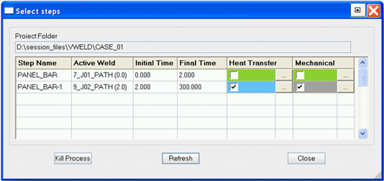
Weld Utilities
Computation Manager
Weld Utilities
Basic Utilities
Welding Sequence Visualization
Computation Manager
    An easy-to-use utility to manage complex solver runs efficiently;
    Gives you an overview of project contents;
    Allows you to control solver jobs;
  Color coding of cells based on solver run status -
    Gray: No computation;
    Blue: Computation running;
    Orange: Problem during computation;
    Green: Computation done;
Export to Pam Assembly

Slide 29
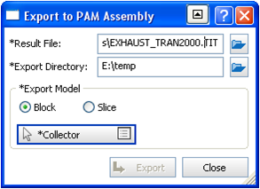
Weld Utilities
Export to PAM Assembly
Weld Utilities
Basic Utilities
Welding Sequence Visualization
Computation Manager
Export to PAM Assembly
    Export the results obtained to PAM Assembly;
    Choose from Block or Slice options;

Slide 30
Outline
What is Visual-Weld?
Model Building
Welding Advisor
Weld Utilities
Heat Treatment Advisor
Post Processing & Report Generation
Tools & Customization
Discussions

Slide 31
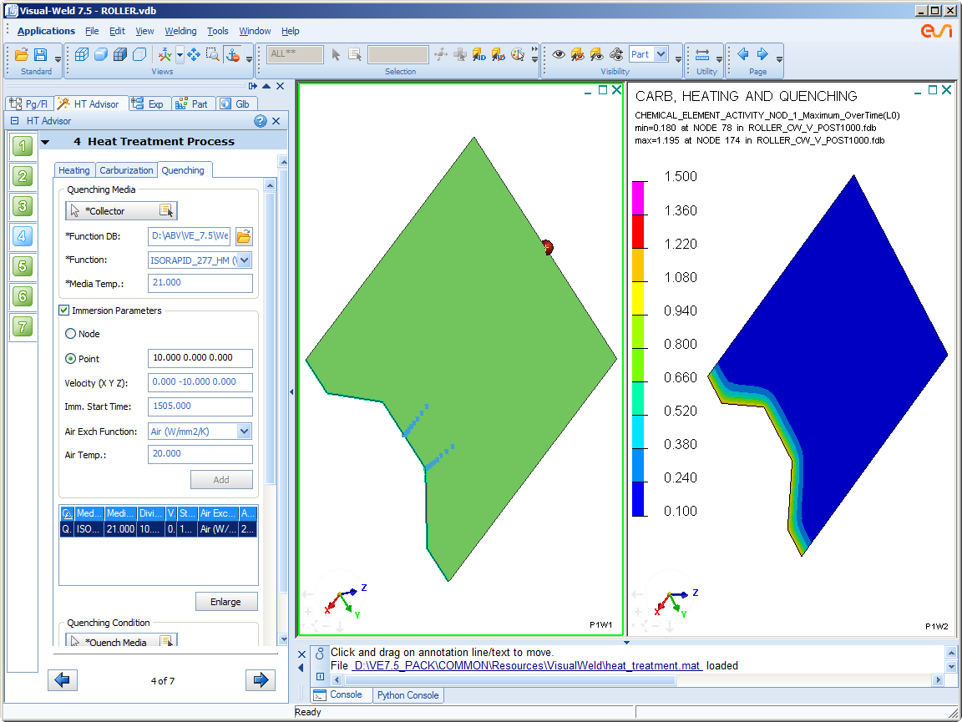
Heat Treatment Advisor
Heat Treatment Advisor
Project Description
Process Definition
Material Properties
Heat Treatment Process
Clamping Condition
Loads & Deformations
Solution Parameters
The Heat Treatment Advisor includes all you need to set up, simulate, and analyze heat
treatment problems.
Computation Manager

Slide 32
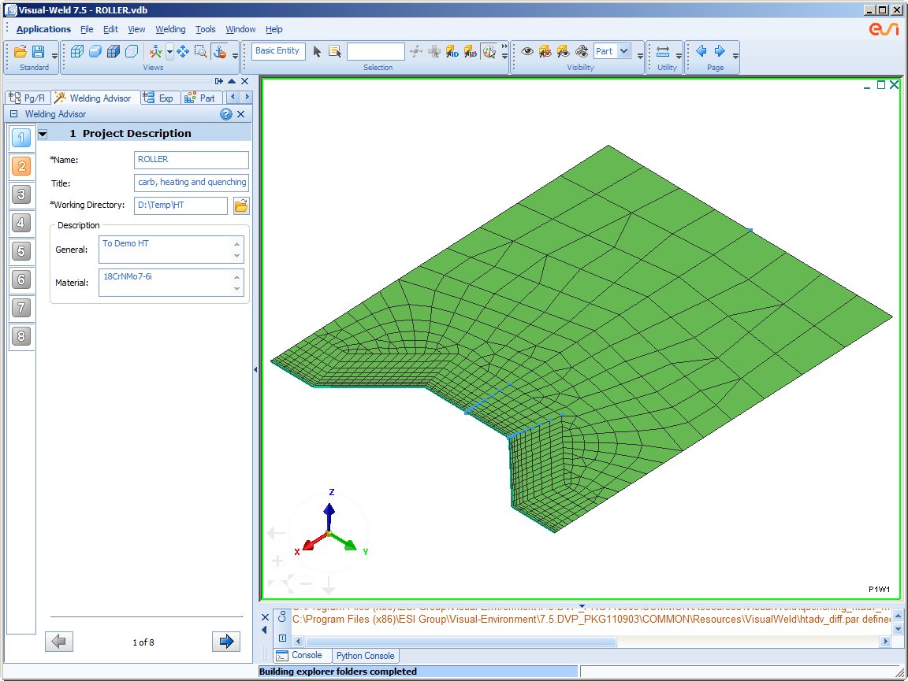
Heat Treatment Advisor
Project Description
Heat Treatment Advisor
Project Description
Process Definition
Material Properties
Heat Treatment Process
Clamping Condition
Loads & Deformations
Solution Parameters
  Enter project details viz. Project Name, Title, Project Path and General description
Computation Manager

Slide 33
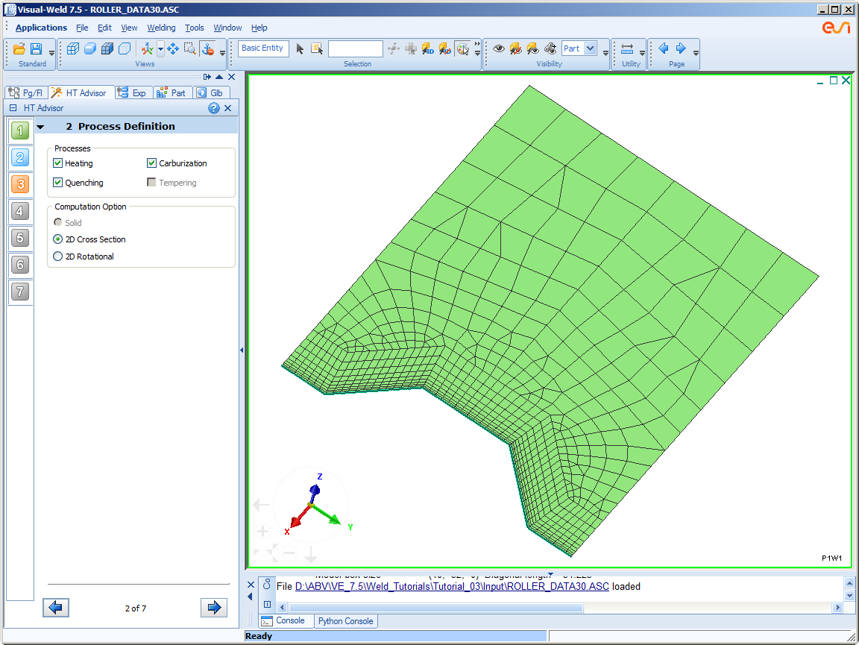
Heat Treatment Advisor
Process Definition
Heat Treatment Advisor
Project Description
Process Definition
Material Properties
Heat Treatment Process
Clamping Condition
Loads & Deformations
Solution Parameters
  Select the required processes for heat treatment; Tempering will be supported in the next release;
  Computation Option set automatically. Modify if needed;
  Define cyclic symmetry for 3D models
Computation Manager

Slide 34
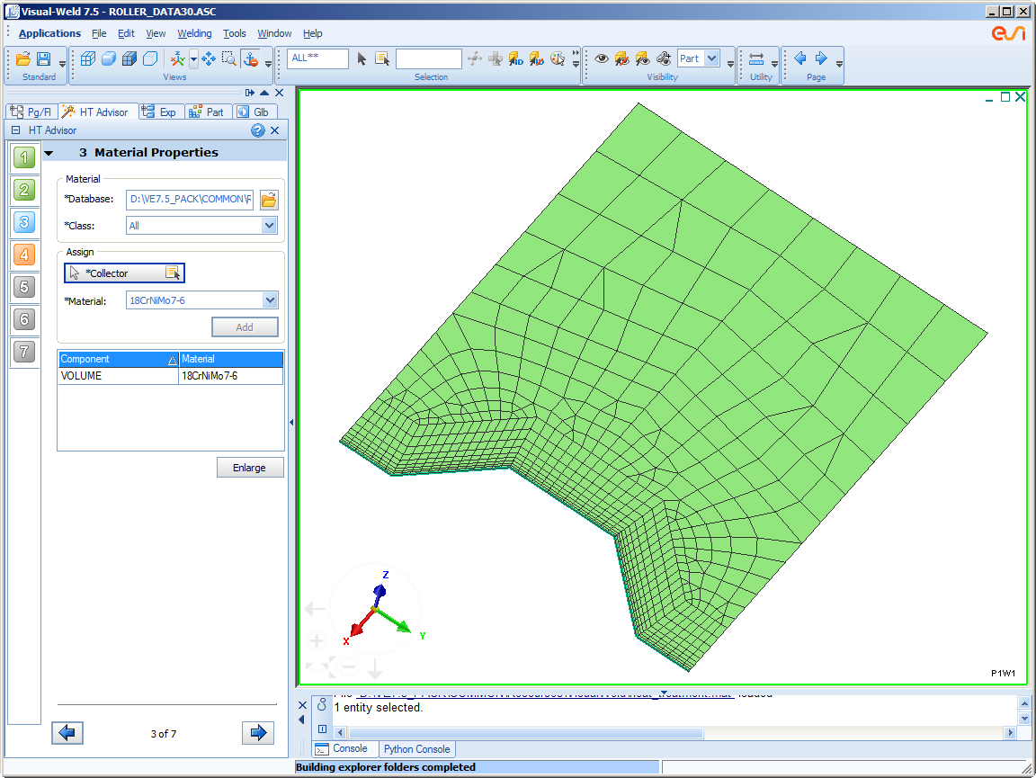
Heat Treatment Advisor
Material Properties
Heat Treatment Advisor
Project Description
Process Definition
Material Properties
Heat Treatment Process
Clamping Condition
Loads & Deformations
Solution Parameters
  Assign materials to required groups;
  Filter material automatically based on the selected process type;
Computation Manager

Slide 35
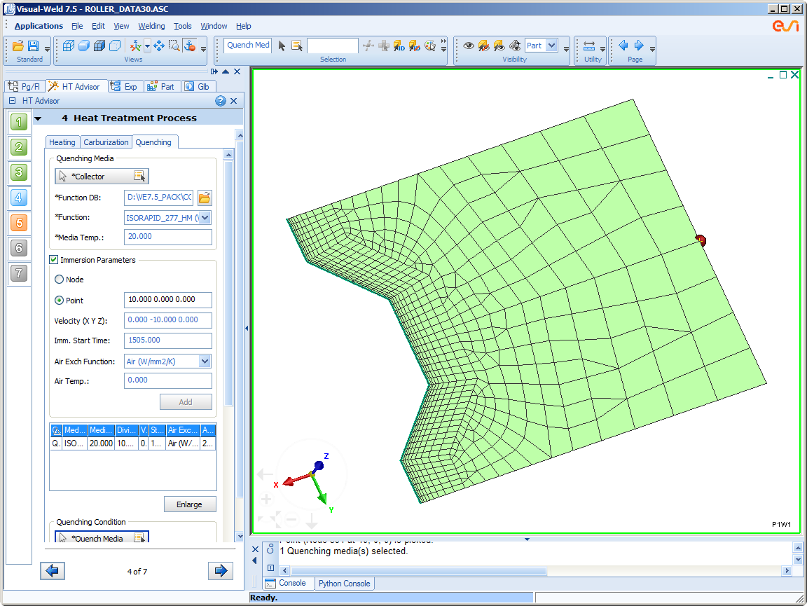
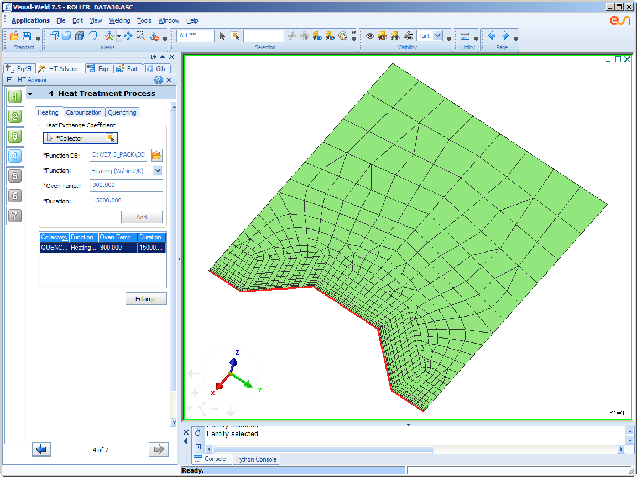




Heat Treatment Advisor
Heat Treatment Process
Heat Treatment Advisor
Project Description
Process Definition
Material Properties
Heat Treatment Process
Clamping Condition
Loads & Deformations
Solution Parameters
  Define Heating, Carburization, quench media and quenching condition;
  You can also define quench media with diving;
Computation Manager

Slide 36

Heat Treatment Advisor
Clamping Condition
Heat Treatment Advisor
Project Description
Process Definition
Material Properties
Heat Treatment Process
Clamping Condition
Loads & Deformations
Solution Parameters
  Define clamps and clamping conditions;
Computation Manager

Slide 37

Heat Treatment Advisor
Loads & Deformations
Heat Treatment Advisor
Project Description
Process Definition
Material Properties
Heat Treatment Process
Clamping Condition
Loads & Deformations
Solution Parameters
  Define loads and loading conditions. This is not mandatory. User can defined loads based on the scenario.
Computation Manager

Slide 38

Heat Treatment Advisor
Solution Parameters
Heat Treatment Advisor
Project Description
Process Definition
Material Properties
Heat Treatment Process
Clamping Condition
Loads & Deformations
Solution Parameters
  Define parameters for computation;
  Use default settings or modify them as needed;
Computation Manager

Slide 39

Heat Treatment Advisor
Computation Manager
Heat Treatment Advisor
Project Description
Process Definition
Material Properties
Heat Treatment Process
Clamping Condition
Loads & Deformations
Solution Parameters
  Solve all Heat Treatment processes in one manager;
  Generate batch scripts for Windows & Linux;
Computation Manager

Slide 40
Outline
What is Visual-Weld?
Model Building
Welding Advisor
Weld Utilities
Heat Treatment Advisor
Post Processing & Report Generation
Tools & Customization
Discussions

Slide 41


Post-Processing
Visualization
Post-Processing
Visualization
Report Generation
    Visualize geometry, contours, curves, printing, pattern, vectors display options and report generations

Slide 42

Post-Processing
Visualization
Post-Processing
Visualization
Report Generation
    Visualize geometry, contours, curves, printing, pattern, vectors display options and report generations

Slide 43


Post-Processing
Report Generation
Post-Processing
Visualization
Report Generation
  From Visual Viewer reports can be generated from File -> Preview by giving various input and by using Drawing blocks

Slide 44

Post-Processing
Automatic Report Generation- Welding Simulation
Post-Processing
Visualization
Report Generation
  For Welding scenarios, Auto report generation is provided. On specifying the working project directory, application automatic picking of mesh & result files from the project folder; Fully customizable; Options to export in pdf and pptx formats

Slide 45
Outline
What is Visual-Weld?
Model Building
Welding Advisor
Weld Utilities
Heat Treatment Advisor
Post Processing & Report Generation
Tools & Customization
Discussions

Slide 46


Tools & Customization
Measure
Tools & Customization
Measure
Customization
General Preferences
  Measure Distance , Angle & Area / Volume;
  Measured quantities dynamically updated during modelling; Option to show/hide measured distances.

Slide 47




Tools & Customization
Customization
Tools & Customization
Measure
Customization
General Preferences
  Customize menus and toolbars.

Slide 48


Tools & Customization
Customization
Tools & Customization
Measure
Customization
General Preferences
  Customize Keyboard shortcuts, mouse buttons, appearance and much more…

Slide 49

Tools & Customization
General Preferences
Tools & Customization
Measure
Customization
General Preferences
  Manage window behaviour;
  Directory setting;
  Selection and View Setting;
  Console settings.

Slide 50

Visual-Weld 7.5
Visual-Weld 7.5
  Updates – Home Page
Quick access to open new document, open file, open project & execute session
Quick access to recently opened files
Highlights of current version
One click access to latest news, services, support and contact
Acess to ESI Twitter, Face book and You tube
Survey Section for quick actions
One click Feedback section

Slide 51
Visual-Weld 7.5
Visual-Weld 7.5
  Updates – Multi Db, *.DAT file reading.
Multi DB support for Material and for Functions
  User can assign materials to components by choosing the material from a wide range of material database files (*.mat). Visual-Weld generates a new .mat file with all materials selected from the db files. In a similar, you can assign functions by choosing them from a wide range of function database files (*.fct).
Supported loading of *.DAT files
  Any valid *.DAT file can be loaded directly into Visual-Weld. This facility allows you to load the DAT file which is generated in Sysweld or any other tool. You can modify the card data directly and export as a *.ASC file. This file can be used in Computation Manager. A log file is generated and posted as a hyper link on the console for your information.

Slide 52

Visual-Weld 7.5
Visual-Weld 7.5
  Updates – Weld-HT Chaining
Weld-HT Chaining
  Heat Treatment project files are restarted if welding project files already exist in the current working directory. An option is given to select Weld - HT chaining or normal heat treatment export. Start time of the heat treatment project files is the end time of the last welding project file.
  * Due to limitation in handling material and function db chained data can’t be re-used to the full extent in this version.
Common windows between Pre and Post processors
  Pages and windows are now managed the same way across all applications for seamless navigation.

Slide 53


Visual-Weld 7.5
Visual-Weld 7.5
  Updates – Work Flow Manager Updates
Block List for work flow managers for quick navigation

Slide 54



Visual-Weld 7.5
Visual-Weld 7.5
  Updates – Explorer Updates
Enabled Page/File view tab and GLB tab in Welding application. GLB Tab allows user to quickly On or Off the desired entities globally.

Slide 55



Visual-Weld 7.5
Visual-Weld 7.5
  Updates – Computation Manager Updates
Export for Cluster
  To allow you to export all the data files through the Computation Manager to solve large models on a cluster.

Slide 56
Visual-Weld 7.5
Visual-Weld 7.5
  Updates – Other Updates
Proper material import from .MAT file for Heat Treatment is supported with HTD, HTL, HTQ and HTS tags.
Option to define “User Length Step” in the “Weld Pool’ section.
Free Air Cooling function is updated to use by default CONVECTIVE AND RADIATIVE LOSSES mm instead Heat Exchange With Air in the Function file.
Explorer is updated to retain the default *.ASC file infromation even on closing the Welding or HT advisor.
Not Yet Deposited Material by default "NO" in General Preferences.
Enhanced and Updated missed out tooltips in Welding and HT advisors.
Context Senstive help given for each steps in Welding and HT advisor.
Solver setting dialog is simplified.
Convert Element Type functionality is added in Tools menu.
Visual Weld generated vdb file can be loaded in any VE applications.
Visual Weld generated vdb compatability issue across platforms
Addressed many issues reported in previous versions.

Slide 57
Outline
What is Visual-Weld?
Model Building
Welding Advisor
Weld Utilities
Heat Treatment Advisor
Post Processing & Report Generation
Tools & Customization
Discussions

