Slide 1


ESF II project of University of West Bohemia
reg. number: CZ.02.2.69/0.0/0.0/18_056/0013239
SURFACES AND THEIR TREATMENT

Slide 2
SURFACES AND THEIR TREATMENT
Lectures: Doc. Ing. Olga Bláhová, Ph.D.
Textbook: Ing. Václav Kraus, CSc.
Content of the Course
Surface and its properties (surface structure, properties)
Surface damage (corrosion, wear)
Methods of product protection (environmental modification, choice of material, design solution, electrochemical and temporary protection)
Preliminary surface treatment (mechanical, chemical)
Organic coatings (paints, plastics, coating technology)
Inorganic coatings (conversion layers, thermal spraying, enamelling)
Metal coatings and layers (thermal, immersion, spray, diffusion, phase transformation, chemical and electrochemical, physical and physicochemical)
Evaluation of surface treatments – exercises

Slide 3
Basic Technological Areas in Surface Treatment
preliminary surface preparation
- mechanical surface preparation
- chemical surface preparation
coatings and coating systems
- organic coatings:
alone
combination with other technologies
- inorganic coatings:
non-metallic: enamels, thermal coatings, etc.
metal: chemical, electrochemical, thermal, etc.

Slide 4
Organic Painting Substances (NH)
Paint-coating:
a continuous coating of the desired properties formed by applying and drying one or more coats of paint on the surface to be treated
Barrier effect (no pores)
80 to 90% of all coatings
advantages: easy accessibility, application, repairability, use on objects of any shape or size
disadvantages: flammability, carcinogenicity, etc.
Use:
protective effect (against weather, sea water, oil, fire, etc.)
decorative
signal, luminous, camouflage, dimming
fungicidal (against moulds and fungi), bactericidal, etc.

Slide 5
NH Components
  Binders
  film-forming substances
    on volatile organic compounds, drying → continuous film
    plasticizers: phthalates, adipates, PCBs (polychlorinated biphenyls – carcinogenic)
  solvents (dilutents): modify viscosity
  Pigments
  anorganic (elements, metal oxides, salts)
  organic
  inhibitory (corrosion retardation: Pb₃O₄, Ca₂PbO₄, Zn dust, etc.)
  neutral (do not affect corrosion: PbCrO₄, TiO₂, Fe₂O₃, Al bronze, mica, etc.)
  stimulating (corrosion support: graphite, soot, etc.)
Fillers
  insoluble in binders, modification of technological properties
  mostly finely ground minerals (limestone, barite, talc, etc.)
Additives
  excipients – modification of technological properties
  e.g., emulsifiers, driers, desiccants (solutions of driers), stabilizers, emollients...

Slide 6
NH Types and Their Use
Basic type of NH Content of solvents Use
Solvent (conventional) approx. 40-60% approx. 28%
High-dry matter (VSNH) approx. 15-25% approx. 12%
Two-component approx. 30-40% approx. 10%
Dilutable in water (VRNH) approx. 2-10% approx. 40%
Other NH and substances approx. 20-30% approx. 4%
Powder NH (PNH) without solvents approx. 6%

Slide 7
NH Labelling
A - asphalt
B - solvent-free - polyester
C - nitrocellulose
E - powder
H - chlorinated rubber
K - silicone
L - alcohol
O - oil, varnish
P - auxiliary painting substances
S - synthetic
U - polyurethane
V - water and emulsion

Slide 8
NH Labelling
1. number after the capital letter:
1 - varnishes, transparent and colourless materials
2 - weakly and medium pigmented materials
3 - tinting pastes
4 - spray pastes
5 - sealants
6 - thinners
7 - driers, hardeners
8 - auxiliary substances for finishing the look of the paint film

Slide 9
A - Asphalt NH
Basic film-forming substances:
natural asphalts and resins from the distillation of crude oil and coal tar
Solubility in non-polar organic solvents:
petrol, toluene, xylene, turpentine, etc.
Drying – in air
- firing (up to 200ºC) → solid, glossy film
Properties:
- flexibility
- chemical resistance
- good in acidic environment except concentrated HNO₃ and H₂SO₄
(oxidizing effect)
- worse in weather conditions: O_{2,}, O₃, emissions, etc.

Slide 10
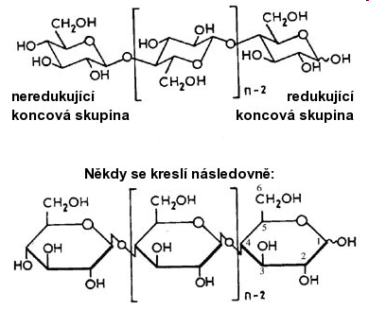
C - Nitrocellulose NH
binders:
cellulose derivatives
2 HNO₃ + C₆H₁₀O₅ → C₆H₈(NO₂)₂O₅ + 2 H₂O
Low-dry matter content:
10-27% - multi-layer coatings needed
solvents:
esters, butyl acetate, alcohols, ketones, toluene, etc.
emollients:
phtalates, phosphates
fast drying
30-60 min
low yield
properties:
good insulation
hardness, fragility
low adhesion to metals:
need for primary coating (oil, synthetic NH, etc.)
resistance:
good against weather conditions, mineral oils, chemicals

Slide 11
O - Oil NH
Natural and artificial resins
drying by oxipolymerization method 8-72 h
yield
80-250 g.m⁻²
properties:
resistance
- good against weather conditions
- bad against
chemical effects
adhesion – good

Slide 12
S - Synthetic NH
Different types of synthetic resins
drying: in air or firing
yield: 80-160 g.m⁻²
Epoxy
- two-component
- chemical curing: 160-180°C, 10-20 min
- drying: fast
- curing: several days
- adhesion: excellent for most coatings
- resistance: good against impacts, mechanical damage
against aggressive environments: hydrocarbons, alkali solutions
less good against especially organic acids
bad against weather, sunlight →
loss of gloss, chalking (higher in a clean atmosphere)
- disadvantage: the possibility of defects if the ratio of both components is not observed
in the case of insufficient mixing

Slide 13
S - Synthetic NH
Epoxymatics
- modification of epoxy NH
- advantages: tolerant to surface pretreatment
large thickness: up to 400 μm
- use: on hand-cleaned steel structures for paint maintenance
Alkyd
- resistance: good against the atmosphere
- multilayer coatings:
information on the applied thickness of wet and dry coatings
need to comply with the drying time (loss of adhesion of layers)
long intervals → poor anchoring (regrinding with sandpaper)

Slide 14
S - Synthetic NH
Acrylic
- one-component from acrylate resins
- physical drying – evaporation of the solvent
- resistance: weatherproof
- good adhesion to coatings: combination with polyurethanes, alkyds, etc.
Acrylic urethane
- similar properties
- lower dosage of isocyanate component
- lower price
Resole
- resole: thermosetting plastic – irreversibly hardening
formation: by polycondensation of phenol with formaldehyde

Slide 15
P - Polyurethane NH
- one-component - curing with air humidity
- two-component - chemical curing
advantages: high resistence against weather conditions, sunlight
use: top layer for NH epoxy, acrylic urethane, etc.
V - Water and Emulsion NH
water-soluble: acrylate, alkyd, epoxy, polyurethane, etc.
binders - dispersions (mixture of substances, one of which is finely dispersed in the other)
- emulsions (heterogeneous mixture of two liquids that do not mix spontaneously)
- or a combination thereof
properties: flexibility, suppleness, balance internal stresses
resistance - against shocks, vibrations
- against the atmosphere (sufficient thickness, no pores)
disadvantages: need for a perfectly clean metal surface
- higher NH consumption
- longer drying

Slide 16
H - Chlorinated Rubber NH
properties:
resistance
- low against weather conditions and organic substances
- excellent against chemicals, mineral oils
flexibility – high
L - Alcohol NH
properties:
gloss – high
resistance
- good against oils
- bad against the weather
abrasion resistance – good
non-conductive

Slide 17
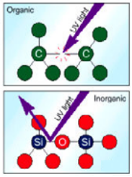
K - Silicone (Polysiloxane) NH
Two-component paint coatings
- high resistance to weathering, sunlight
- need for good pre-treatment
use: for zinc ethyl silicate primers, etc.
Silicones: inorganic-organic polymers of the general formula [R2SiO] n,
wherein R is an organic substituent
- chemically stable chain -Si-O-Si-O-Si, etc.
organic groups chemically bonded to the free bonds of Si atoms
- stable properties over a wide temperature range: heat resistance of silicone rubbers:
−60 to +180°C (especially −100 to +260°C, over a short time up to +320°C)
- relatively inert to living organisms
- relative non-flammability, good electrical insulating properties, long-term resistance to UV radiation and weather conditions,
water repellency (hydrophobicity) and vapour permeability, good adhesion
Fluorinated silicones: oil resistant (automotive industry)
Use:
oils and pastes (harmless, thermally conductive and, at the same time, electro-insulating), emulsions of silicone oils, impregnation for tents, jackets, one-component sealants vulcanizing with air humidity at normal temperatures, two-component rubbers vulcanizing after catalyst addition; for the production of flexible molds and potting (water repellent), varnishes (highly heat-resistant), sealants (protection of printed circuit boards, sanitary and construction use), defoamers, cosmetics (soaps, shower gels, shampoos, shaving foams), fins, bathing caps, breast implants , silicone bracelets, foams (sealing of e.g. cable passages), kitchen utensils (baking tins, rolls, etc.)

Slide 18
Zinc NH
Zinc-rich paints – paint coatings with high zinc content - cold galvanizing
Binder: organic, inorganic
One-component, two-component
Pigment: Zn dust → paint coating: up to 96% of zinc
Zinc ethyl silicate NH
- solvents: organic
- curing: humidity 50-80% (lower → soft, wiping off)
acceleration: water-spray
degree of curing:
MEK test: a piece of coarse cotton fabric saturated with methyl ethyl ketone is pressed with the thumb to the paint and 50 double 50-mm-long strokes are made; the result is evaluated according to the scale given in the regulation
Zinc NH based on water glass (aqueous Na₂SiO₃ solution) – solvent: water
Pretreatment: blasting, R_{a} = 25-60 μm
Thickness: 75-200 μm, higher → cracking, peeling
Porosity after application → top coat:
quickly applied: blisters, foaming - in a few months - depending on w eather conditions

Slide 19
NH Application Technology
Surface preparation, e.g.:
perfect removal of old paint
removal of corrosion, dirt, grease
possibly the use of a chemical bath
rinsing
drying out
sandblasting or blasting
blowing away dirt residues
phosphating
chromating
anodizing
Affecting
anchorage
drying
undercorrosion
Aspects
object (size, shape, quantity, etc.)
required coating properties (appearance, thickness, stress, etc.)
surface quality (porosity, degree of purity - pre-treatment, etc.)
NH properties (drying speed, castability, conductivity, etc.)
economy
(material, labour-intensity, etc.)
ecology

Slide 20
Liquid NH Application Technology
Spaces:
space for pretreatment
space for NH application - one or several technological operations
space for coating leakage
space for drying or firing the coating
drying at 20º C: 0.5 to 24 hours or more
dryers: 60-180º C
space for product cooling
Ecology:
air extraction, wastewater treatment (spraying, etc.)

Slide 21
Liquid NH Application Technology
Methods:
Manual application
Pneumatic spraying
High-pressure spraying
Spraying in a heated state
Electrostatic spraying
Dipping
Rolling
Electrochemical application
Chemical application

Slide 22
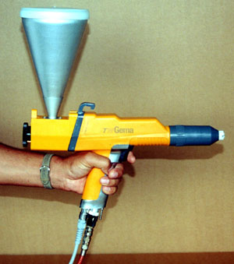
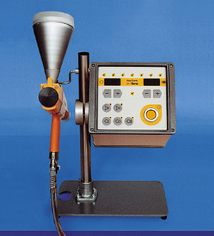
Application Technology
Manual
performance 10-15 m².h⁻¹
Pneumatic spraying
performance 40-200 m².h⁻¹

Slide 23
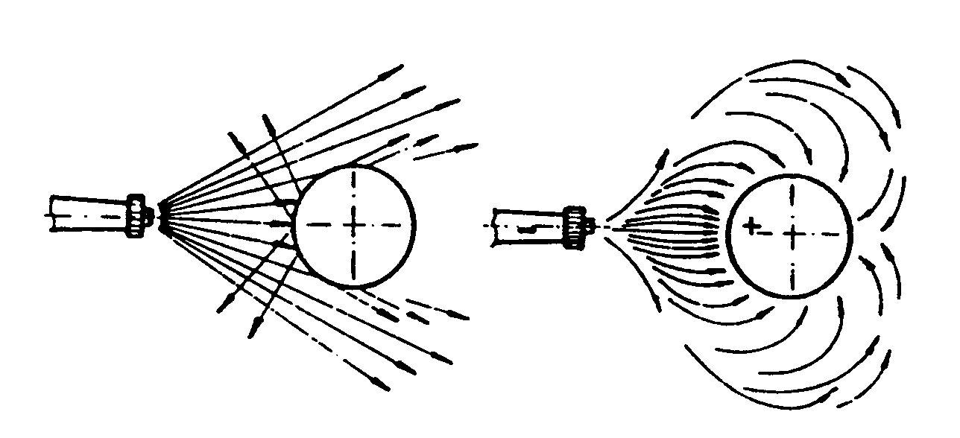
Spraying Technology
High-pressure spraying – for high-dry NH
Spraying in a heated state – accelerated drying
Electrostatic spraying :
Conventional and electrostatic application method

Slide 24
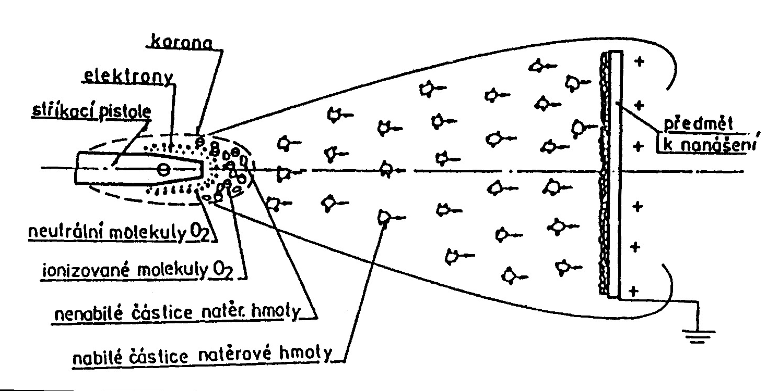
Electrostatic Spraying

Slide 25
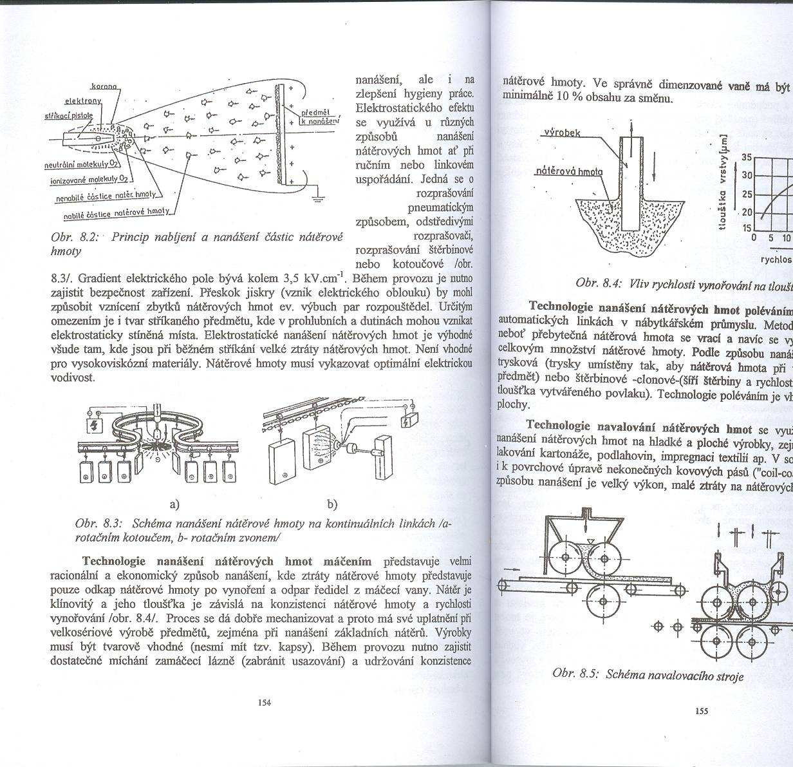
Spraying on Continuous Lines
with rotating disc
with rotating nozzle

Slide 26
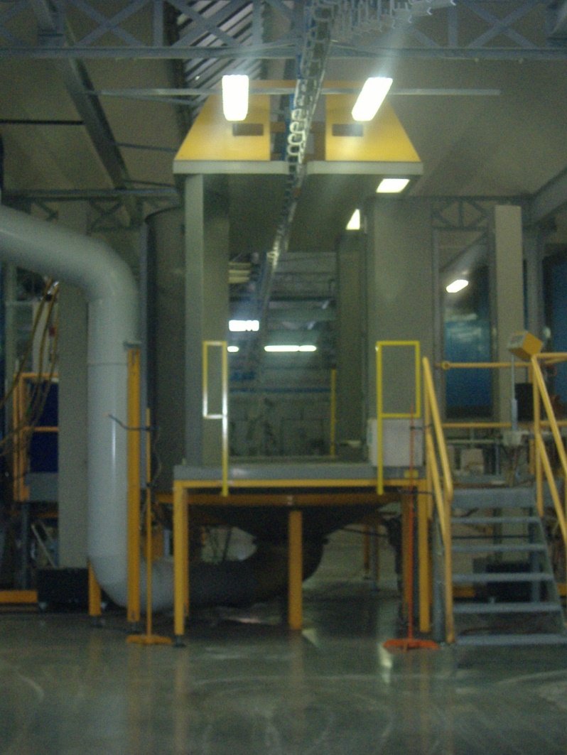
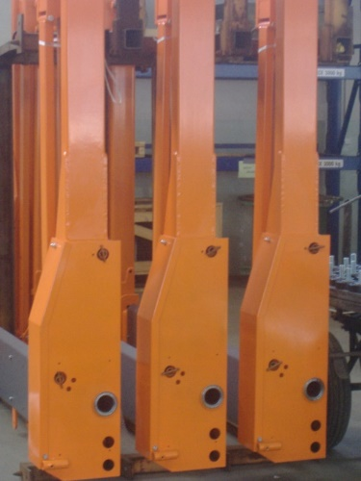
Work Line
Line parameters:
Length up to 320 m
Max. load capacity of one field 100 kg
Possibility of double-sided application
Curing temperature 100-250° C
Speed according to the type and thickness of the material

Slide 27
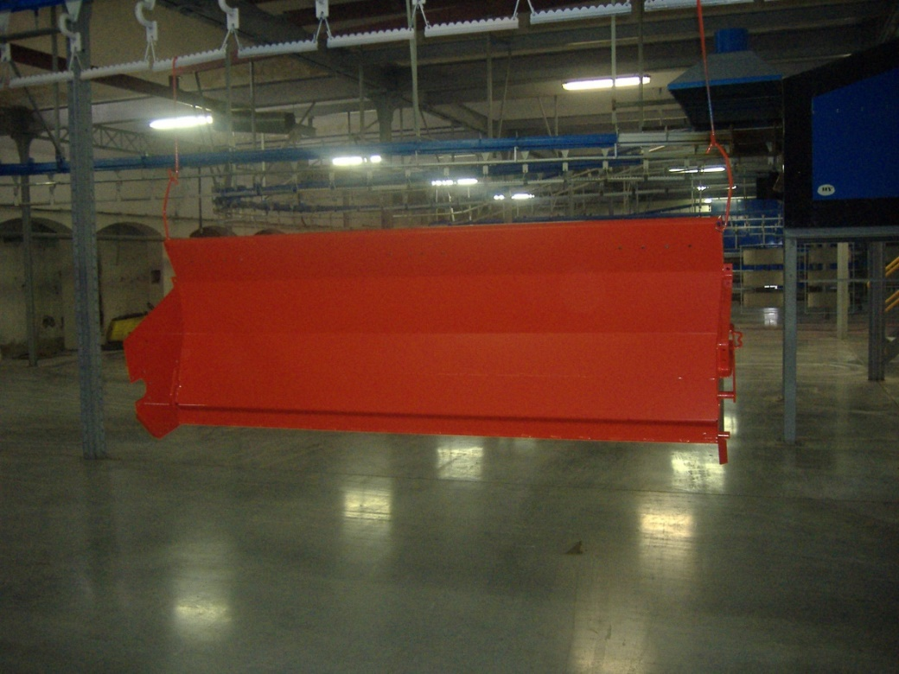
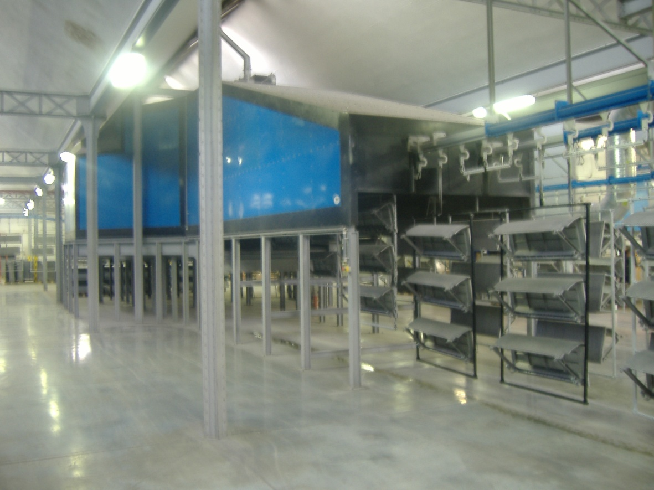
Product Suspension
Drying Chamber

Slide 28
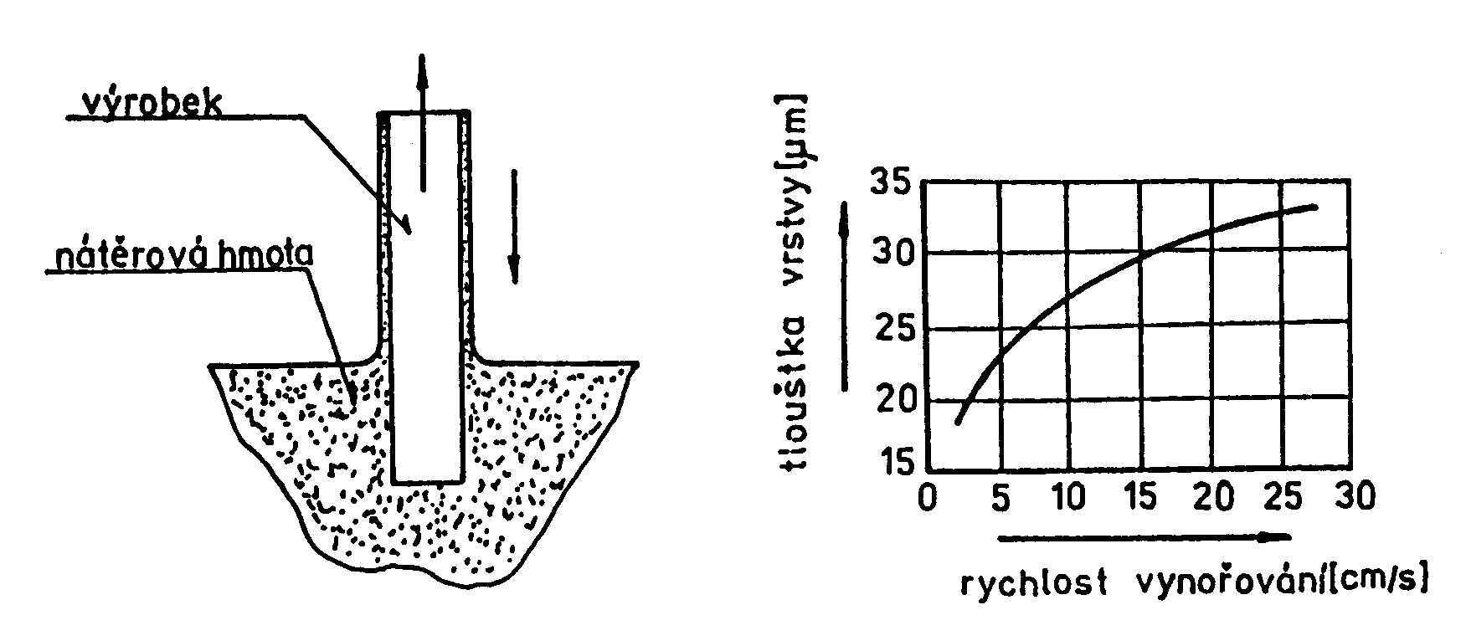
Dipping Application
Economical process:
Losses:
  drip after emergence
  evaporation of solvents
For large series
  Can be mechanized
Suitable shape of products
  without "pockets"
Mixing
  Against settling
Maintaining appropriate consistency

Slide 29
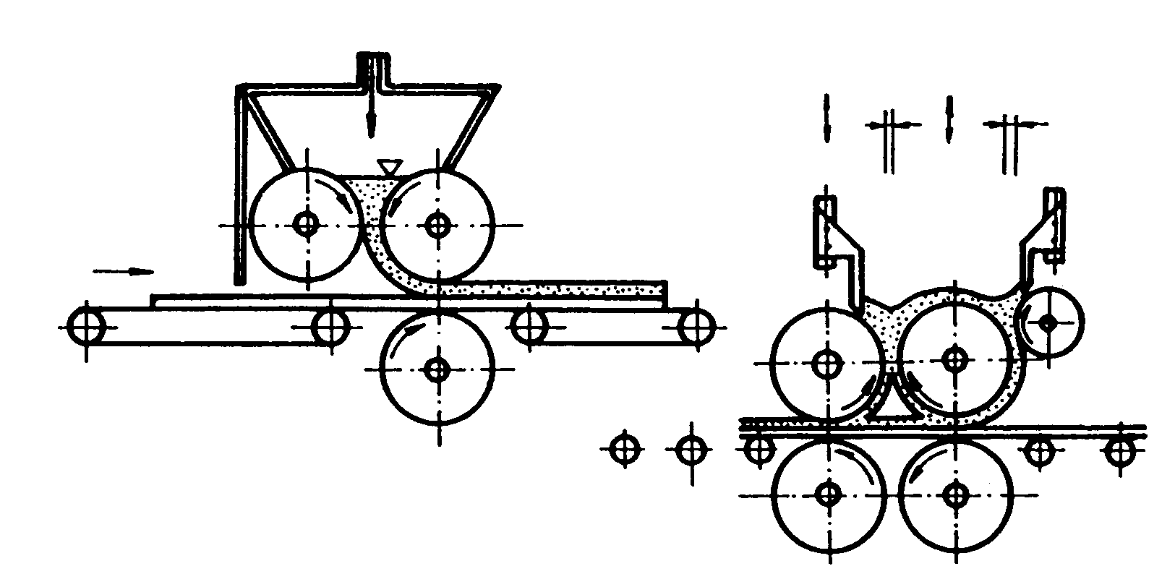
Application by Pouring and Rolling

Slide 30
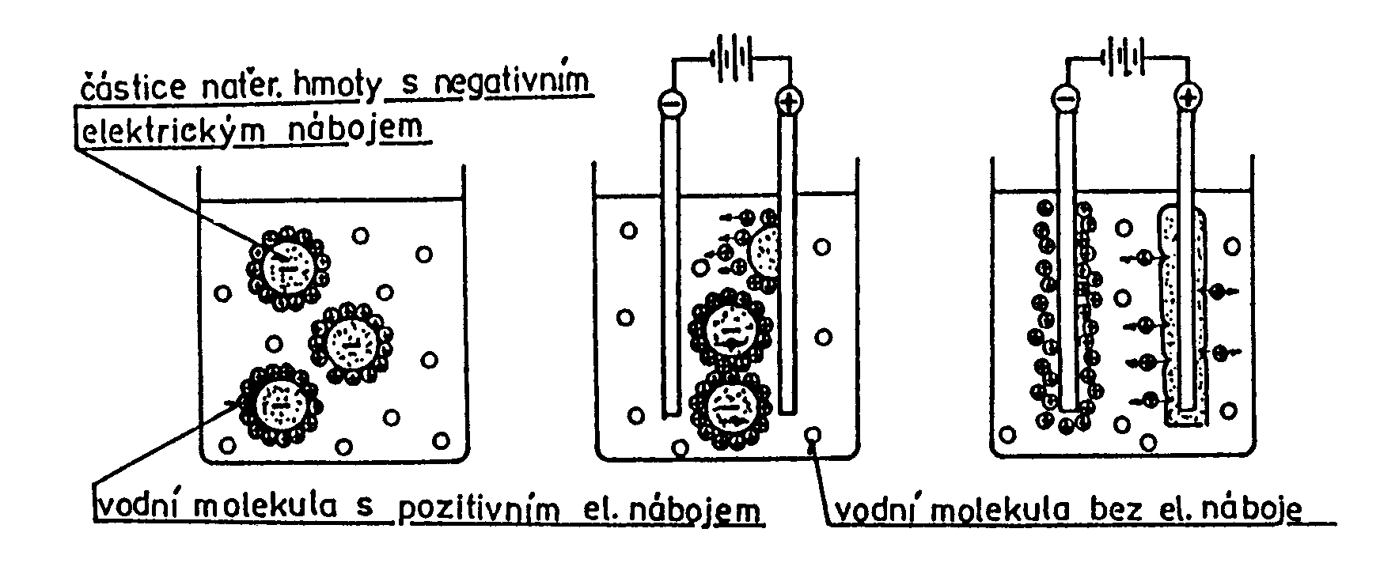
Electrochemical (Electrophoretic) Application
Special epoxy or acrylate polymers (resins)
anaphoresis: resin = anion
(in practice since 1963 – Ford

Slide 31
Electrochemical (Electrophoretic) Application
Special epoxy or acrylate polymers (resins)
cataphoresis: resin = cation (in practice since 1978 – France)
Procedure:
pretreatment: chemical degreasing, removal of corrosion and scale, homogeneous fine-grained Zn (Fe) – phosphate
functional paint solution
cathode – product, auxiliary anode
DC voltage 250-400 V →
- migration of ions to electrodes:
- water electrolysis: H₂O → H⁺ + OH⁻
- colour electrodeposition:
colour cation on cathode neutralized
hydroxyl anion → loss of solubility,
adhesion to the product
non-sticking paint back to the bath
acetate anions from paint to anode →
stability of the dye bath
polymerization: 165-180°C approx. 15 minutes

Slide 32
Electrochemical (Electrophoretic) Application
Components of a functional cataphoresis bath - homogeneously mixed in DEMI (demineralized) water:
resin (binder)
paste (pigment) - determines the colour shade
additives (solvents, pH regulator)
Advantages of cataphoretic painting:
excellent anti-corrosion resistance at small thickness (approx. 25 μm) – 1000 h in salt mist
high running-in even to inaccessible places (cavities)
fully automatic process excluding the human factor
short painting time 150-250 s
high process efficiency – more than 99% colour utilization
uniform thickness – easy quality control
ecology: DEMI water – major solvent,
organic solvent content below 2%
→ economic advantage
Product requirements:
conductivity
can be immersed
withstand a temperature of 150-200°C
-

Slide 33
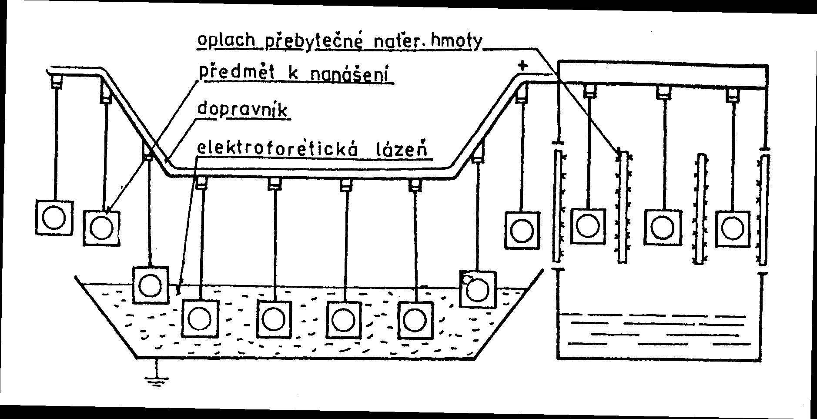
Electrochemical (Electrophoretic) Application

Slide 34
Drying and Firing of Coatings
Curing:
Physical (evaporation)
Chemica
(polymerization: UV, etc.)
According to the temperature
drying
additional drying
firing
Phases:
evaporation
drying to a state of possible handling
drying to a state of hardness
ageing

Slide 35
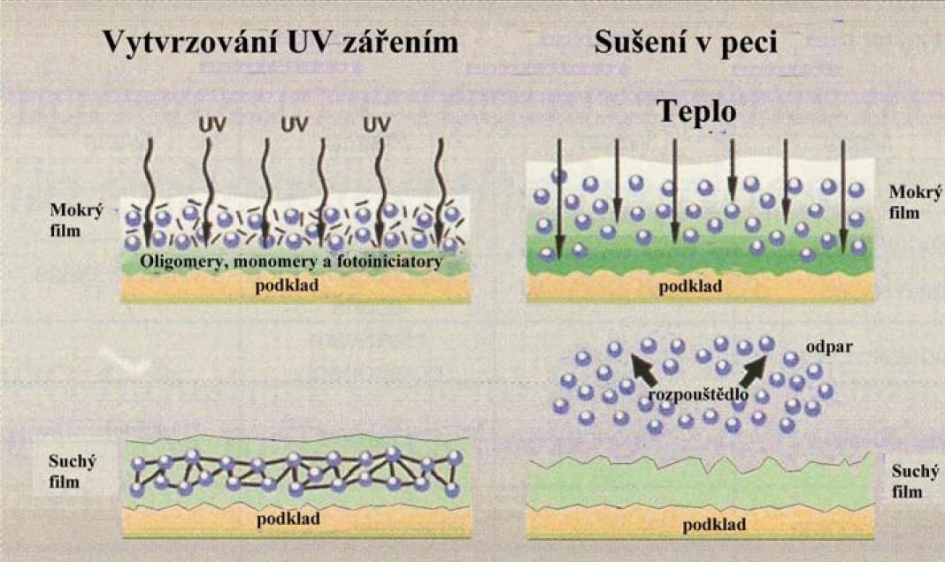
NH Cured by UV Radiation
UV - varnishes
photopolymerizing materials together with photoinitiators for UV curing:
resins of the unsaturated polyester or simple epoxy acrylate type
aliphatic urethane acrylates – excellent resistance to cracking and yellowing
polyester acrylates
acrylic acrylates
modified epoxy acrylates
cationically cured
cycloaliphatic epoxides
good adhesion to various
types of substrates UV - lak Klasický lak

Slide 36
NH Cured by UV Radiation
Safety of UV varnishes
composition: acrylate resins and monomers specially designed for this technology – safer and less toxic than some components of water-soluble and solvent-based varnishes
high or no flash point
very little or no VOC (volatile organic compounds) emissions
very low toxicity
not part of mutagens and carcinogens
waste is not any hazard
are not absorbed through the skin like solvents
very low vapour pressure – reduced risk of inhalation
secure technology

Slide 37
NH Cured by UV Radiation
Equipment safety
UV overexposure: reddening of the skin
exposure limits for UV radiation
shielding, clothing, glasses
safety switches; switch off the device if the shields are removed
personal dosimeters: detection of electromagnetic radiation
exposure meters: light intensity measurement

Slide 38
NH Cured by UV Radiation
Comparison of costs
conventional varnish: ≈ 33% dry matter
1l of varnish: ≈ 13 m² of dry film 25 μm thick
"UV varnish": ≈ 99.7% dry matter → higher price for 1 l
1l of varnish: ≈ 40 m² of dry film 25 μm thick
→ lower price per 1 m² of 9%
drying ovens for conventional varnishes – partial performance even if not varnished
UV lamps – operation only at the time of exposure of the cured layer
→ lower energy costs

Slide 39
NH Cured by UV Radiation
Operating area requirements
Drying ovens for conventional thermal curing: length 15 to 30 m, area 50-90 m²
UV equipment of equivalent performance: area 5-9 m²
Time requirements
Conventional varnishing:
Varnishing 2 min
Drying 15-30 min
Cooling 10-25 min
UV varnishing:
UV varnishing 2 min
Curing 2 min

Slide 40
NH Cured by UV Radiation
Productivity
no paint build-up inside the spray booth → reduction of cleaning time between shifts and on weekends
shorter curing times → higher line performance
faster curing → less possibility of contamination of the surface of varnished parts → less scrap

Slide 41
NH Cured by UV Radiation
Advantages
environmentally safe technology, environmentally friendly and enabling producers to meet very demanding requirements
efficient varnishing with extremely low emissions, safe and competitive compared to conventional varnishes and equipment
Use
mainly the automotive industry

Slide 42
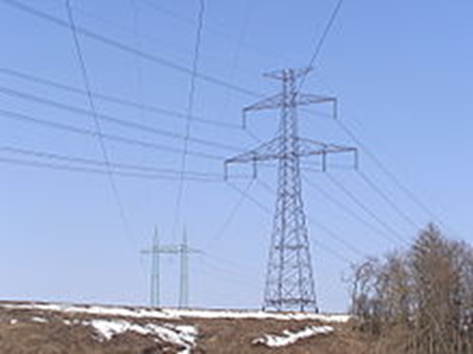
Protection of NH Steel Structures
Pretreatments:
Blasting
  metallically clean surface
  suitable roughness
High pressure water jet cleaning
  to remove grease and soluble salts
Pickling
  descaling (iron oxides) – after painting: inner corrosion
  hot rolled steel sections and sheets
  costly process – mass production
Degreasing
  grease and dirt – prevent perfect anchoring of the paint
  water-based degreasers
  technical gasoline – when degreasing is performed only occasionally
  new constructions – increased attention when cleaning welds and their surroundings

Slide 43
Protection of NH Steel Structures
Cleaning previously painted surfaces
  the protective coating loses its function over time → production of a maintenance coating
  pretreatment:
    manual and mechanized brushing: the remaining rust contains sulphates, absorbed water, or chlorides; they support the course of corrosion → short life of finished coatings
    application of rust stabilizers on the brushed surface; they contain phosphoric acid and tannin – low adhesion of coatings in crevices where the concentration of stabilizers occurs → suitable for flat surfaces
Influence of conditions during coating production
  Temperature:
    prescribed minimum temperatures – surface temperature usually lower than air temperature (cold nights)
    high temperature – adverse effect: rapid evaporation of solvents and thinners through pores
  Time:
    multilayer coatings – observance of intervals between the production of individual layers; long intervals: reduction of protective efficiency – closure of dust particles, often soluble → formation of pores

Slide 44
Degradation of Coatings in the Atmosphere
Effects on NH resistance:
    type of binder:
      epoxy coatings: sunlight: loss of gloss, destruction
    type of pigment used: influence on the rate of penetration of oxygen, water and aggressive components of the air (sulfur dioxide, etc.)
      coatings with barrier protection mechanism (thickness 300-400 μm)
    thermal expansion of base material and coatings:
      steel and other metals: higher thermal coefficient of thermal expansion than coatings: thermal stress → loss of adhesion
    internal stress: effect on adhesion and protective properties
      coatings exposed to elevated temperatures and coatings exposed to atmospheric conditions for a long time

Slide 45
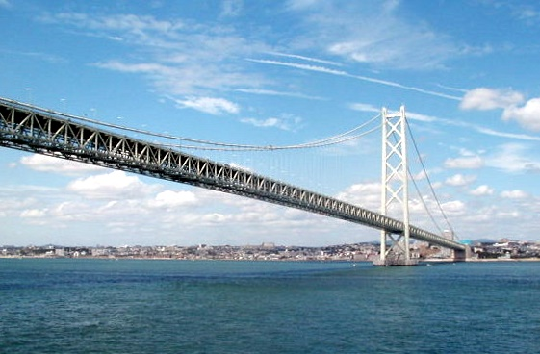
Coatings for Atmospheric Conditions
Acrylic coatings
Alkyd coatings
Epoxy modified coatings
Polyurethane coatings
Polysiloxane coatings
Coatings from water-soluble paint substances
Zinc coatings

Slide 46
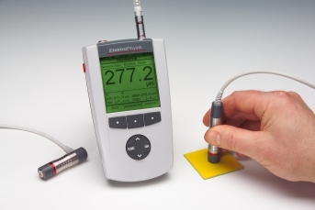
Coating Properties
Coating thickness
  barrier mechanism protection – depends on thickness
  optimal thickness – penetration of the corrosive environment through the capillaries is not occurring
  increase in thickness → increase in coating efficiency
  → increase in internal stress → peeling
  exposure to atmospheric effects → thickness reduction, destruction
  two layers: thickness up to 400 μm
  formation of pores – the presence of air in the coating, unsuitable mixing the two-component mixture
  Determination of coating thickness
    destructive and non-destructive methods
    electromagnetic devices

Slide 47
Coating Properties
Adhesion of coatings
  not completely clean surface – oxide layer
  formation of strong chemisporporic and adsorption bonds between paint components and oxides – suitable additives in NH
  adhesion changes with time
  Determination of coating paint adhesion
    grid test – the most used method
    cross-cut method – two cross-cuts with an angle of 45º and a length of 25 mm, tearing off with adhesive tape – 6 degrees of adhesion
    tear-off test – for coatings with thicknesses over 250 μm, expressed as the force required to tear off a unit of the coating area in MPa

Slide 48
Protective Coating Properties
Porosity of coatings
  dangerous for coatings with an adhesive or barrier mechanism
  decreases with increasing thickness
  influences:
    type of NH
    type of solvent
    conditions for making paints
  dimensions of pores and properties of their walls: influence on the possibility of penetration of the corrosive environment
  must be checked especially in storage facilities: tanks for chemical and aggressive substances
  Determination of porosity
    non-destructive methods – small thickness
    high-tension test – large thickness

Slide 49
E - Powder Varnish Coatings
Principle:
Melting and run-off of powder particles
Advantages (comparison with NH):
technologically undemanding, energy saving → lower price
saving solvents, ease of waste disposal
→ environmental protection
high quality single-layer coating → time saving
high usability of the material
operational safety during preparation and storage
possibility of automation → saving of work space
high chemical and corrosion resistance → saving of material and raw materials
better coverage of surface irregularities
Disadvantage:
do not contain anti-corrosion pigments → combinations with inorganic non-metallic coatings, e.g., phosphate – simultaneous increase of adhesion of the coating to the metal substrate

Slide 50
E - Powder Varnish Coatings
Use:
steel, galvanized sheet metal, aluminium, copper and their alloys, non-metallic materials
Properties:
abrasion resistance
resistance to higher temperatures
colour fastness
antibacterial
surface impermeability
defined electrical resistance or conductivity
facade quality
immutability of properties even in extreme atmospheric conditions

Slide 51
E - Powder Varnish Coatings
Thermosets (thermosetting polymers):
Epoxy powder paints(EP)
for interiors
very good resistance to corrosion and some chemicals
Polyester powder paints (PES)
for exteriors
high resistance to UV radiation and other weather conditions
Epoxy polyester powder paints (PEP), so-called hybrids ("mixes")
the most commonly used powder paints
for interiors
for products exposed to adverse weather conditions for a short time
Polyurethane powder paints (PUR)
very resistant to weather conditions
transparent polyurethane powder varnishes
Acrylic powder paints (AC)
for exteriors
high resistance to chemicals

Slide 52

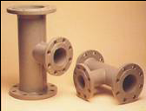
Powder Paints
Polyamide 11
for coating metal parts
does not require curing
various technologies:
- electrostatic spraying: thickness 80-200 μm
- applying the powder to the preheated part
- heat application
- rotary coating
- fluidized bed application: thickness 300-500 μm
Fluidization: bringing particles to a state of buoyancy
Fluidized particles behave like a liquid
- in powder paint containers, there is a porous bottom through which the fluidizing gas
(air)passes, which brings the powder paint particles into a fluid state
- the powder behaves like a liquid and is transported
through a hose in the fluid state to the application gun

Slide 53
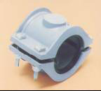
Powder Paints
Polyamide 11
Properties:
low moisture absorption
excellent abrasion resistance
excellent impact resistance
low coefficient of friction
excellent flexibility
low specific weight: 1.05-1.15 g/cm³
resistance to - weather conditions
- water: sewage, marine
- salt fog
- electrochemical corrosion
- hydrocarbons, solvents and other chemicals

Slide 54
Zinc Powder Paints
Epoxy powders with 40-60% Zn
Procedure: pretreatment: high-quality blasting
base coat: zinc powder
curing: 160-180°C, 10-20 min
top coat/s: powdered or solvent NH
Coating up to 96% zinc: Zn particles touch → barrier protection
+ cathodic protection → protection against undercorrosion and pitting corrosion
Small thickness 40-60 μm: salt fog test:
2,000 h until the occurrence of red rust
Combination with polyester coating 60 μm thick: salt fog test: 5,000 h until the occurrence of red rust
Adhesion to steel: approx. 10 MPa
In practice since 1998: trucks – without defects
Higher price of powders: 240-280 CZK/kg: price of coatings higher by approx. 30% → high quality, environmentally friendly

Slide 55
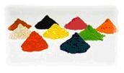
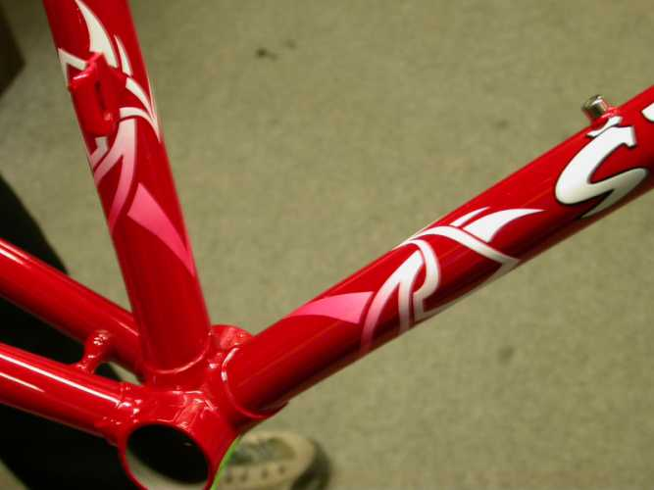
Use of Powder Paints
washing machines, refrigerators, stoves, microwave ovens
metal furniture, home accessories, safes, locks, hangers
consumer electronics and computer technology covers
bicycles, sports equipment and exercise machines
office and study aids,
magnetic boards
shoehorns, bottle openers
brake pads, wheel discs,
interior metal parts
motorcycle components
radiators, fire extinguishers, letter boxes
lighting fixtures
perfume bottles
decorative flower pots, cigarette cases
electrical distribution boxes
metal ceilings, fittings, etc.

Slide 56
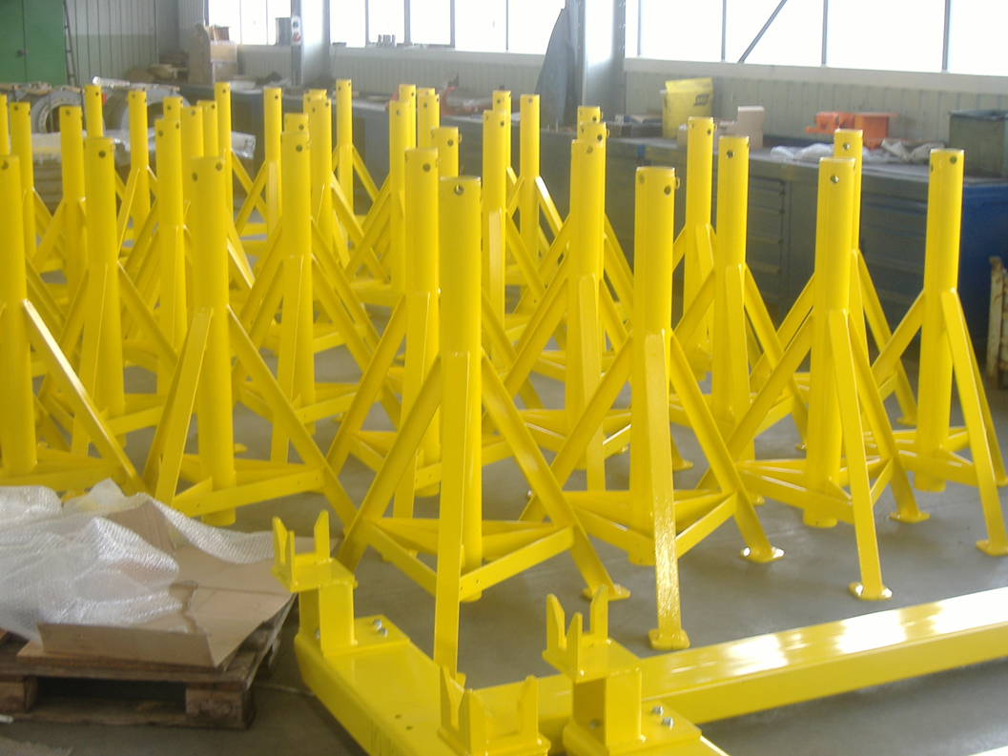
Powder Coating Technology
With preheating
swirl (fluid) application
plating
thermal spraying
flameless spraying
dispersion coating
plastisol application
In an electrical field
electrostatic charging
tribostatic charging

Slide 57
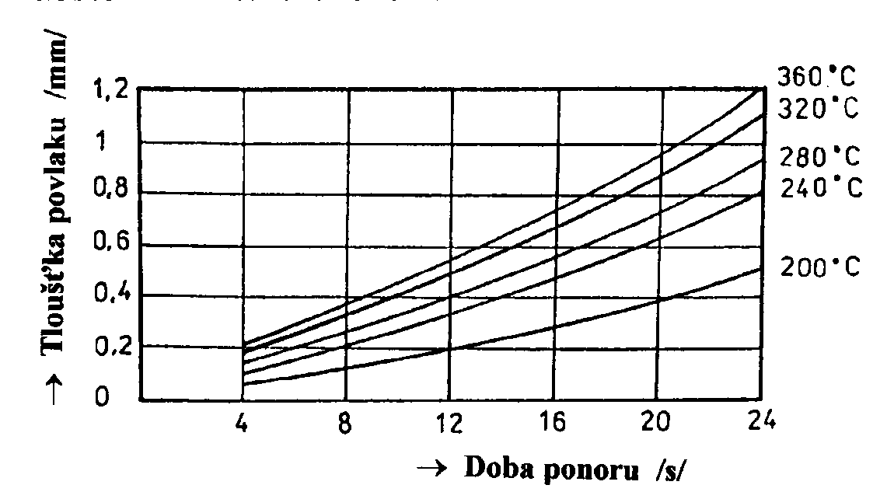
Swirl (Fluid) Application
Thickness up to 1 mm
Powder utilization 100%
Coating time up to 10 s
Less investment intensive
Procedure:
Heating the object above the melting point of the powder
Immersion in aerated powder – behaves like a liquid
Welding the powder to the surface of the object – spillage → continuous coating
Thermoplastics: the coated object cools
Reactoplastics: further heating → crosslinking – curing
high-pressure polyethylene

Slide 58
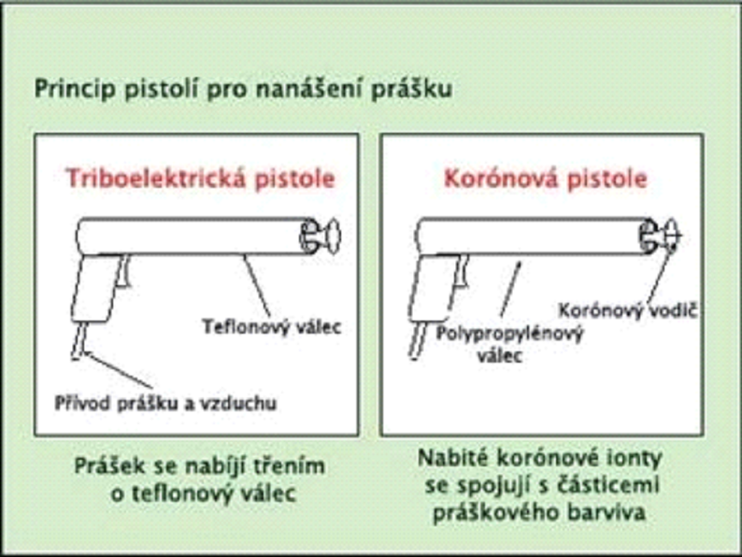
Application of Powder Paints in an Electric Field
surface pretreatment: degreasing, pickling, phosphating, chromating
application equipment: mixing the powder with compressed air
→ magazine → application gun → product
powder "charging": electrostatic energy → attracting particles to the product + sticking
a) triboelectric pistol: friction against the inner wall of the Teflon pistol
- suitable for epoxies
- easy maintenance
- greater thickness
b) corona pistol:
- HV voltage electrode (70-100 kV)
→ corona discharge

Slide 59
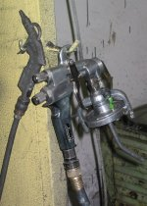
Application of Powder Paints in an Electric Field
Influences on the quality of coatings
Quality of compressed air
- clean and dry
- maximum permissible concentration of water 1.3 g/cm³, oil 0.1 g/cm³
Quality of air in the painting workshop
- relative humidity (ideal is between 45-50%)
Quality of plastic powder
- the moisture content of the powder must not exceed 0.4%
- the glass transition temperature should be below 50˚C
- maximum proportion of particles with a size of 35-40 μm
Good grounding of the object
Coating properties
Coating thickness below100 μm
Uniformity, decorativeness
Heat treatment up to 200°C for 10 to 20 minutes

Slide 60
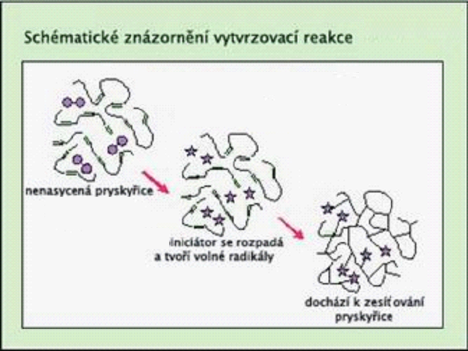
Firing of Powder Paints
curing ovens: chamber, passable
powder melting: T = 60-80°C (glass transition point) →
creating a continuous layer
firing: in the temperature range (160-200°C, heat resistant: higher T)
lower limit: temperature at which polymerization begins
sometimes with catalysts
removal, cooling, assembly
final assembly, packaging, shipping
Advantages:
single coat coating system
excellent adhesion
without primers
without subsequent drying
high labour productivity
→ economic savings

Slide 61
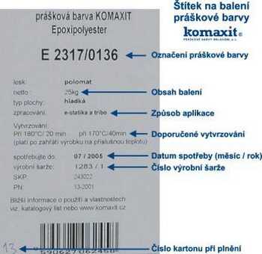
Labelling Powder Paints

Slide 62
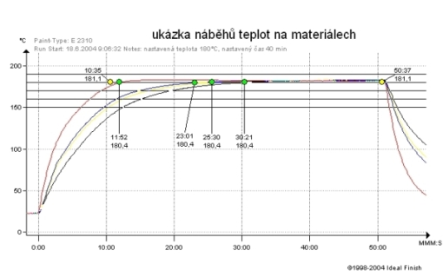
Firing Time
First yellow dot:
the time when the air temperature reached 180°C and the 40-minute reading started
Green dots:
time when the sheets reach the set temperature of 180°C
Second yellow dot:
end of reading; pulling products out of the furnace
Thickness of the material | Burning time from reaching the air temperature of 180°C
1 mm | 10 min
5 mm | 18 min
10 mm | 23 min
Red curve: temperature profile on a 1 mm thick sheet metal
Blue curves: thicker sheets

Slide 63
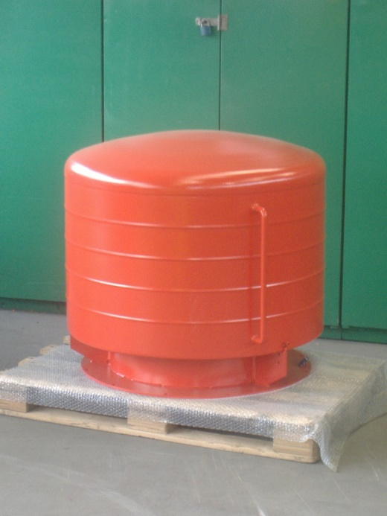
- curing below the recommended T: colour polymerization: slow and imperfect negative effect on "smoothness" → "orange peel"
- slow onset of T: negative effect on “smoothness"
- curing above the recommended T: formation of defects in the layer and on the surface of the paint degradation of resins, pigments →
- cracking and peeling of the paint on impact
- insufficient matt
- poorer chemical and weather resistance
- shorter life slight overfiring – less of a problem than insufficient firing overburning – economically disadvantageous
Failure to Comply with the Firing Parameters

Slide 64
Optimization of Firing
Adherence to temperature and time
Measurement of the temperature course directly on the product and measurement of the air temperature in the chamber and continuous furnaces:
the measuring device and the probes (thermocouples) go into the furnace together with the product
Measuring the rate of the rise of T on the product: differences in temperatures on the products and at different points in the furnace
Evaluation: finding out how the paint is fired on the product under the given conditions, then deducing the causes of defects20

Slide 65
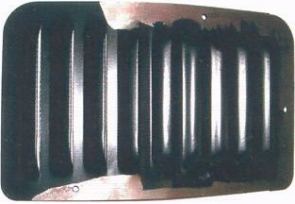
Peeling of Powder Paint
Reasons:
contamination of the substrate with grease or incoherent particles:
peeled paint does not break and is flexible
b) bad firing:
pieces of peeled paint are not flexible; they break when bent
bending of the paint plate; colour burned to less than 70% of the recommended T peels off
- it peels off even with a light blow
underfired matt colours:
- glossier than well fired

Slide 66
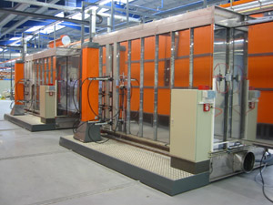
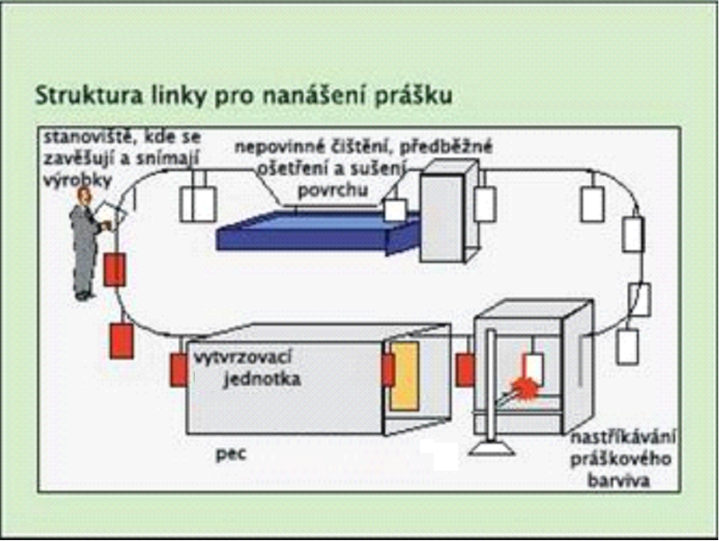
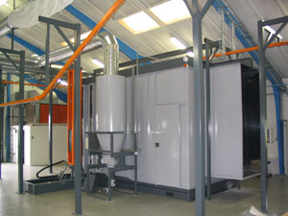
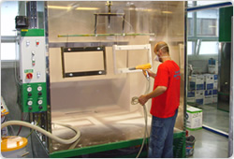
Work Lines

Slide 67
Technologies and their Effectiveness
NH deposition technology NH losses during deposition
Brush 3 to 5%
Roller (manual) 3 to 5%
Pneumatic spraying 20 to 70%
High-pressure spraying (high dry NH) 20 to 70%
Hot NH spray (drying acceleration) 20 to 50%
Electrostatic spraying 10 to 40%
Cloning 10 to 20%
Watering 10 to 20%
Dipping 10 to 20%
Rolling (sheets) 5 to 10%
Electrochemical deposition (water dilutable NH) 10 to 20%
Electrostatic application of powdered NH 10 to 15%
Fluid application of NH powders 10 to 15%

Slide 68
Sol-gel Method
chemical method of preparation of special non-metallic materials (oxides, etc.)
homogenization of the starting component in solution →
sol → gel

Slide 69
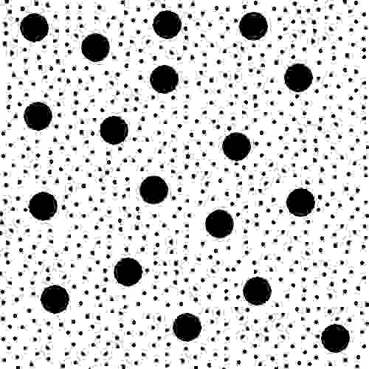
Sol
Colloidal solution
Particles: 1 nm to 1000 nm
particles of the dispersed component
solvent

Slide 70
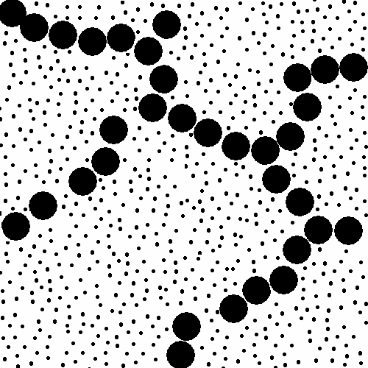
Gel
Gelation:
the particles of the dispersion component precipitate and bind to each other → spatial interconnection
viscosity increases
solidification → gel:
structure:
spatially highly porous network
there is solvent in the pores
particles of the dispersed component
solvent

Slide 71

Xerogel
evaporation of the solvent (25-100ºC) → xerogel
strengthening the gel structure
air in the pores instead of solvent
highly porous structure
large specific surface area
e.g.:
silica gel
  porous SiO₂
  moisture absorber
gelation of aqueous glass sol
  aqueous Na₂SiO₃ solution
particles of the dispersed component

Slide 72
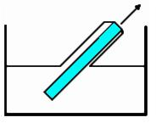
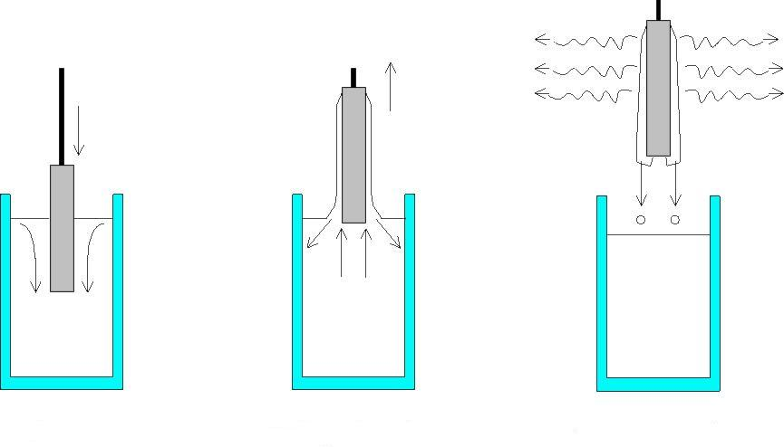
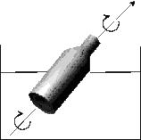
DIP-COATING Technology
Dip-coating:
substrate immersed in liquid (sol)
constant temperature and atmospheric conditions
pulling at a constant speed

Slide 73
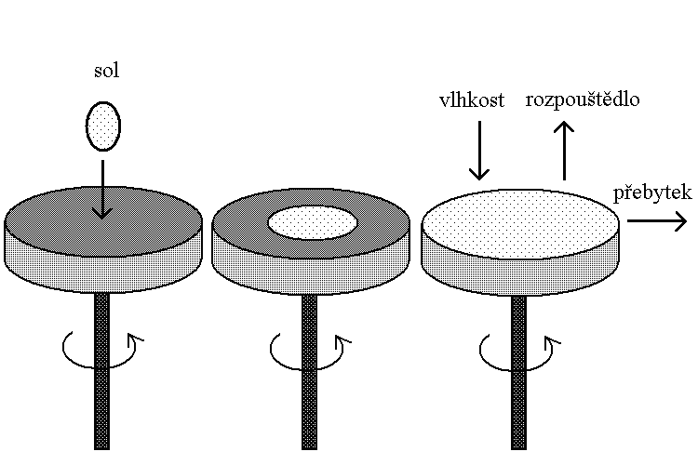
SPIN-COATING Technology
rotation of the substrate about its own axis perpendicular to the applied surface
spin-on glass – microelectronics
glasses with rotational symmetry, e.g., optical lenses
layer thickness: several hundred nm to 10 μm

Slide 74
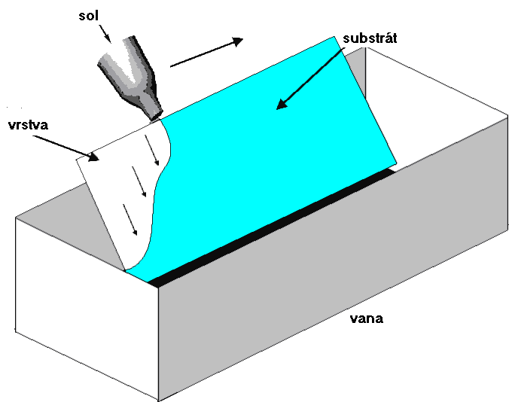
FLOW-COATING Technology
applying the solution to the substrate
modification of glass properties:
  e.g.: application of polycarbonate layers on car windows
advantages:
application of layers also on curved surfaces
application on large areas

Slide 75
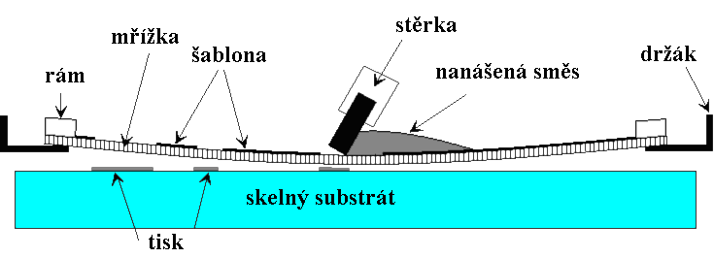
PRINTING Technology
Printing
use: car and decorative glass, glass stove doors, etc.
procedure:
  the material (organic polymer) is applied to the glass by screen printing
  drying by heat or UV radiation (the substrate and the applied film must have a similar value of thermal expansion so that the layer does not crack during firing and cooling)
  heat treatment
  layer thickness: tens to hundreds of μm

Slide 76
Application of the Sol-gel Method
Sol-gel layer – chemical bonding to the surface
Thickness:
normally 20-150 nm
or repeated application or in special cases up to hundreds of µm
Application:
application by various techniques
polymerization – by the action of UV light or by the addition of catalysts
heat treatment – inorganic layers
Use:
anti-corrosion coatings for metal surfaces: aluminium, steel, etc.
optical and electro-optical components
protective and decorative coatings

