Slide 1


ESF II project of the University of West Bohemia in Pilsen
reg. number: CZ.02.2.69/0.0/0.0/18_056/0013239
KEV/EPV

Slide 2
Outline
AC power supply systems
Ways of power supply
Main electric parts of the vehicles with series motor
Ways of control of series motor at AC traction
Traction rectifier, replacement circuit
Voltage and current waveforms
Schema of the vehicle
Traction characteristics

Slide 3
AC power supply systems
15 kV 16,7 Hz. Since the beginning of 20th century. Germany, Austria, Switzerland, Norway, Sweden
25 kV 50 Hz (60 Hz). It is considered the most advantageous today. Hungary, part of France, part of the former USSR, India, Pakistan, further lands which started with electrification later (Denmark). In Czech Republic southern main tracks.
Transition between AC and DC systems is provided by dual current vehicles.

Slide 4
Advantages and disadvantages of AC supply systems
Advantages:
Smaller cross-section of the supply line, lighter conduction
Longer power sections - 40 km against 20 km
Lower losses in supply line (approx. eight times lower current)
Lower number of power stations
Stray currents – at DC systems they cause pipe corrosion
Disadvantages:
Asymmetrical load of superordinate supply system
Each traction vehicle includes traction transformer

Slide 5
Way of supply at AC system

Slide 6
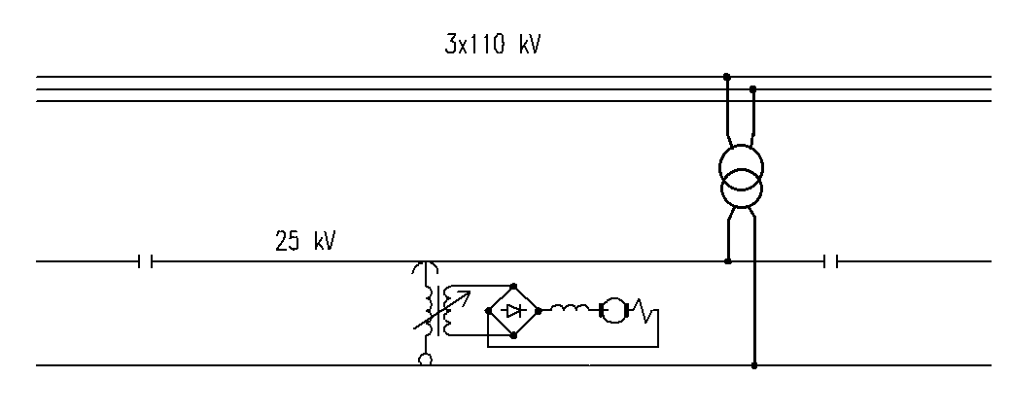

Slide 7
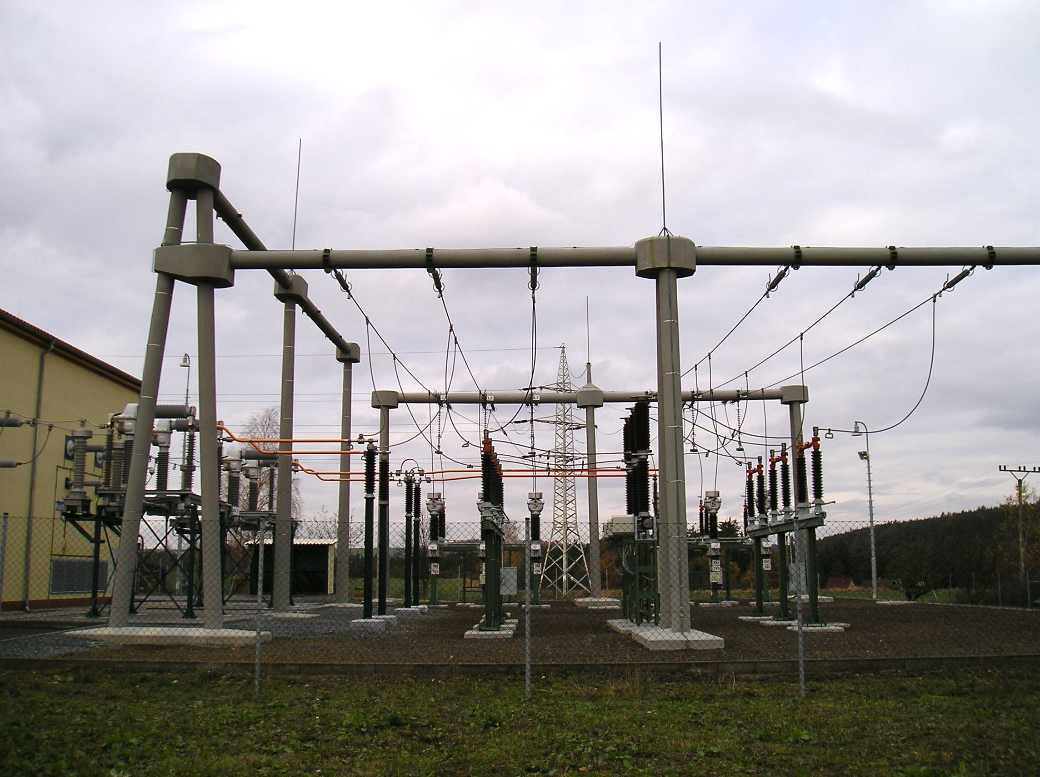
Power station Vranov – outer part

Slide 8
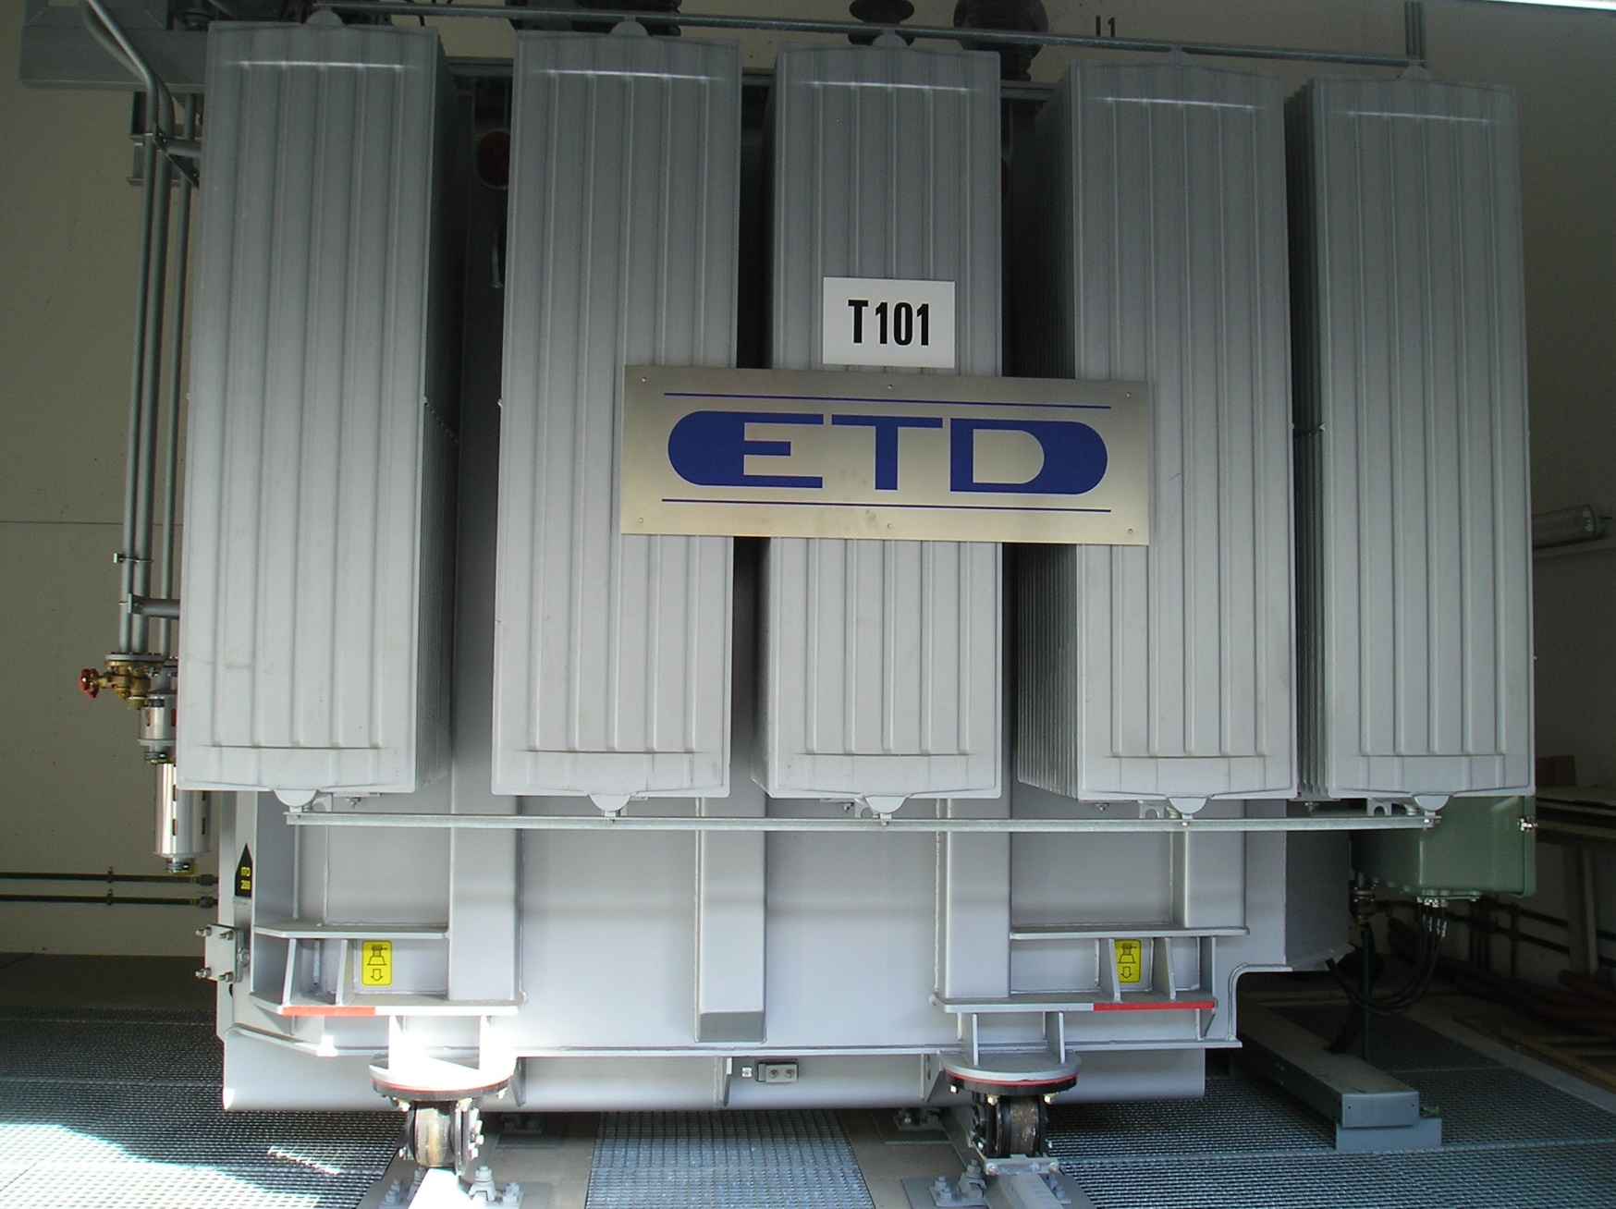
Power station Vranov – transformer

Slide 9
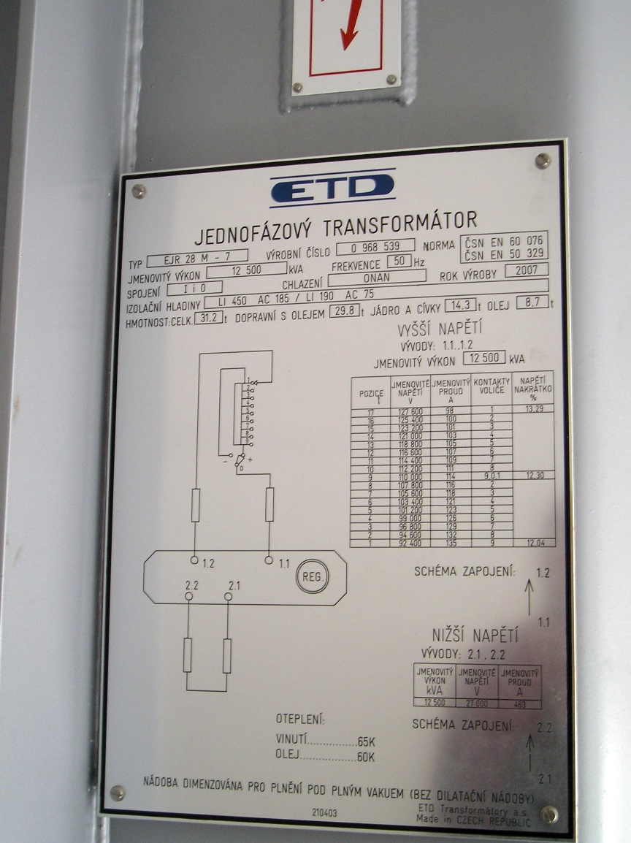
Transformer label

Slide 10
Main parts of the AC vehicles with series motors
DC series motor
Transformer with tap control
Uncontrolled rectifier (the most frequent in bridge connection)
smoothing choke

Slide 11
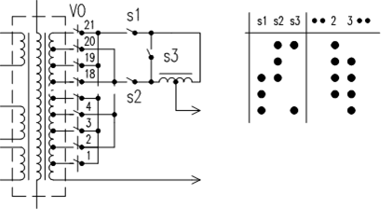
Voltage control at low voltage side

Slide 12
Voltage control at high voltage side

Slide 13
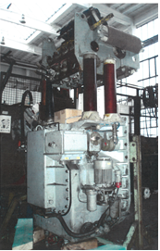
Tap changer of class 242 loco

Slide 14
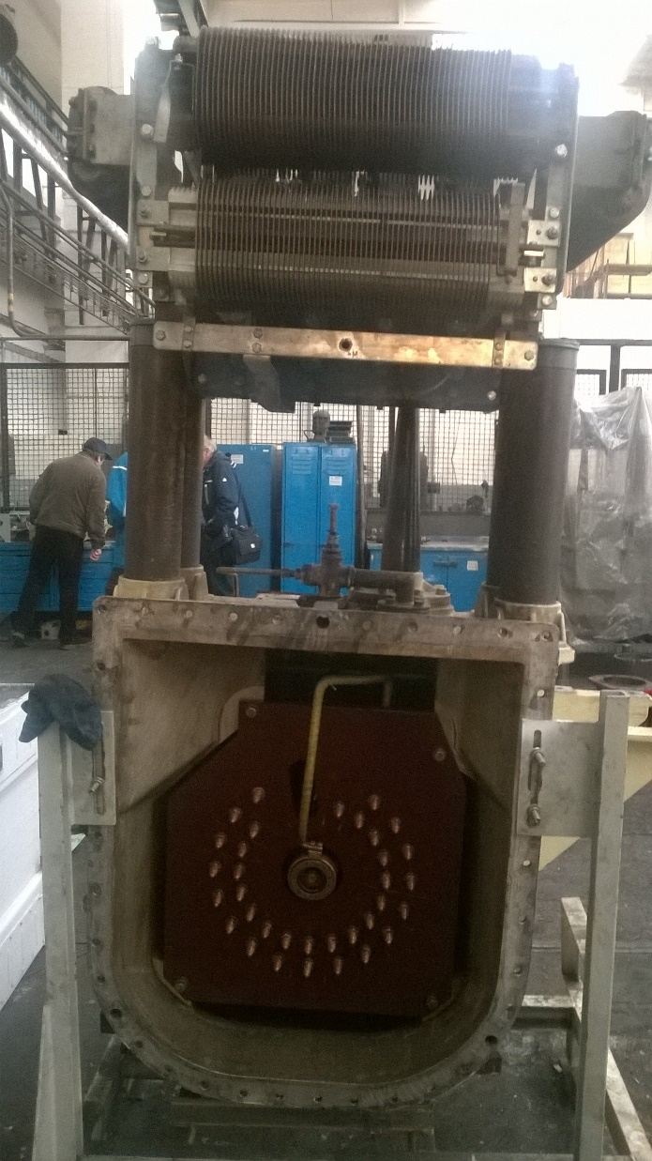
Tap changer – rear view

Slide 15
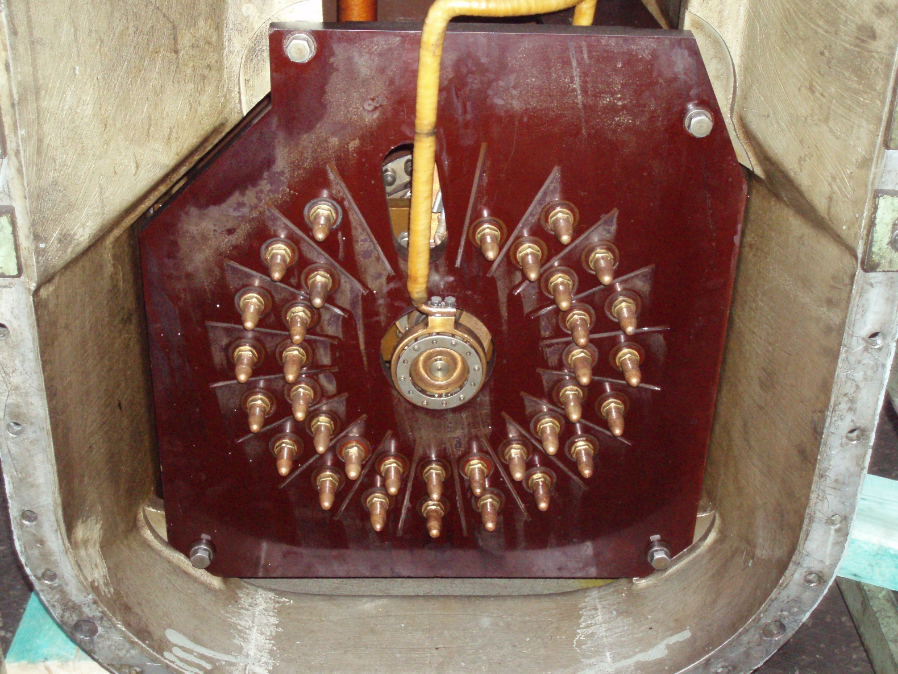
Selector

Slide 16
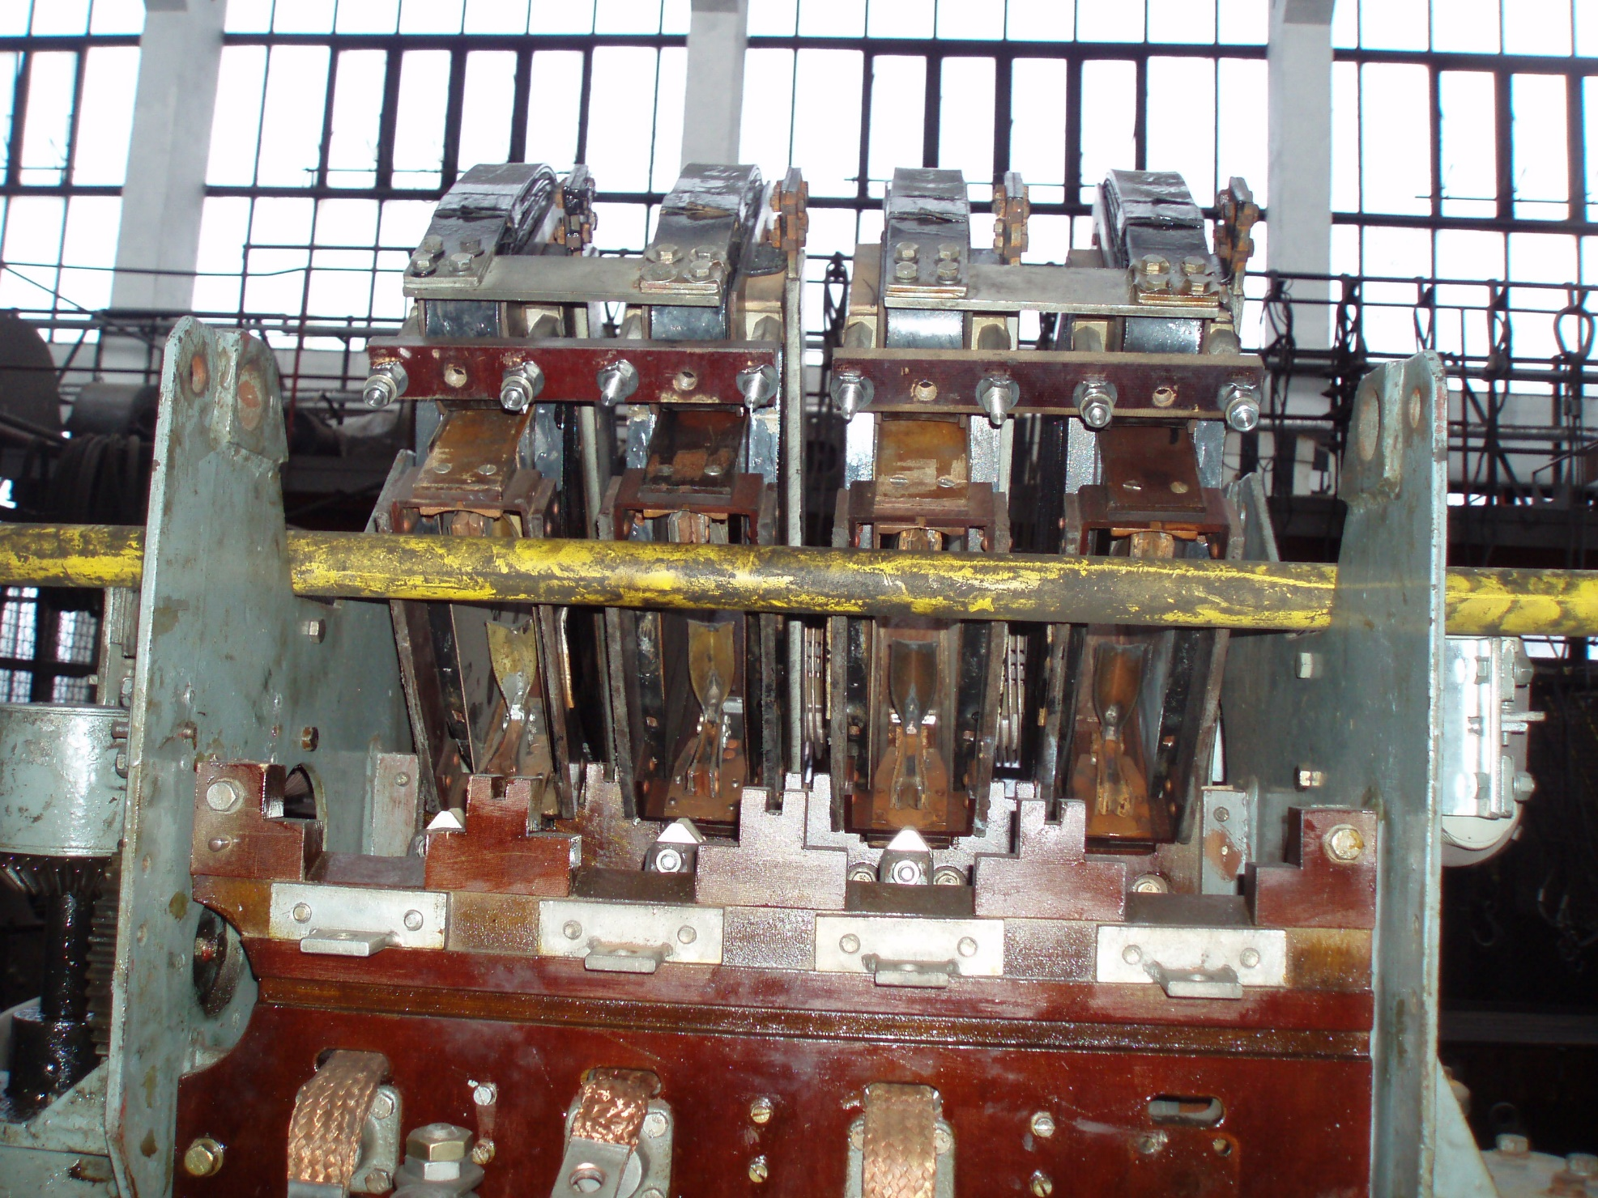

Stykačová část

Slide 17
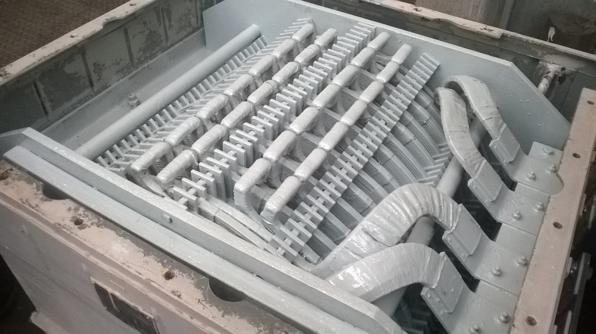
Smoothing choke

Slide 18
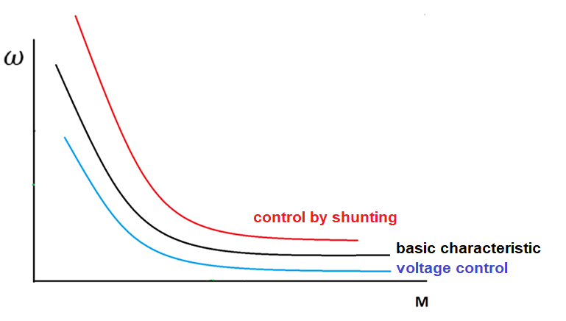
Control of series motor at AC system

Slide 19
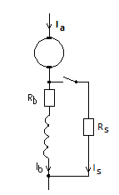
Control by shunting

Slide 20
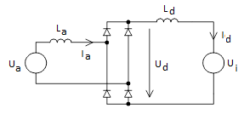
Replacement circuit

Slide 21
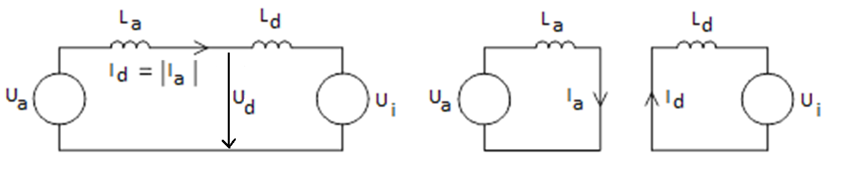
Powering to the load, commutation

Slide 22
Course of voltages and currents

Slide 23
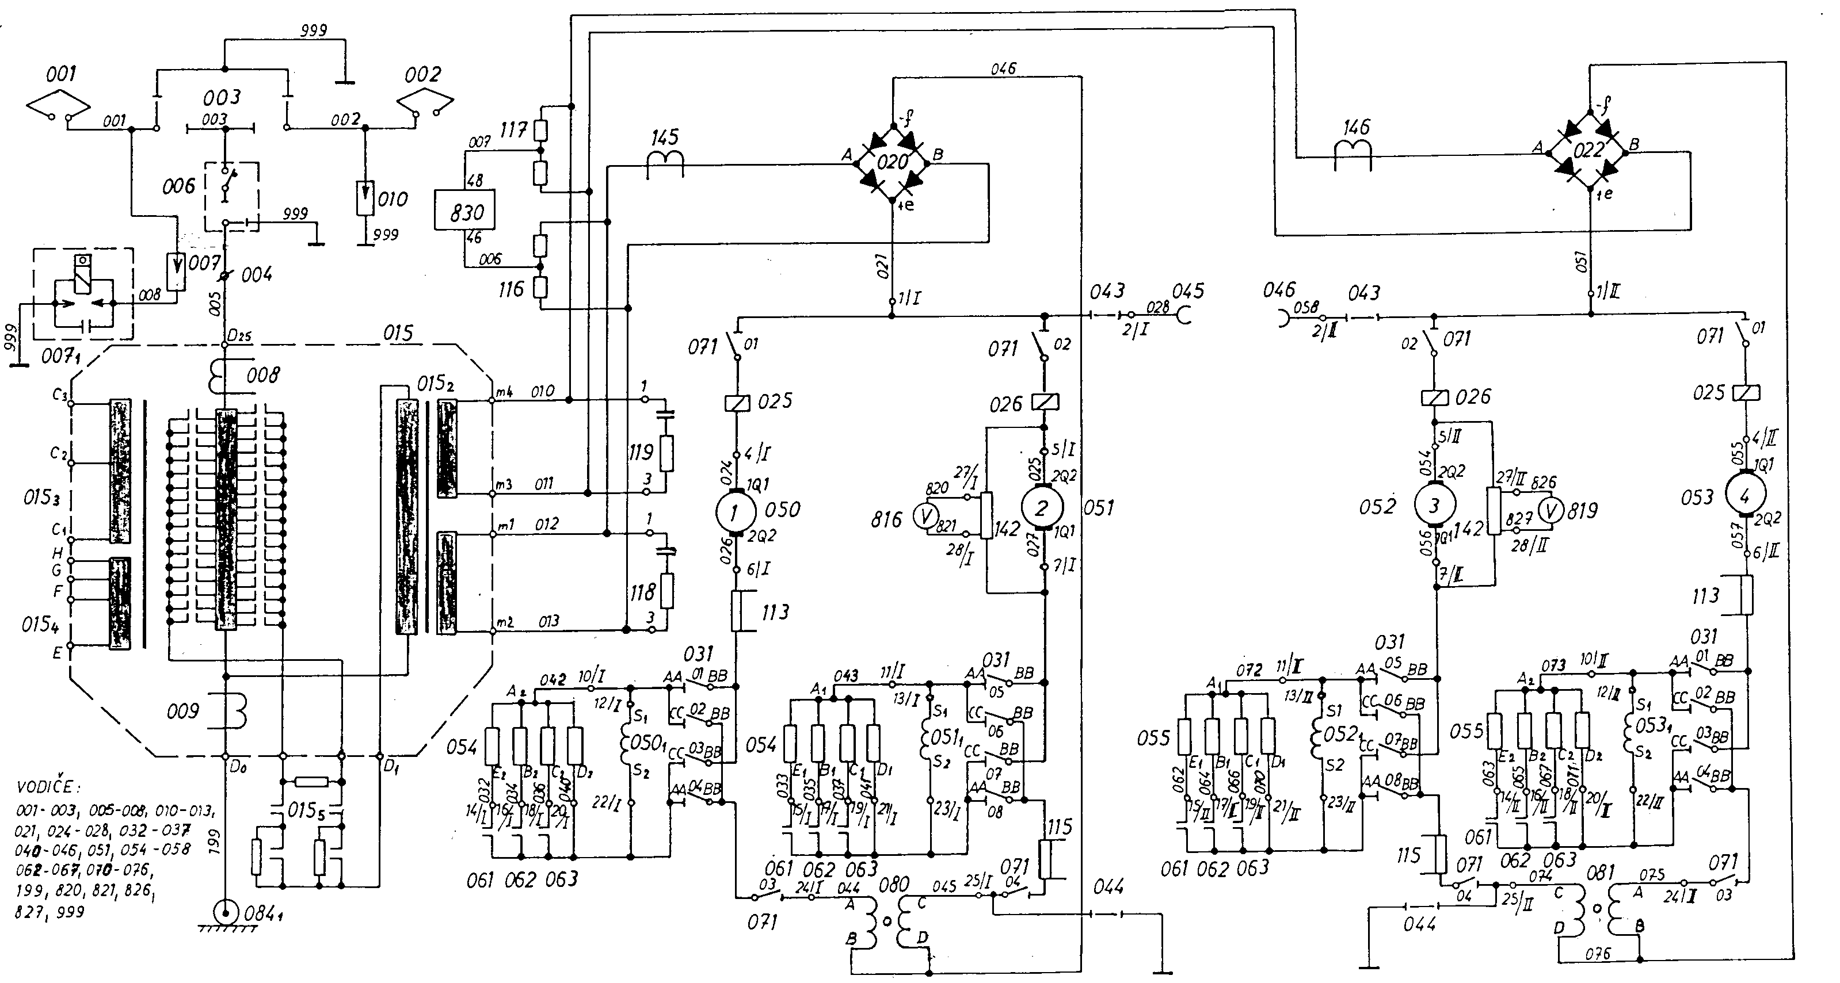
Power diagram of class 64E loco

Slide 24
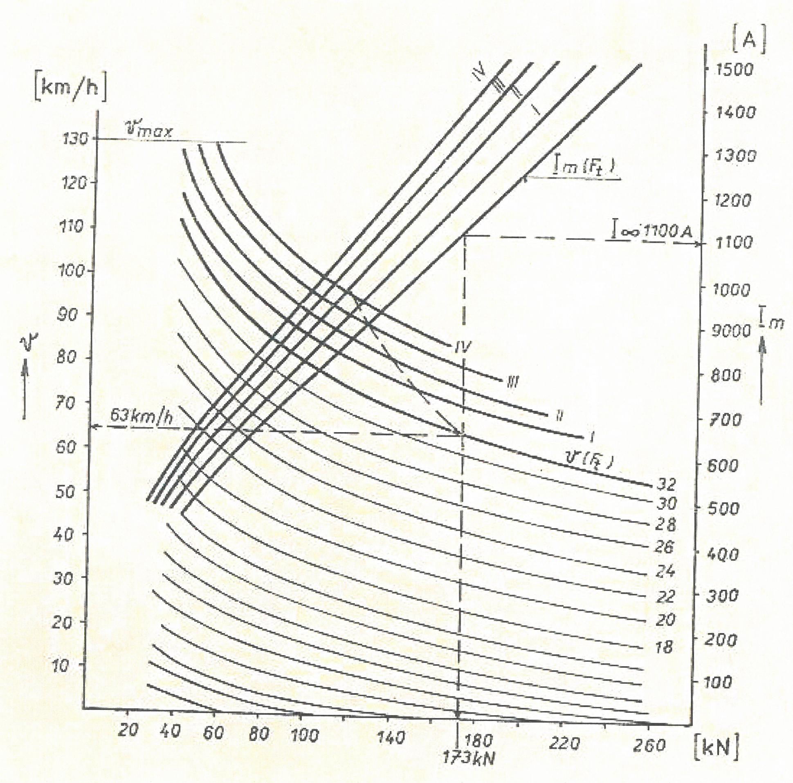
Traction characteristics of class 64E loco

Slide 25
Thank you for your attention.

Slide 26
Questions
Which AC supply systems do you know?
In which lands these AC systems can be found?
Which are advantages and disadvantages of AC supply systems in comparison with DC systems?
How is provided transition between AC and DC systems?
Which are ways of supply at AC system?
Which are main parts of the AC vehicles with series motors?
Which are two basic ways of voltage control?
Which basic parts the tap changer consist of? Describe its function.
How the series motor at these vehicles is controlled?

Slide 27
Draw replacement circuit of the drive at these vehicles.
Which are two parts of rectifying of AC voltage are at these vehicles?
Draw a course of voltages and currents at AC as well DC side at these vehicles.
Draw a block diagram of these vehicles.
Draw a traction characteristics of these vehicles.

