Slide 1


ESF II project of the University of West Bohemia in Pilsen
reg. number: CZ.02.2.69/0.0/0.0/18_056/0013239
KEV/EPV

Slide 2
ADHESION
ELEKTRICKÉ POHONY VOZIDEL
Antonín Glac

Slide 3
Content
Slip and slide characteristics.
Influence of the vehicle construction to the adhesion
Adhesion measurement and modeling
Support materials
  Elektrická trakce 7: Adheze. Doc. Ing. Jiří Danzer CSc.

Slide 4
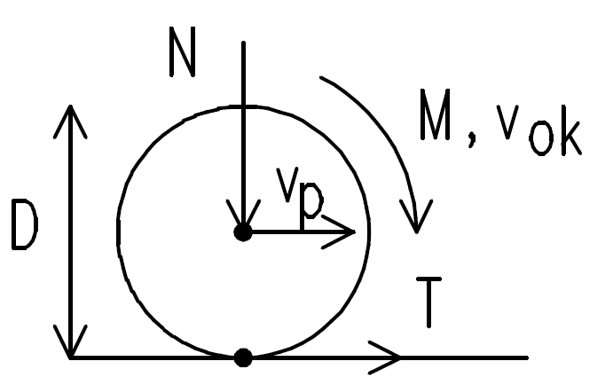
Adhesion
Ability to transmit tangential forces in the contact of two surfaces without any (obvious) relative movement
Set of physical properties of the contact surfaces of a wheel and a rail to transmit tangential force

Slide 5
Adhesion
Slip
  Speed of wheels rapidly increase relatively to the longitudinal speed of a vehicle due to increase traction force or worsening adhesion conditions
    Mechanical stress of a drive, possible overspeed
    Wheels and rail damage
    Longitudinal shocks of a train set
    Traction force decrease, possible delay or getting stuck on a track
Skid
  Speed of wheels is significantly lower (or zero) relatively to the longitudinal speed of a vehicle,
    Flat shaped damage of wheels
    Decrease of average braking force (leads to longer braking distance)
    Could be caused by brakes, even the non-driven axles must have anti-skid device

Slide 6
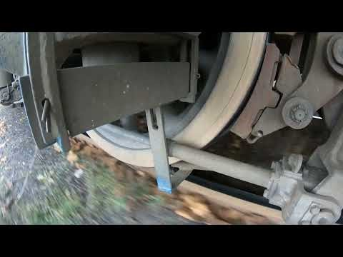

Slide 7
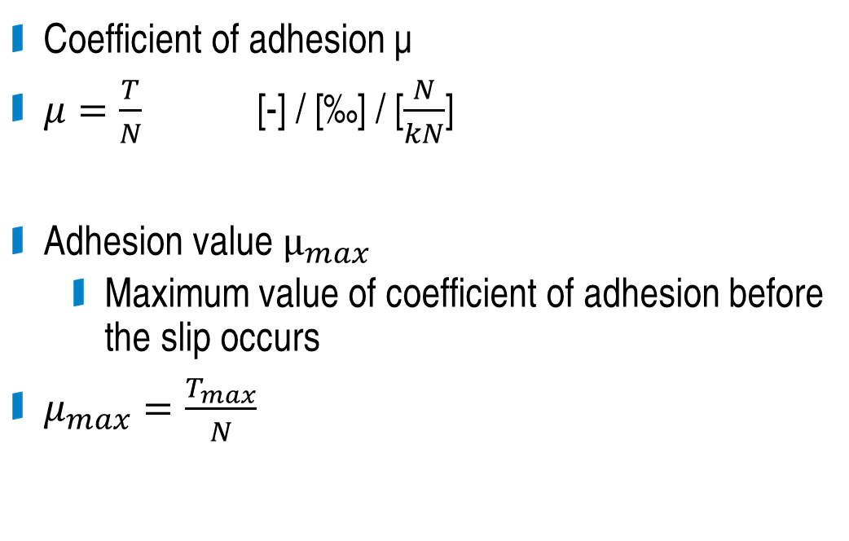
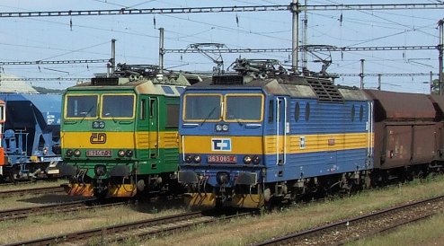
Adhesion value
Coefficient of adhesion µ
$μ=\frac{T}{N}$ [-] / [‰] / [$\frac{N}{kN}$]
Adhesion value $µ_{max}$
  Maximum value of coefficient of adhesion before the slip occurs
$μ_{max}=\frac{T_{max}}{N}$

Slide 8
Adhesion value
The adhesion value is influenced by many effects, measured values have large variance
Conditons in a contact surface
  Presence of substances in the contact surface (water, oil, dust, rust, leaves,...)
  Contact surfaces material properties
Speed

Slide 9
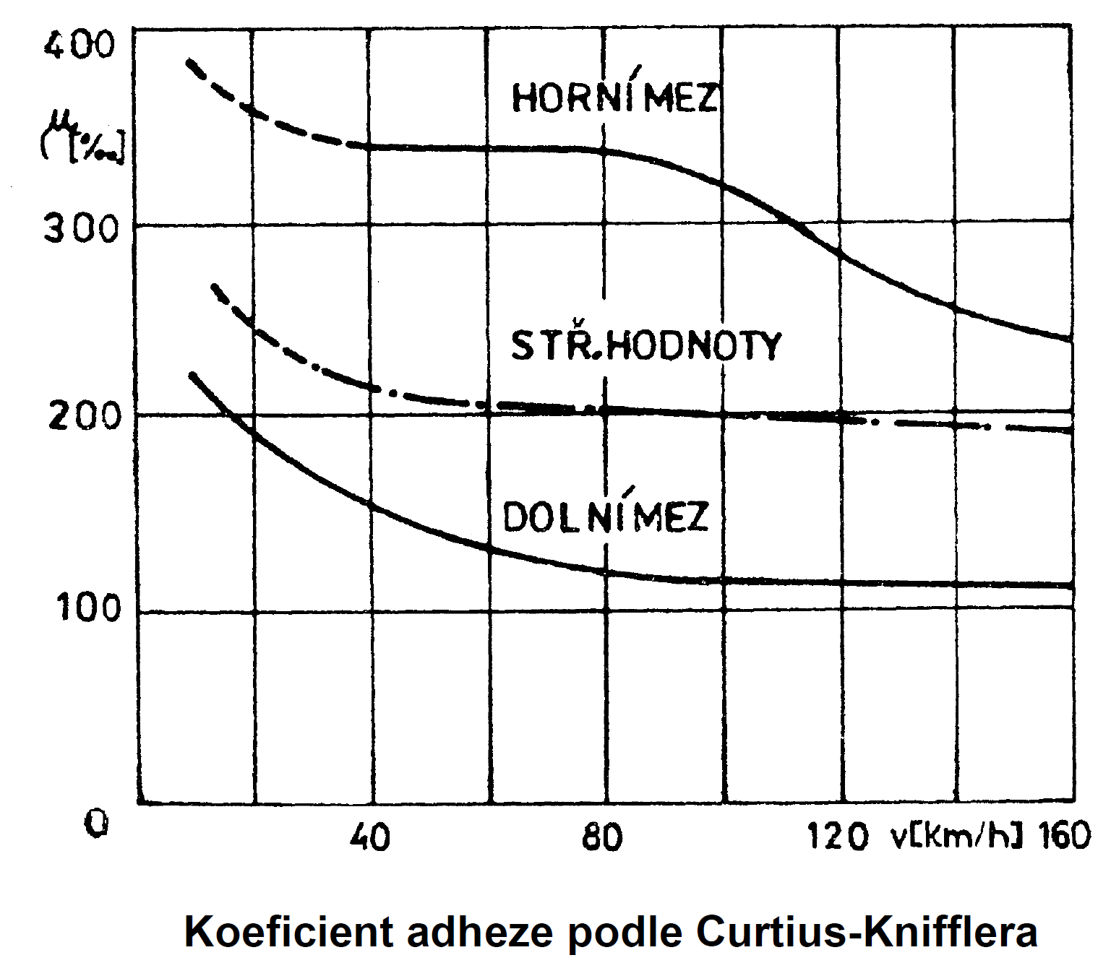
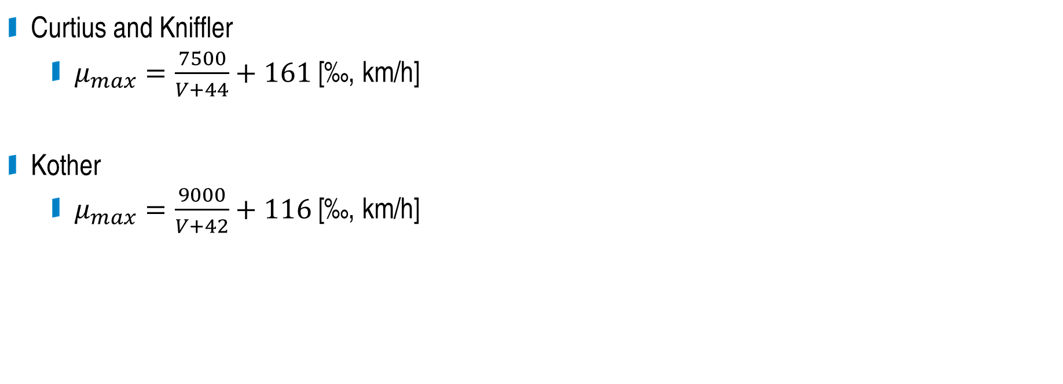
Adhesion value – empirical formulas
Curtius and Kniffler
  $μ_{max}=\frac{7500}{V+44}+161$ [‰, km/h]
Kother
  $μ_{max}=\frac{9000}{V+42}+116$ [‰, km/h]
Adhesion value by Curtius-Kniffler

Slide 10
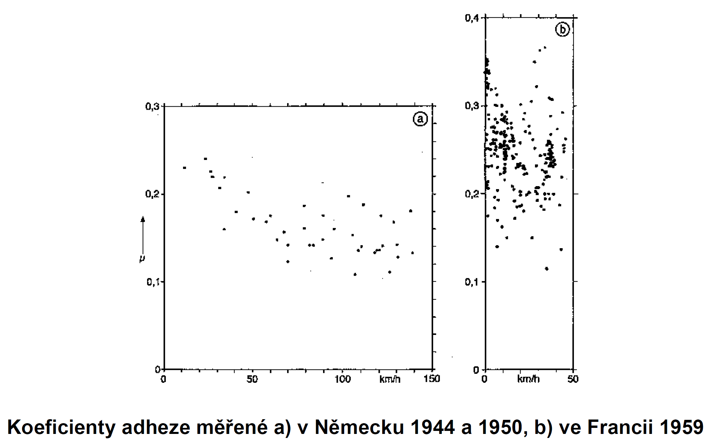
Adhesion value – measurement
Measured adhesion values a) in Germany 1944 and 1950 b) in France 1959

Slide 11
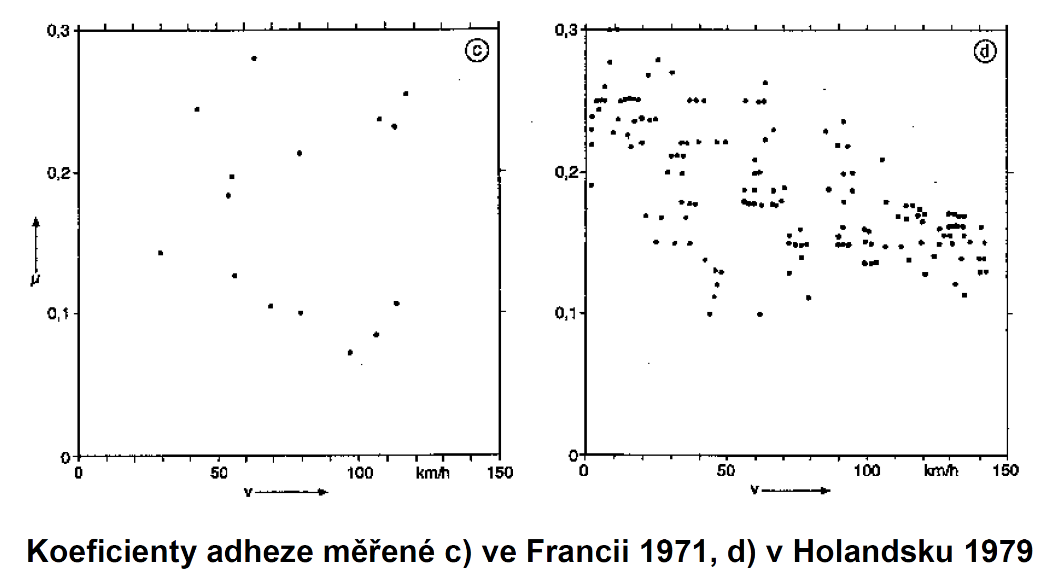
Adhesion value – measurement
Measured adhesion values c) in France 1971 d) in Netherland 1979

Slide 12
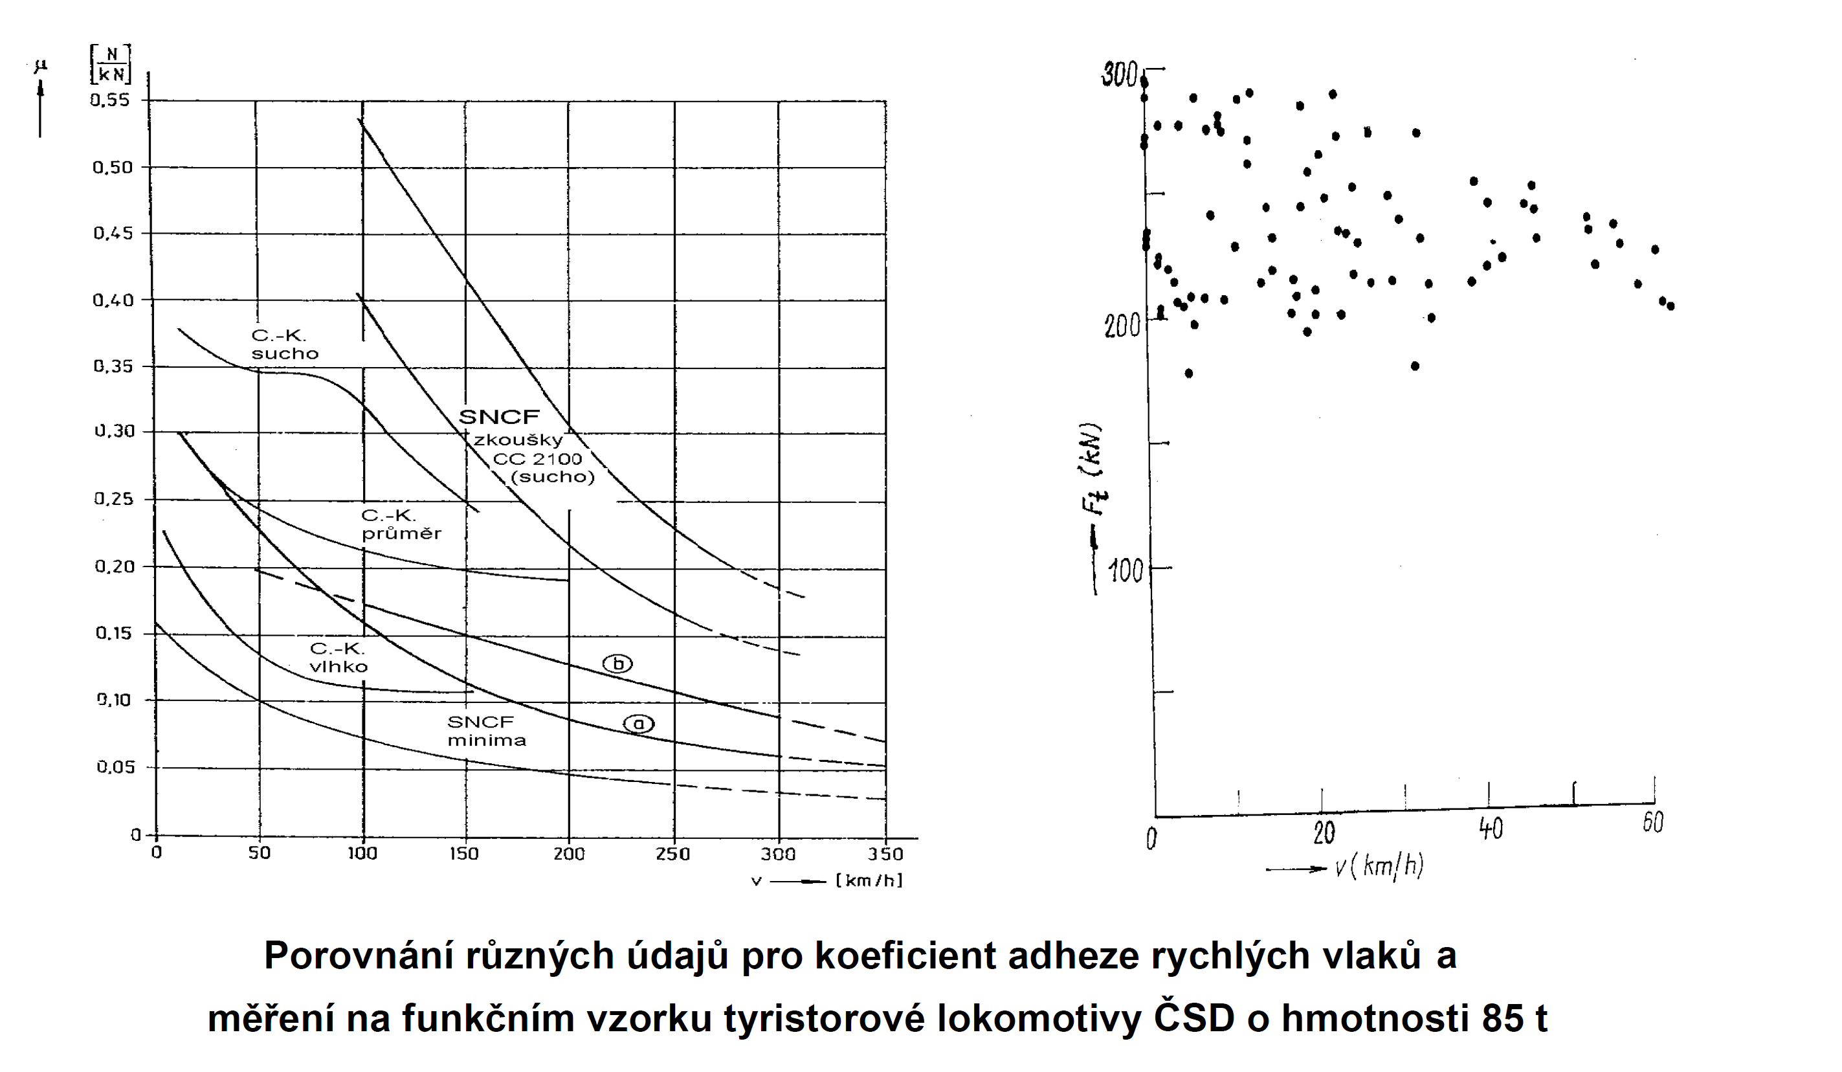
Adhesion value – measurement
Comparison of adhesion coefficient by various conditions

Slide 13
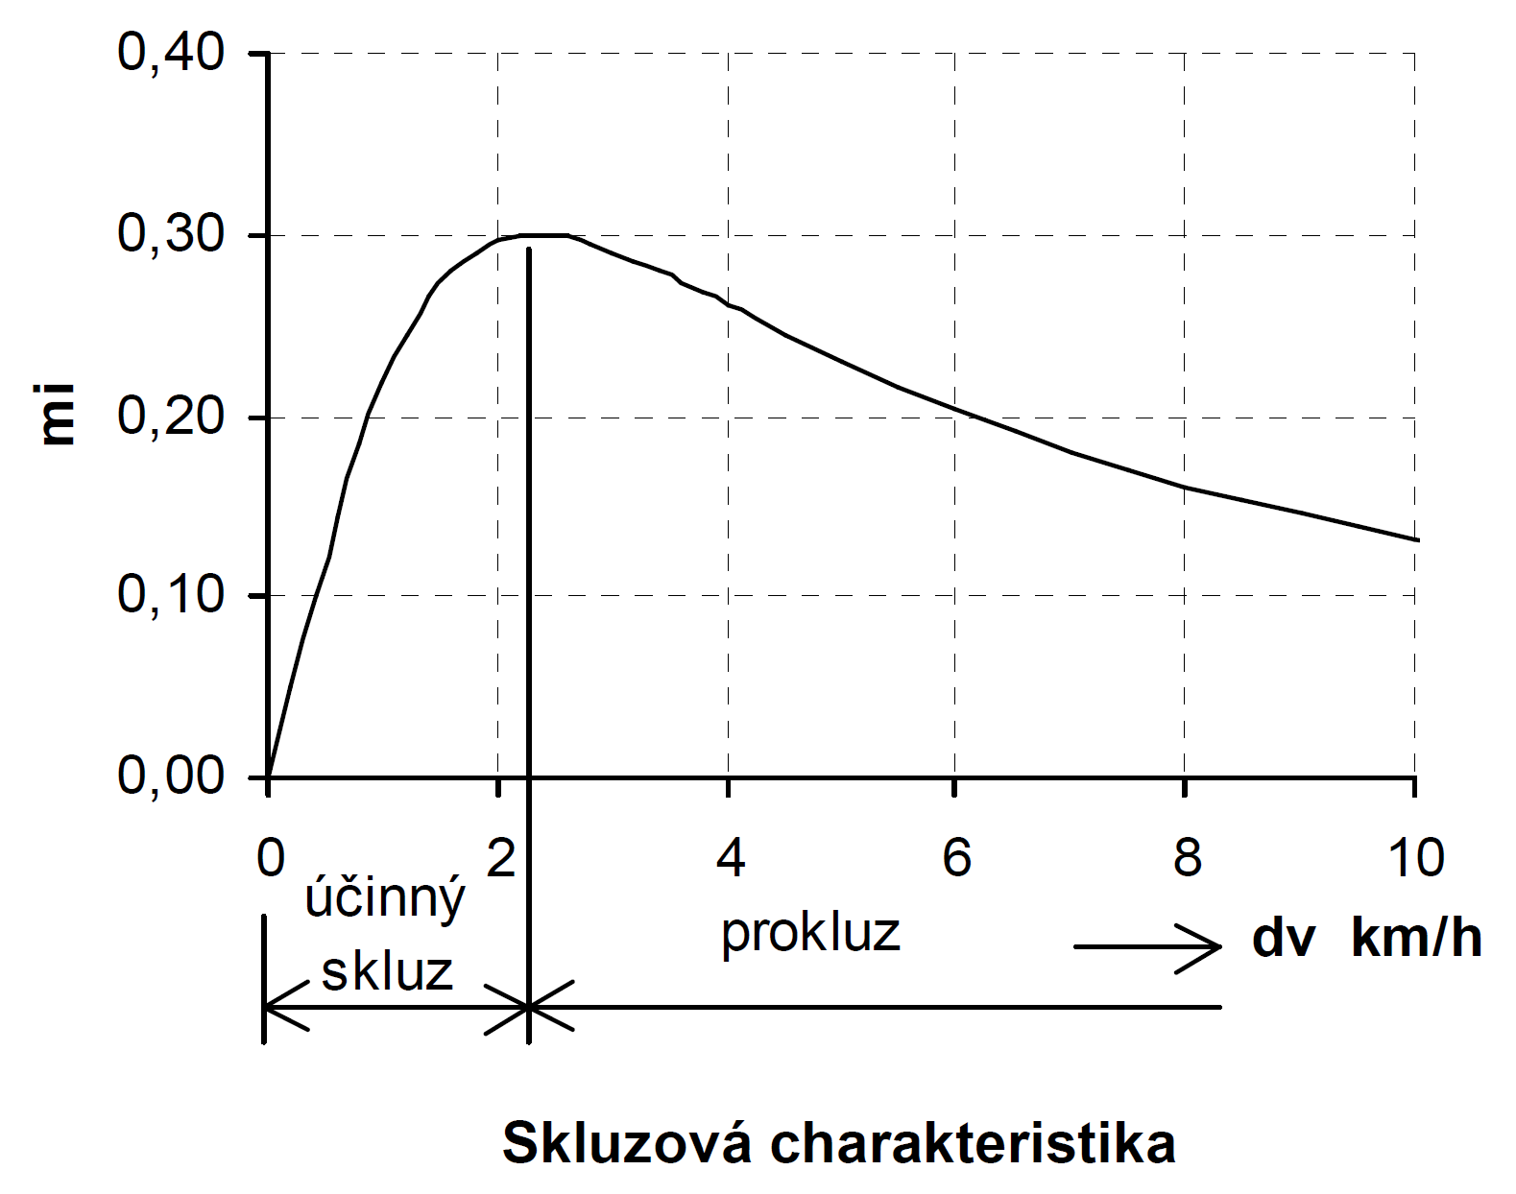
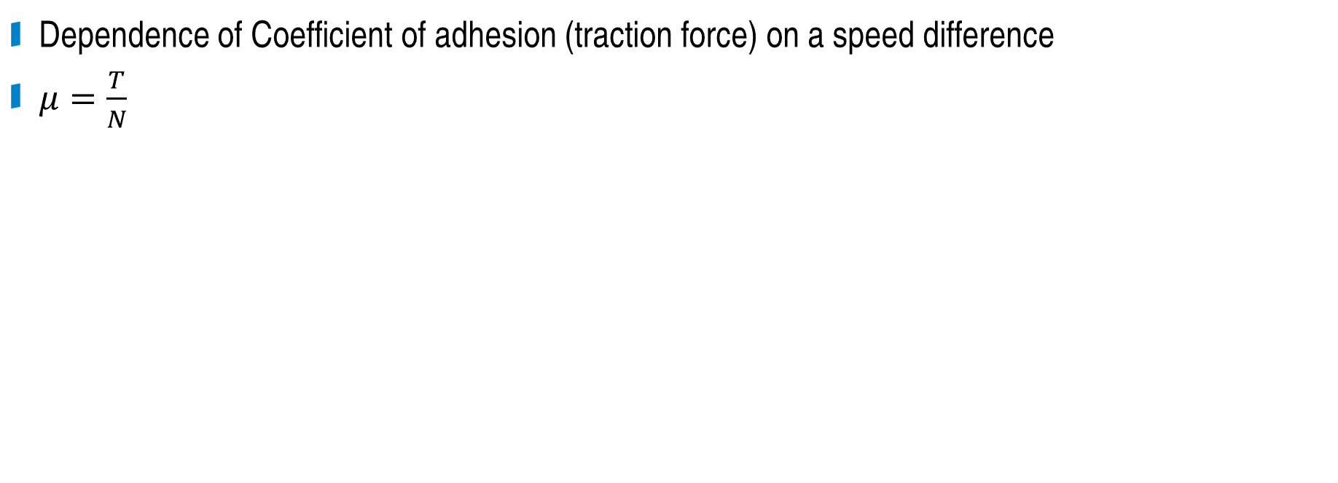
Slip characteristics
Dependence of Coefficient of adhesion (traction force) on a speed difference
$μ=\frac{T}{N}$
stable slip
unstable slip
Slip characteristics

Slide 14
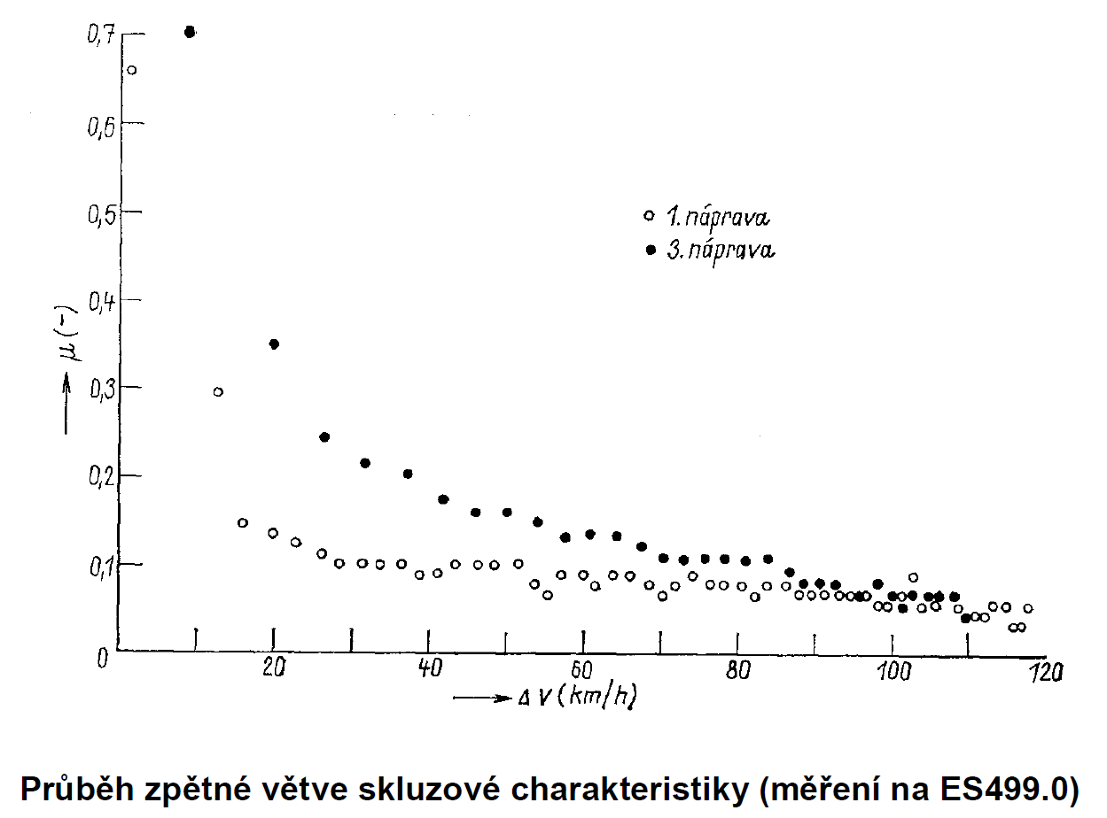

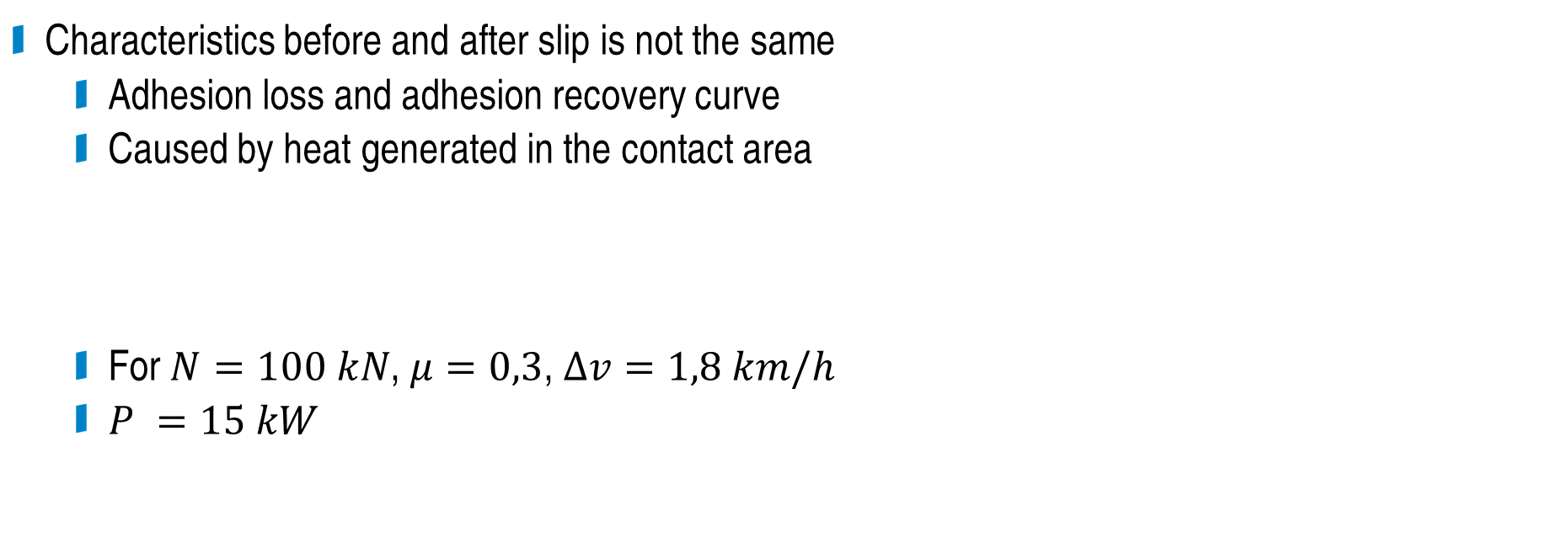
Slip characteristics
Characteristics before and after slip is not the same
  Adhesion loss and adhesion recovery curve
  Caused by heat generated in the contact area
  For $N=100 kN$, $μ=0,3$, $∆v=1,8 km/h$
  $P =15 kW$
1. axle
3. axle
  Adhesion loss and adhesion recovery curve (measured on ES499.0)

Slide 15
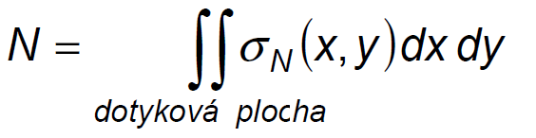
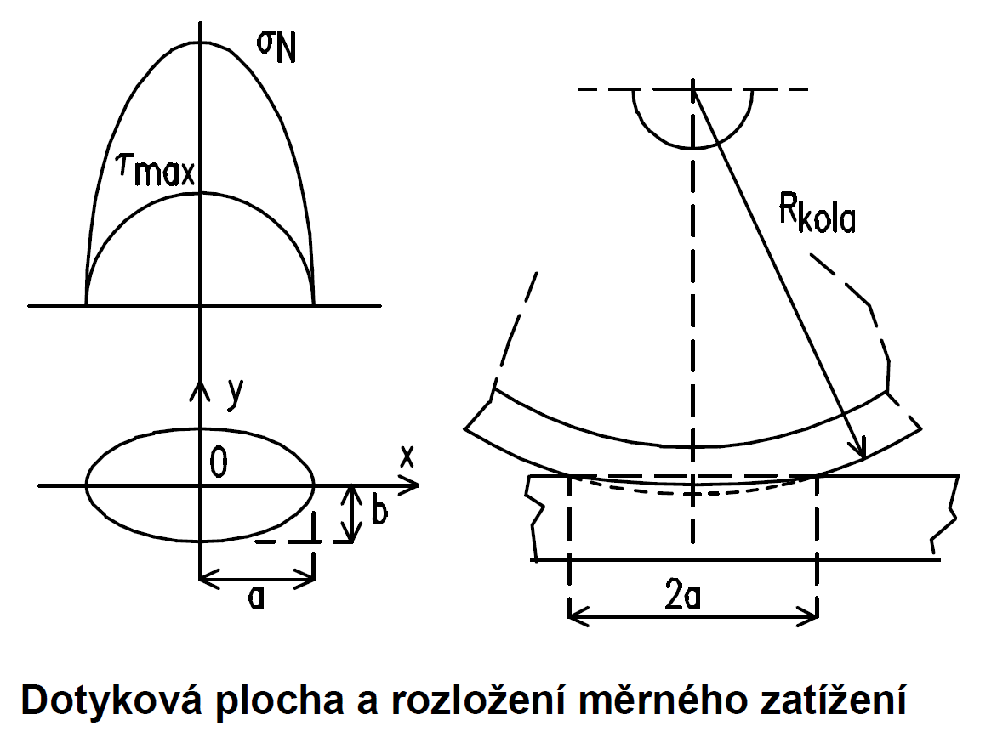

Contact area
contact area
We assume contact of two cylindrical surfaces
  Contact area is ellipse shaped
For
  Wheel load force 100 kN
  Wheel diameter 1000 mm
  Radius of a rail head 100 mm
The contact ellipse dimensions:
  Major axis a=8,6 mm
  Minor axis b=3,0 mm
  Area 81 mm²
$$R_{wheel}$$
Contact area and load distribution

Slide 16
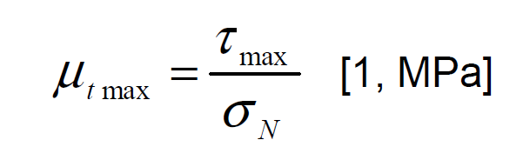
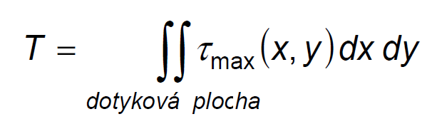
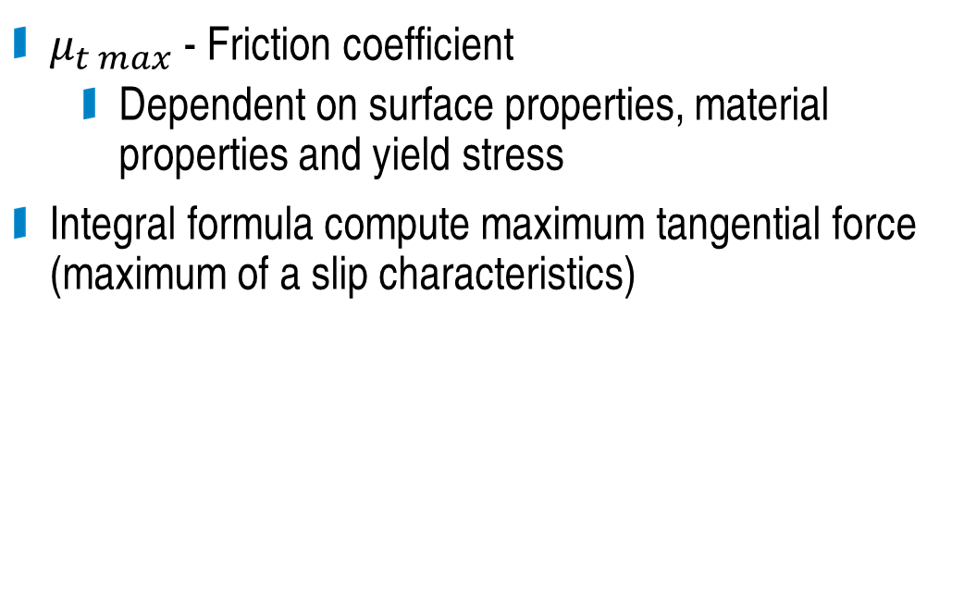

Contact area
$μ_{t max}$ - Friction coefficient
  Dependent on surface properties, material properties and yield stress
Integral formula compute maximum tangential force (maximum of a slip characteristics)
contact area
$$R_{wheel}$$
Contact area and load distribution

Slide 17
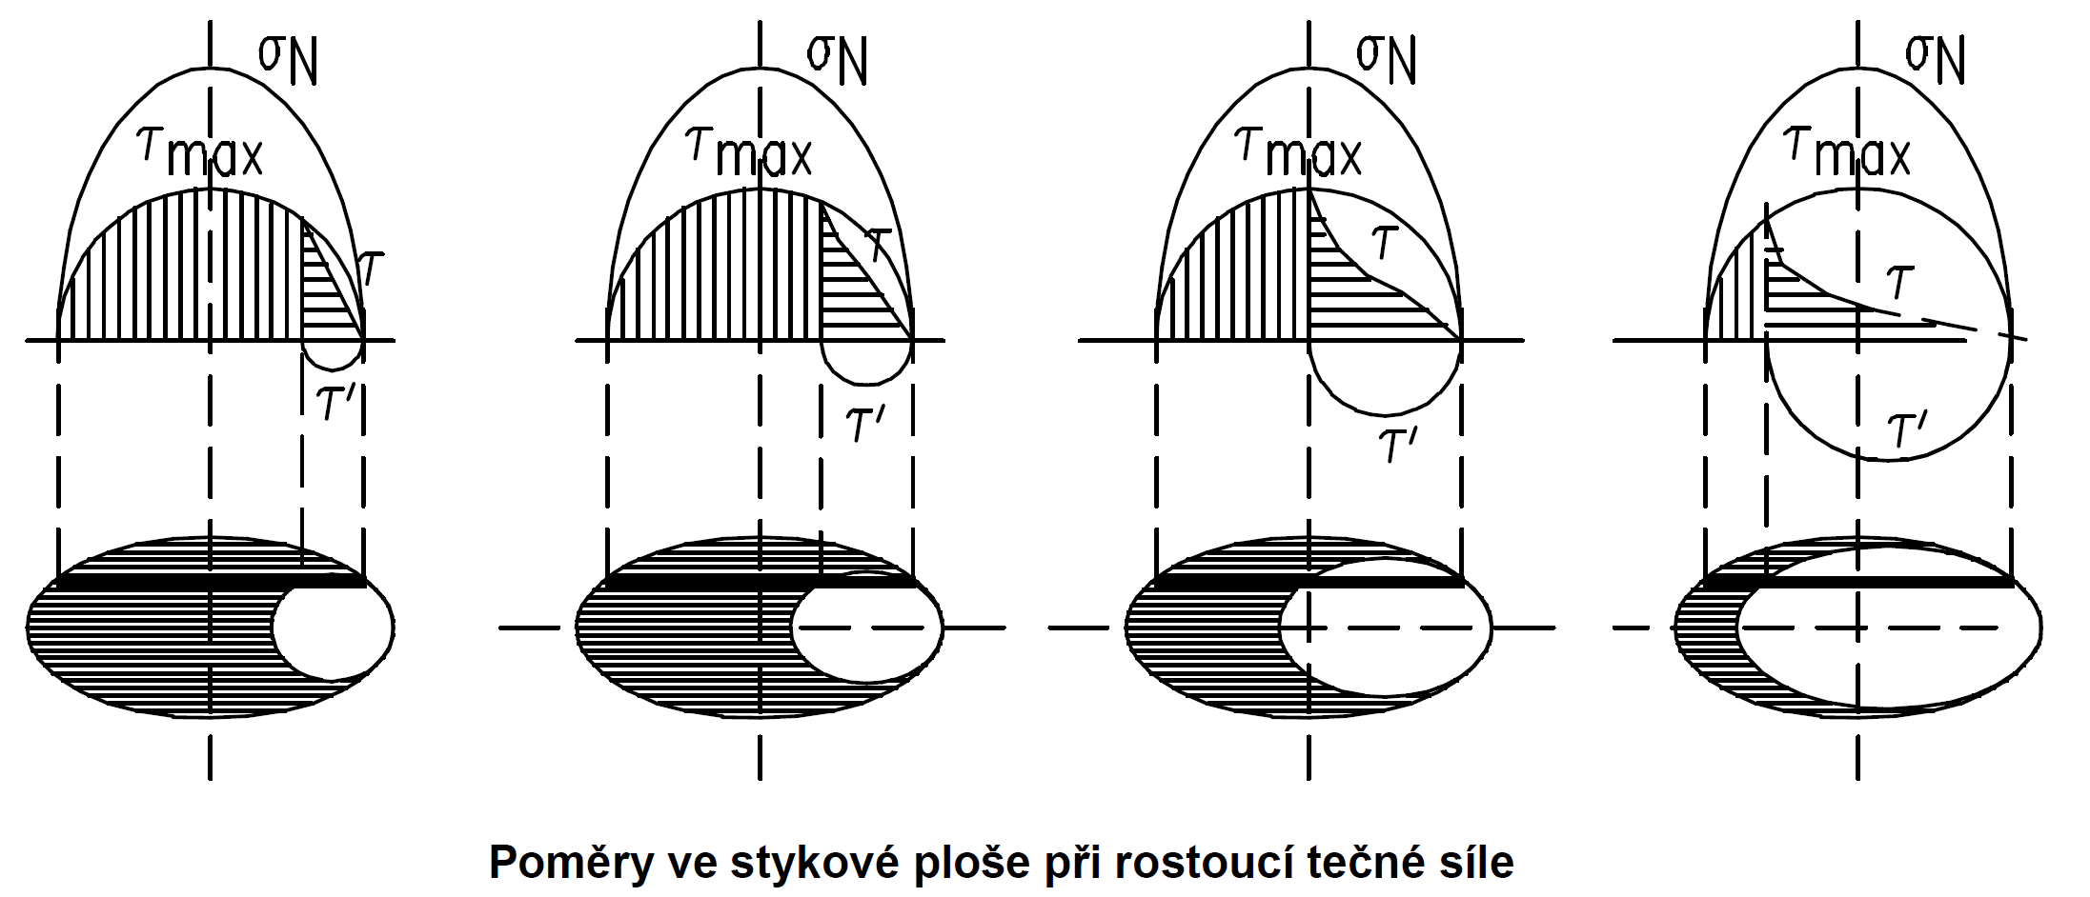
Contact area
Model by Carter (1926)
  Division the contact area to adhesion and slip area.
Contact area by rising traction force

Slide 18
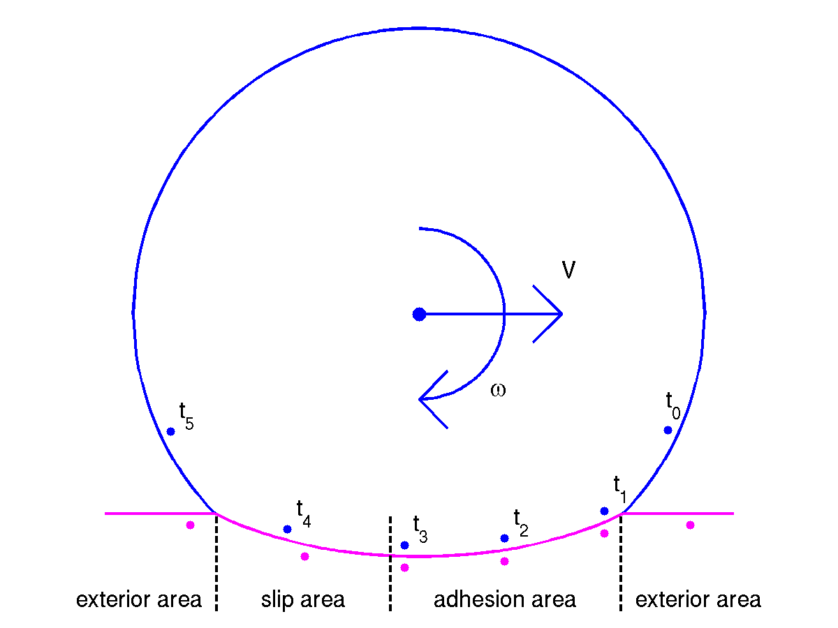
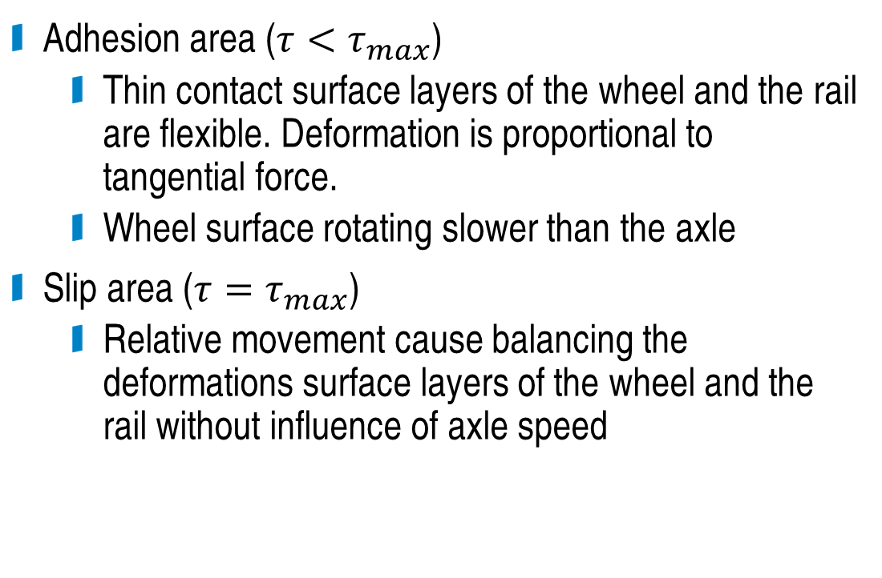
Contact area
Adhesion area ($τ<τ_{max}$)
  Thin contact surface layers of the wheel and the rail are flexible. Deformation is proportional to tangential force.
  Wheel surface rotating slower than the axle
Slip area ($τ=τ_{max}$)
  Relative movement cause balancing the deformations surface layers of the wheel and the rail without influence of axle speed

Slide 19
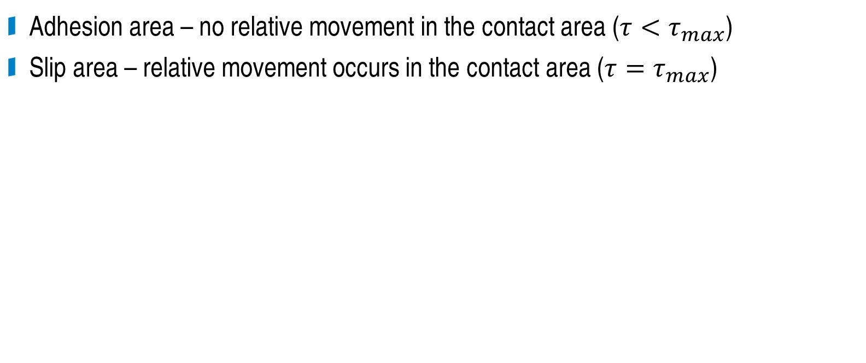
Contact area
Adhesion area – no relative movement in the contact area ($τ<τ_{max}$)
Slip area – relative movement occurs in the contact area ($τ=τ_{max}$)
Contact area by rising traction force

Slide 20
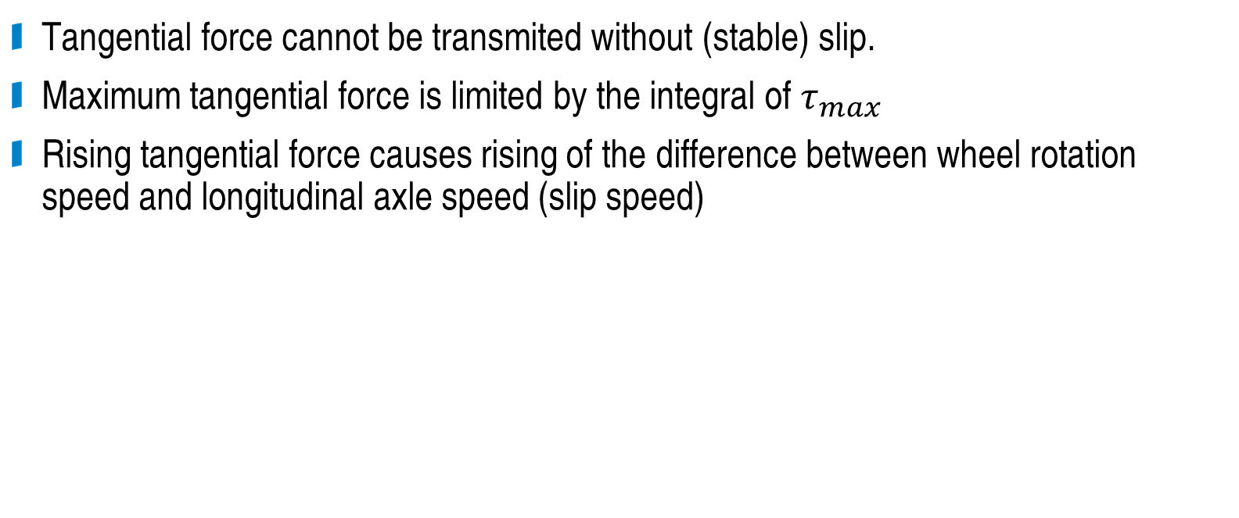
Contact area
Tangential force cannot be transmited without (stable) slip.
Maximum tangential force is limited by the integral of $τ_{max}$
Rising tangential force causes rising of the difference between wheel rotation speed and longitudinal axle speed (slip speed)
Contact area by rising traction force

Slide 21
External influences
Presence of external substances in the contact area
  Water, oil, dust, leaves,... (unwanted)
  Sand (on purpose)
Heat
  „cleaning effect“ – reduce damp and grease, roughening of the contact area
Contact area roughness
Contact area shape
Transverse slip
  Curves
  Sinusoidal movement of the axle

Slide 22
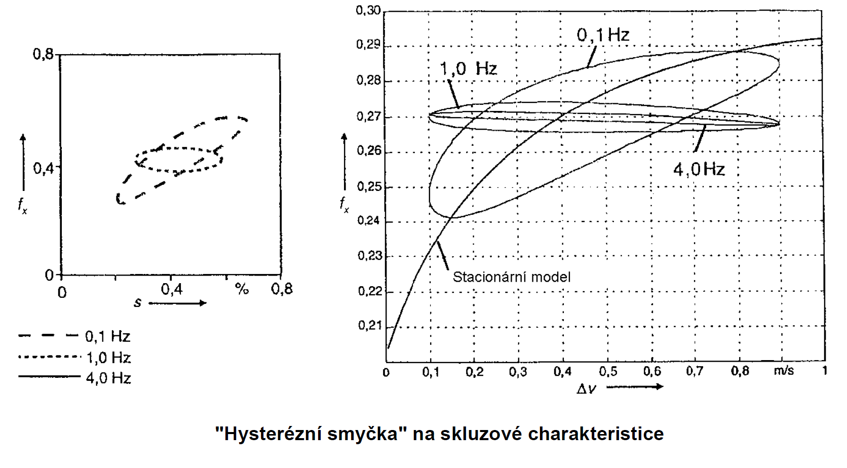
Dynamic effects
Slip is increased → heat dissipation in the contact is increased → warming and cleaning of the contact area → adhesion value is increased → slip is decreased
Steady state model
„Hysteretic loop“ on the slip characterstics

Slide 23


Slide 24
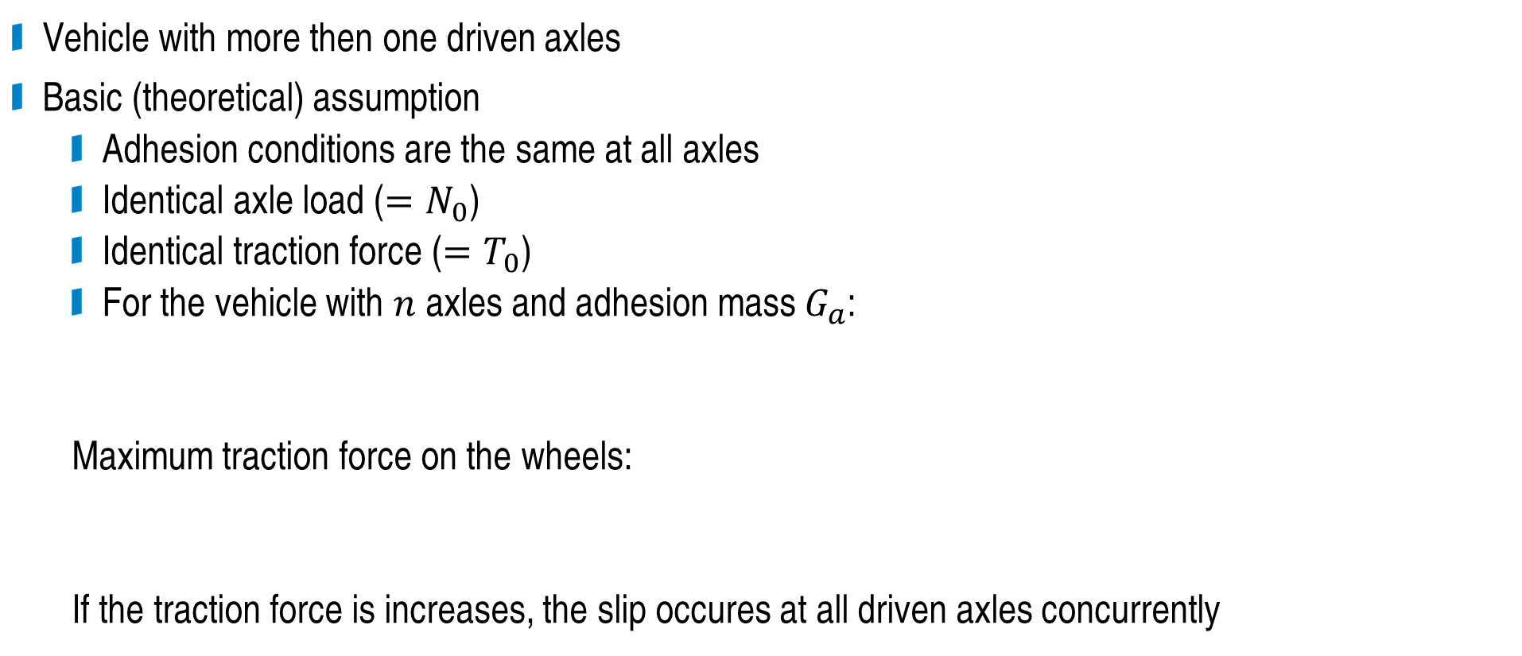
Adhesion properties of a vehicle
Vehicle with more then one driven axles
Basic (theoretical) assumption
  Adhesion conditions are the same at all axles
  Identical axle load ($=N_{0}$)
  Identical traction force ($=T_{0}$)
  For the vehicle with $n$ axles and adhesion mass $G_{a}$:
  Maximum traction force on the wheels:
  If the traction force is increases, the slip occures at all driven axles concurrently

Slide 25
Adhesion properties of a vehicle
Practically
  Influence of the construction of power transmission to the coupling, causing the static changes of the axle load
  Influence of the mechanical construction of a drive
  Influence of the suspension, damping, inertia and dynamic change of the axle load during the drive
  Intentional imbalance of traction force for each axle in order to improve adhesion conditions of the vehicle
  Changes of adhesion value (slip characteristic shape) among axles due to cleaning effect.
Maximum traction force is limited by axle of worse adhesion conditions.

Slide 26
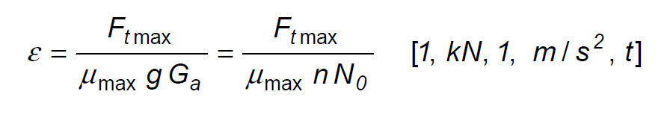
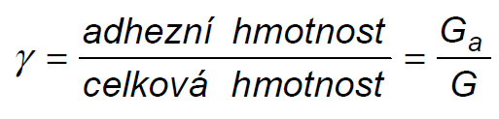
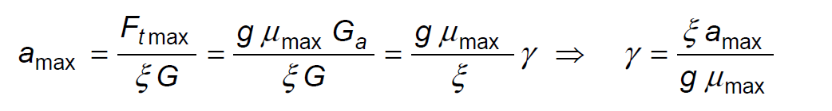
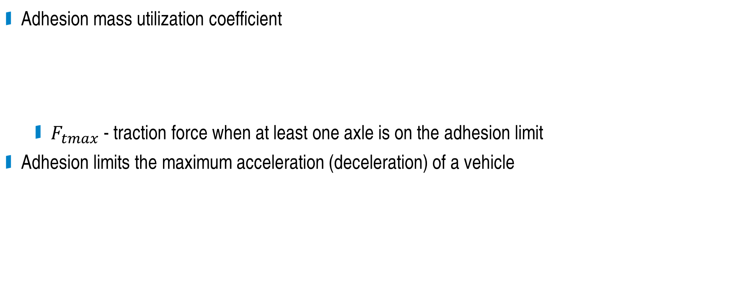
Adhesion properties of a vehicle
Adhesion mass utilization coefficient
  $F_{tmax}$ - traction force when at least one axle is on the adhesion limit
Adhesion limits the maximum acceleration (deceleration) of a vehicle
Adhesion mass
Total mass

Slide 27
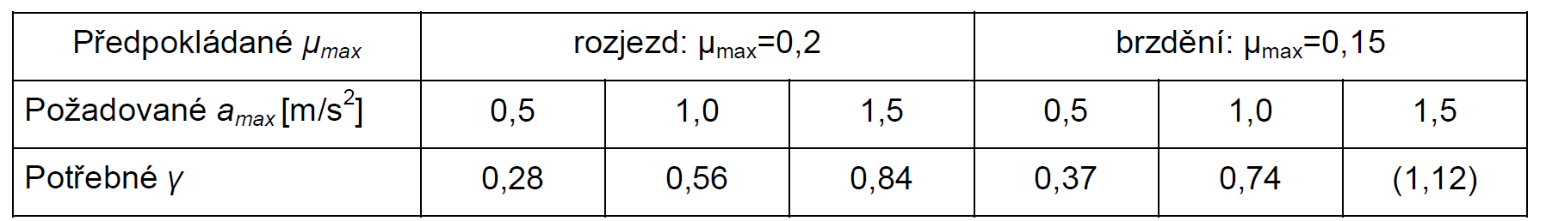
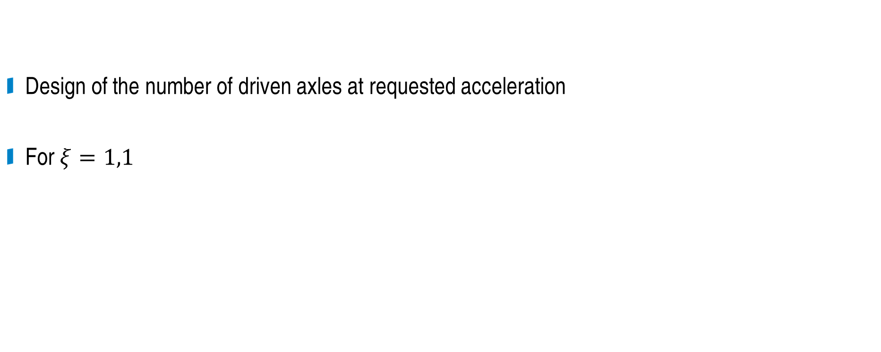
Adhesion properties of a vehicle
Adhesion mass
Design of the number of driven axles at requested acceleration
For $ξ=1,1$
Total mass
Expected
Acceleration
Braking
Requested
Minimal

Slide 28
Vehicle construction influence
Drive configuration (individual or common drive for axles)
Axle load changes during drive (caused by traction force transmission)
Dynamic axle load changes caused by the suspension

Slide 29
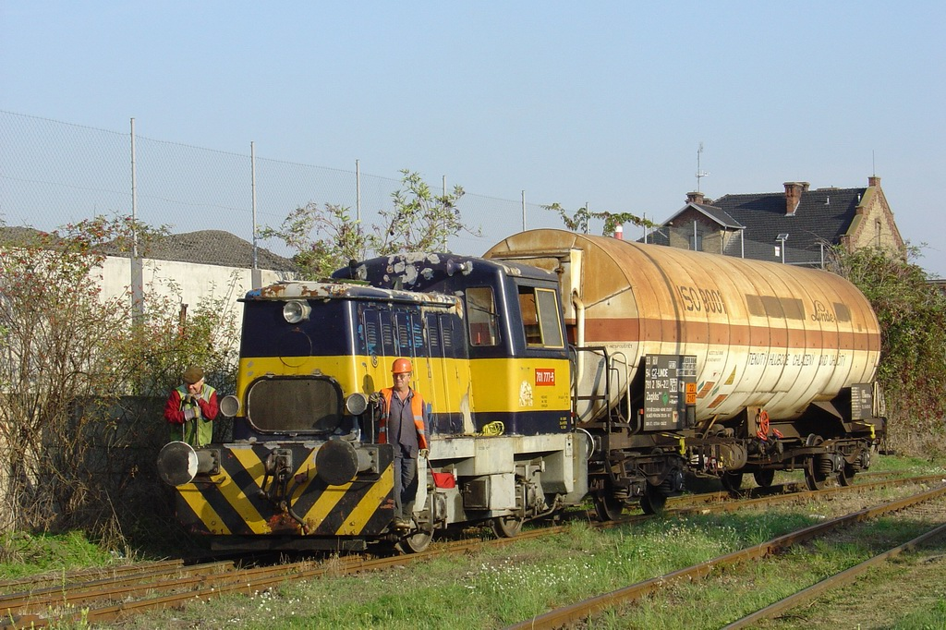
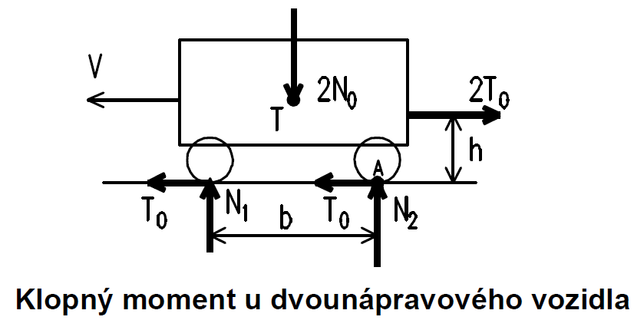
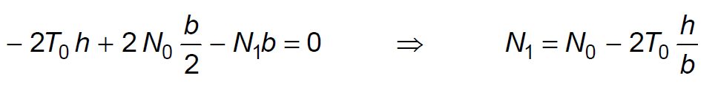
Tilting moment
Two axle vehicle
  Due to the traction force, front axle load is reduced, rear axle load is increased

Slide 30
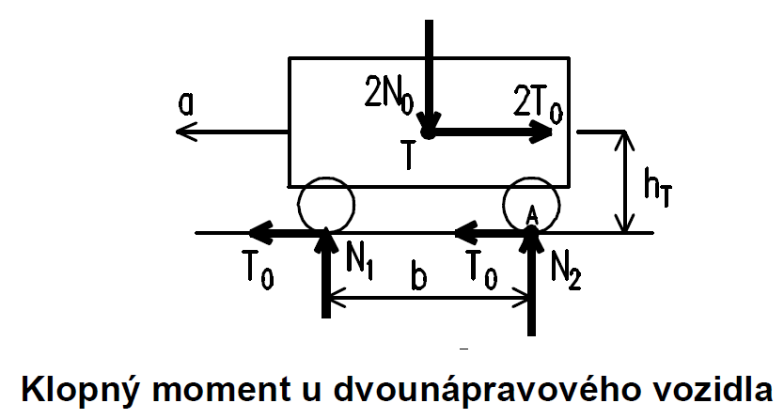
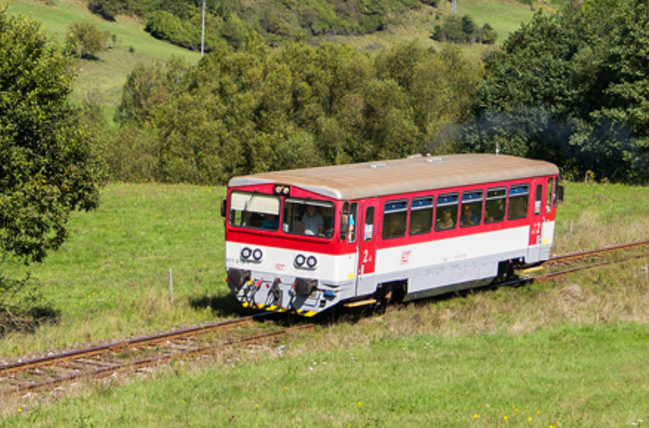

Tilting moment
Two axle vehicle
  Accelerating
  Dependent on the position of centre of mass
  In comparison to tilting moment caused by traction force, tiliting moment caused by acceleration is present even if no traction force is on the coupling (e.g. EMU with all axles driven)

Slide 31
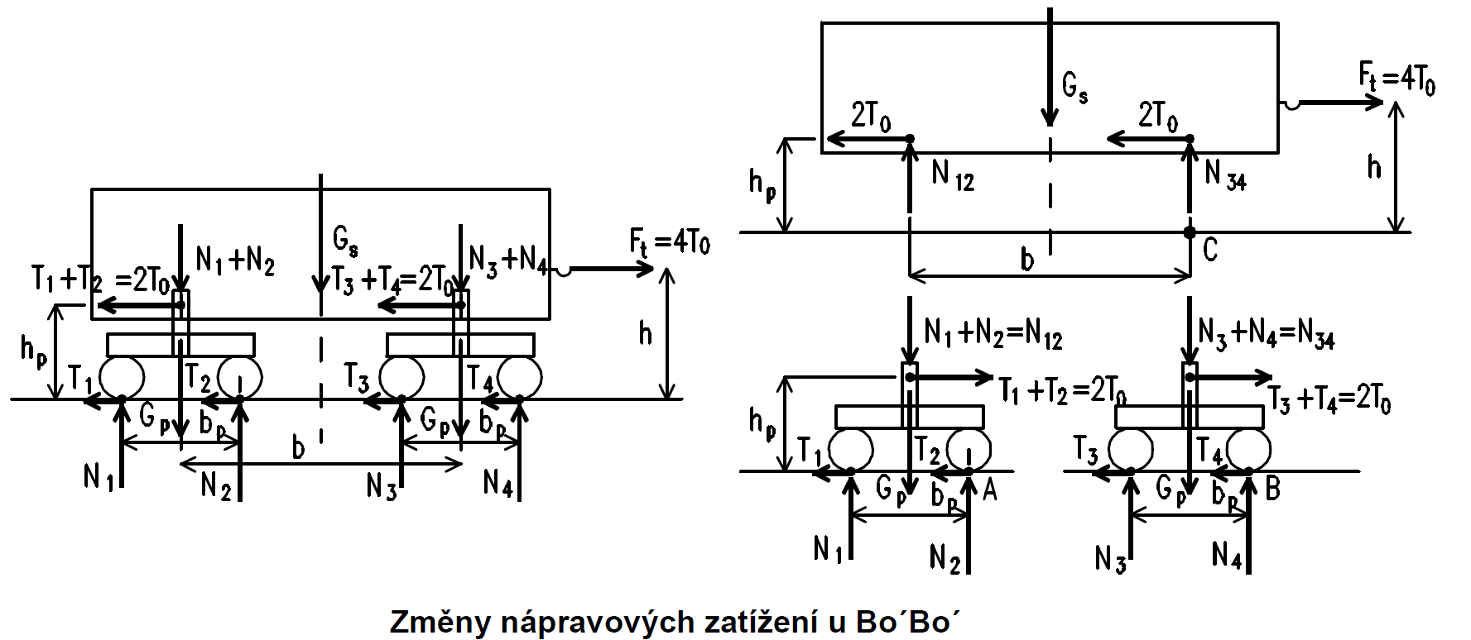
Tilting moment
Four axles vehicle
Axle load changes at Bo‘Bo‘ vehicle

Slide 32
Tilting moment
Four axles vehicle
  Traction force is transfered through the pivot
  First and (partially) third axle load are decreased
Axle load changes at Bo‘Bo‘ vehicle

Slide 33
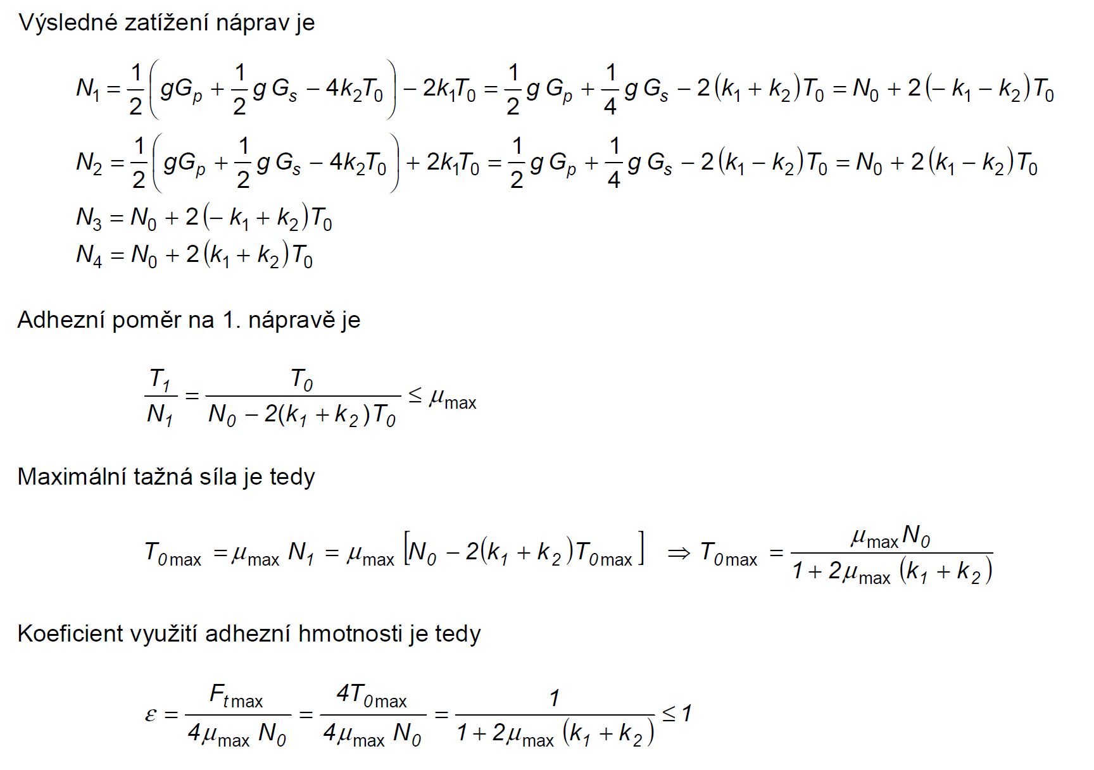
Tilting moment
Axle load on each axle:
Coefficient of adhesion on the first axle:
Maximum traction force:
Adhesion mass utilization coefficient:

Slide 34
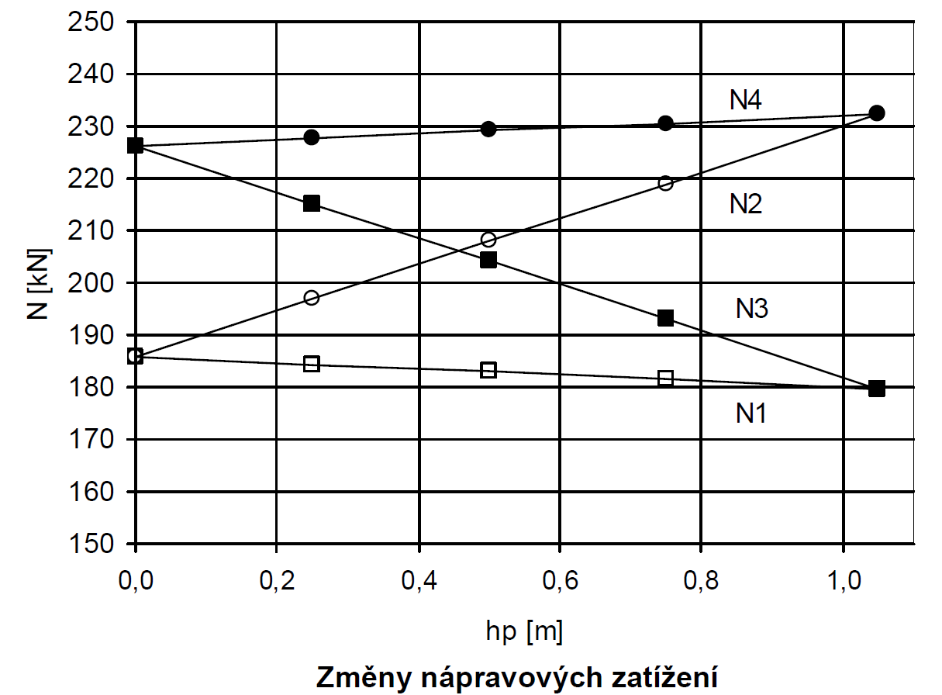
Tilting moment
Four axles vehicle
  Dependence of axle load on the height of the bogie pivot
Axles load changes

Slide 35

Dynamic effects
Swinging
  Vertical movement
  Both axles load are periodically increased and decreased
  Caused by rail roughness
Swaying
  Turning in transverse direction
  Dynamic axle load are periodically moving between front and rear axle
  Caused by rail roughness and traction forces changes
Dynamic axles load changes at two axles vehicle

Slide 36
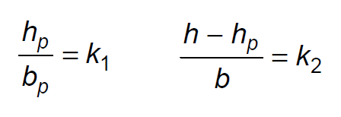
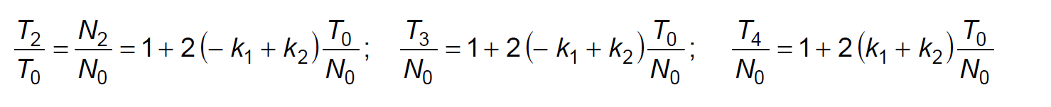
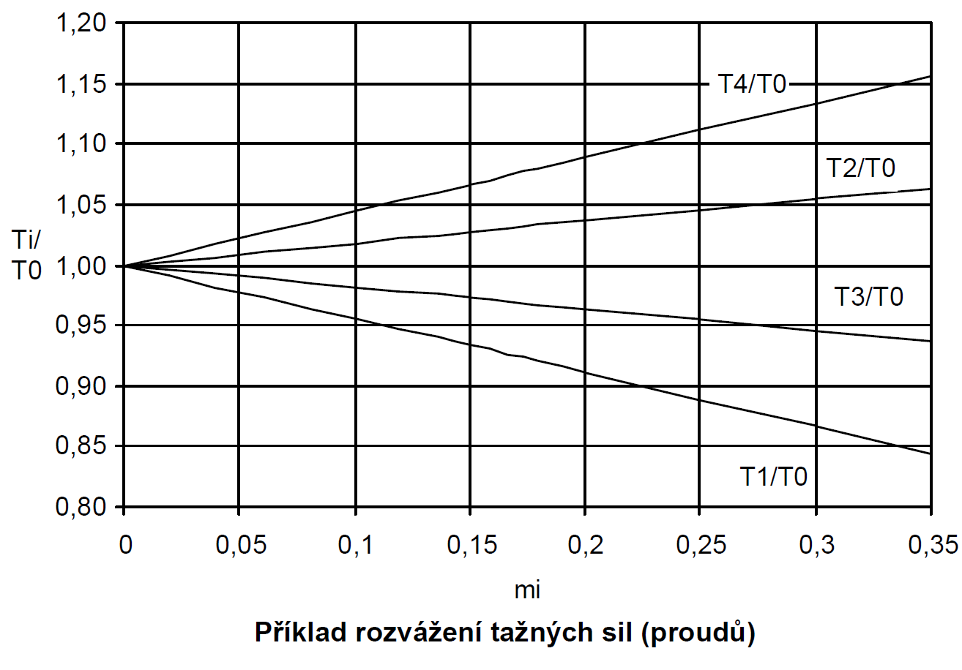
Influence of „current imbalance“
Intentionally imbalanced traction force distribution
Example of imbalance of traction forces (currents)

Slide 37
Adhesion measurement and modeling
Many influences difficult to define forming adhesion properties of a vehicle
Large variance of measured data

Slide 38
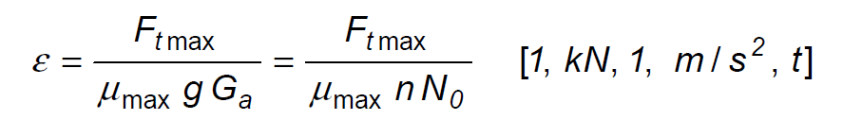
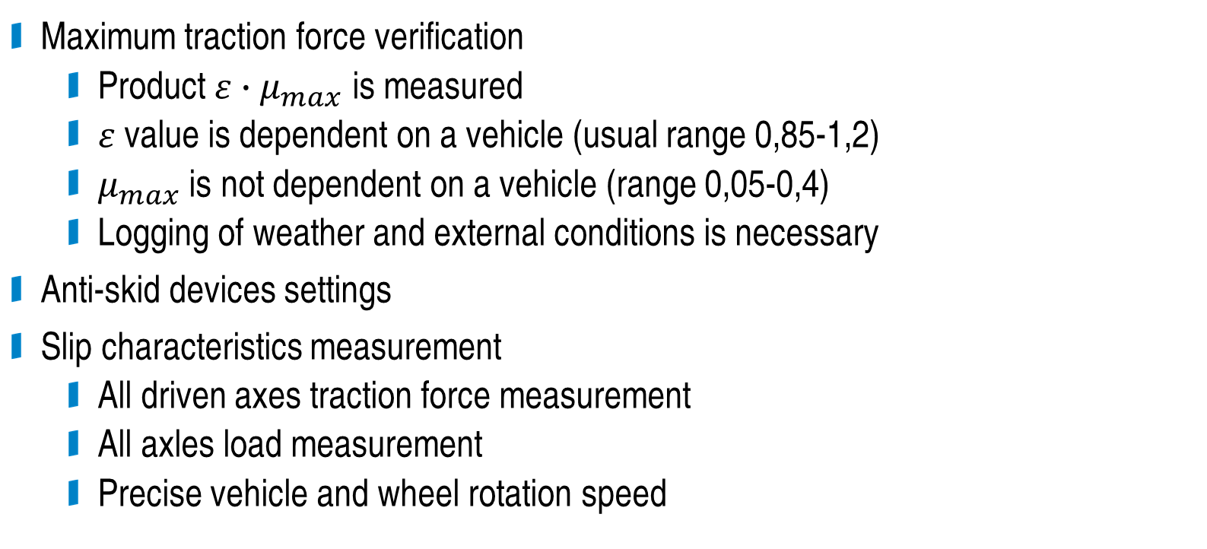
Adhesion measurement
Maximum traction force verification
  Product $ε∙μ_{max}$ is measured
  $ε$ value is dependent on a vehicle (usual range 0,85-1,2)
  $μ_{max}$ is not dependent on a vehicle (range 0,05-0,4)
  Logging of weather and external conditions is necessary
Anti-skid devices settings
Slip characteristics measurement
  All driven axes traction force measurement
  All axles load measurement
  Precise vehicle and wheel rotation speed

Slide 39
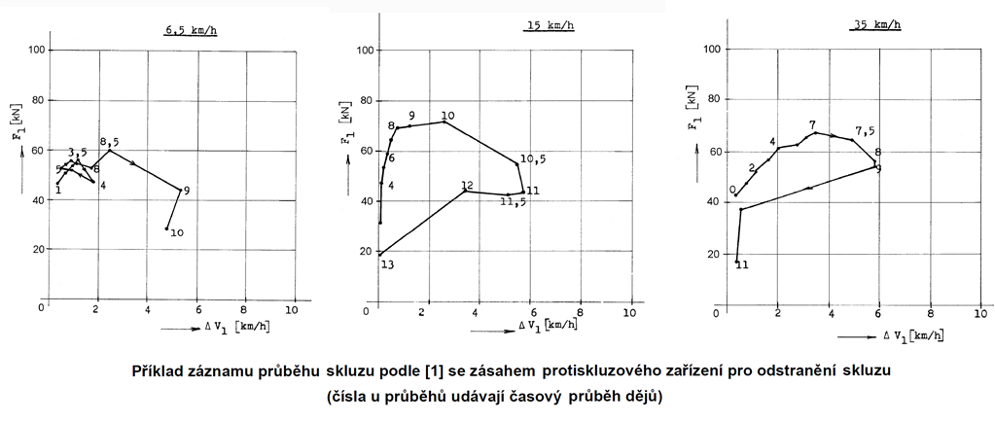
Adhesion measurement
Measurement of the slip and the anti-slip device reaction
(numbers define the time)

Slide 40
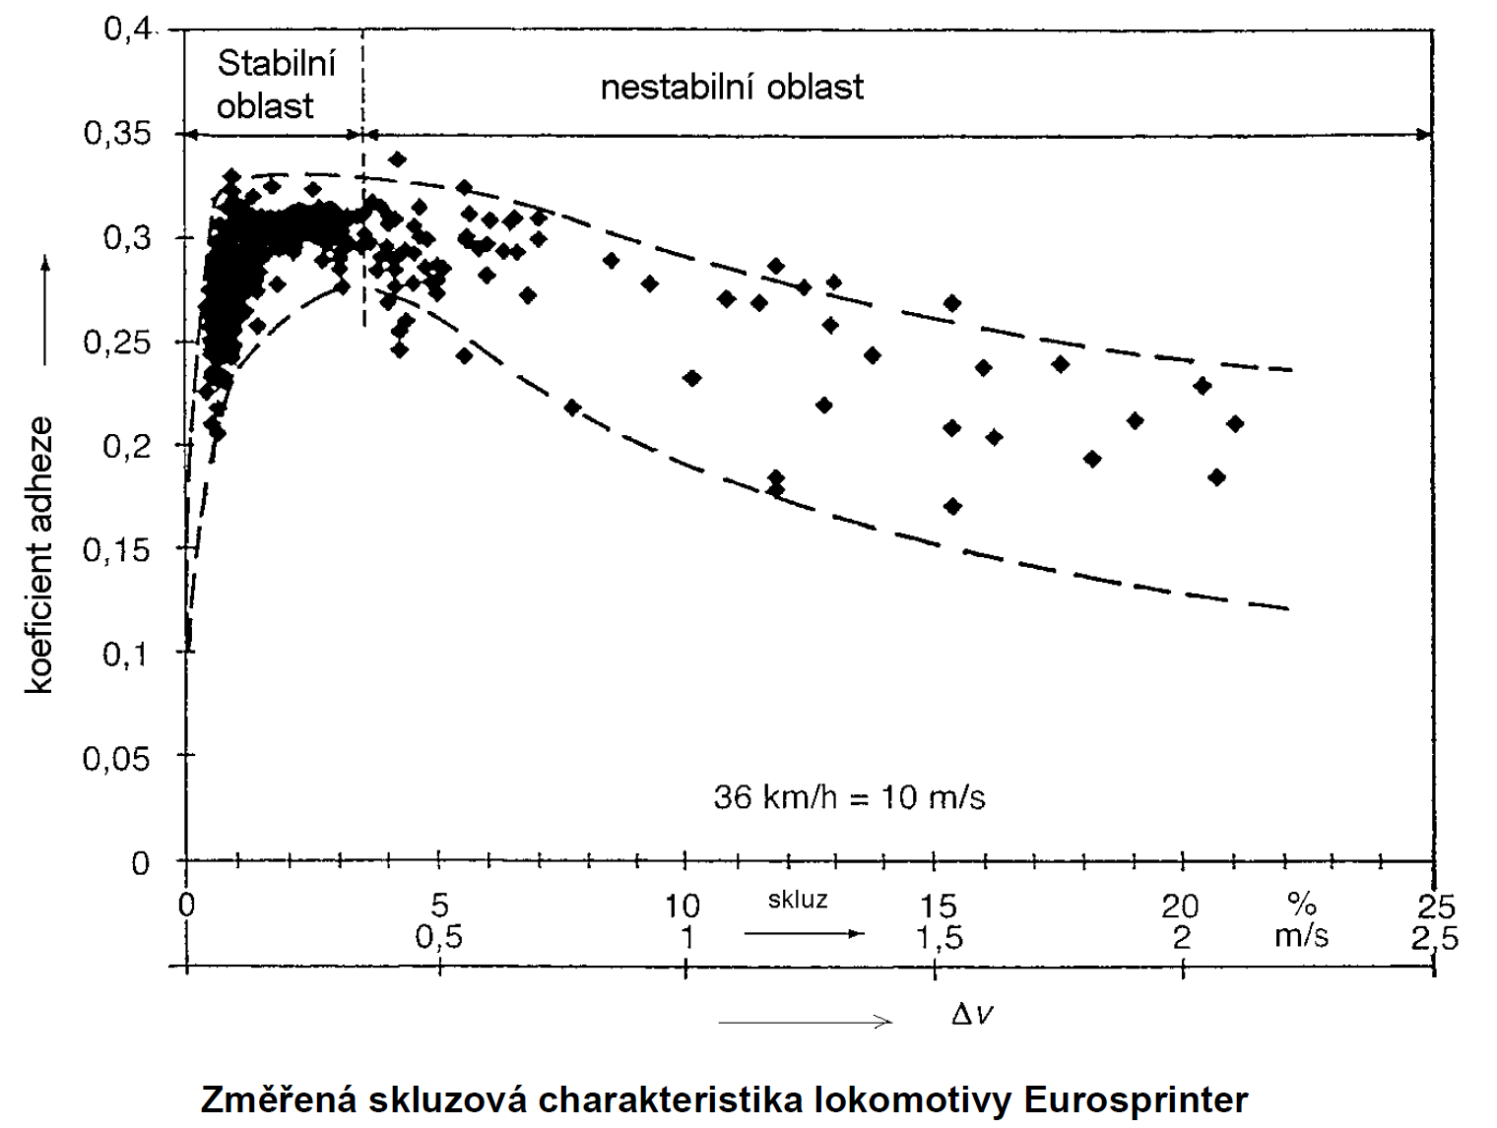
Adhesion measurement
Stable
region
Unstable region
Coefficient of adhesion
Measured slip characteristics of the Eurosprinter locomotive

Slide 41
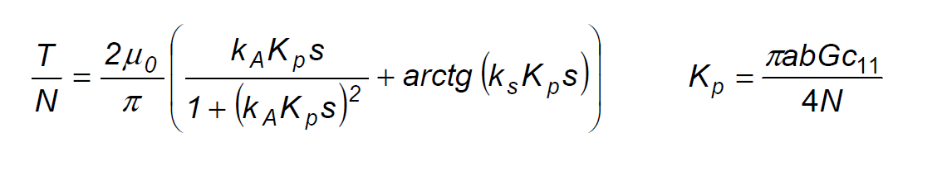
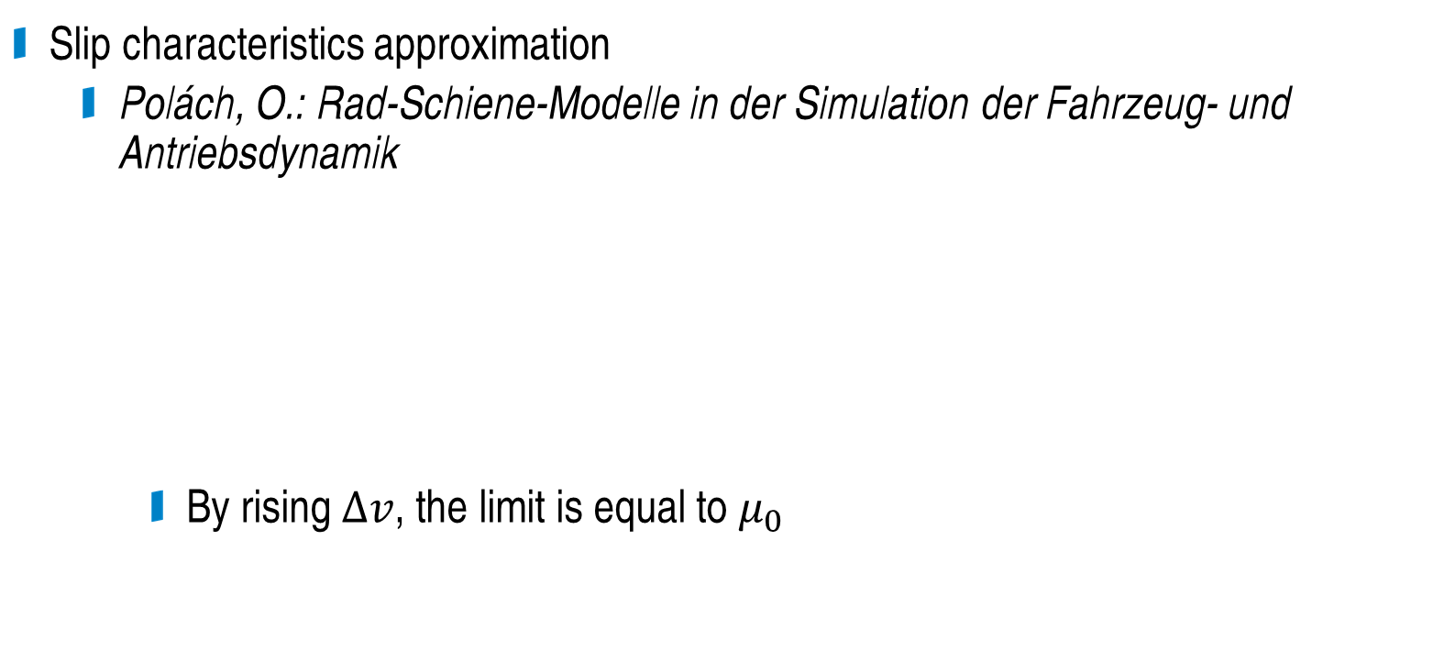
Adhesion modeling
Slip characteristics approximation
  Polách, O.: Rad-Schiene-Modelle in der Simulation der Fahrzeug- und Antriebsdynamik
    By rising $∆v$, the limit is equal to $μ_{0}$

Slide 42
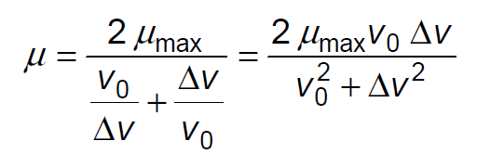
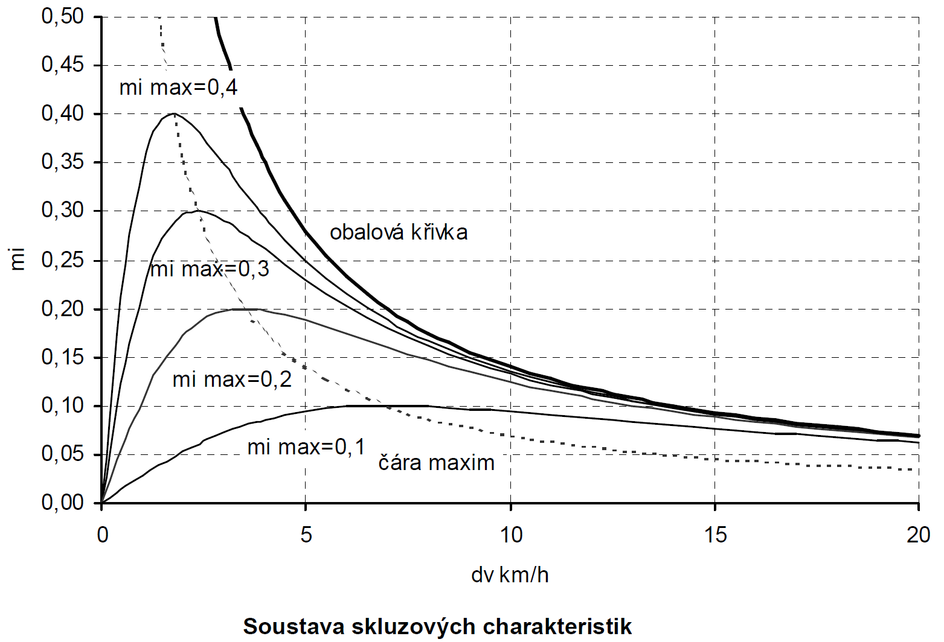


Adhesion modeling
Slip characteristics approximation
  Danzer
    $v_{0}$ is the slip speed when $μ=μ_{max}$
    By rising $∆v$, the limit is equal to $0$
  Decreasing adhesion coefficient leads to slip speed increase
    Possible model:
Set of slip characteristics

Slide 43


Example
Accident at Kdyně in 2020

Slide 44
Adhesion
Thank you for your attention
Antonín Glac
377 634 108
glac@fel.zcu.cz
fel.zcu.cz

Slide 45
Questions
What is the difference between slip and skid?
What are the main factors affecting the adhesion?
What is the variance of the measured adhesion coefficient around the empirical formulas of Curtius and Kniffler?
What formula can be used for the approximation of the slip characteristic?
How is the slip characteristic changed during the dynamic phenomena?
Have all the axles of the vehicle the same slip characteristic?
What is the influence of the tilting moment to the adhesion properties of the vehicle?

