Slide 1


Writing your literature review
Bc. Veronika Vrbská, MSc.
ESF II project of the University of West Bohemia in Pilsen
reg. number: CZ.02.2.69/0.0/0.0/18_056/0013239

Slide 2
A literature review is…
A critical and structured evaluation of scholarly research, i.e. articles, books, and other sources (e.g. dissertations, etc.) that are relevant to a particular topic, area of research, or theory.

Slide 3
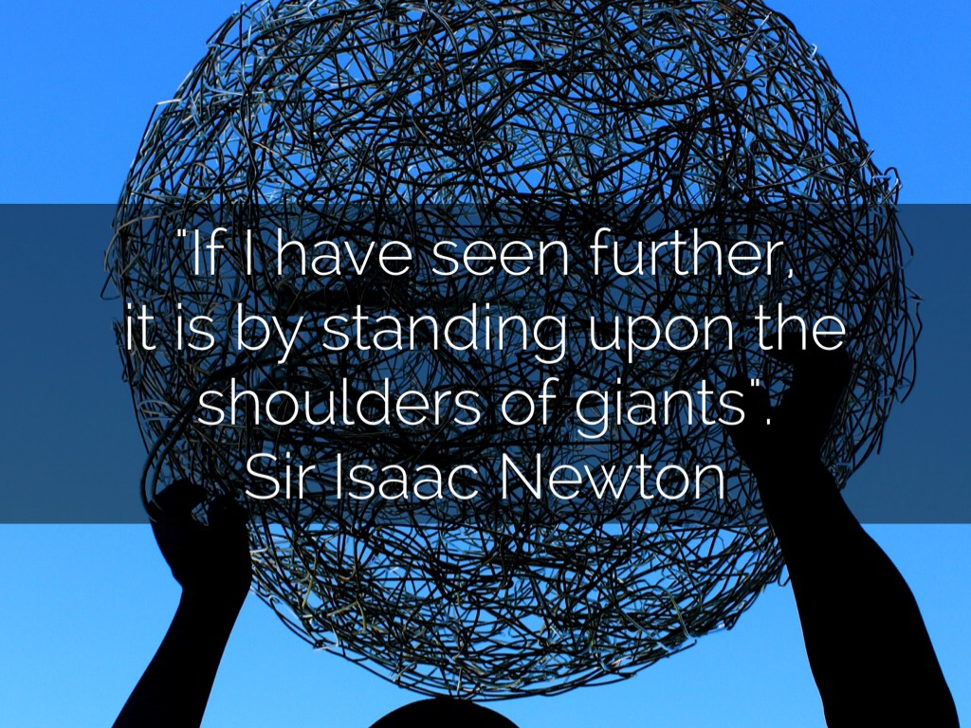

Slide 4

The basics…
There is an issue – a research problem
Researchers are debating this issue
Your role is to critique this literature, identify a gap in research, and construct a research question
Develop a research method to investigate that question
Analyse the results of your research to find an intervention into the research debate
The Literature Review

Slide 5
The purpose of the lit review is to…
Provide a context and rationale for your work
  Identify gaps which your work might fill
  Show how your work relates to existing research: overview of the debates and controversies surrounding your topic
  Justify your method and research design
  To do these you will need to:
    Summarise and evaluate other people’s work and demonstrate their significance

Slide 6
Also to…
Introduce terminology and definitions
Demonstrate your understanding of theory and method
Demonstrate your research, selection, and decision-making skills – it must be logical, systematic, and accurate

Slide 7
A literature review is NOT…
  An exhaustive bibliography
  A selection of quotations and summaries – you must evaluate your sources
  A description or repetition of what each work reported
  A group of unconnected critical evaluations
  A series of bullet points
  One way to write a great review is to…
Notes:
This latter point is my biggest criticism of how the lit review is often constructed, and the most common mistake people make when writing one.

Slide 8

READ OTHER LITERATURE REVIEWS!

Slide 9
Activity
Read the following literature review.
What relationships does the author establish between the different studies cited?
How does the author relate other scholars’ work to his/her own?

Slide 10
Activity
Many professionals are beginning to look towards sustainable urban drainage systems (SUDS) as an alternative to traditional urban drainage systems. SUDS attempt to store, treat and dispose of storm water closer to its source and are increasingly being viewed as effective measures to reduce run off volume, improve runoff quality and promote the recharging of groundwater (CIRIA 2000). Although SUDS have been incorporated into drainage designs for a number of years, they have failed to make a large-scale impact. Many believe this is due to the limited knowledge we have about their actual performance in the field (Delectic 1999) and the wide range of pollutant removals which are reported in various studies (Schueler et al. 1992; Young et al. 1996). It is now widely accepted that urban storm water is polluted and has detrimental effects on our waterways. However, few models exist at present which predict he movements of storm runoff and the pollutants held within it whilst travelling through a SUDS design. Such a model will help to assess the levels of pollutants being contained within SUDS and the levels that continue to reach our waterways.
(Overton, 2002, p.1 cited in Ridley, 2008, p. 26).
Notes:
Definitions do not have to be extensive; see example above.

Slide 11
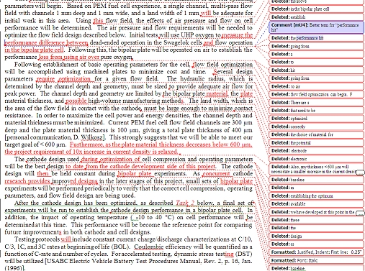
How do we create a great review?
By:
Researching
Making a plan
Organising our material
Writing several drafts!

Slide 12

Researching for your review
Find relevant literature on your topic and follow trails of references
  Use key words
  Use articles for other sources
Identify key themes/ideas/stages in the approach to the topic – keep a notebook so you can keep adding to as you read

Slide 13
Start with a plan: who has written what?
Theory | Who? | When? | Principles | Book/ Document
Hegemonic Stability Theory | Charles Kindleberger | 1973 | 1. 2. 3. | “The World in Depression: 1929-1939”
Liberalism | John Locke | 1689 | 1. 2. 3. | “ Two Treatises of Government”
Realism | Niccolo Machiavelli | 1513 | 1. 2. 3. | “The Prince”

Slide 14

Organising your review
Chronological
  Show advances
  Changes over time
  Issues to be addressed
Thematic
  Key issues, themes, debates
  Isolate key issues
Methodological
  Different methods – evaluate
  Identify key method

Slide 15
Writing your review (I)
Introduction (some people write this last)
What are the origins of my topic? Paragraph on history of my topic if applicable
What are the main issues and debates about the topic? Why is there controversy?
Which are the main theories and concepts?
Give definitions

Slide 16
Writing your review (II)
What questions have been addressed to date?
How have answers to these questions increased our understanding and knowledge about the topic?
Are these answers still relevant/valid? Why/why not?
Your research: are you going to do anything differently or in the same way? Why?
Remember: Don’t just state - evaluate!

Slide 17
This means…
You must critique some works in depth
Others, you may just refer to
Think of your literature review as a funnel…

Slide 18
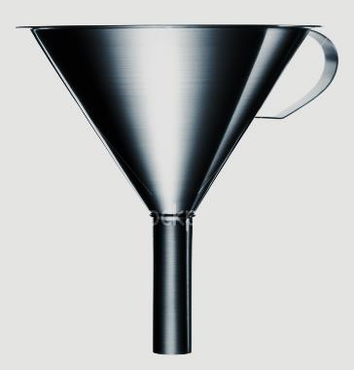
The funnel metaphor
Context
Research
history
Debates
Main studies
Concepts
Definitions
Methodologies
Your project/aims
Notes:
What are the key sources
Context: what does the reader need to know before you commence the review?

Slide 19
Always consider how you will use the research you evaluate in your project

Slide 20
To evaluate means to be critical …
Being critical is:
  A refusal to accept the conclusions of other scholars at face value
  A balanced presentation of reasons why the conclusions of other scholars may be accepted or treated with caution
  A clear presentation of your own evidence and argument, leading to your conclusion
  A recognition of the limitations in your own evidence, argument, and conclusions

Slide 21

So, being critical is about…
…asking questions:
How?
Why?
To what effect?
Says who?
So what?

Slide 22
Critical evaluation:
What does the author want you to believe?
What is the proposed answer/solution?
What theories have been employed? Are they appropriate? Why/why not?
What arguments, evidence, or experiments are presented in support of the solution?
Are they convincing? Why/why not?
What does the paper contribute to your discipline?
What future directions for research does it suggest?
What questions remain unanswered?

Slide 23
TAKE A STANCE!

Slide 24
Significant research has shown that…
Researchers argued…
Conversely, other research has come from a predominately…
As a response, a number of studies…
Yet, these studies did not consider…
Additional research has suggested…
As a consequence, in this study…

Slide 25
Another example
Paragraph 1: Researchers tend to follow two main approaches…
Paragraph 2: The first approach emphasises… However, this does not account for…
Paragraph 3: The second approach builds on previous models by…..
Paragraph 4: Both approaches are able to… However, this study will draw mostly upon the second approach because…..
Notes:
(Check: “Academic writing: Rhetorical functions in academic, (14) Taking a stance” on UEFAP.com)

Slide 26
Activity
Read the previous literature review again.
What words/phrases are used to introduce a study?
Which words/phrases are used to indicate stance?

Slide 27
Activity
Many professionals are beginning to look towards sustainable urban drainage systems (SUDS) as an alternative to traditional urban drainage systems. SUDS attempt to store, treat and dispose of storm water closer to its source and are increasingly being viewed as effective measures to reduce run off volume, improve runoff quality and promote the recharging of groundwater (CIRIA 2000). Although SUDS have been incorporated into drainage designs for a number of years, they have failed to make a large-scale impact. Many believe this is due to the limited knowledge we have about their actual performance in the field (Delectic 1999) and the wide range of pollutant removals which are reported in various studies (Schueler et al. 1992; Young et al. 1996). It is now widely accepted that urban storm water is polluted and has detrimental effects on our waterways. However, few models exist at present which predict the movements of storm runoff and the pollutants held within it whilst travelling through a SUDS design. Such a model will help to assess the levels of pollutants being contained within SUDS and the levels that continue to reach our waterways.
(Overton, 2002, p.1 cited in Ridley, 2008, p. 26).

Slide 28
Use language to take a stance
Showing strong commitment | Showing agreement | Showing cautious detachment
It is clear that… | The following issues demonstrate suitably that… | Hancock (2009) notes that…
In summary, it is evident that… | The examples given earlier show the advantages of… | These examples suggest…
Hence, it comes as no surprise that… | Todd (1990) provides a useful approach to… | Thus, these arguments denote…
Smythe (2004) aptly emphasises how… | This definition of sustainability is more comprehensive because… | Both approaches propose …
To date, the strongest case has been made by…

Slide 29
Stuck for words?
www.phrasebank.manchester.ac.uk

Slide 30
Literature Review Checklist
Does your review show a clear understanding of the topic?
Have all key landmark works been cited and discussed?
Is there a structure and logical development to the review?
Does the review state clear conclusions about previous research using appropriate evidence?
Is the text written in a clear style, free of spelling and grammatical errors with complete references?
Does the review show the variety of definitions and approaches to your research topic?
Does the review reach sound recommendations using coherent argument that is based on evidence?

Slide 31

Web resources
Birmingham University (2010) Companion for Undergraduate Dissertations (Online) http://www.socscidiss.bham.ac.uk/s11.html#a10
University of Toronto (no date) The Literature Review: A Few Tips on Conducting It (Online) http://www.writing.utoronto.ca/advice/specific-types-of-writing/literature-review

