Slide 1

Writing an argument
Bc. Veronika Vrbská, MS.c
ESF II project of the University of West Bohemia in Pilsen
reg. number: CZ.02.2.69/0.0/0.0/18_056/0013239

Slide 2
Aims:
Discuss how to think critically
Explore critical reading
Examine how to write in an academic way

Slide 3
Critical thinking and reading
It’s important we engage with the research we read and ask questions – this is our responsibility as academics (but it also helps us ensure we process the information)
Critical thinking and reading is about asking questions; so what do we ask? What makes ‘good’ research?

Slide 4
Interrogating a text: the SQ3R process
Why are you reading?
Survey
Question
Read
Repeat
Review
Set goals for your reading
Read quickly: skim or scan
Read for comprehension, notes
Are your questions answered?
Robinson (1946)
Notes:
The S Q 3R method is a common approach to take: First we work out why we want to read the text before setting goals for reading – the question you wish to find out. Of course, don’t limit yourself to these goals, but it is important to make sure your reading is targeted – and ensure your goals are critical
Then, through quickly reading through and finding out where the information is held, you are able to read through to take notes and answer your questions – its like reading the book before watching the movie.
British library example.
Working out why you are reading is the most important aspect – set yourself goals for the process, once you know what the text is likely to offer

Slide 5
Critically evaluating research
What is the main argument?
What are the main supporting reasons?
Evaluate sources and methods
Consider the assumptions that have been made – is there a possibility of bias?

Slide 6
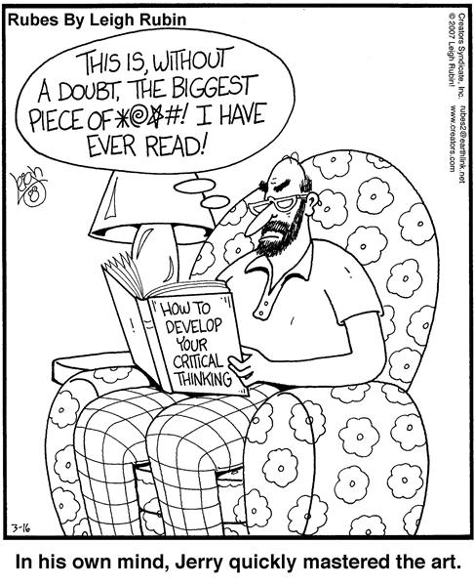
Critical reading…

Slide 7
SO WHAT?!
So, what does this evidence suggest?
So, what are the implications of this observation?
So, what might have caused these results?
So, (why) should we care?
So, what does this mean for the issue being discussed
So, what are the consequences for the field?
Notes:
Update

Slide 8

Summary
Read actively – do not dive straight in but consider what you want from the source and where you might find that information
Ask the source questions to identify its conclusions and reasons
Detailed critique will involve an awareness of wider debates so you can make comparisons and connections

Slide 9

What is effective academic writing?

Slide 10



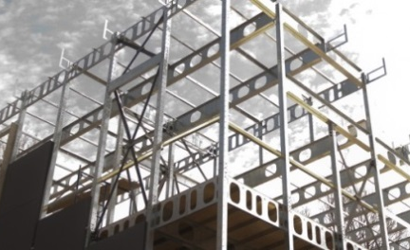
Academic writing should FOCUS and should be…
Formal
Objective
Concise
Unemotional
Structured
The tragic case of…
Sadly…

Slide 11
1. Formal
What’s wrong with this sentence?
Given that the family was still in absolute chaos and all the social workers were in the same boat, as you can imagine, there weren’t many things they could do to help. What on earth could a social worker do in this situation?
Avoid emotive language
Avoid colloquial or informal language
Avoid the second-person (‘you’)
Avoid superfluous adverbs

Slide 12
1. Formal
What’s wrong with this sentence?
Given that the family was still in absolute chaos and all the social workers were in the same boat, as you can imagine, there weren’t many things they could do to help. What on earth could a social worker do in this situation?
The case workers visiting Family X reported that many difficulties persisted in a number of areas. For example, the eldest child, Daniel, was frequently absent from school and the father, Rob, was rarely present in the home. Studies (Smith, 2012; Taylor, 2013) have suggested that improving parent-child guidance may help to improve this situation.

Slide 13
2. Objective
Subjective
Balanced evidence-based
Opinion
Academic argument
Advertising in social media is more important than print advertising.
While research by Singh (2005) suggests that print remains the most popular form of advertising, Cook (2011) argues that publicity through social media is more effective because…

Slide 14

3. Concise (and clear)
Think carefully about the words/phrases/terminology you are using
Are you actually saying what you want to say?
Remove redundancy
E.g. The task was really difficult The task was difficult
Avoid waffle – get straight to the point!
Research shows that lots of people that study Social Work end up going on to work in local authorities in the future.
Research by Simons (2013) notes that 68% of 2010 graduates from social work courses in London found employment in social worker roles within 12 months of graduating. This trend is further supported by Thomas (2012) who noted that…. From this it could be argued that…

Slide 15

4. Unemotional
Effective academic writing avoids emotion
Think carefully about the words/phrases/terminology you are using

Slide 16

5. Structured

Slide 17
Critical reading is careful reading
Watch out for hedges – cautious language
could
mostly
Often
May/might
Read and read again!
Make sure you do not misrepresent other people’s views
Do they really say what you think they say?

Slide 18


Showing off your ability to incorporate sources in a variety of ways can help to highlight your detailed understanding of research and help to form a well constructed assignment

