Slide 1


Importance of Evidence Based Practice:
Value and
Challenges
Bc. Veronika Vrbska, MSc.
ESF II project of the University of West Bohemia in Pilsen
reg. number: CZ.02.2.69/0.0/0.0/18_056/0013239

Slide 2
Outline
By end of session you should:
Have an understanding of the importance of EBP and what it involves
Have considered barriers to EBP
Have considered enablers to EBP
Have considered future of EBP in OT

Slide 3
What comes to mind when thinking about evidence-based practice?

Slide 4
Evidence based practice is about making good decisions
What decisions do we make in practice?
What evidence do we use to inform our decisions? Why?
What is the difference between evidence from research and evidence from our own experience?
Notes:
What assessment should I use? What intervention should I use? Where should I deliver my therapy? How long for and over what period of time? Is it better to see patients in a group or 1:1? Should I deliver this intervention or refer to a colleague? How can I demonstrate that what I have done is effective? How can I demonstrate that it is cost effective? Should I let this person be discharged today (Are they “safe” for discharge”)? Should I use compensatory or remedial approach?

Slide 5
Definition
The conscientious, explicit, and judicious use of current best evidence in making decisions about the care of individual patients
(Sackett et al 1996)
Notes:
What assessment should I use? What intervention should I use? Where should I deliver my therapy? How long for and over what period of time? Is it better to see patients in a group or 1:1? Should I deliver this intervention or refer to a colleague? How can I demonstrate that what I have done is effective? How can I demonstrate that it is cost effective? Should I let this person be discharged today (Are they “safe” for discharge”)? Should I use compensatory or remedial approach?

Slide 6
Concerns about EBP
Quantitative over qualitative research (Whiteford 2005)
Complex needs & social context = complex practice (Ballinger and Wiles, 2001; Richardson et al, 2004; Whiteford, 2005)
Reduces clinical freedom
Erosion of professional judgement (Fish & Coles 1998)
Cochrane reviews – Drs, nurses, physios, service users involved more than OT! (McCluskey 2003)
EBP = an expectation of a correct answer, or a clear-cut ‘best practice’ (Whiteford, 2005)

Slide 7
Evidence Based Practice (Sackett et al 2000)
BEST AVAILABLE RESEARCH EVIDENCE
CLINICAL EXPERIENCE AND EXPERTISE
EBP
SERVICE USER PREFERENCES, VALUES, CIRCUMSTANCES

Slide 8
Evaluate the Evidence
Is this the BEST AVAILABLE evidence to answer my clinical question?
Do these results apply to my client?
Does the assessment/intervention/evaluation fit in with my client's values, preferences, culture, desired goals and outcomes?
Are there resources available to implement the assessment/intervention/evaluation?
(Adapted from Bennett & Bennett, 2000)
Notes:
Different evidence answers different questions)
i.e. is my client so different from those in the study that its results cannot help me?)
3. Communicate with client
4. If not – how can you get them?

Slide 9
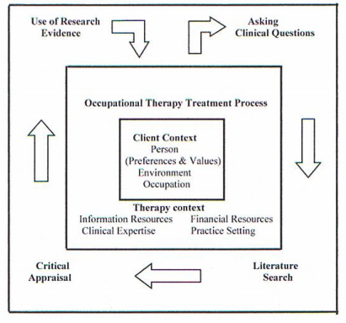
Framework for EBP (Bennett & Bennett 2000)

Slide 10
Why is it important?
Improve client outcomes
Meet client’s expectations
Enable clinician’s stay up to date
Communicate OT’s research base
Vast majority of evidence of varied quality
Stimulate clinically relevant research
Accountability
Justify need for specific services

Slide 11
Implementation EBP by OTs
OTs hold positive attitudes towards EBP BUT how much is EBP implemented in OTs clinical practice?
Low use standardised outcome measures
In line with other professionals
↑Years practice ↓EBP utilisation
OTs rely on colleagues (including many non-OT colleagues) for source of clinical information
“Custom, practice, and expert opinion were identified as the most frequently applied forms of evidence.” (Sweetland and Craik, 2001 cited in Upton et al, 2014)
(COT, 2013; Upton, Stephens, Williams & Scurlock-Evans, 2014)

Slide 12
Evidence Practice Gap
EVIDENCE
PRACTICE
"Between the health care we have and the care we could have lies not just a gap but a chasm" (IOM, 2001, p. 1)

Slide 13
What do you think are the barriers in implementing evidence-based practice?
How can we close the Gap?

Slide 14


Slide 15

Barriers to EBOT
(Upton, Stephens, Williams & Scurlock-Evans, 2014)
Workload and time pressures
Accessibility of databases
Perception of evidence base
Organisational factors
EBP vs. Traditional approaches
Training, knowledge, skill, personal motivation
Notes:
1. Workload, time, staffing, training/knowledge, skills, support/organisational barriers, relevance, applicability, quality evidence, communication (accessibility to databases), time effort, personal motivation, conflict client centred practice, safety and prioritising

Slide 16
Awareness
Too little or too much evidence?
Skill and knowledge:
Not searching systematically
Only having superficial understanding evidence
Be wary – even many “evidence based” guidelines are based on poor evidence
Different types of evidence answer different questions
“Simply using whatever research evidence you happen to obtain from reading the few journals that you subscribe to is not going to sufficiently meet your information needs or keep you updated with research.” (Hoffmann et al, 2013, p.3)

Slide 17
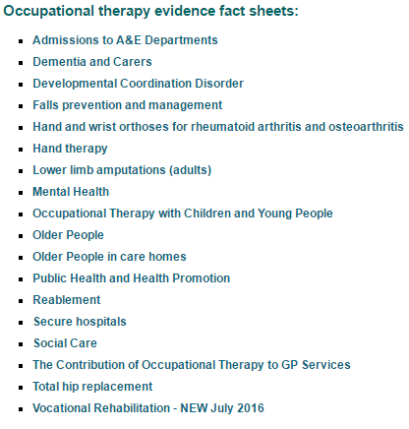
Awareness
Peer Learning e.g. journal clubs, knowledge brokers, social networks, professional organisations
Clinical supervision and reflective practice
Online and peer shared resources e.g.
  OTSeeker http://www.otseeker.com/
  OTCATS http://www.otcats.com/
  COT hOT Topics

Slide 18
Acceptance
Attitudinal Barriers
Reflect on own attitudes
Who do you trust and why? (Peers, educators, researchers)
How do you stop someone using non-evidence based interventions?

Slide 19
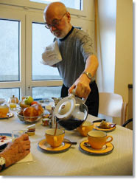
Applicability
Philosophically sound?
Outcomes appropriate?
(Gustafsson et al, 2014)
Always applicable e.g. multi-morbidities?
B Constraint induced movement therapy (CIMT) should only be considered in people who have 20 degrees of active wrist extension and 10 degrees of active finger extension, and should only be started if the team has the necessary training and the patient is expected to participate fully and safely able to

Slide 20
Feasibility
Available interventions and materials?
Service restrictions
  Money training
  Money materials
  Money assessments
Training needs – evidence based training needs
Feedback on piloting / use of interventions

Slide 21
Service user involvement
SHARED DECISION MAKING
1. Understand the patient’s experiences and expectations
2. Build partnerships
3. Discuss the evidence, including a balanced discussion about uncertainties
4. Present recommendations
5. Check for understanding and agreement (Hoffmann et al, 2014)

Slide 22
What can we do?
Gap analysis – surveys and clinical audit
Identify barriers and enablers in service including attitudinal
Train research literate, research oriented practitioners who are confident in using EBP
Develop research capacity in profession – MDT collaborations
Standardised assessment tools:
http://www.cot.co.uk/position-statements/occupational-therapists%E2%80%99-use-standardised-outcome-measures
Describe interventions well so they can be replicated/contact for more information
Online and peer shared resources – open access
  Organisational change – systems approach
  HE-Practice collaborations
  Any other ideas?

Slide 23

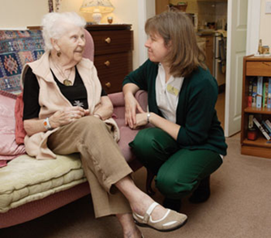
Theory to Practice

Slide 24
Reading
Bennett S & Bennett JW (2000) The process of evidence-based practice in occupational therapy: Informing clinical decisions. Australian Occupational Therapy Journal, 47, 171-180.
Clare Taylor, M. (2007) Evidence-based Practice for Occupational Therapists (2nd ed). Oxford: Blackwell Publishing.
Cusick A (2001) OZ OT EBP 21c: Australian occupational therapy, evidence-based practice and the 21st century . Australian Occupational Therapy Journal, 48(3), 102-117.
Dubouloz, C.-J., Egan, M., Vallerand, J., & von Zweck, C. (1999). Occupational therapists’ perceptions of evidence-based practice. American Journal of Occupational Therapy, 53, 445 – 458.
Greeenhalgh, T, Howick J & Maskrey N (2013) Evidence based medicine: a movement in crisis? British Medical Journal, 348 http://www.bmj.com/content/348/bmj.g3725
Gustafsson L, Molineux M & Bennett S (2014) Contemporary occupational therapy practice: The challenges of being evidence based and philosophically congruent, Australian Occupational Therapy Journal, 61 p 121-123

Slide 25
Reading
Hackett K, Newton J, Rapley T, Deane K, Deary V, Ng W-F (2014) Systematic reviews of occupational therapy interventions: summarizing research evidence and highlighting the gaps. British Journal of Occupational Therapy, 77(9), 479–482.
Hoffmann T, Bennett S, Tomsett C, Del Mar C. (2014) Brief training of student clinicians in shared decision making: a randomised controlled trial. Journal of General Internal Medicine, 29(6):844-9
Hoffman, T.C., Glasziou, P.P., Boutron, I., Milne, R., Perera, R., Moher, D., Altman, D.G., Barbour, V., Macdonald, H., Johnston, M., Lamb, S.E.L., Dixon-Woods, M., McCulloch, P., Wyatt, J.C., Phelan, A., & Michie, S. (2014). Better reporting of interventions: Template for intervention description and replication (TIDieR) checklist and guide. British Medical Journal, 348. http://www.bmj.com/content/348/bmj.g1687
Hoffmann T, Bennett S & Del Mar C (2013) Evidence based Practice across the Health Professions, 2nd Ed, Chatswood: Elsevier Australia
Holm, M. B. (2000). Our mandate for the new millennium: Evidence-based practice, 2000 Eleanor Clarke Slagle lecture. American Journal of Occupational Therapy, 54, 575 – 585.

Slide 26
Reading
Howick J, Glasziou & Aronsen JK (2010) ‘Evidence-based mechanistic reasoning’, Journal of the Royal Society of Medicine, 103 (11) p. 433-441
Institute of Medicine. (2001). Crossing the quality chasm: A new health system for the 21st century. Committee on Quality of Health Care in America, Institute of Medicine. Washington DC: National Academies Press.
Sackett DL, Rosenberg WMC, Gray JAM, Richardson WS (1996) Evidence based medicine: What it is and what it isn't, British Medical Journal, 312 , 71–72
Sackett DL, Straus SE, Richardson WS et al. (2000) Evidence-Based Medicine: How to Practice and Teach EBM. 2nd ed. Edinburgh, Scotland: Churchill Livingstone Inc.
Tomlin B & Borgetto B (2011) Research pyramid: A new evidence-based practice model for occupational therapy, American Journal of Occupational Therapy, 65(2), 189-196.
Upton D, Stephens D, Williams B, Scurlock-Evans L (2014) Occupational therapists’ attitudes, knowledge, and implementation of evidence-based practice: a systematic review of published research. British Journal of Occupational Therapy, 77(1), 24–38.

