Slide 1
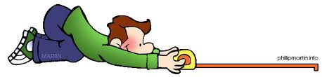

Outcome Measures
&
Evidenced Based Practice
ESF II project of the University of West Bohemia in Pilsen, reg. number: CZ.02.2.69/0.0/0.0/18_056/0013239
Bc. Veronika Vrbska, MSc

Slide 2
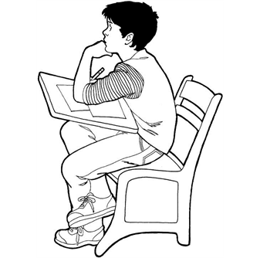
Outcomes
By the end of the lecture you should be able to:
To identify why & how we can measure
To be able to evaluate the psychometric properties of an outcome measure tool
To be able to critique an outcome measure tool to be used in practice and research
To think about how we can use outcome measures to demonstrate cost-effectiveness & cost-efficiency

Slide 3
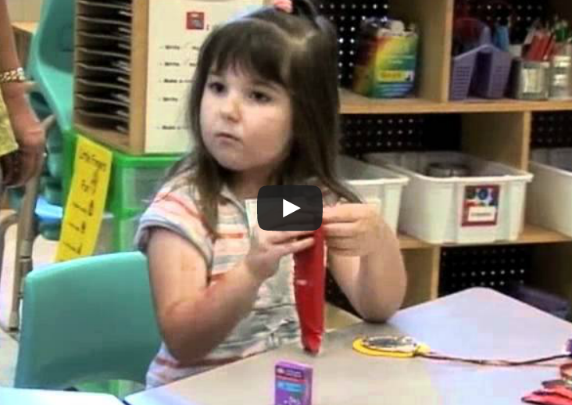
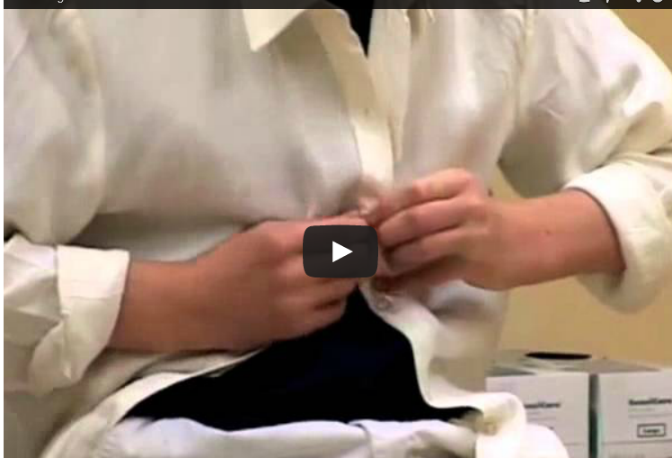
What are your groups observations of these children
http://elearning.canchild.ca/dcd_workshop/eating.html
http://elearning.canchild.ca/dcd_workshop/dressing.html

Slide 4
Question 1
Clinically why do we need to measure?
Question 2
Politically: Why do we need to measure?
Question 3
From you experience can you give some information on and some examples of the following?
Categorical
Descriptive
Predictive
Evaluative

Slide 5
Question 1
Why do we need to measure?
Providing valid and consistent information about clients
Goal setting
Deciding on most effective intervention
Monitoring client’s progress
Identify service needs
Demonstrate cost-effectiveness & cost-efficiency

Slide 6
But also….
You can’t rely solely upon your perception
Selective attention and memory (recall bias)
Subtle acts of distortion
The need to believe
You can’t rely solely upon anybody else’s perception
PROVIDES AN OBJECTIVE, QUANTIFABLE MEASUREMENT

Slide 7
Question 2
Politically: Why do we need to measure?
Demand for Evidence-based practice (EBP)
Demand for robust clinical governance and clinical audit activities
The use of standards, care pathways, protocols and guidelines

Slide 8
Question 3
Categorical – to label/diagnose/ categorise a client with a specific problem
Descriptive – to describe current functional status or circumstance at one point in time, provides baseline data for intervention planning
Predictive – performance in assessment will predict performance on other areas (e.g. OT kitchen assessment and safety on discharge)
Evaluative – outcome measurement of performance over time.

Slide 9
International Classification of Function -CY
Focus on Function
Body Function/
Impairment
Activity Skill
PARTICIPATION
Tone/Dystonia
ROM -
Active&Passive
Posture /Balance
Power
Grasp & Release
Sensation-Sensory Perception
Eating and drinking
Self Care
Meal Preparation
Play
Tool use
Family Activities
Social Activities
School Activities
Pre-Vocational
Leisure
Community e.g. shopping,cinema
ENVIRONMENT
PERSONAL FACTORS
Physical and Emotional Support
Equipment
Age
Motivation/Interests
Aspiration
Notes:
Body Function – Easy (Easier) to assess quantitatively and quickly
Activity Skill – Relatively easy to define and measure – not so easy to link to participation and outcomes
Participation – Access to and participation in range of family, social, vocational and leisure activities
Environment – Transitions & Expectations plus Assistive Technology

Slide 10
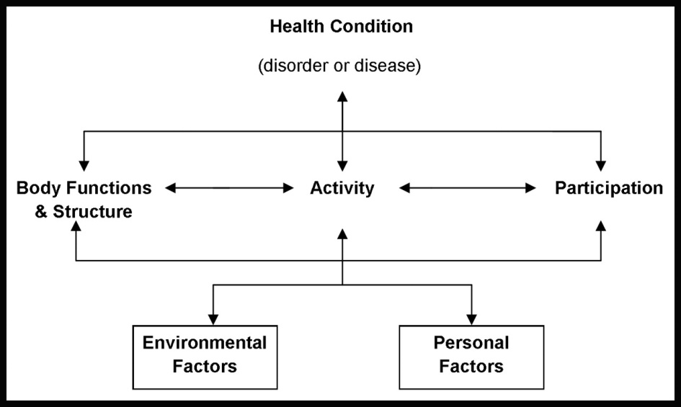
ICF: (WHO, 2001)
Try to think about assessment and what areas of the ICF is targeted

Slide 11
How we measure?

Slide 12
How do we measure?
Important to combine qualitative & quantitative methods:
To achieve a thorough assessment
They have different functions
Designed to answer different questions

Slide 13
How do we measure:
1. Quantitative data collection methods
Focus on factual information and are mostly expressed with numerical scores:
Standardised outcome measures
Observation testing methods, e.g. range of movement
Structured self-report or proxy report data, e.g. frequency of a particular behaviour over a period of time

Slide 14
Standardised Tests
Standardised Tests
Why do we standardise?

Slide 15
Questions
How would you standardise catching a ball?
What are some things you need to consider when developing a task for a standardised assessment?
Would age matter? How so, give examples of any adaptations
Come up with a standardised task for catching for a 4 year old, 8 year old and 15 year old.

Slide 16

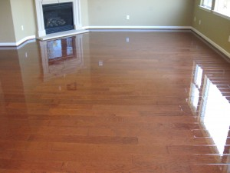
Ceiling effect
Test is too easy
Floor effect
Test is too hard

Slide 17
Standardised assessments
Published
Designed for a specific purpose
Designed for use with a specific population
Detailed instructions on how and when it should be administered
Standard procedures on scoring and interpretation of scoring
Valid
Reliable
Responsive

Slide 18
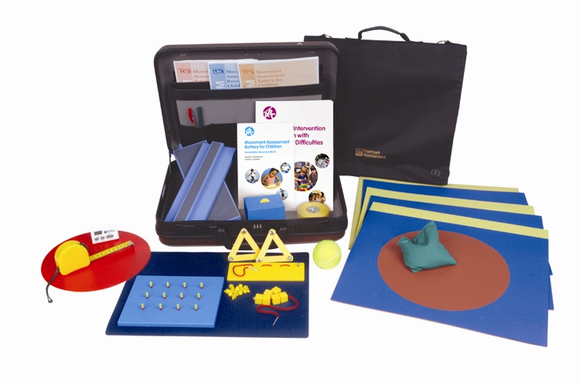
How Standardised Tests are Developed
Movement Assessment Battery for Children -2 (Henderson, Sugden & Barnett, 2007)

Slide 19
Overview: Movement ABC-2 Test
Features of the Test
focus on identification and description of impairments of motor function in children
age norms for 3 - 16 years (based on representative sample of 1172 children in the UK)
administration time 20 - 40 minutes
used by professionals with a variety of backgrounds (educational / medical)
19

Slide 20
Purpose of the test
To:
  identify those with movement difficulties
  describe the movement difficulties
  help make a diagnosis
  chart development over time
  help with intervention planning
May be used with other tests: DASH etc.
20

Slide 21
Structure of the Test
Manual Dexterity (3 tasks)
Aiming & Catching (2 tasks)
Balance (3 tasks)
8 tasks for each age band
21

Slide 22
M-ABC 2
 | Age Band 1 3 – 6 years | Age Band 2 7 – 10 years | Age Band 3 11 – 16 years
Manual Dexterity 1 | Posting coins | Placing pegs | Turning pegs
Manual Dexterity 2 | Threading Beads | Threading lace | Triangle With nuts & bolts
Manual Dexterity 3 | Bicycle trail I | Bicycle trail II | Bicycle trail III
A&C: Catching | Catching bean bag | Two-hand catch | One-hand catch
A&C: Aiming | Throwing bean bag into box | Throwing bean bag into box | Throwing at wall target
Static Balance | One-leg balance | One-board balance | Two-board balance
Dynamic Balance 1 | Jumping in squares | Hopping in squares | Zig-zag hopping
Dynamic Balance 2 | Walking heels raised | Heel-to-toe walking | Walking backwards
22

Slide 23
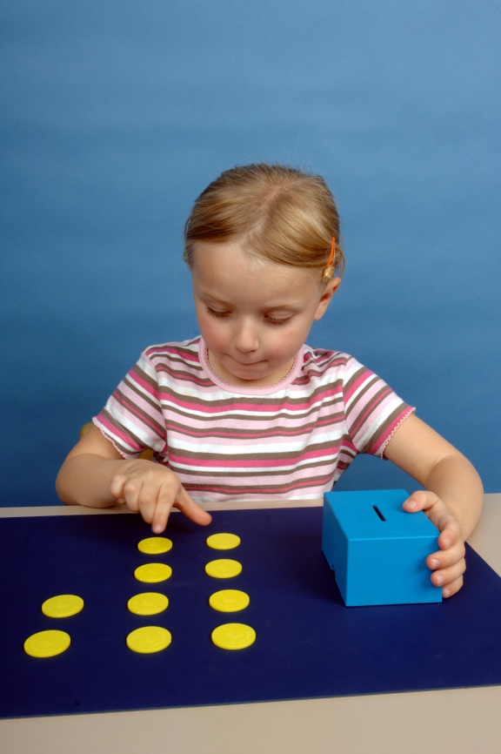
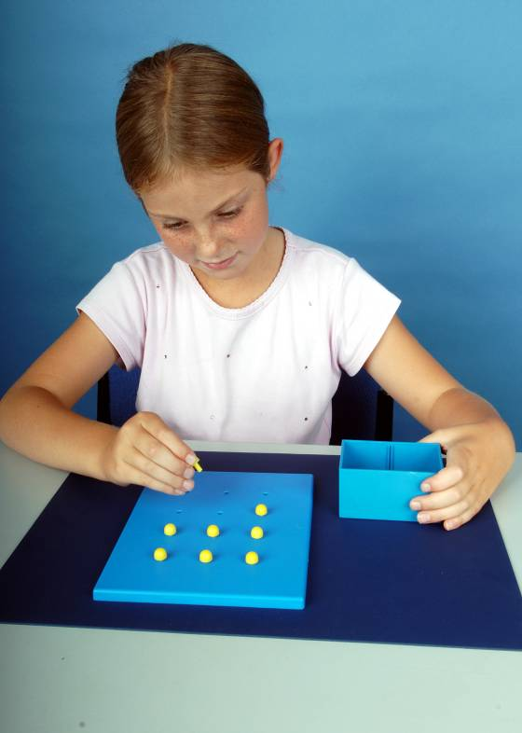
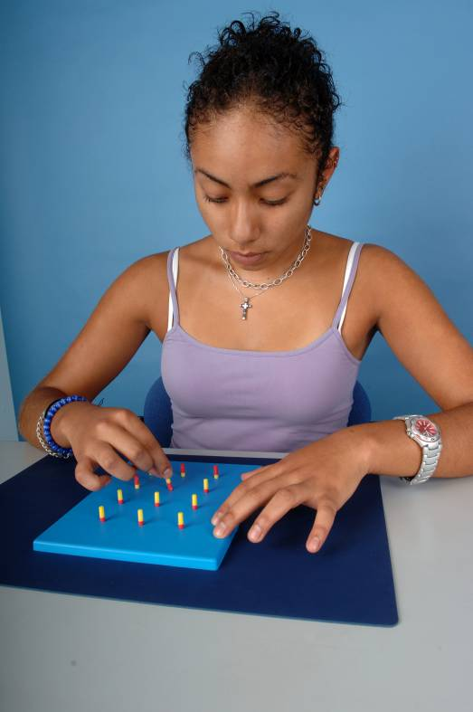
MD 1: Speed & accuracy of each hand
Placing pegs
Turning pegs
Posting Coins
23
Notes:
Speed and sureness of movement by each hand.
Equipment – mat, coins, box
Posting coins
6 for 3-4 year olds, 12 coins for 5-6 years.
Specified start and stop positions.
Place pegs
Start/stop
Not roll around
Turn pegs
Clear colours
Start/stop

Slide 24
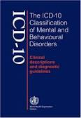

Official Diagnostic Manuals
World Health Organization
1992
Specific developmental disorder of motor function
(SDDMF)
American Psychiatric Association
2013
Developmental Coordination Disorder (DCD)

Slide 25
Standardised assessments:
Points to consider
Some standardised outcome measures:
Not client orientated
Do not measure current concepts
Borrowed from other disciplines
Designed for research purposes and not just clinical practice
Occupational performance is the result of complex relationships

Slide 26
But….How do you know if the measure is any good?

Slide 27
Does the measure….
measure what it is supposed to measure? [Validity]
measure performance in the same way each time? [Reliability]
discriminate between severity groups?
[Sensitivity]
detect changes in health status?
[Responsiveness]

Slide 28
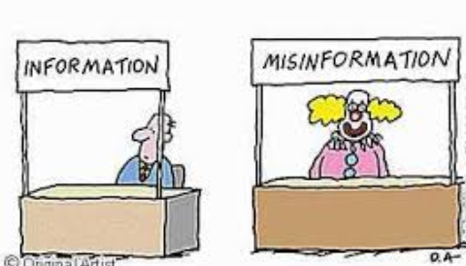
Reliability is…
The ability of a tool to measure a concept in a consistent manner (Hinton, 2004)
Can be measured in different ways

Slide 29
Validity is…
The ability of a tool to measure what is supposed to measure
Composed of different components:

Slide 30
Sensitivity: Can it accurately identify people with difficulties?

Slide 31
How accurate is my test?
Classification Accuracy: how well a test correctly identifies or excludes a condition
e.g. how well a pregnancy test identifies pregnant women as pregnant and not pregnant women as not pregnant
Sensitivity: how well a test correctly identifies a condition
e.g. how well a pregnancy test identifies pregnant women as pregnant
Specificity: how well a test correctly excludes a condition
e.g. how well a test identifies not pregnant women as not pregnant
Notes:
If a woman is told by a pregnancy test that she’s not pregnant and she actually is, that’s not good.
If a woman is told by a pregnancy test that she’s pregnant and she actually isn’t, that’s not good
All presented as percentages

Slide 32
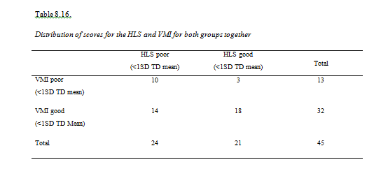
Sensitivity
  Ability of a measurement tool to identify those who have a condition
Children with handwriting difficulties who were not identified

Slide 33
Qualitative measures: no substitute for clinical reasoning!!

Slide 34
How do we measure:
Qualitative data collection methods
Focus on feelings, perceptions, values related to what has happened or the significance of a problem:
Casual conversations with the client and their carers using open-ended questioning techniques
Semi-structured interviews or questionnaires

Slide 35
How do we measure: Direct methods
Self-reports - Patients report on their level of function / performance and provide information on:
Person’s description of roles, occupations, routines & values
Living situation
Future goals – client-centred practice
Experiences from disability

Slide 36
How do we measure: Direct methods
Self-report data are collected through:
Structured, semi-structured or informal interviews (face to face/ telephone)
Written format using standardised / non-standardised questionnaires, checklists (post, email, fax, given to person)
Self-rating e.g. visual analogue scale
Self-monitoring through client journals
Narratives
Card sorting
E.g EQ5D-5L

Slide 37
How do we measure: Direct methods
Therapist observational/ collected data through:
Administration of a standardised test that requires the performance of test items which are observed & recorded
Becoming a participant-observer of client’s performance while engaging in an activity with the person

Slide 38
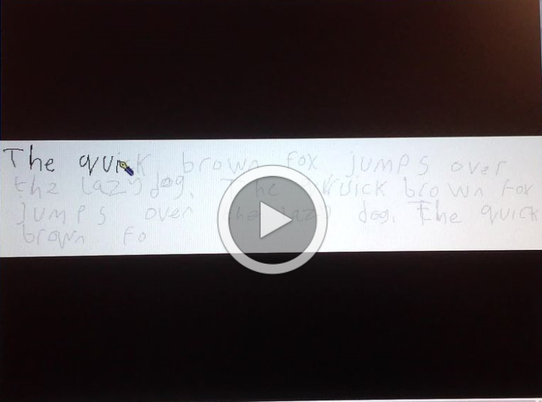
Clinical Informal Observations

Slide 39
Responsiveness
  Ability of a measurement tool to detect clinical change
  Measured:
  - Calculation of percentage change
  Effect size (larger effect size indicates greater responsiveness).:
  Mean (time 1) – Mean (time 2) / SD (time 1)
Small size effect < 0.5

Slide 40
Cost Effectiveness & EBP

Slide 41
ICF: (WHO, 2001)
Try to think about assessment and what areas of the ICF is targeted

Slide 42
References
Bland, J.M. & Altman, D.G. (1997). Statistics notes: Cronbach’s alpha. British Medical Journal, 314, 572.
Carey, L.M. (1994). Measuring and evaluating school learning, 2nd ed. Boston: Allyn and Bacon.
Clark, L.A. & Watson, D. (1995). Constructing validity: Basic issues in objective scale development. Psychological Assessment, 7, 309-319.
Greenhalgh J, Long AF, Flynn R, Tyson S (2008) "It's hard to tell": The challenges of scoring patients on standardised outcome measures by multidisciplinary teams: a case study of neurorehabilitation. BMC Health Services Research 2008, 8:217 doi:10.1186/1472-6963-8-217
Helms, J.E., Henze, K.T., Sass, T.L. & Mifsud, V.A. (2006). Treating Cronbach’s alpha reliability coefficients as data in counseling research. The Counseling Psychologist, 34(5), 630-660.
Hinton, P.R. (2004). Statistics explained, 2nd ed. London: Routledge.
Henderson, S., Sugden, D., & Barnett, A. (2007). Movement Assessment Battery for Children (2nd ed.). (Movement ABC-2). Examiner’s Manual. London: Pearson Assessment.
Jerosch-Herold C (2005) An evidence-based approach to choosing outcome measures: a checklist for the critical appraisal of validity, reliability and responsive studies, British Journal of Occupational Therapy. 68(8): 347-353.
Laver-Fawcett A (2007) Principle of assessment and outcome measurement for occupational therapists and physiotherapists: Theory, skills and application. UK: John Wiley & Sons
Prunty, M., Barnett, A., Wilmut, K., & Plumb, M. (2016). Visual perceptual and handwriting skills in children with Developmental Coordination Disorder. Human Movement Science, 49,54-65
Spiliotopoulou G (2009) Reliability reconsidered: Cronbach's alpha and paediatric assessment in occupational therapy, Australian Occupational Therapy Journal 56 (3) : 150- 155
Unsworth, C. (2000). Measuring the outcome of occupational therapy: Tools and resources. Australian Journal of Occupational Therapy, 47(4), 147-158.

Slide 43
Questions?
Thank you for listening!

