Slide 1
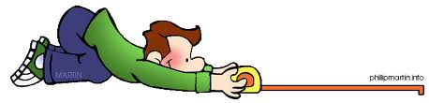

Outcome Measures
ESF II project of the University of West Bohemia in Pilsen, reg. number: CZ.02.2.69/0.0/0.0/18_056/0013239
Bc.Veronika Vrbska, MSc

Slide 2
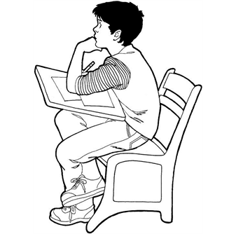
Outcomes
By the end of the lecture you should be able to:
To identify why & how we can measure
To be able to evaluate the psychometric properties of an outcome measure tool
To be able to critique an outcome measure tool to be used in practice and research
To think about how we can use outcome measures to demonstrate cost-effectiveness & cost-efficiency

Slide 3
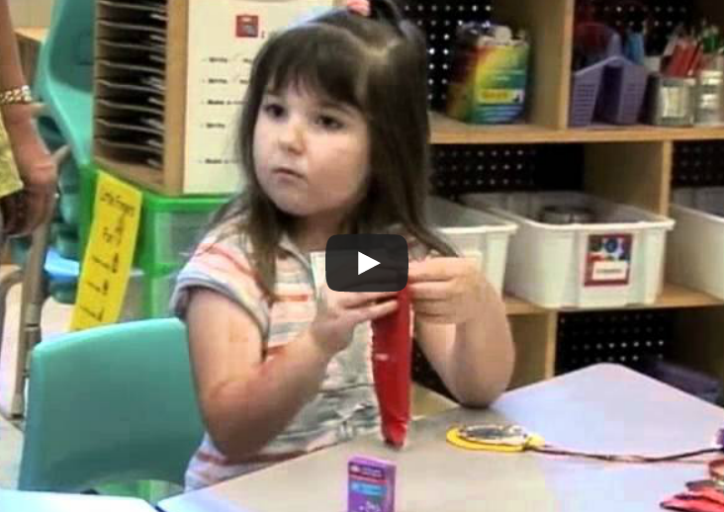
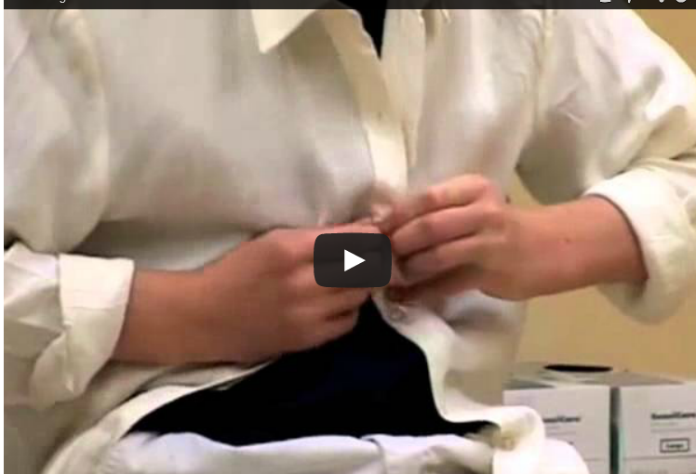
What are your groups observations of these children
http://elearning.canchild.ca/dcd_workshop/eating.html
http://elearning.canchild.ca/dcd_workshop/dressing.html

Slide 4
Question 1
Clinically why do we need to measure?
Question 2
Politically: Why do we need to measure?
Question 3
From you experience can you give some information on and some examples of the following?
Categorical
Descriptive
Predictive
Evaluative

Slide 5
Question 1
Why do we need to measure?
Providing valid and consistent information about clients
Goal setting
Deciding on most effective intervention
Monitoring client’s progress
Identify service needs
Demonstrate cost-effectiveness & cost-efficiency

Slide 6
But also….
You can’t rely solely upon your perception
Selective attention and memory (recall bias)
Subtle acts of distortion
The need to believe
You can’t rely solely upon anybody else’s perception
PROVIDES AN OBJECTIVE, QUANTIFABLE MEASUREMENT

Slide 7
Question 2
Politically: Why do we need to measure?
Demand for Evidence-based practice (EBP)
Demand for robust clinical governance and clinical audit activities
The use of standards, care pathways, protocols and guidelines

Slide 8
Question 3
Categorical – to label/diagnose/ categorise a client with a specific problem
Descriptive – to describe current functional status or circumstance at one point in time, provides baseline data for intervention planning
Predictive – performance in assessment will predict performance on other areas (e.g. OT kitchen assessment and safety on discharge)
Evaluative – outcome measurement of performance over time.

Slide 9
International Classification of Function -CY
Focus on Function
Body Function/
Impairment
Activity Skill
PARTICIPATION
Tone/Dystonia
ROM -
Active&Passive
Posture /Balance
Power
Grasp & Release
Sensation-Sensory Perception
Eating and drinking
Self Care
Meal Preparation
Play
Tool use
Family Activities
Social Activities
School Activities
Pre-Vocational
Leisure
Community e.g. shopping,cinema
ENVIRONMENT
PERSONAL FACTORS
Physical and Emotional Support
Equipment
Age
Motivation/Interests
Aspiration
Notes:
Body Function – Easy (Easier) to assess quantitatively and quickly
Activity Skill – Relatively easy to define and measure – not so easy to link to participation and outcomes
Participation – Access to and participation in range of family, social, vocational and leisure activities
Environment – Transitions & Expectations plus Assistive Technology

Slide 10
How we measure?

Slide 11
How do we measure?
Important to combine qualitative & quantitative methods:
To achieve a thorough assessment
They have different functions
Designed to answer different questions

Slide 12
How do we measure:
1. Quantitative data collection methods
Focus on factual information and are mostly expressed with numerical scores:
Standardised outcome measures
Observation testing methods, e.g. range of movement
Structured self-report or proxy report data, e.g. frequency of a particular behaviour over a period of time

Slide 13
Standardised Tests
Standardised Tests
Why do we standardise?

Slide 14
Questions
How would you standardise catching a ball?
What are some things you need to consider when developing a task for a standardised assessment?
Would age matter? How so, give examples of any adaptations
Come up with a standardised task for catching for a 4 year old, 8 year old and 15 year old.

Slide 15

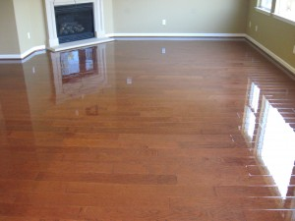
Ceiling effect
Test is too easy
Floor effect
Test is too hard

Slide 16
Standardised assessments
Published
Designed for a specific purpose
Designed for use with a specific population
Detailed instructions on how and when it should be administered
Standard procedures on scoring and interpretation of scoring
Valid
Reliable
Responsive

Slide 17
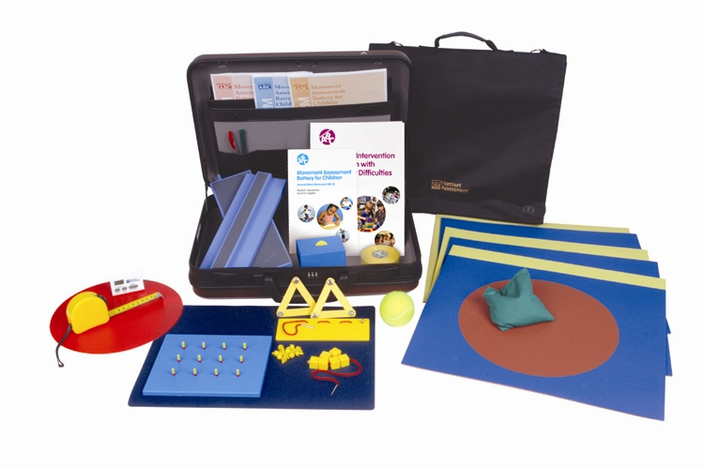
How Standardised Tests are Developed
Movement Assessment Battery for Children -2 (Henderson, Sugden & Barnett, 2007)

Slide 18
Overview: Movement ABC-2 Test
Features of the Test
focus on identification and description of impairments of motor function in children
age norms for 3 - 16 years (based on representative sample of 1172 children in the UK)
administration time 20 - 40 minutes
used by professionals with a variety of backgrounds (educational / medical)
18

Slide 19
Purpose of the test
To:
  identify those with movement difficulties
  describe the movement difficulties
  help make a diagnosis
  chart development over time
  help with intervention planning
May be used with other tests: DASH etc.
19

Slide 20
Structure of the Test
Manual Dexterity (3 tasks)
Aiming & Catching (2 tasks)
Balance (3 tasks)
8 tasks for each age band
20

Slide 21
M-ABC 2
 | Age Band 1 3 – 6 years | Age Band 2 7 – 10 years | Age Band 3 11 – 16 years
Manual Dexterity 1 | Posting coins | Placing pegs | Turning pegs
Manual Dexterity 2 | Threading Beads | Threading lace | Triangle With nuts & bolts
Manual Dexterity 3 | Bicycle trail I | Bicycle trail II | Bicycle trail III
A&C: Catching | Catching bean bag | Two-hand catch | One-hand catch
A&C: Aiming | Throwing bean bag into box | Throwing bean bag into box | Throwing at wall target
Static Balance | One-leg balance | One-board balance | Two-board balance
Dynamic Balance 1 | Jumping in squares | Hopping in squares | Zig-zag hopping
Dynamic Balance 2 | Walking heels raised | Heel-to-toe walking | Walking backwards
21

Slide 22
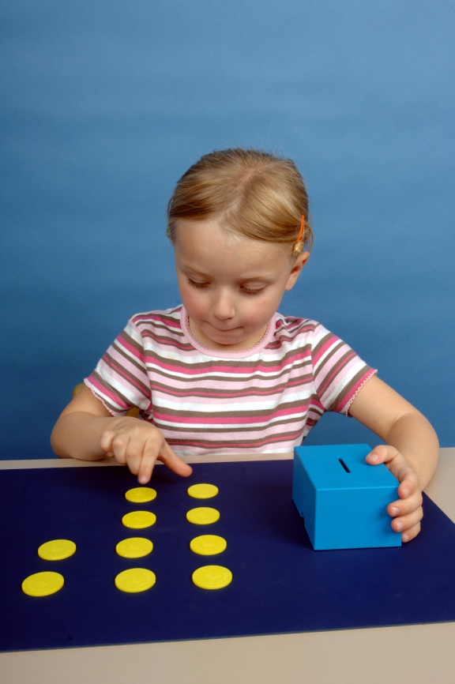
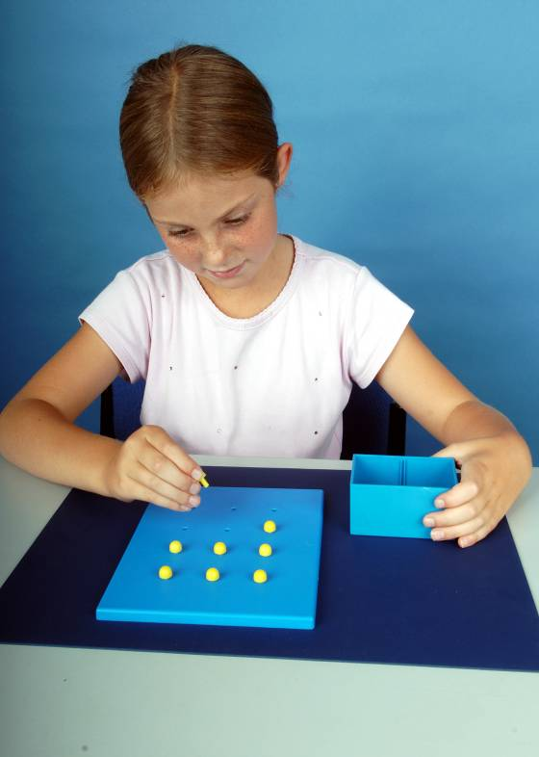
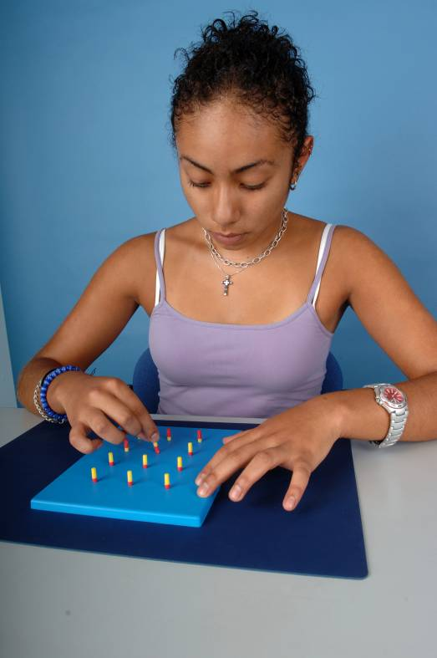
MD 1: Speed & accuracy of each hand
Placing pegs
Turning pegs
Posting Coins
22
Notes:
Speed and sureness of movement by each hand.
Equipment – mat, coins, box
Posting coins
6 for 3-4 year olds, 12 coins for 5-6 years.
Specified start and stop positions.
Place pegs
Start/stop
Not roll around
Turn pegs
Clear colours
Start/stop

Slide 23
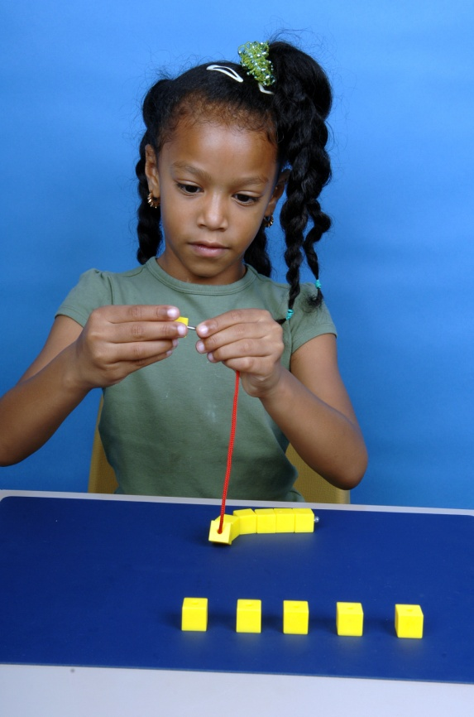
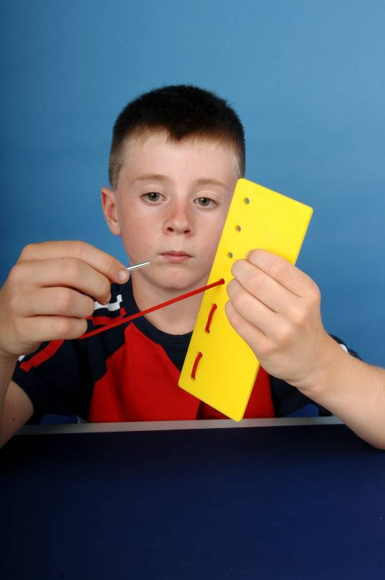
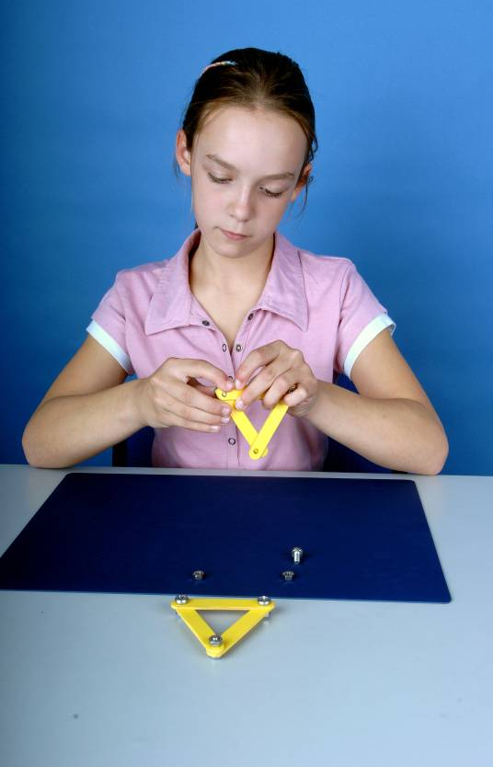
MD 2: Speed & accuracy of two hands working together
Triangle with nuts & bolts
Threading Beads
Threading Lace
23
Notes:
Coordination of the two hands for the performance of a single operation.
Beads
6/12
Start/stop positions
Thread lace
Extra holes
(not nut and bolt)
Start and stop
Clarified instructions for timing
Triangle
Not want cutting
New, better progression,
Beads too easy
Other tasks not quite right progression

Slide 24



MD 3: Control of a pen with preferred hand
Drawing Trails
24
Notes:
Hand eye coordination as required in the control of a pen.
Selection of pens – one for AB1, different for AB2 & 3
Change of shape to avoid problems of pen lifts – eg. On tips of flower trail.
Revised shape
Increased sensitivity by having reduced width half way along
Improved scoring – errors of discontinuous line, gaps, crossing boundary, reversal etc.

Slide 25
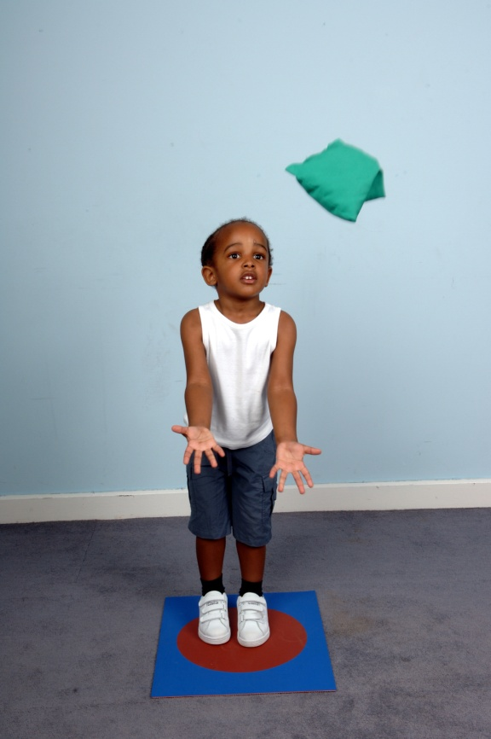
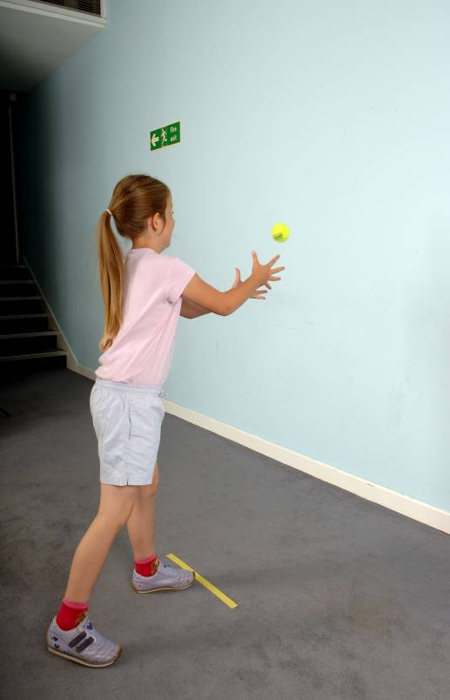
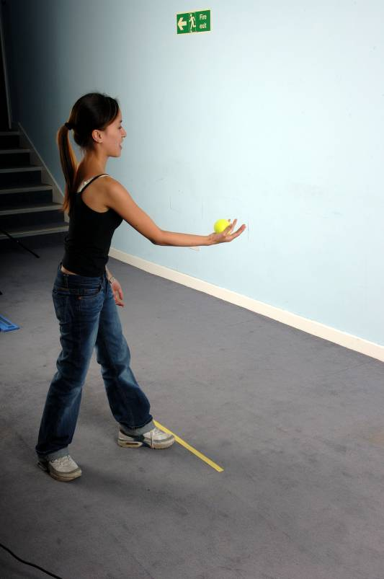
Catching
Catching bean bag
Catching with two hands
Catching with one hand
25
Notes:
A large proportion of children with movement difficulties find aiming and catching difficult.
Accuracy of receiving a moving object projected either by the assessor or by the child.
Much discussion about whether thrown by examiner through all age bands.
Variability and make it too easy.
Improved instructions regarding fails.

Slide 26
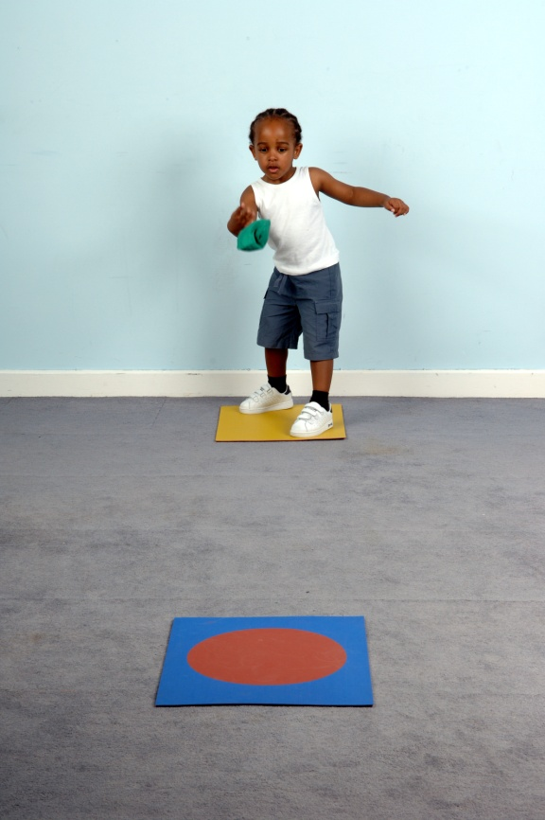
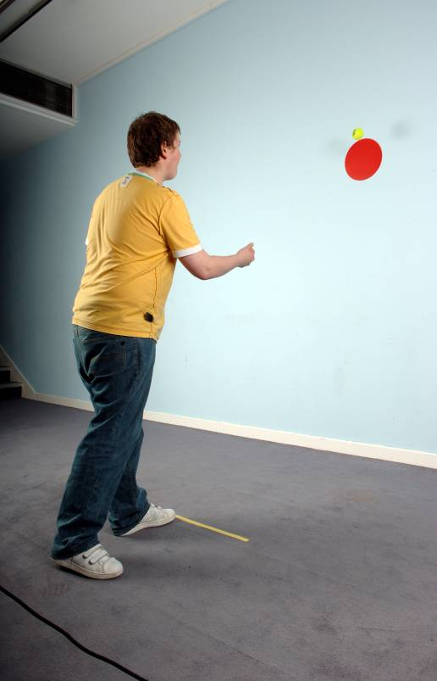
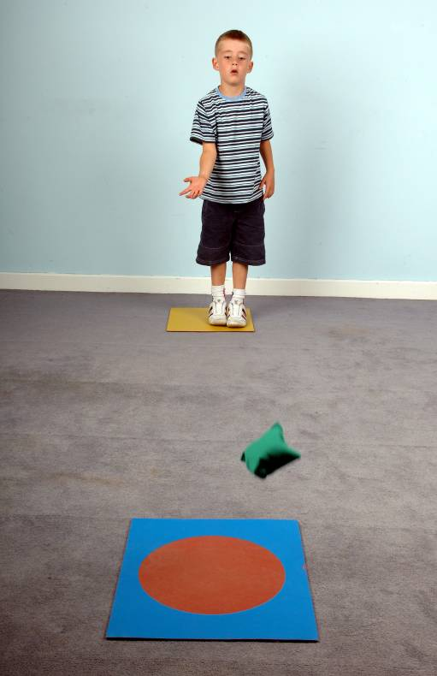
Aiming
Throwing bean bag onto mat
Throwing bean bag onto mat
Throwing at wall target
26
Notes:
Accuracy of aiming at a target.
Dropped rolling ball – difficult to assume kneeling position and get pendular swing of arm – box was bulky.
New floor mats used, also for measuring the distance.

Slide 27
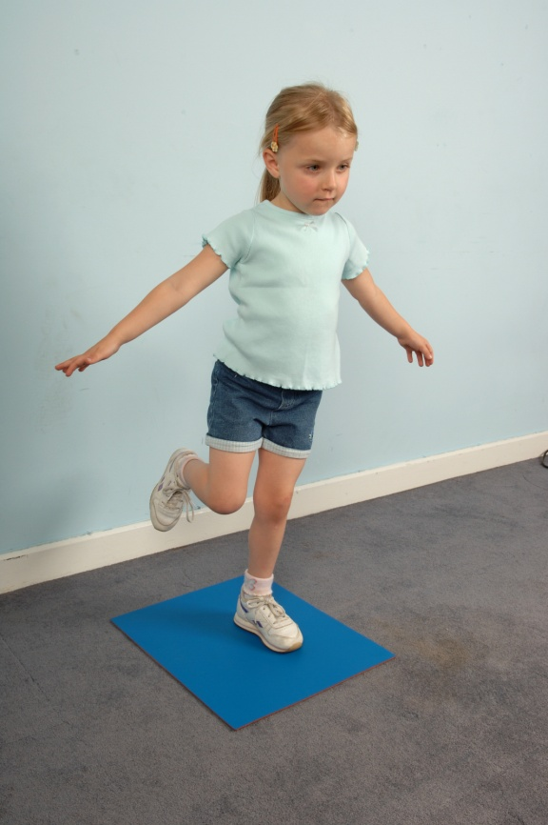
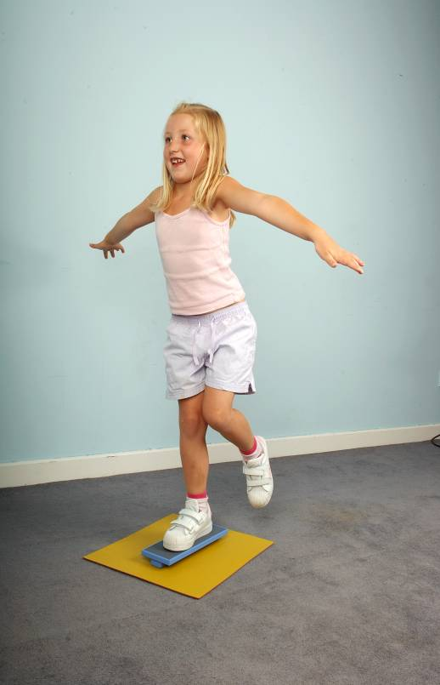
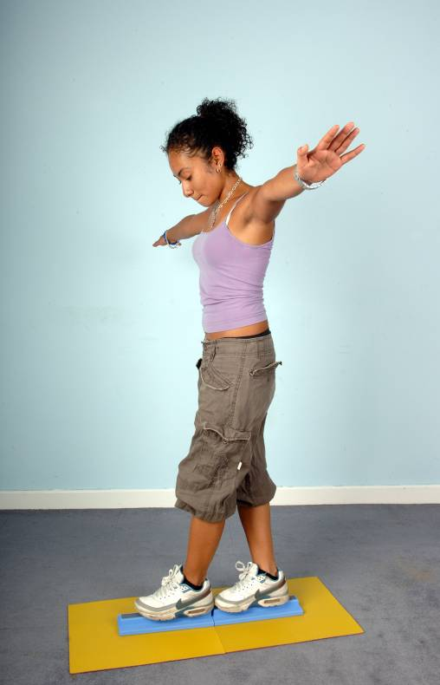
Static balance
One leg balance
One board balance
Two board balance
27
Notes:
Static balance. Child is required to hold a specified position for as long as possible.
Stand on mat
AB2 – higher, easier to see and score
AB3 – pieces lock together so not move out of alignment

Slide 28
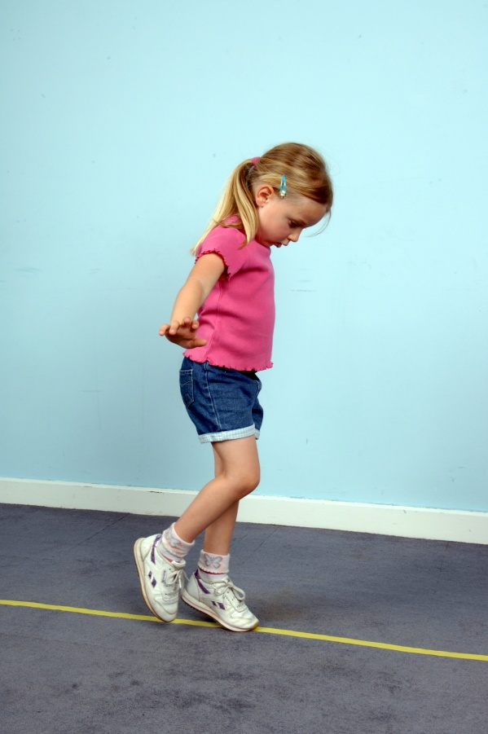
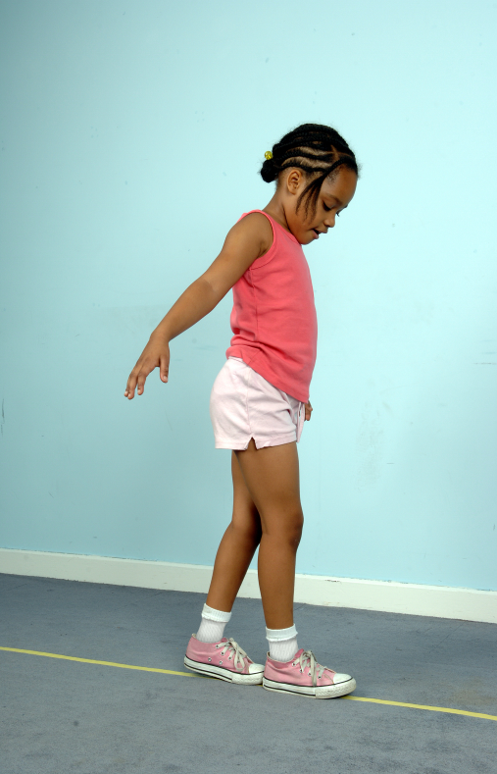
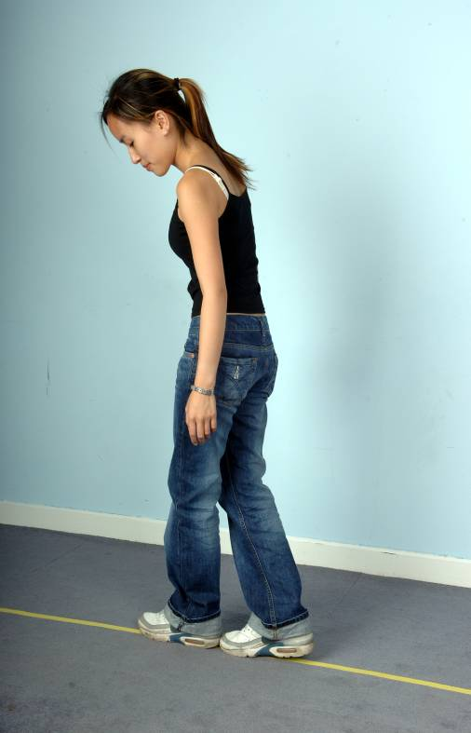
Dynamic balance 1: slow and accurate
Walking heels raised
Walking heel-to-toe
Walking backwards
28
Notes:
Involves slow accurate movement
As before
Only line to tape down
Improved instructions on when to start a new trial

Slide 29
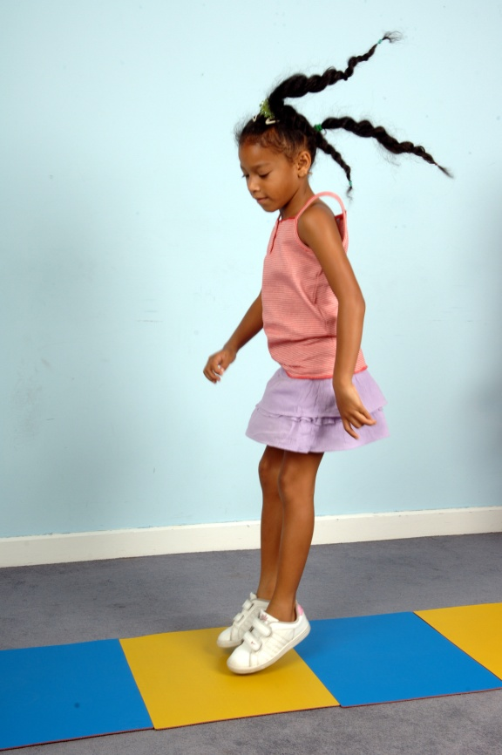
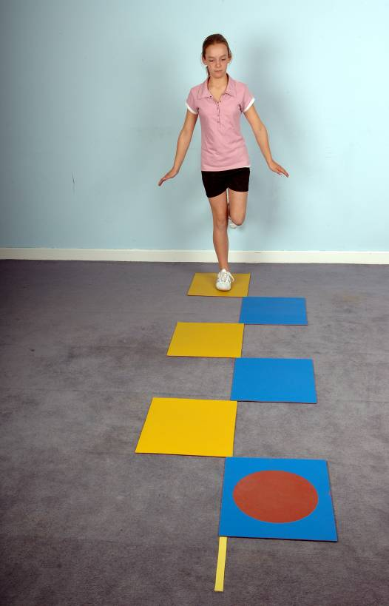
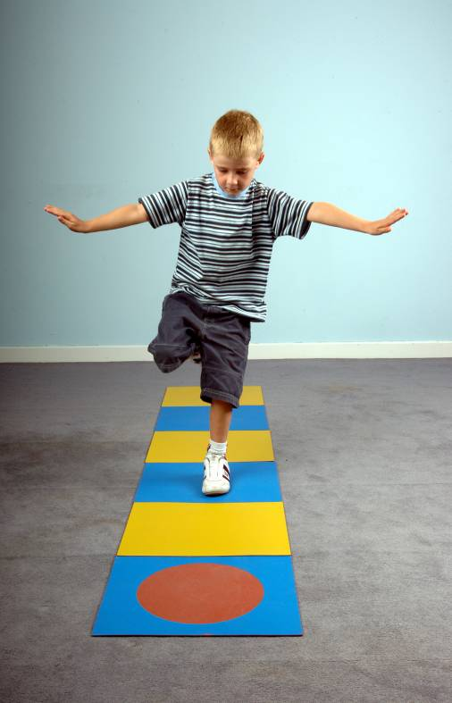
Dynamic balance 2: fast & explosive
Jumping on mats
Hopping on mats
Zig-zag hopping
29
Notes:
Involves fast, explosive movement.
Use of floor mats.
Quick and easy to measure out.
Durable.
Start on first, alternate colours, finish on last.

Slide 30
Standardised assessments:
Points to consider
Some standardised outcome measures:
Not client orientated
Do not measure current concepts
Borrowed from other disciplines
Designed for research purposes and not just clinical practice
Occupational performance is the result of complex relationships

Slide 31
Other Factors
Tai Video

Slide 32



The Patient
Attention
Wants to play with
test items
Does not want to
participate
Does not want to concentrate
32
60

Slide 33


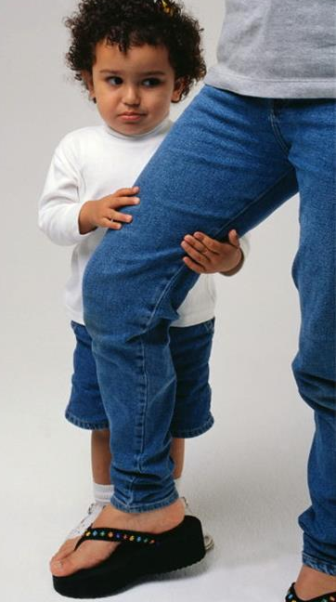
The Patient
Motivation
I am stressed by
my performance
I am not very good
I am anxious and shy
33
62

Slide 34
But….How do you know if the measure is any good?

Slide 35
Does the measure….
measure what it is supposed to measure? [Validity]
measure performance in the same way each time? [Reliability]
discriminate between severity groups?
[Sensitivity]
detect changes in health status?
[Responsiveness]

Slide 36
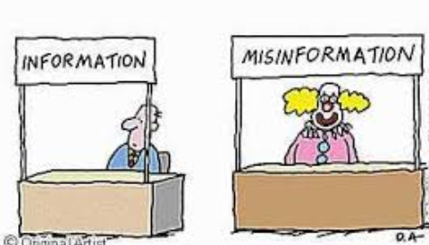
Reliability is…
The ability of a tool to measure a concept in a consistent manner (Hinton, 2004)
Can be measured in different ways

Slide 37
Types of reliability
Inter-rater reliability:
“the degree of agreement between 2 or more raters”
Measured:
Correlation between the scores recorded by 2 or more therapists administering the test to the same person at the same time
(r /rho >= 0.90)
Comparison analysis using Cohen’s Kappa (K)

Slide 38
Types of reliability
Intra-rater reliability:
“the measurement variation within 1 rater assessing the same participant more than once”
Measured:
Comparison analysis

Slide 39


Inter- or Intra-
Intra-rater
Inter-rater

Slide 40
Types of reliability
Test-retest reliability (stability):
“degree of consistency between measurements across various points in time”
Measured:
Correlation of scores between two administrations on the same people
r /rho >= 0.70
Intraclass correlation coefficient

Slide 41
Types of reliability
Internal consistency
“Measures whether participants are responding to the different items of a questionnaire in a consistent manner in a single trial”
Measured:
- Cronbach’s α: Examines the average inter-item correlation of the items in a questionnaire
If all items are measuring the same thing (without any error) ► “α = 1”
If there is no shared variance in the items, then these are supposed to reflect only error ► “α = 0”
It is being used to make inferences about the homogeneity / unidimensionality of a tool

Slide 42
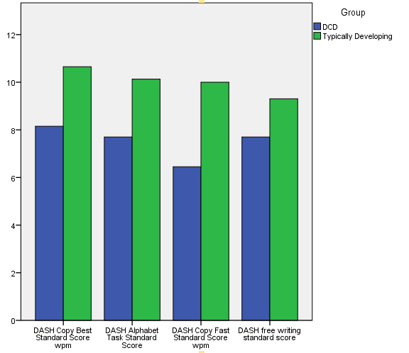
Internal consistency

Slide 43
Validity is…
The ability of a tool to measure what is supposed to measure
Composed of different components:

Slide 44
Types of validity
Content validity
“the extent to which a measure is a complete representation of the concept of interest”
Process:
  Item bank – qualitative : literature & interviews → item construction & testing
Can be assessed by judges rating item relevance, importance etc. / focus & nominal groups / Delphi studies
  Scale calibration – quantitative stats & qualitative revisions

Slide 45
Types of validity
Construct validity
”the extent to which scores of an instrument correlate with scores on other instruments that according to the theory should correlate”
“Unidimensionality or multidimensionality?”
  Convergent validity – they should correlate ,e.g. a reading test with working memory
  Discriminative validity – able to distinguish between individuals or groups

Slide 46
Types of validity
Criterion validity
“the extent to which scores on a new scale correlate with scores on a scale measuring the same construct or predict an individual’s performance in specific activities”
  Concurrent validity – agrees with measures of the same construct , e.g. a new tool for working memory with an existing one
  Predictive validity – accuracy with which a measurement predicts future events

Slide 47
Sensitivity: Can it accurately identify people with difficulties?

Slide 48
How accurate is my test?
Classification Accuracy: how well a test correctly identifies or excludes a condition
e.g. how well a pregnancy test identifies pregnant women as pregnant and not pregnant women as not pregnant
Sensitivity: how well a test correctly identifies a condition
e.g. how well a pregnancy test identifies pregnant women as pregnant
Specificity: how well a test correctly excludes a condition
e.g. how well a test identifies not pregnant women as not pregnant
Notes:
If a woman is told by a pregnancy test that she’s not pregnant and she actually is, that’s not good.
If a woman is told by a pregnancy test that she’s pregnant and she actually isn’t, that’s not good
All presented as percentages

Slide 49
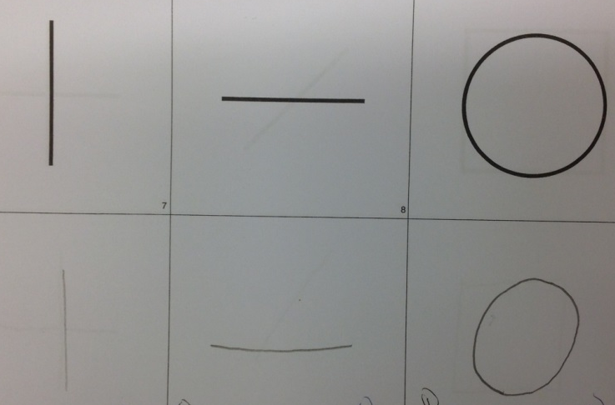
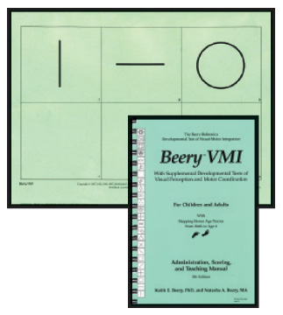
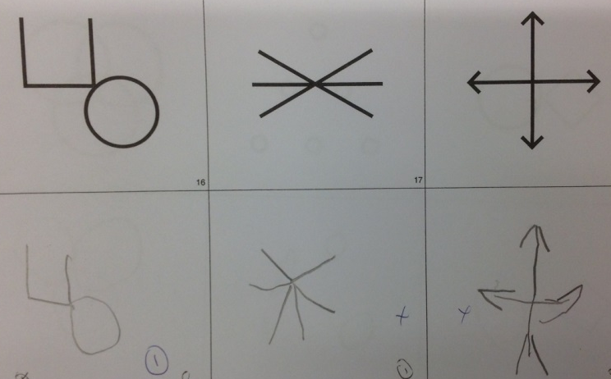
Beery-Buktenica Developmental Test of Visual Motor Skills
Visual Motor Integration

Slide 50
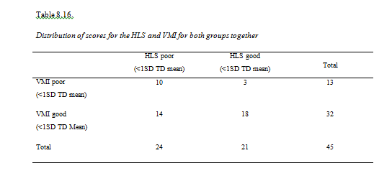
Sensitivity
  Ability of a measurement tool to identify those who have a condition
Children with handwriting difficulties who were not identified

Slide 51
Qualitative measures: no substitute for clinical reasoning!!

Slide 52
How do we measure:
Qualitative data collection methods
Focus on feelings, perceptions, values related to what has happened or the significance of a problem:
Casual conversations with the client and their carers using open-ended questioning techniques
Semi-structured interviews or questionnaires

Slide 53
How do we measure: Direct methods
Self-reports - Patients report on their level of function / performance and provide information on:
Person’s description of roles, occupations, routines & values
Living situation
Future goals – client-centred practice
Experiences from disability

Slide 54
How do we measure: Direct methods
Self-report data are collected through:
Structured, semi-structured or informal interviews (face to face/ telephone)
Written format using standardised / non-standardised questionnaires, checklists (post, email, fax, given to person)
Self-rating e.g. visual analogue scale
Self-monitoring through client journals
Narratives
Card sorting
E.g EQ5D-5L

Slide 55
How do we measure: Direct methods
Therapist observational/ collected data through:
Administration of a standardised test that requires the performance of test items which are observed & recorded
Becoming a participant-observer of client’s performance while engaging in an activity with the person

Slide 56
Responsiveness
  Ability of a measurement tool to detect clinical change
  Measured:
  - Calculation of percentage change
  Effect size (larger effect size indicates greater responsiveness).:
  Mean (time 1) – Mean (time 2) / SD (time 1)
Small size effect < 0.5

Slide 57
Critiquing measurement tools (Laver-Fawcett 2007)
What is the purpose of the tool?
What population has the tool been designed for?
What domain/concept does it address?
In which environment can it be administered?
Is it standardised?
What scoring system is used?
What are the levels of reliability?
What validity has been established and how?
What is the clinical utility of the tool?
What is its’ responsivity?
What qualification/training is required of the assessor?

Slide 58
References
Bland, J.M. & Altman, D.G. (1997). Statistics notes: Cronbach’s alpha. British Medical Journal, 314, 572.
Carey, L.M. (1994). Measuring and evaluating school learning, 2nd ed. Boston: Allyn and Bacon.
Clark, L.A. & Watson, D. (1995). Constructing validity: Basic issues in objective scale development. Psychological Assessment, 7, 309-319.
Greenhalgh J, Long AF, Flynn R, Tyson S (2008) "It's hard to tell": The challenges of scoring patients on standardised outcome measures by multidisciplinary teams: a case study of neurorehabilitation. BMC Health Services Research 2008, 8:217 doi:10.1186/1472-6963-8-217
Helms, J.E., Henze, K.T., Sass, T.L. & Mifsud, V.A. (2006). Treating Cronbach’s alpha reliability coefficients as data in counseling research. The Counseling Psychologist, 34(5), 630-660.
Hinton, P.R. (2004). Statistics explained, 2nd ed. London: Routledge.
Henderson, S., Sugden, D., & Barnett, A. (2007). Movement Assessment Battery for Children (2nd ed.). (Movement ABC-2). Examiner’s Manual. London: Pearson Assessment.
Jerosch-Herold C (2005) An evidence-based approach to choosing outcome measures: a checklist for the critical appraisal of validity, reliability and responsive studies, British Journal of Occupational Therapy. 68(8): 347-353.
Laver-Fawcett A (2007) Principle of assessment and outcome measurement for occupational therapists and physiotherapists: Theory, skills and application. UK: John Wiley & Sons
Prunty, M., Barnett, A., Wilmut, K., & Plumb, M. (2016). Visual perceptual and handwriting skills in children with Developmental Coordination Disorder. Human Movement Science, 49,54-65
Spiliotopoulou G (2009) Reliability reconsidered: Cronbach's alpha and paediatric assessment in occupational therapy, Australian Occupational Therapy Journal 56 (3) : 150- 155
Unsworth, C. (2000). Measuring the outcome of occupational therapy: Tools and resources. Australian Journal of Occupational Therapy, 47(4), 147-158.

Slide 59
Questions?
Thank you for listening!

