Slide 1

How to choose examination methods in physiotherapy
ESF II project of the University of West Bohemia in Pilsen
reg. number: CZ.02.2.69/0.0/0.0/18_056/0013239
Mgr. Votík

Slide 2
Examination
Need to set a therapeutic statements in line with examination
  impairment
  Disability – specific for particular patient
  Character of disease
According to examination we can estimate the influence of specific intervention and we can select and set adequate intervention (efectivity)

Slide 3
Choose of examination method
Neccessery to ask yourself following questions:
Which method / examination is best used to objectify the issue?
What physical task best reveals the observed deficit?
According to the answer to the questions, I choose the method of examination:

Slide 4
Patients´history -> Empirie
Aspection -> Subjectivity
Palpation
Tests, questionares, -> EBM principles scales
Kinematic,
Neurophysiological
Kinetic Analysis
simplicity
->
EBM principles

Slide 5
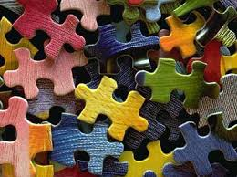
EBM – Evidence Based Medicine
Evidence-based medicine is looking for the best possible approach for the individual patient
  In diagnostics
  In therapy
  It has its pitfalls
    Atomization - analytically and not very synthetically
    We can see individual puzzles but not the complete picture of it

Slide 6
EBM
It is essential to be aware of the existence of significant interpersonal and intrapersonal variability
This variability is mainly a reflection of the uniqueness of each individual and the myriad influences that currently affect the CNS, so it will never be possible to fully objectify an individual matter, such as movement.
"The result of the work underlines the fact of modern medicine, where objective instrumental measurements without palpation and clinical examination provide limited limiting information."

Slide 7
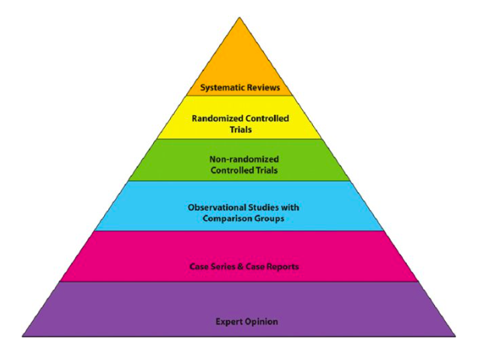

Slide 8
What criteria must it meet in order for it to be EBM?
Objectivity
Validity
  Test accuracy
  Does the test really measure the measured property?
Reliability
  Test reliability
  How well the method measures
  (for more see another ppt about statistical analysis of data sample from prof. Richards)

Slide 9
Sensitivity
  The probability that the test will be positive in patients
Specificity
  The probability that the test is negative in people without the disease

Slide 10
Where to find EBM
Databases:
https://pubmed.ncbi.nlm.nih.gov
https://scholar.google.co.uk
https://www.researchgate.net

Slide 11
But beware!
You will find a study on each opinion, which will confirm it to you!
The need to always put in context and in the context of kinesiological principles.
The number of articles read is not a guarantee of quality and knowledge.
Sponsor?
Quality of stat analysis?

Slide 12
Occurrence of EBM in physiotherapy
Clinical examination methods
Testing Scales
Questionnaires
Movement analysis methods

Slide 13
Movement analysis in experimet
Pilost measurment!
Still condition withou changes in PRE/POST
See more on slide about EBM criteria

Slide 14
Options of movement analysis
Examination of the course of movement - biomechanical methods
  Kinetic methods – dynamic analysis
  Kinematic methods - kinematic analysis (regardless of the cause of movement)
Examination in terms of neural mechanisms of motor control - neurophysiological methods
  Electromyography (EMG)

Slide 15
What does that tell us?
According to aspects (kinematics, kinettics, neurophysologics) it is possible to describe partial qualities of movement and specifically to approach an objectively determined pathology
The possibility of creating a rational basis for rehabilitation practice based on experimental studies - as in other clinical disciplines
According to aspects (kinematics, dynamics, neurophysol.) it is possible to describe the partial quality of movement and specifically to approach the pathology objectively
Most motion analysis technologies also offer therapy modules
Repetitive movement - repetition without repetition, safe, degree of assistance, often on the principle of game
Use also in therapy

Slide 16
In conclusion
We need to realize that the devices in the physiotherapy give us a wider range of more rational results of functional movement examination.
They provide us with their further processing with simultaneous repeatability and a great possibility of entering the process of neuroplasticity.
It cannot replace human-personal and professional communication between therapist and patient
It is ideal to combine

