Slide 1




ESF II project of the University of West Bohemia in Pilsen
reg. number: CZ.02.2.69/0.0/0.0/18_056/0013239

Slide 2
Kineamtics analysis - goniometry
Device for measuring angles in a joint, two arms, one fixed and the other mobile.
Clinical use through simple and useful examination of static angle values
However, little usability if we want to investigate the angle dynamically during different positions and variations.
Electrogoniometer
It has its limits - based on comparison with motion capture

Slide 3
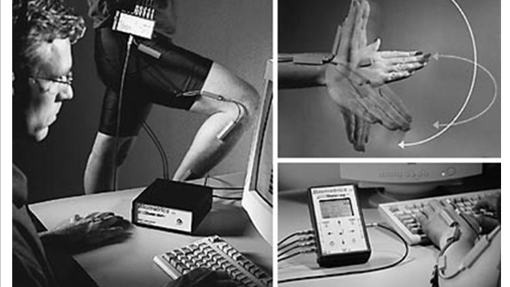

Slide 5


