Slide 1




ESF II project of the University of West Bohemia in Pilsen
reg. number: CZ.02.2.69/0.0/0.0/18_056/0013239

Slide 2
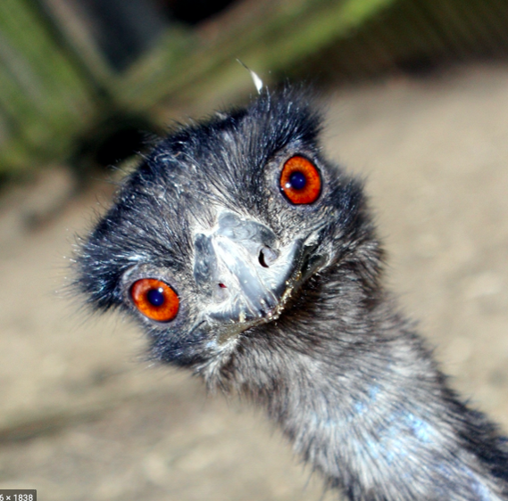
IMU
What is IMU?

Slide 4
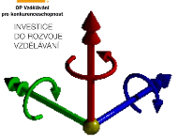
IMU
Innertial measurment units – IM sensor
Connecting ACC, GYRO, MAG, EMG, some of them GPS too
Combination of modalities is giving us more precise stream of infromation and giving higher quality pictures of someones´movement

Slide 5
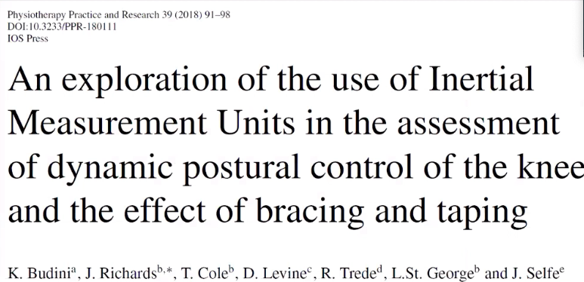
IMU use examples:

Slide 6
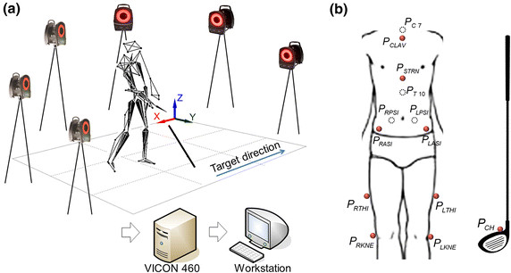
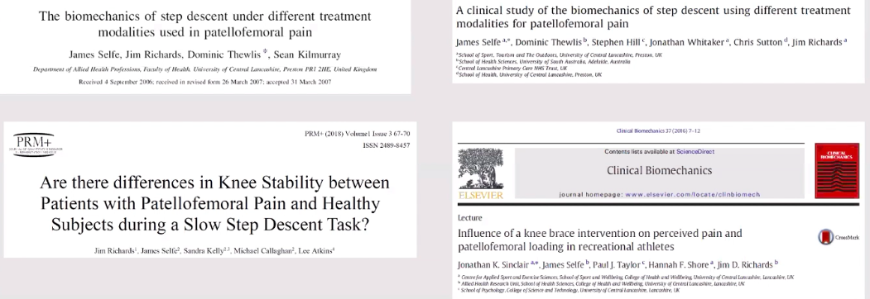
Comparing motion capture systems and IMU

Slide 7
It means low cost IMU is giving us same quality movement analysis as motion capture systems.

Slide 8
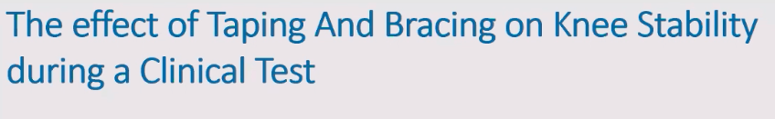
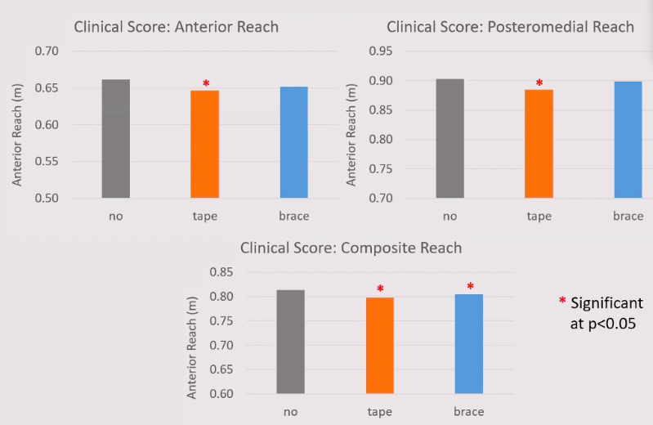
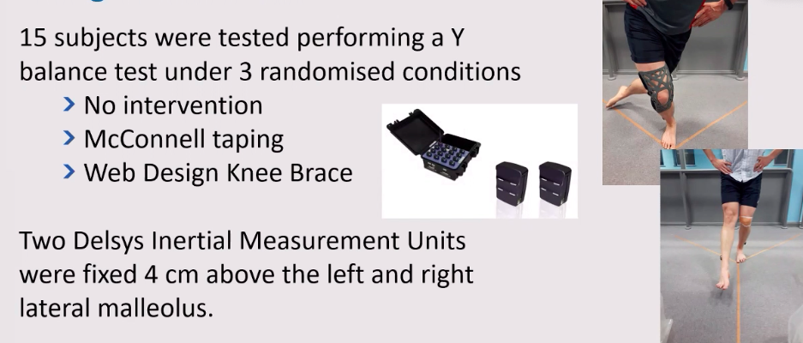
w/o CICH

Slide 9
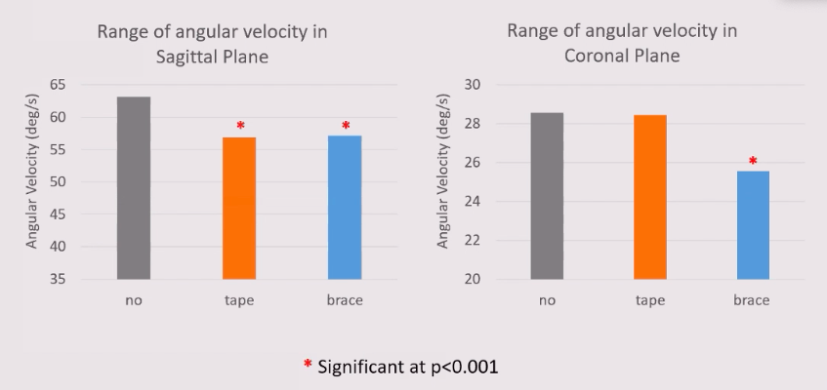
Using part of IMU in movement analysis – using analasys of: angular velocit

Slide 10
It means: We are capable to evaluare proportional changes using IMU
We can see that tape/brace affects dynamic stability of lower limb
IMU is possible to use – sensitive enouh to capture clinical changes in clinical eviroment not only in a laboratory enviroment

Slide 11
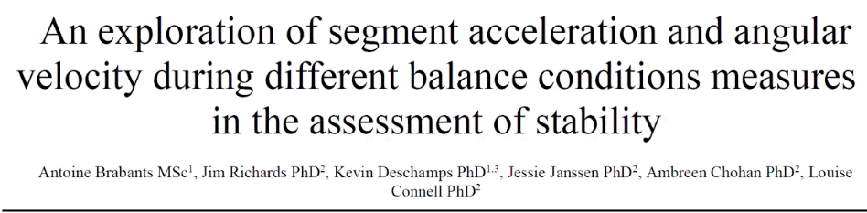
What parameters we should be interested in if we wanna evaluate stability?

Slide 12
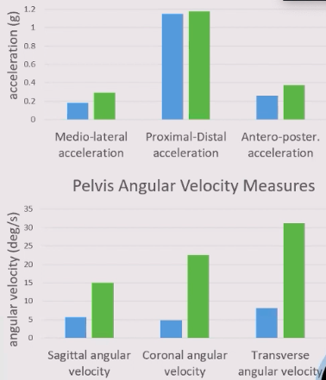
Pánev acc
Airex surface

Slide 13
IMU (Uhlová rychlost - gyroskop)
Je dostatečně validní metoda měření v porovnání s Vicon (motion analysys systeem). - není dále potřeba laboratoř

