Slide 1




ESF II project of the University of West Bohemia in Pilsen
reg. number: CZ.02.2.69/0.0/0.0/18_056/0013239
Surface EMG

Slide 2
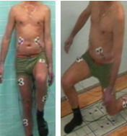
Definice
EMG > Capturing of electiracl potentials generated by muscle cells
surface EMG (sEMG)
  Registration of electrical manifestations of muscle system activity using surface electrodes
  Approach to electrophysiological / neurophysiological processes that are directly related to the origin of movement and the production of force

Slide 3
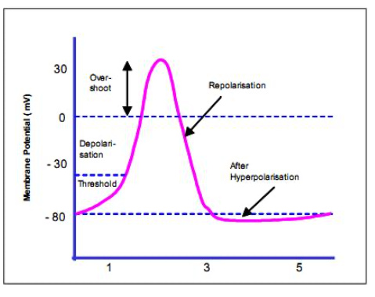
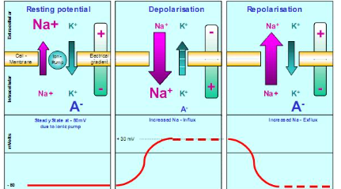
Essence of EMG
ACH
Action potencial is spreaded in MN > neuromucular junction > postsynaptic membrane > sarcolema depolarisation> muscle contraction> repolarisation

Slide 4
Essence of EMG
Signal generated by muscle fibres as result of MU recruitment is called MUAP – motor unit AP
It means: Captured signal is always interference of APs of more than one MU

Slide 5
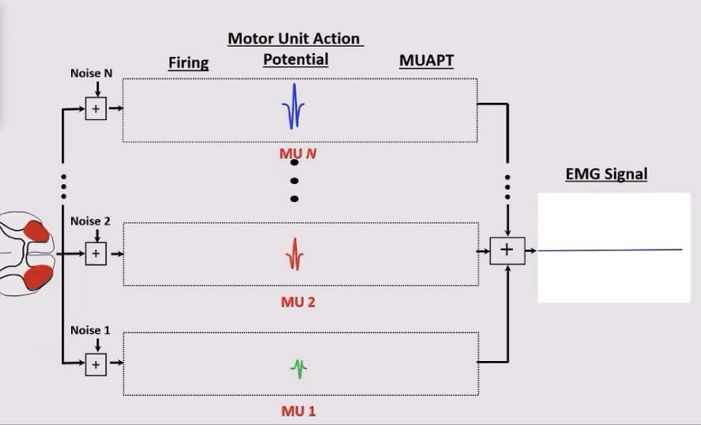

Slide 6
Sumace AP
Adrian – Bronckův zákon
Časová sumace
Prostorová sumace
  Hennemanovo pravidlo
Přii zvyšování svalové síly kombinace obou typ sumací (v závislosti na velikosti aktivace svalu). ASI
Notes:
A-B zákonZ kterého vyplývá, jak už bylo řečeno, asynchronní aktivace MU, tzn., že nově napojená MU zůstává aktivní do té doby, než dojde k poklesu síly. Inaktivace MU probíhá v opačném pořadí, než v jakém byl prováděn nábor. Asynchronní způsob aktivace MU je zodpovědný
23
za plynulý nárůst vyvíjené síly, ale nelze jím dosáhnout maximálního silového momentu. Další nárůst síly může být dosažen zvýšením frekvence vzruchů přicházejících kaktivovaným MU, tzv. pálení (firing) – časová sumace. Tímto způsobem lze dosáhnou krátkodobého zvýšení síly na úroveň maxima, za cenu rychlého nástupu únavy

Slide 7


