Slide 1
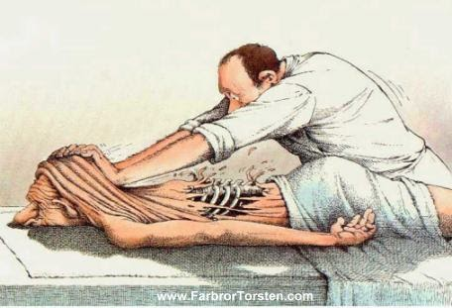

Classical Massage
ESF II project of the University of West Bohemia in Pilsen, reg. number: CZ.02.2.69/0.0/0.0/18_056/0013239
Mgr. Iva Hereitová
KFE FZS

Slide 2
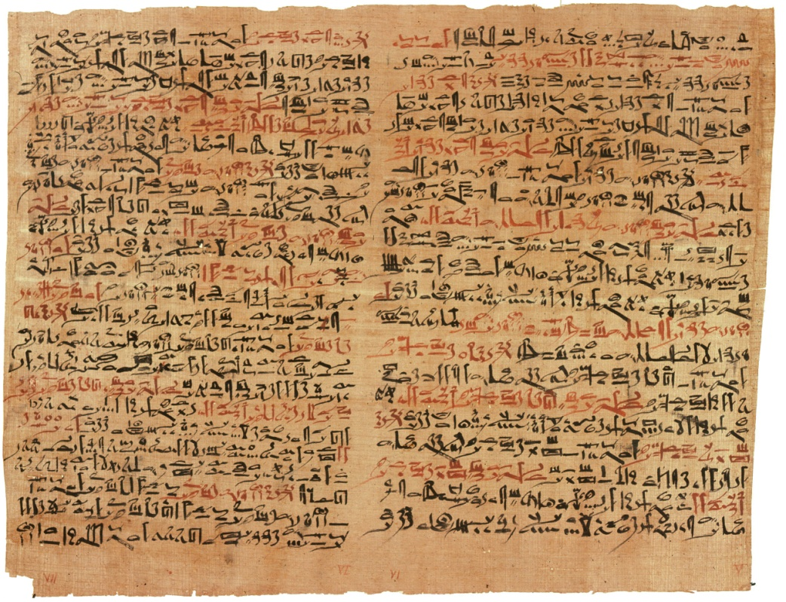
History
Ebers papyrus
  from ancient Egypt (5000 BC)

Slide 3
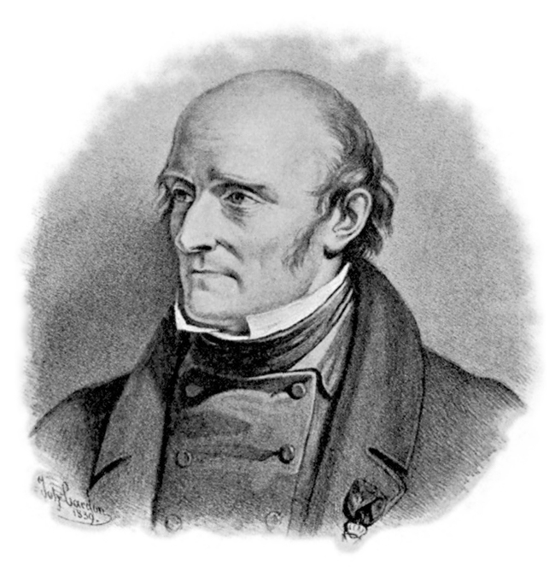
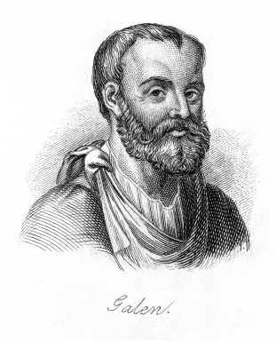
History
Cladius Galenus
  purposefully used massage in training gladiators; distinguished between preparatory massage (frictio) and regenerative massage (apoterapeutic)
Pehr Henrik Ling
  Missionary; upon return from the Orient to Sweden, he founded a massage school; in 1813, he founded the Central Gymnastics Institute in Stockholm, where he also taught therapeutic physical exercises

Slide 4
Massage
The word "massage" comes from the French word message, which comes from the Greek word massein
Kneading

Slide 5
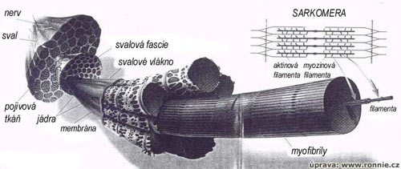
Massage
= mechanical effect on the body in the muscle and fascia layer; impact on deep vessel system
  Effects: reflexive, biochemical and mechanical

Slide 6
Massage Duration
According to the scope and goal of the massage
Total massage 50-60 min
Lower limbs 10 min
Back and shoulders 7-10 min
Abdomen 5 min
Chest 3-5 min
Back of the neck 3-5 min
Head and face 5-10 min

Slide 7
Massage Direction
Centripetal (towards the heart)
  Torso – longitudinal or transverse, parallel to the spine
  Abdomen – along the large intestine
  Back of the Neck – from the back of the head to the shoulders or along the spine

Slide 8
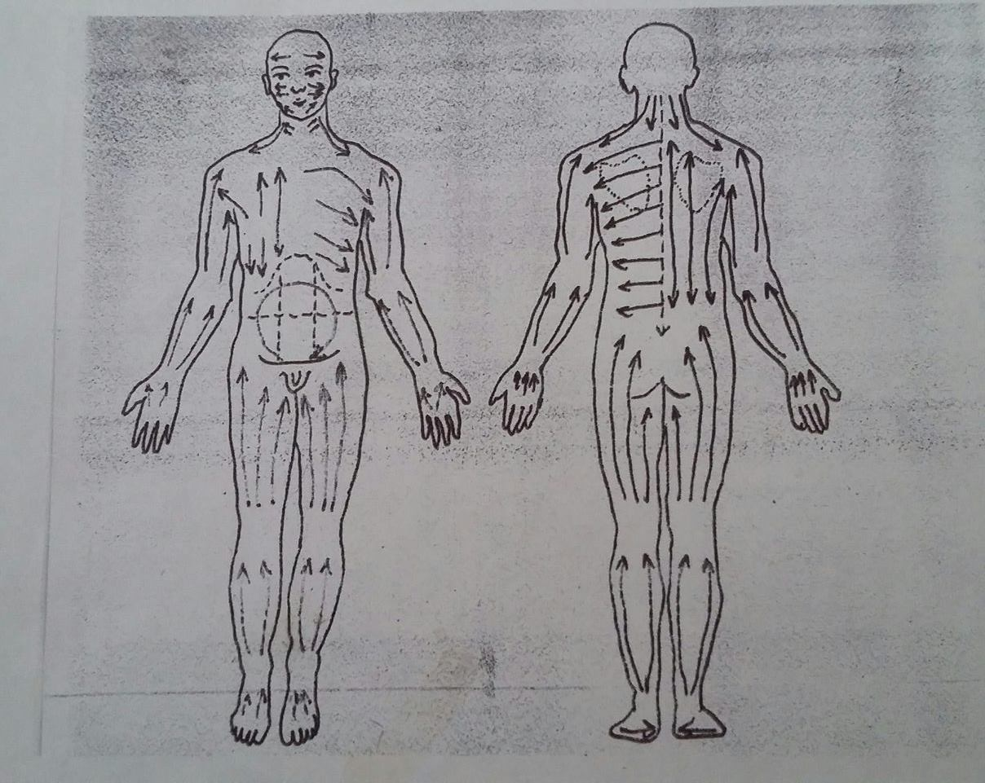

Slide 9
Massage Dosing
depends on the choice of individual strokes and their order
their intensity
the speed of stroke repetitions
the number of stroke repetitions and their regularity
the duration
What matters are the acuteness or chronicity of a disease and the aim of the massage.

Slide 10
Massage Means
Good Glide and Adhesion;
Massage Effect Enhancement
Soaps
Powders
  These, as well as soaps, were used in the 1980s and 1990s due to the shortage or lack of other massage products
Alcohol solutions
  Used locally on certain regions or at the end of the massage
Special alcohol lubrication solutions for sports clients
  Improved alcohol solution; not suitable for long massage
Creams, ointments, gels
  Used for local massage of certain parts of the body affected by a problem (e.g. joint, muscle or tendon damage)

Slide 11
Massage Means
Oils
  Today, these are the most popular and versatile massage means.
  They have good glide and are suitable for long massages.
Emulsions
  Consisiting of three components: water, oil and emulsifier, used to emulsify water and oil
  Two emulsion types: oil in water or water in oil
  May contain more active substances (essential oils, vitamins, flavonoids, panthenol, etc.)
  Easily mixable with sweat; not preventing sweating during the massage, which is even good for emergency massage
  Basic, cooling and warming emulsion types

Slide 12
Muscle Disorders
Tone change
Blood flow disorder
Limitation of function and pain
Muscles
  Poor posture, phasic vs tonic muscles, trigger points, static load, professional sport
Joints
  arthrosis deformans – movement pattern limited
Vertebrogenic disorders
  Hernia of a disc, skoliosis, rickets, post-traumatic vertebral fracture, unequal length of lower limbs, etc.
Post-traumatic
Nerve-affecting
Reflex-affecting
  CHOPN, asthma, constipation

Slide 13
Indications
Functional disorders of the locomotor system
Local disorders of subcutaneous connective tissues = "connective gelosis "
B) Muscle disorders
  Loss of balance between activation and relaxation
  Disorders of regulation of arterial inflow and venous and lymphatic outflow
  Intercellular environment disharmony

Slide 14

Total Contraindications
System diseases, tumours and infectious diseases
Metabolic DECOMPENSATION!!!!
  heart, lungs, kidneys

Slide 15
Total Contraindications
Fascia cracks, muscle hernias
Muscle ruptures (partial and total)
Tendon ruptures
Fractures and dislocation of joints
Hematoma

Slide 16
Local Contraindications
Abdomen
  Bleeding conditions, ascites, liver and spleen enlargement, large hernia, urinary retention, constipation megacolon, menses, pregnancy
Lower limbs
  Extensive varices, inflammation of the veins and trophic skin disorders
Inflammatory swelling of joints and inflammation of soft tissues
Acute neuritis, places of fresh scars and injuries, TB and high blood pressure

Slide 17
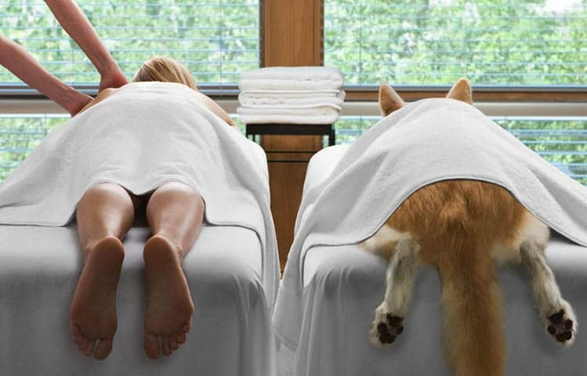
Thank you for your attention

