Slide 1

Upper limb massage
Mgr. Iva Hereitová
FZS ZČU
ESF II project of the University of West Bohemia in Pilsen, reg. number: CZ.02.2.69/0.0/0.0/18_056/0013239

Slide 2
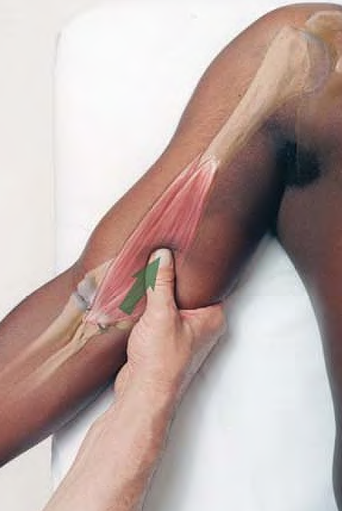
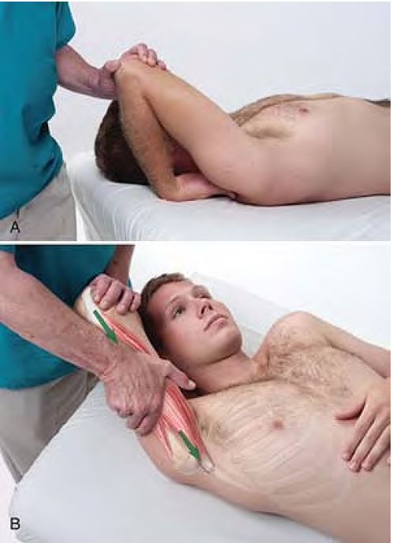
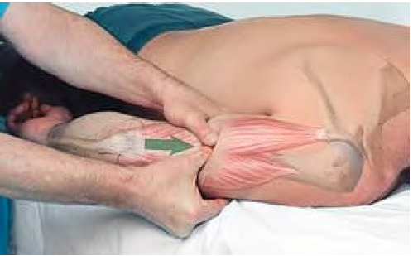
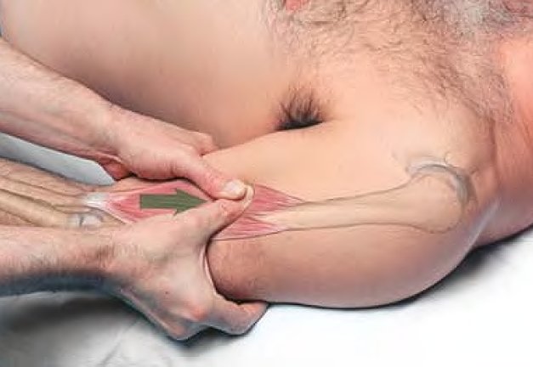
Stripping massage M. Triceps brachi
M. biceps brachii

Slide 3
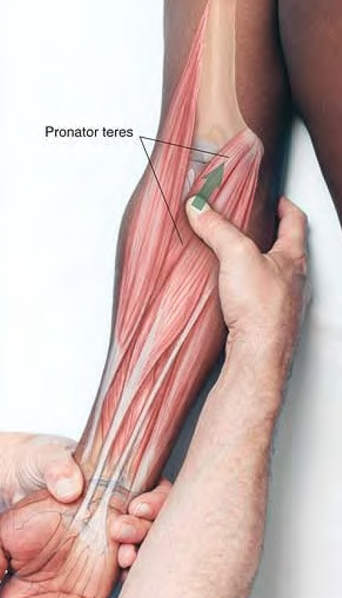
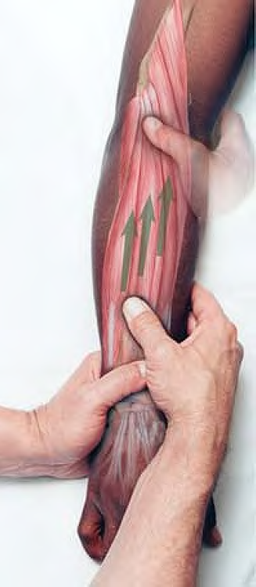
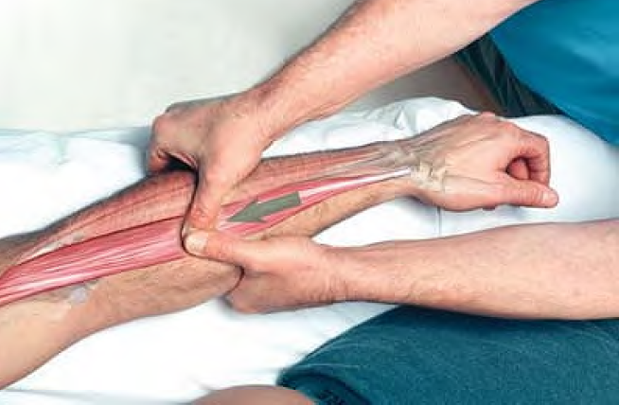
Stripping massage of the extensors, flexors and pronator teres using the thumb

Slide 4
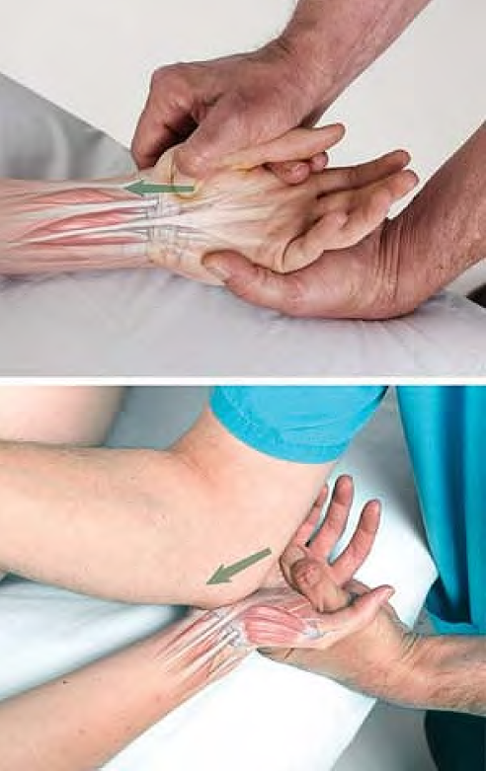
Stretching the flexor retinaculum using the thumb and elbow

Slide 5
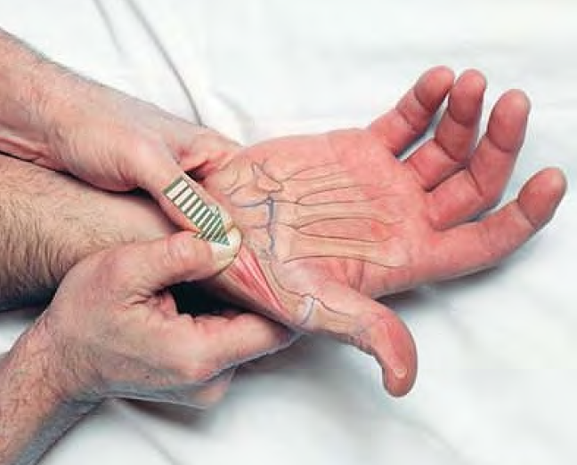
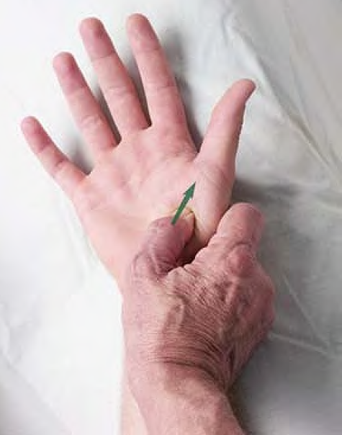
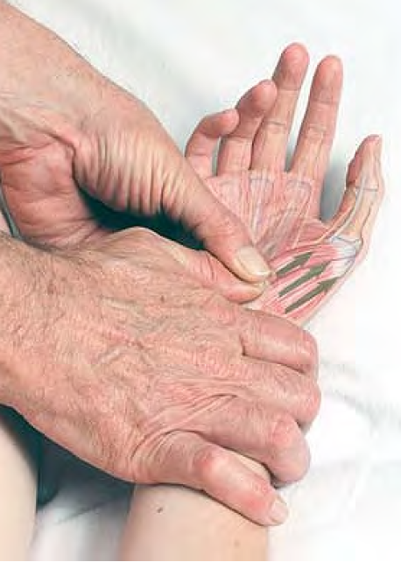
Stripping massage of the muscles of the thenar eminence

Slide 6
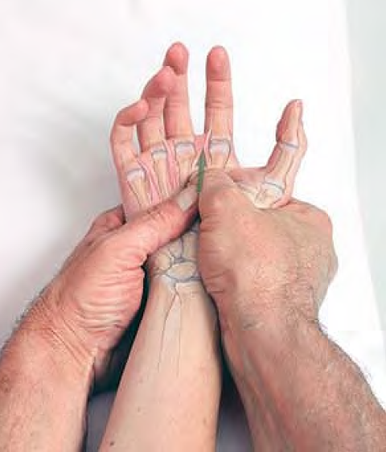
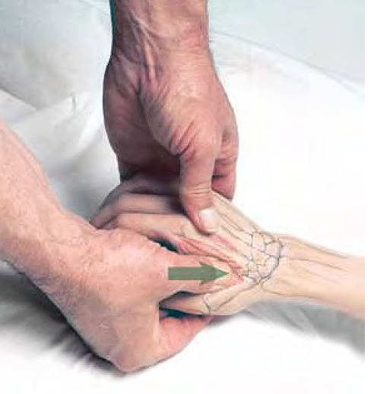
Stripping massage of dorsal interosseous muscles

