Slide 1

ESF II project of the University of West Bohemia in Pilsen
reg. number: CZ.02.2.69/0.0/0.0/18_056/0013239
Introduction
Development and Globalization
UNYP

Slide 2
What is Globalization?
Globalization
  Globalization
    Globalization
      Globalization
        Globalization
          Globalization

Slide 3
Globalization
Brettonwoods institutions
Opposition in the South
Transfer of production of ecologically HARMFUL Products to the south
ANTI-CAPITALIST PROTESTS

Slide 4
Evils of globalization?
According to some: globalization has ethical and ecological dimension because everything is tradeable: genes, organs, seeds, knowledge, information, water….
It eliminates state borders due to the flow of capital

Slide 5
Immanuel wallerstein
Dependency theory derived from Marxism
Impossible to understand political and ideological changes in the world without material or economic processes
Wallerstein theory of world systems:
  Minisystems
  World empires
  World economies

Slide 6
World system theory
Minisystems
    Primitive division of labor
    Simple agricultural or foraging societies
World empires
    Diverse cultural systems
    But only one political-economic system
World economies
    Diverse states and cultures
    Division of labor organized by the core

Slide 7
World system theory
Core
    Concentration of key technologies, knowledge, sophisticated economic activities and services
Semiperiphery
    Used by the core and at the same time (ab)uses the periphery
Periphery
    Cheap labor and Natural resources

Slide 8
Wallerstein geo-economic model
1450-1600 Western Europe (Amsterdam, Antwerp) was the core, the mediterranean was a semiperiphery, new world a periphery
1600-1750 Western Europe including england turned most of the word into a periphery
1730-1870 industrial revolution, England was the core
End of 19th century: Recession of england coincided with rise of france and germany
Another phase was acquisition of colonies in africa
WWI: rise of the USA – central power
Last phase (1970s and 1980s) characterized by state protectionism, recession, and instability was accoridng to Wallerstein another era in the development of the world system

Slide 9
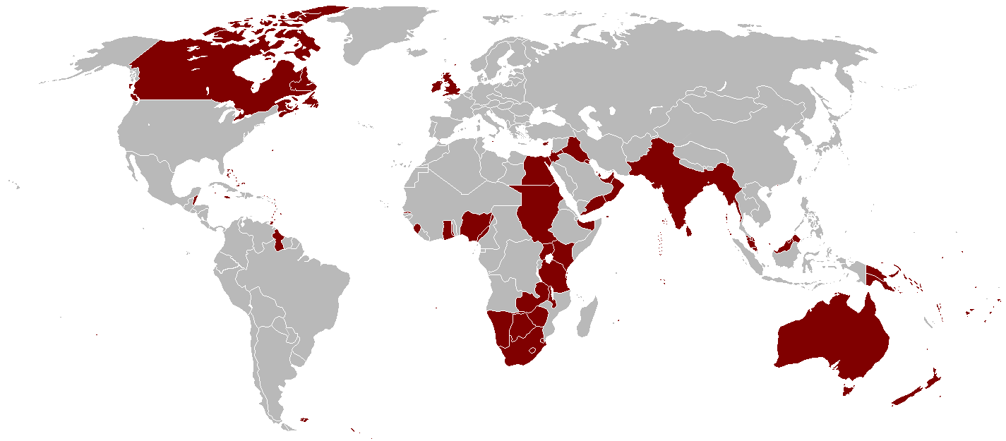

Slide 10
Göran Therborn
1) expansion of world religions 4th to 7th century
2) european colonial expansion at the end of the 15th century, 1494 Treaty of Tordesillas
3) Seven years war 1756-1763
4) from the mid-19th century to 1918 Era of European colonialism
5) WWII and cold war, dynamics of technological revolution primarily in transportation
6) Contemporary era, former power blocs replaced by dynamical economic processes

Slide 11
Main global institutions
World bank
  Assistance in financing development projects
International monetary fund
  For the stability of global economy
GATT – general agreement on tariffs and trade , 1995 replaced by World trade organization

