Slide 1

Globalization, Development and Migration (the case of the Horn of Africa)
ESF II project of the University of West Bohemia in Pilsen, reg. number: CZ.02.2.69/0.0/0.0/18_056/0013239

Slide 2
Migration, conflict, environment
Environmental
Socal, political
Rural-urban
Rural-rural
International

Slide 3
Push and pull factors
Social instability, conflicts, corruption, abuse, general frustration, „no future“ generation
Attractivity of European welfare state, stability, peace, future

Slide 4
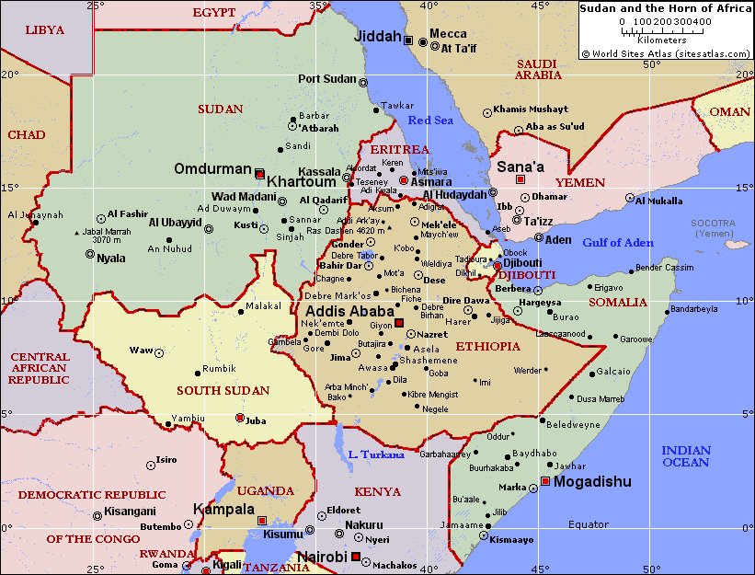
Horn of Africa
Ethiopia, Eritrea, Djibouti, Somalia
Broader HoA includes also Sudan, South Sudan, Kenya
Cross-border disputes
Pan-Somalism
Separatism, fragmentation

Slide 5
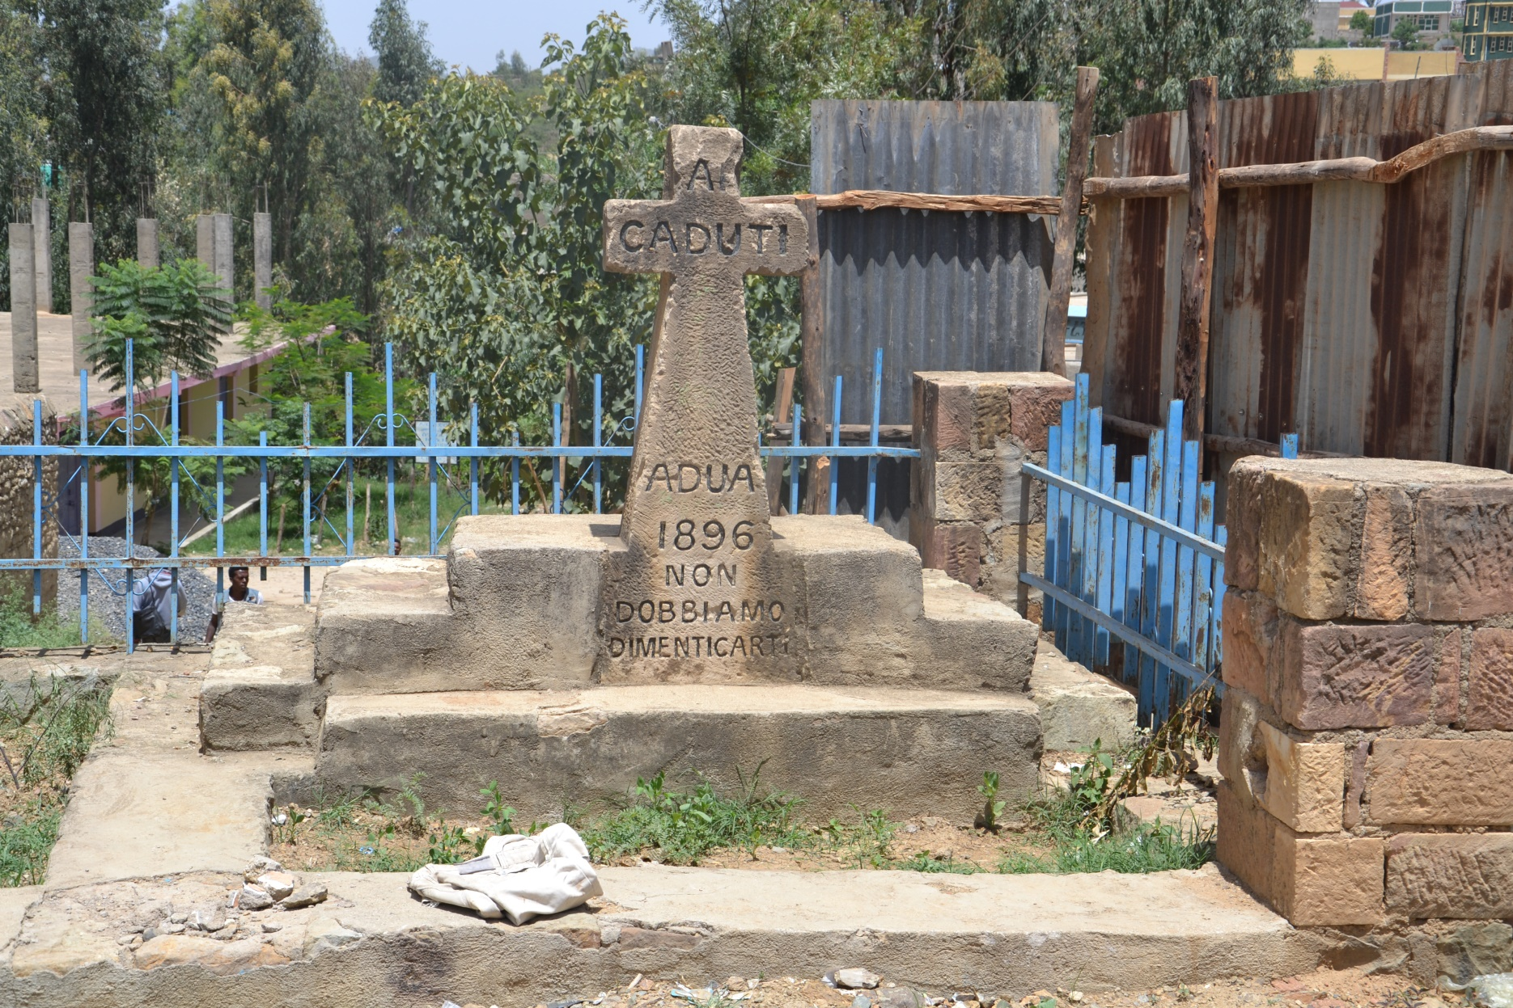
Historical background
Africa Orientale Italiana 1936-1941
Eritrea an Italian colony from 1890 to 1941
British Somaliland and Italian Somalia fused in 1960
Sudan independent in 1956: subsequent civil war in the South

Slide 6
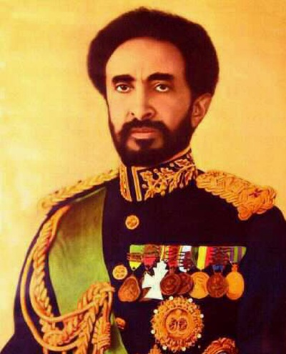
Historical background
Eritrea fighting for liberation since 1962
1974 fall of the Emperor and the rule of the Derg in Ethiopia
Pan-Somalism under Siad Barré and invasion to Ethiopia
1972-1983 Peace in the Sudan
Since 1983 second civil war, SPLM/A

Slide 7
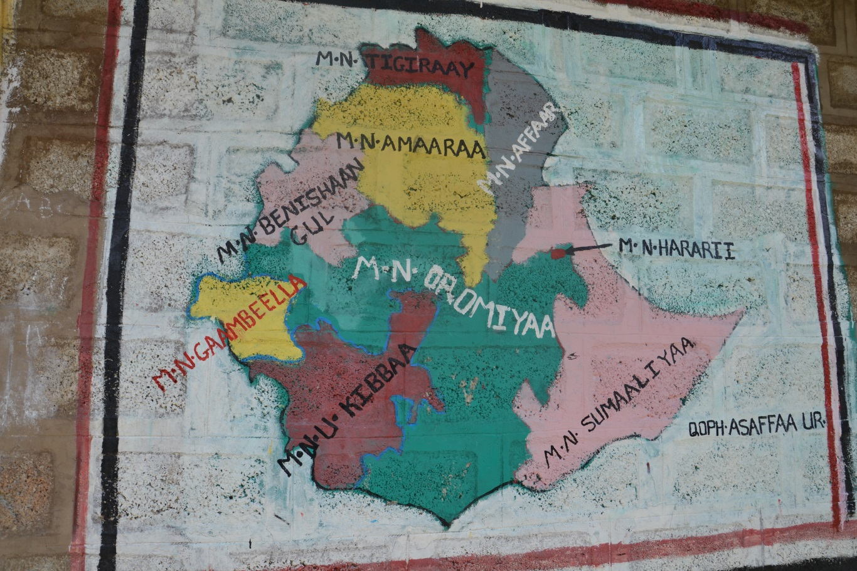
Ethiopia after 1991
1991 fall of the Derg
Federal constitution 1995
Ethnic federalism
So-called revolutionary democracy
Developmental state policy

Slide 8
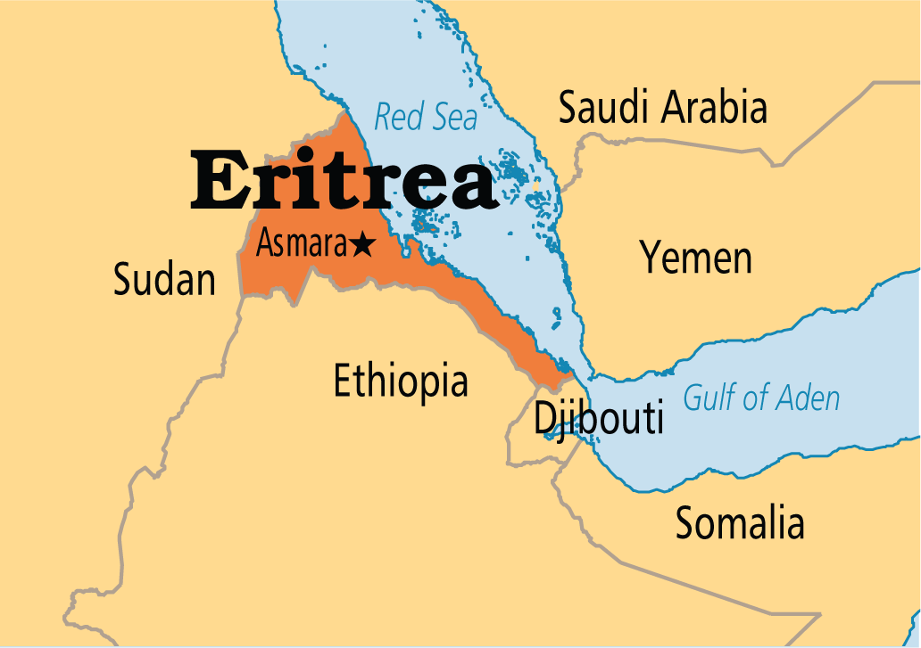
Eritrea
Border clashes
Support of Ginbot 7 and
As-Shabaab
Isaias Afeworki
Highest flow of migrants

Slide 9
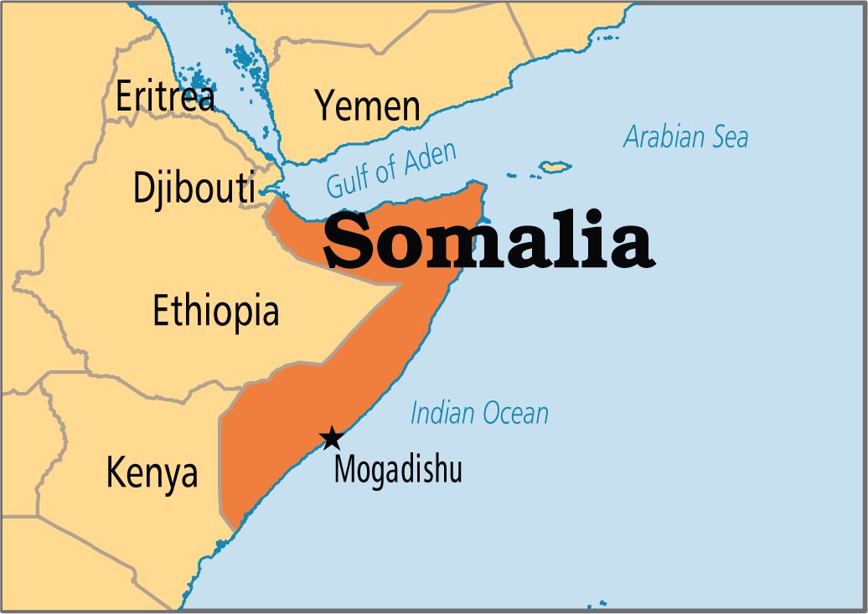
Somalia
Somali minority
Marginalization
Pan-Somalism
Military intervention
As-Shabaab

Slide 10
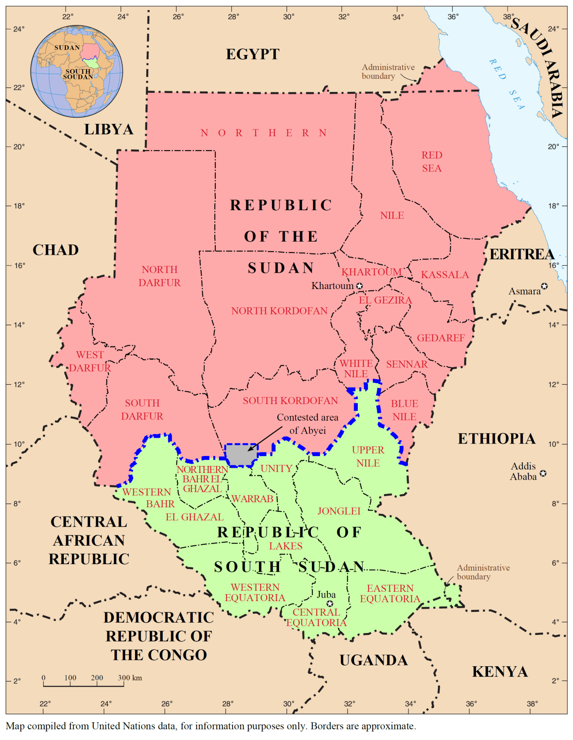
Sudan/South Sudan
Civil conflict in S. Sudan
ETH and UGA military involvement
Nuer and Anywaa clashes in Gambella
Sudan: recipient of ETH and ERI refugees
Internal problems in Darfur, Red Sea, Kordofan

Slide 11
Demography
1974: 32 million
2006: 77 million
2017: 100 million

Slide 12
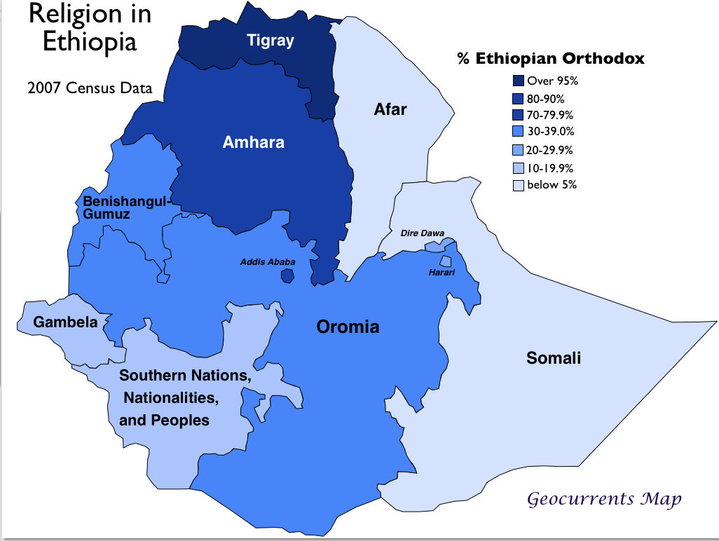

Slide 13
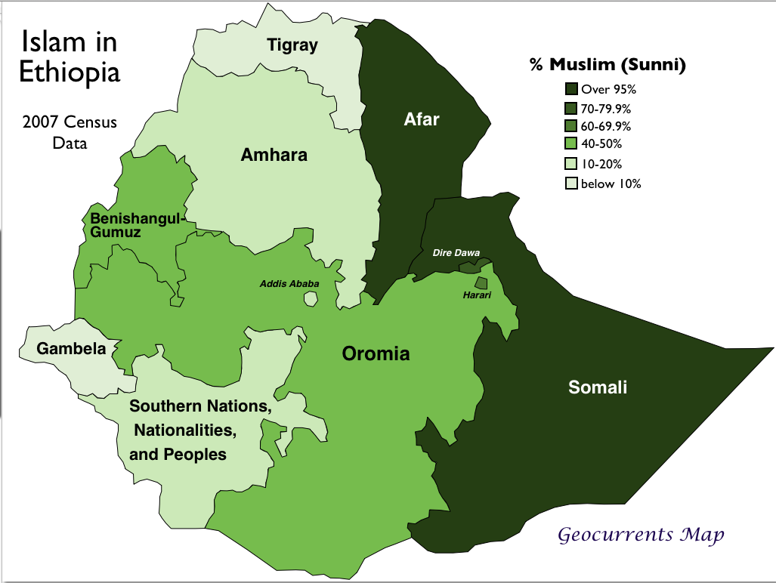

Slide 14
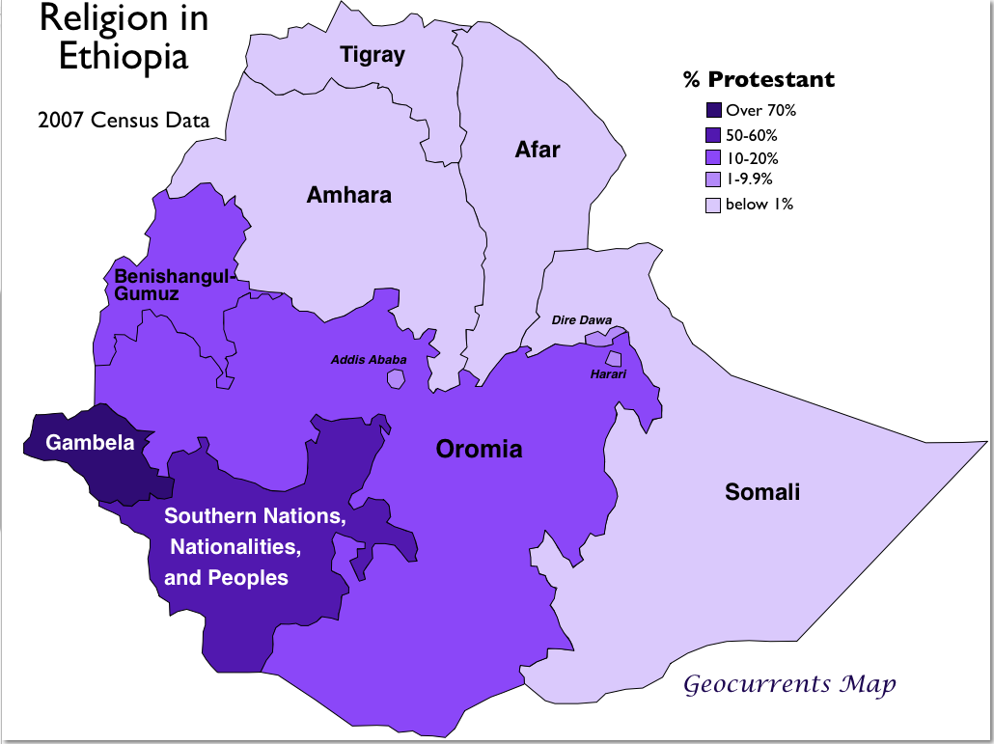

Slide 15
Instability and fragility
United Nations Development Programme (UNDP): Ethiopia 174th position, one of the lowest human developments
Only 11,4% of people have access to the internet (e.g. Gabon, Senegal, or Côte d’Ivoire over 21%)
Democracy index places Ethiopia on the 125th position among authoritarian regimes
Corruption Perception Index (TI) gives Ethiopia 108th position (Botswana tops at the 35th position, the best among African countries)

Slide 16
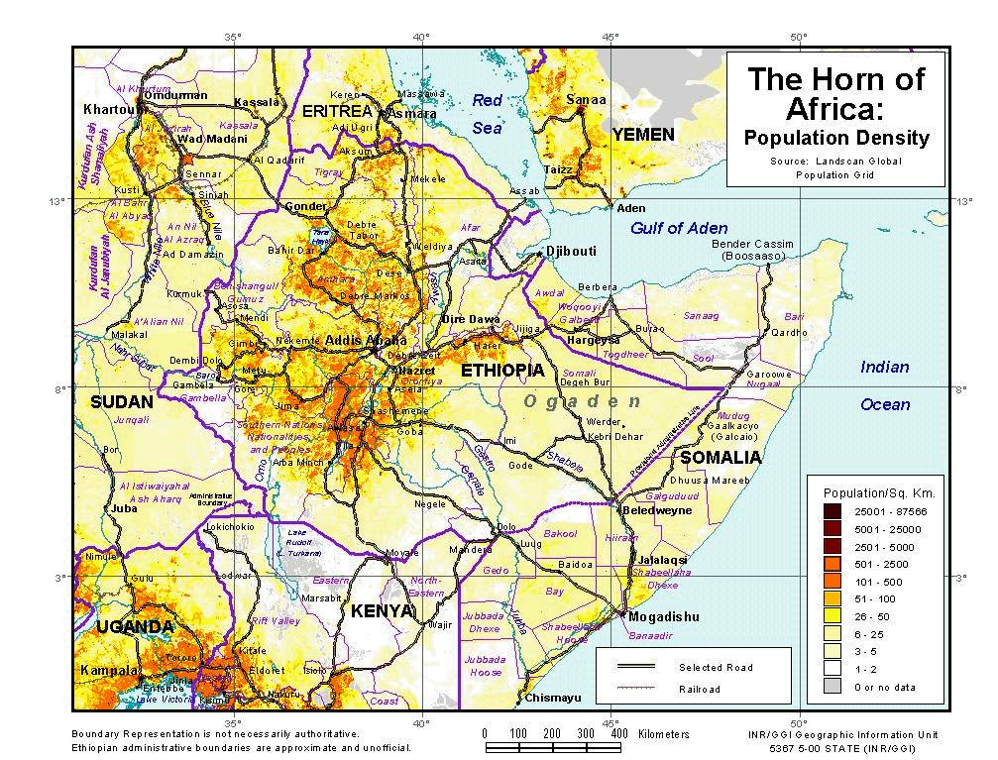

Slide 17
Internal migration
Rural-urban migration: primarily to Addis Ababa
High unemployment rates in Addis
80,5% of people living in rural areas (e.g. Gabon only 12%)
Migration for work opportunities, education, escape from early marriage
Work opportunities limited, most end up in informal sector, incl. sex industry
Life in cities frequently does not meet expectations

Slide 18
Internal migration
Rural-rural migration
Along traditional lines of marriage
Often in peripheral regions
Agro-pastoralist communities

Slide 19
Internal migration
Resettlement
2003 National Food Security Strategy: to ressetle 2.2 million people from chronically food-insecure areas
Hailed as success but faced serious criticism
Poor management, malaria, lack of equipment for agriculture
Conflict within the resettlement camps and between the resettled and locals

Slide 20
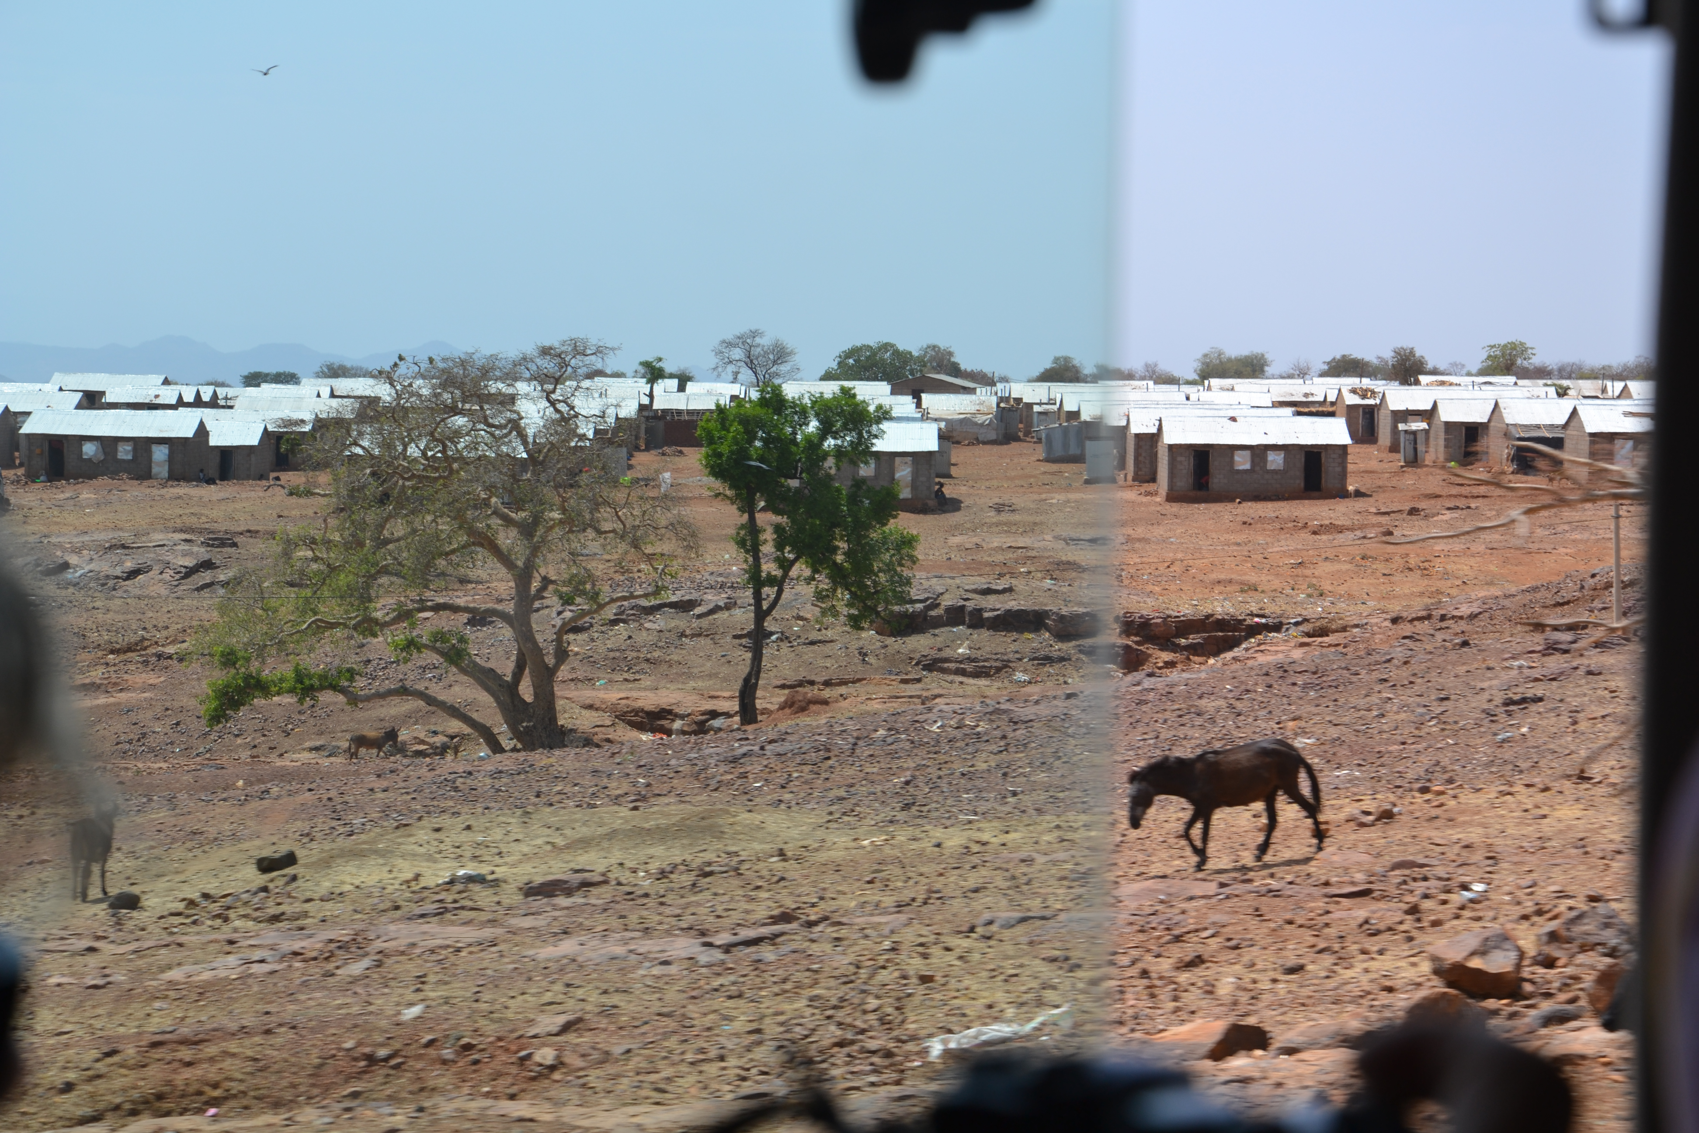
Refugee camps
Ethiopia hosting more than 750,000 refugees in 2015/2016
Refugee camps in Tigray and Somali regions
Cross-border migration from South Sudan
Conflicts in Gambella
Nuer and Anywaa conflict over dominance, land, autochtony

Slide 21
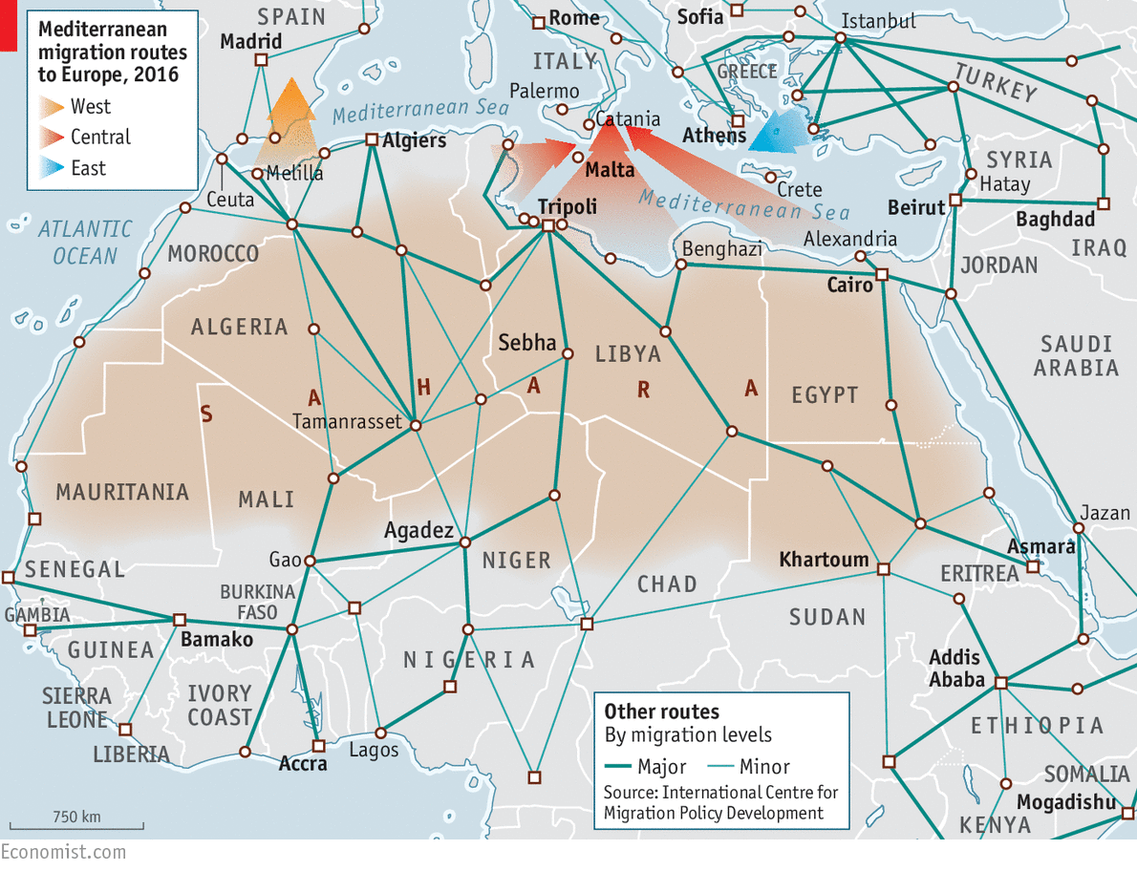

Slide 22
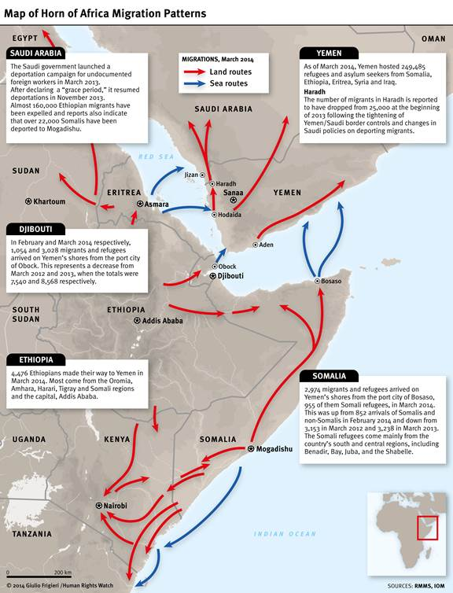
International Migration
Relatively small (compared to war zones, or Eritrea)
Destinations:
  Africa: ca. 9%
  Asia: ca. 37.5%
  Europe: ca. 21.4%
  LatAm: ca. 0.2%
  N/Am: ca. 30%
  Oceania: ca. 1.5%

Slide 23
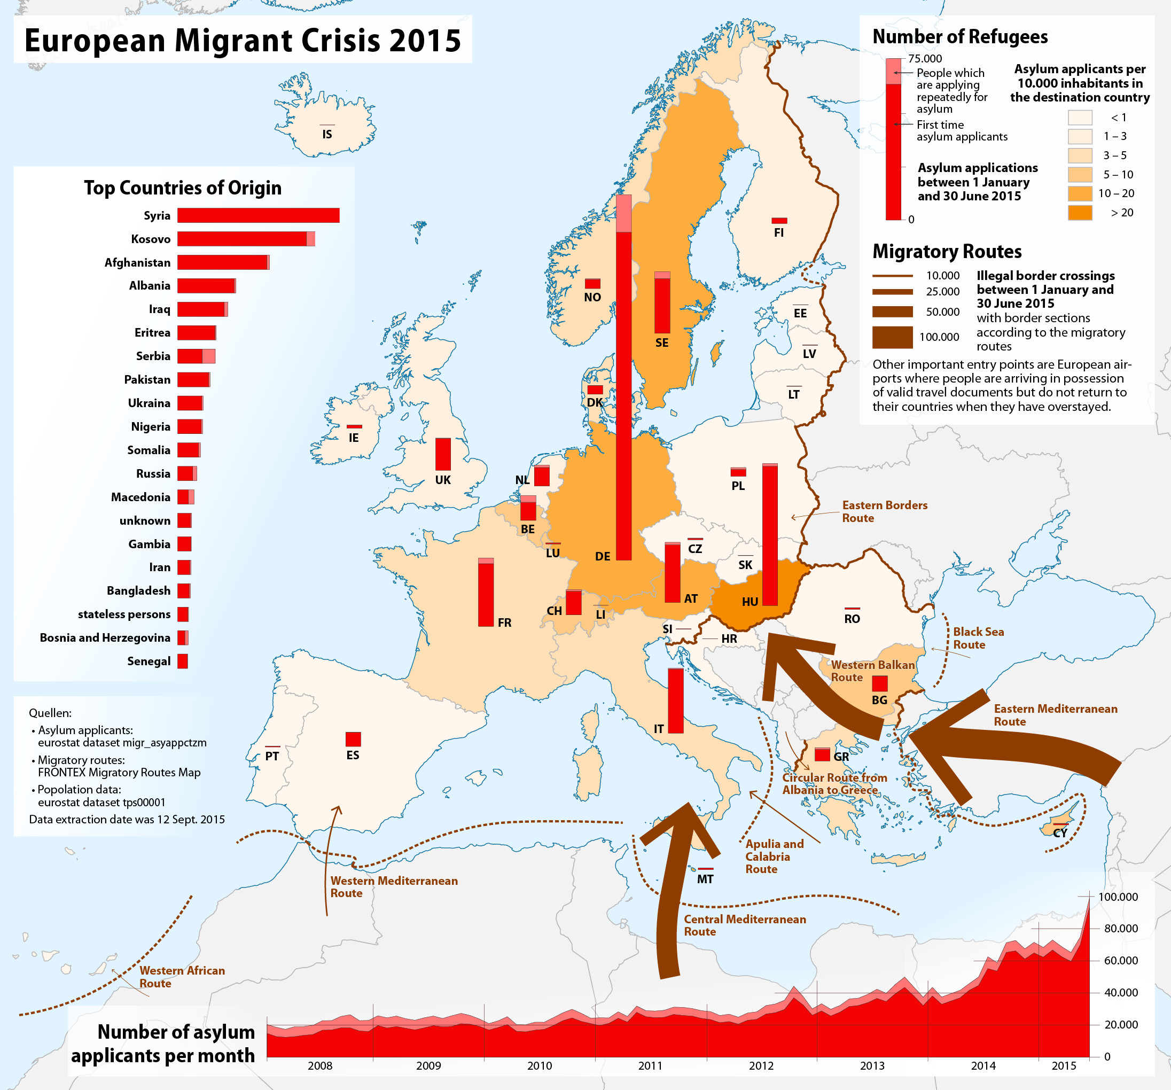

Slide 24
Migration to the Middle East
Part of international trafficking, facilitator/contractor
Saudi Arabia until 2016 (significant number of suicides)
UAE, Lebanon, Kuwait, Qatar, and even Yemen before the war
About 130,000 in 2010
Mostly domestic workers, or poorly paid jobs, large number in sex industry, mainly in Dubai

Slide 25
Migration to the Middle East
In many cases they use tourist visas
Or work permits
Frequent sexual and physical abuse
Seeking psychiatric help
Helping families back home with minimal or no personal profits

Slide 26
Environmental Causes
Repeated droughts in the Horn of Africa
1983-85
2011, 2016/2017
Agriculture-based societies, dependent on weather conditions
Lack of preventive mechanisms, infrastructure, redistribution

Slide 27
Socio-political causes
Anti-governmental protests in Ethiopia since proclamation of AA Master Plan
State of Emergency
Flow of young people from Gonder and Bahir Dar to the Sudan
Political migrants: rise of Eth refugees in Nairobi (Oromo)

Slide 28
Miration from Somalia
Tahriib – word from Arabic associated with illegal activities such as traficking or smuggling
Now related to emigration of young men from Somalia through Sudan and Libya to Europe
Results in social problems becasue elders remain back home – may have serious consequences for the future of Somalia
On the other hand, during Islamic Courts Union period of stabilization frequent returns from GBR to Somalia

Slide 29
Migration from Somalia
1) tahriib is a youth phenomenon affecting people from 18 to 21yrs
2) Smugglers in Somaliland and Puntland facilitate the journey
3) tahriib is an individual thing, young man do that without informing their family
4) many of them held for ransom – then the family is involved, paying ca. 7,700USD per person
5) risks, death, abuse
Finland declared Somalia a safe country and thus making it less possible to get asylum

Slide 30
Migration from Somalia
88% of Somalis use the route:
Somali regions – Ethiopia – Sudan – Libya – Italy
The rest uses some of the routes leading to Greece
Leave now – pay later scheme (magafe – the one who never misses)
Ransom money sent to: Libya (48%), Sudan (38%), Italy, Dubai, Ethiopia
Diaspora effect: exit strategy (passport, money, opportunities)

Slide 31
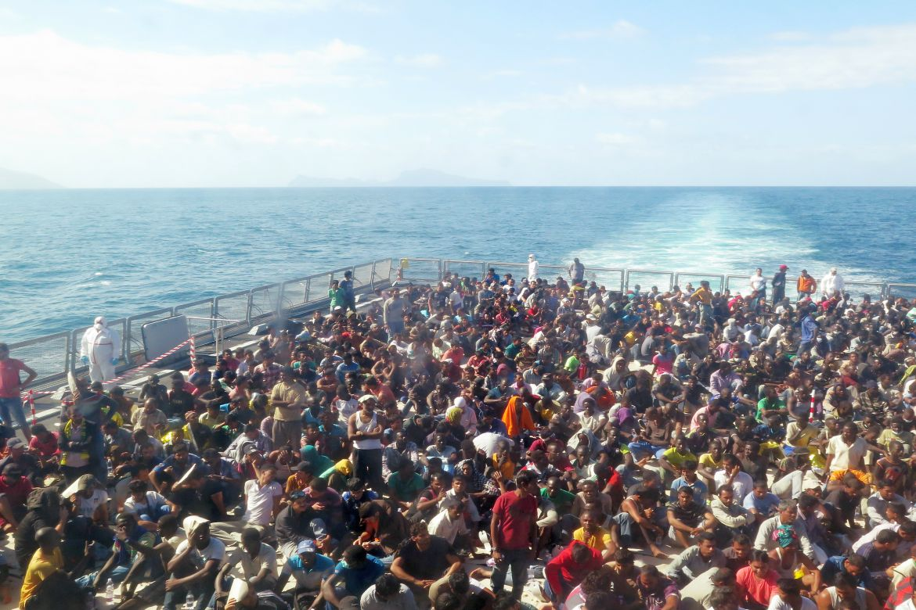

Slide 32
Kenya
Major refugee camp in Dadaab
Attempts to close it down
Somali refugees offered 400USD for return
Security issues related to ash-Shabaab
Significant Ethiopian refugee community in Nairobi

Slide 33
Brain drain and remittances
One of the most affected countries
Especially the so-called medical brain drain (up to 30%)
Shortage of skilled workers in Ethiopia (universities lack highly educated scholars)
Tendency of the govt to mobilize the diaspora for development projects in Ethiopia
Total inflow of remittances for Ethiopia more than 360 million USD

Slide 34
Diaspora
Primarily USA, Italy, Sweden, GBR, the Netherlands, Israel
Different groups within the diaspora along ethnic lines
OLF rejects the notion of Ethiopia and supports the independence
2 strategies: help and investment/remittences; rejection of any involvement (primarily OLF followers or anti-govt activists)

Slide 35
Future?
Further destabilization of Ethiopia may lead to greater waves of migration
Uganda and Ethiopia with the highest number of refugees on their territories
Governments still not sufficently capable of dealing with environmental challenges
In Kenya: frequent criticism over lack of willingness of the govt to deal with draught and famine (used as a political game)

Slide 36
Conclusion
Migration within and from HoA not a new phenomenon
Environmental, social, and political causes usually combined
Destabilization of HoA may likely increase migration (as seen on the example of South Sudan)
Longlasting impact on local societies (migration of youth, educated, skilled…)

Slide 37
Thank you for your attention

