Slide 1

Cultural Imperialism, Eurocentrism, Gender, Sexuality
ESF II project of the University of West Bohemia in Pilsen
reg. number: CZ.02.2.69/0.0/0.0/18_056/0013239

Slide 2
Eurocentrism
Imperialism placed Europe in the centre
Eurocentric histories
Hegel: fate of Asian empires to be subjected to Europeans
Idea of time and history: dynamic West
Hegel: Africa unhistorical

Slide 3
Eurocentrism
Western modernity far from monolithic
Creolité – hybridized cultures
New, dynamic and in conflict with European modernity
Some ways of being modern became monstrous

Slide 4
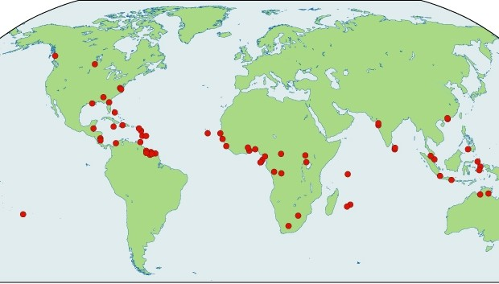

Slide 5
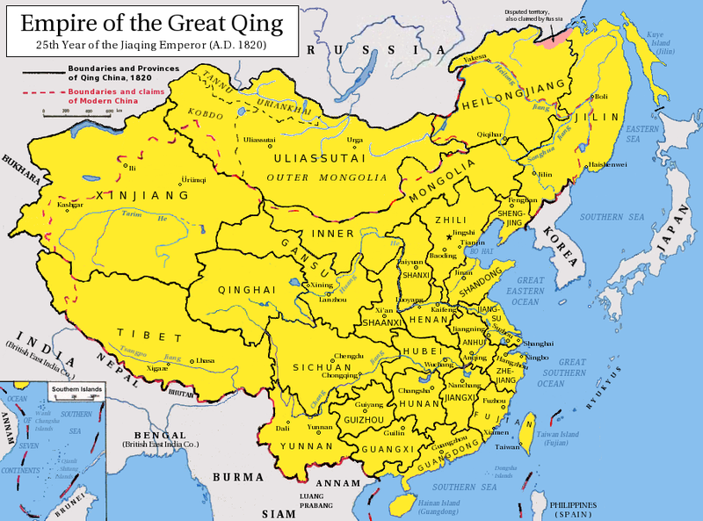
China and Japan
Reactions to European and US imperialism
Collapse of Chinese Empire, rise of Japan Empire
China‘s isolation, Opium Wars 1839-40, forcing China to open up its trade
Expansion of British cultural and economic superiority

Slide 6
China and Japan
China: hostility to Western ideas led to ckash between modernizers and traditionalists
Kuomintang (admired Japan‘s modernization)
Traditionalists wanted to return to Old Chinese Empire
Civil war between communists and nationalists

Slide 7
China and Japan
Japan: Meiji (1866-1912) – civilization and enlightement
1904-5 defeat of Russia
1919 League of Nations
Acceptance by the White powers

Slide 8
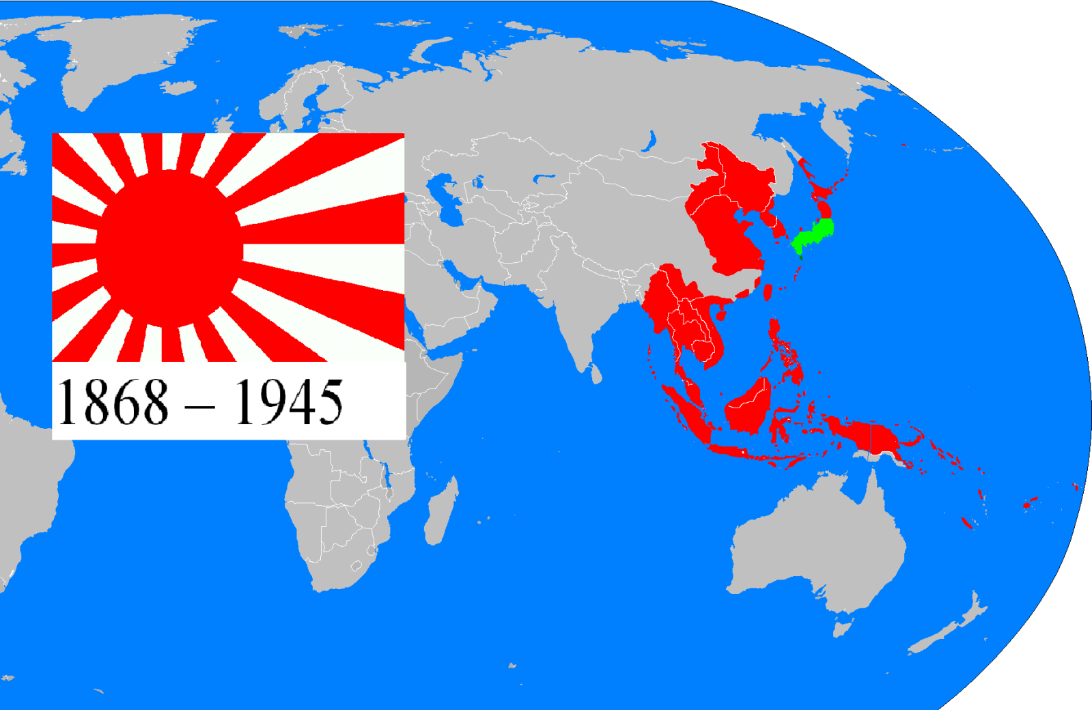

Slide 9
China and Japan
Japanese strategy to renew Asian civilizations through Japanization
After openness to Western modernity return to Japanese roots and militant nationalism
Japan as Britain of Asia, relatively homogeneous
China diverse, experience with rather oppressive imperialism

Slide 10
Culture and Imperialism
Empire was as much a cultural and intellectual as a political/economic phenomenon
Said: constructing colonial subjects
Cultural interactions between the colonizers and the colonized
Anti-Western but not necessarily anti-modern movements (with exeptions such as Khmer Rouge)

Slide 11
Colonial encounters
Imperial powers needed indigenous allies
Collaboration with certain indigenous groups intensified inequality in later periods
Encounters through trade, exchange and sexuality
Religious encounters

Slide 12
Gender and Sexuality
Cultural imperialism included Western medicine, science, technology, Christianity, education, languages, law, taxation….
Masculine imperialism
Women: securing race discipline, uniformity and order
Preventing men from going native

Slide 13
Gender and sexuality
White women superior to African/asian women
Women treated as labor force
Colonized people arguably conceptualized as feminine, submissive, pleasure-giving….
Control of sexuality and superior white gender relations maintained social hierarchy and distance between ruler and ruled

