Slide 1




ESF II project of the University of West Bohemia in Pilsen
reg. number: CZ.02.2.69/0.0/0.0/18_056/0013239

Slide 2

Globalisation, culture and (social) media
Department of Politics and International Relations
Faculty of Arts at the University of West Bohemia in Pilsen
Přemysl Rosůlek

Slide 3
G. & culture
Culture can be the major power of the economic and political transformation (D. Held, B. Buzan)
Culture = interpretative framework, which is attached to our day-to-day practice, relations to others, our desires and hopes

Slide 4
G. & culture
Barrie Axford & 4 types of topics
Axioms:
There is existence of important global culture
There is overlapping and polarization at the dividing line between global, national and local culture
There is culture of convergence, differentiation and hybridization
Culture and communication: main (symbolical) importance is in communication

Slide 5
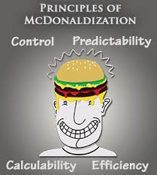
Barrie Axford (#1): existence of ONE important global culture
Two major – different - topics:
1) Cultural homogenization (G. Ritzer)
= Paradigm of McDonaldization
2) Cultural imperialism (Wallerstein)
= Paradigm of World Culture, Wallerstein and geoculture
= infantilization of society (Benjamin Barber)
= joy
= cloth
= fast foods
= Hollywood as symbol

Slide 6
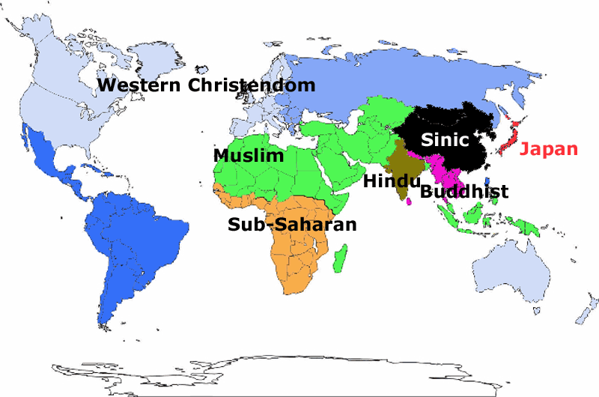
Barrie Axford (#2): polarization (global / national / local culture)
Rise of National cultures
Emergence of civilizational ethos
Christendom contra Islam
Clash of Civilization
(Samuel Huntington)

Slide 7
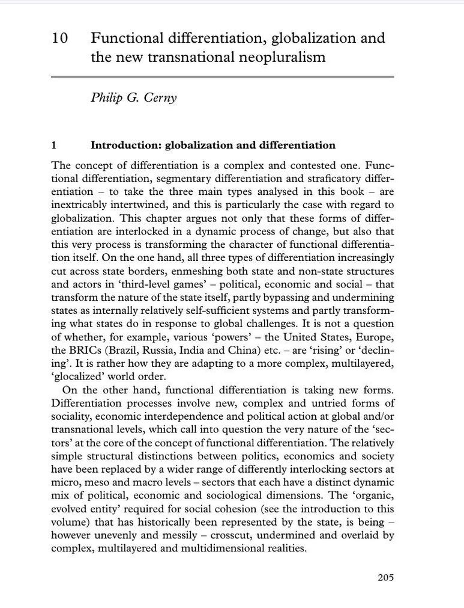
Barrie Axford (#3) culture of convergence, differentiation and hybridization
The concept of differentiations:
Functional
Segmentary
Stratificatory
Cultural convergence:
It „…refers to the tendency of cultures to change and adapt to frequent exposure to other cultures. The more cultures are in contact with each other, the more similar they will be. …The higher the levels of interaction, the faster and more thoroughly cultures will converge, becoming more alike in their behaviors, ideologies, art, and so on“ (study.com)
Hybridization: „The process by which a cultural element blends into another culture by modifying the element to fit cultral norms“ (Open Education Sociology Dictionary)
E.g. „global restaurants chains like Kentucky Fried Chicken or McDonald´s (KFC), modifying their menus to suit the tastes or mores of different cultures (Open Education Sociology Dictionary)

Slide 8

4 types of glocalization
relativization
accomodation
hybridization
transformation

Slide 9





Barrie Axford (#4) = meaining of symbolical production of culture through media and consumption
Communication is a key tool for culture (media) to become global:
E.g.:
cultural imperialism (CNN)
indigenization (e.g. Spread of radio in places in Africa during 1990s)
glocalization – e.g. regional branches of VIVA and MTV

Slide 10
Media and the major paradigms
Global village (Mc Luhan)
World-system theory (media imperialism)
Networked society (Manuel Castells)
Jürgen Habermas (global public sphere)

Slide 11

Global village (Mc Luhan)
Kai Hafez – three characteristics (accepted positively):
(1) interconnected system
(2) system change
(3) interdependency

Slide 12

World-system theory (media imperialism – I. Wallersteen)
Media as a message of cultural imperialism
Media industry (USA) aimed at colonial and post-colonial states
Acceptance of comercial US model
Media as a tool of spreading culture, style, values, entertainment (US cultural influence)
„Colonization“ of communication in the Third World

Slide 13
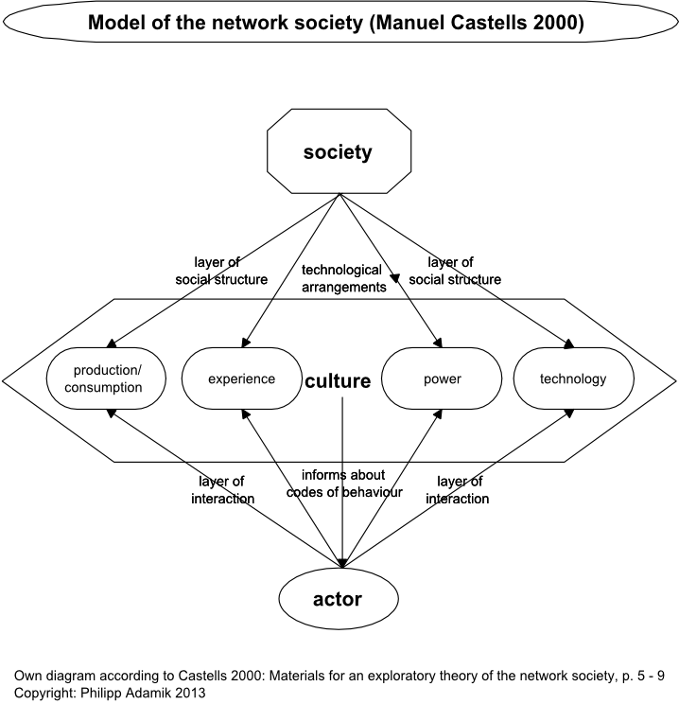
Networked society (Manuel Castells)
The age of information
New economy
Know-how
Education
IT
Global interconnected with local (= glocalization)
Hybridization
Influential big cities

Slide 14
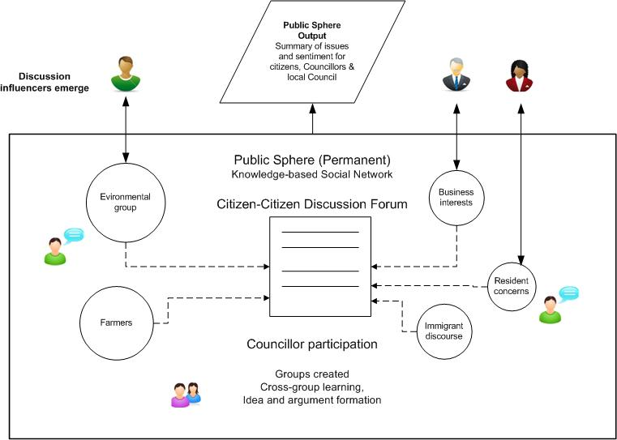
Jürgen Habermas and global public sphere model

Slide 15
Discussion (part)

Slide 16
New forms of communications :

Slide 17
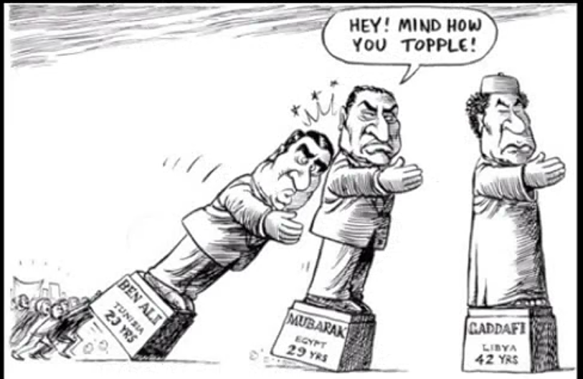
Al Džazíra effect

Slide 18
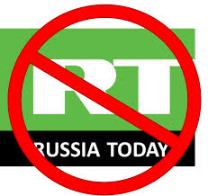
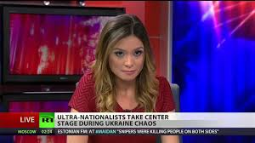
RT/Sputnik propaganda

Slide 19
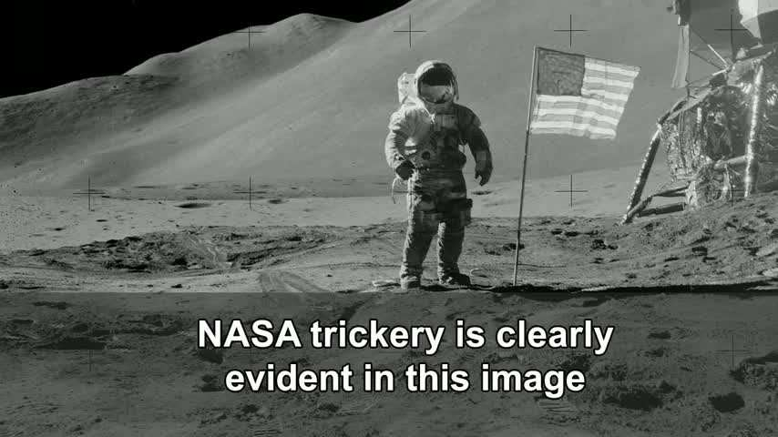
Hoax

Slide 20

Trolling

Slide 21
Conclusion

