Slide 1




ESF II project of the University of West Bohemia in Pilsen
reg. number: CZ.02.2.69/0.0/0.0/18_056/0013239

Slide 2

China and America or Chinamerica?
Přemysl Rosůlek
Department of Politics and International Relations Faculty of Arts UWB in Pilsen

Slide 3
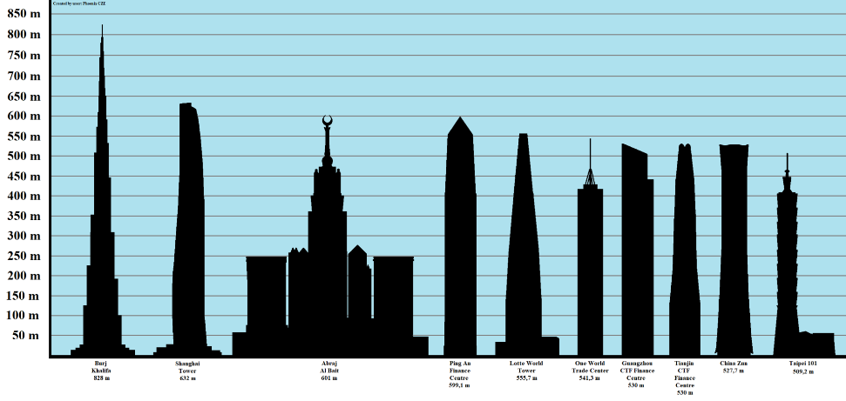
Postamerican world (Fareed Zakaria)
West is not dominant any more, e.g. tallest building in the world:
Burj Khalifa [Burdž Chalífa], Dubai, 828m
Merdeka 118, Kuala Lumpur, Malaysia, 679m
Shanghai Tower, Shanghai, China, 632m
(…)
7) One World Trade Center, 541m, New York, USA

Slide 4
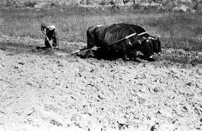
China as a superpower?
End of 1970s:
agrarian country
car was exceptional
phone: institutions had to give permission for use of public phone
widespread poverty

Slide 5
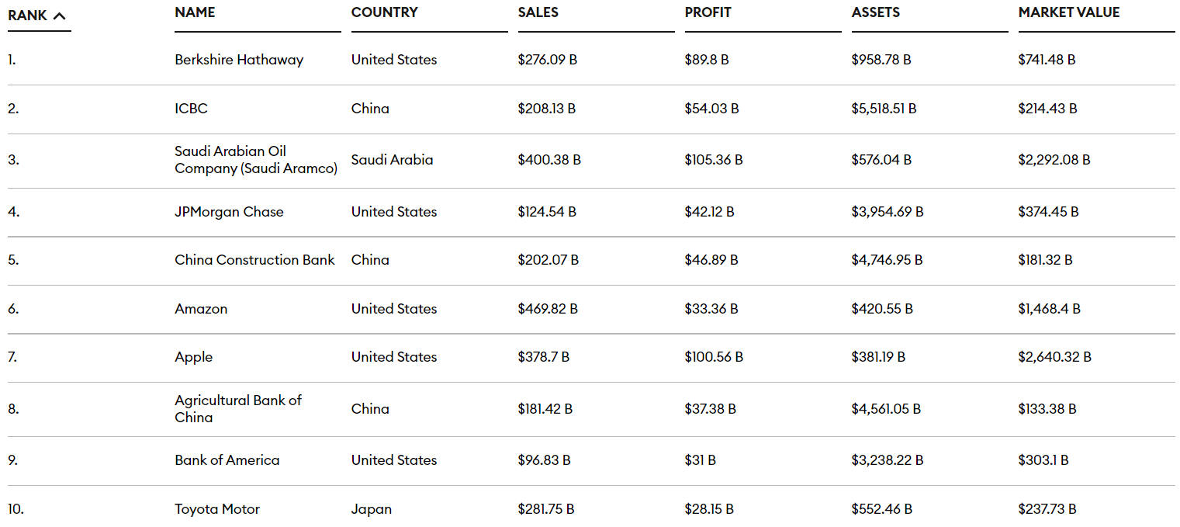
China – from 1980s „several decades of economic miracle“
major economic power side by side with the USA
most important FDI player
high surpluses of foreing trade bilance
factory of the world: first in producing copy machines, microwaves, shoes, toys, mobile phones….
world TOP 10: China 3 corp., US 5 corp. (Forbes)

Slide 6
China and contemporary period
2009: China became highest exporter in the world (artifically underestimated currency)
high foreign exchange reserves
most important creditor to USA
first in consumption of energy

Slide 7
China as a global superpower
„G2“ = from the year 2007 (historian Neil Ferguson)
„Chinamerica“ = idea of US-Chinese tandem
Zbigniew Brzezinski: conception of „G2“

Slide 8
China as a global power?
The goal is internal stability not to Cíl je interní stabilita, not to control world (politically or militarily)
strategy of multilateralism
no demands to become superpower in all aspects (e.g. culture)
E.g. Africa = hard power and development of „soft-power“ diplomacy
(e.g. Chinese language at schools in some African countries /e.g. newly in South Africa from 1/2016, offering stay at universities in China; to learn Chinese language is considered as prestigeous at e.g. Zimbabwe

Slide 9
Economy as a proof of world power?
high foreign exchange reserves
state assets invested in foreign countries (e.g. China Investment Corporation, China Export-Import Bank)
= they have given loans to governments and firms in last years more than the World Bank.
= they have given credits to Indian energetic and construction firms (now e.g. CEFC (China Energy Company Limited) in Czech Republic: some media (Barandov TV, Týden.cz and weekly journal), soccer club FC Slavie Praha etc.).

Slide 10
China and BRICS
Non-formal leader of this group
Brasil – power in food and primary commodities (raw materials (pl)) the most important partner of China

Slide 11
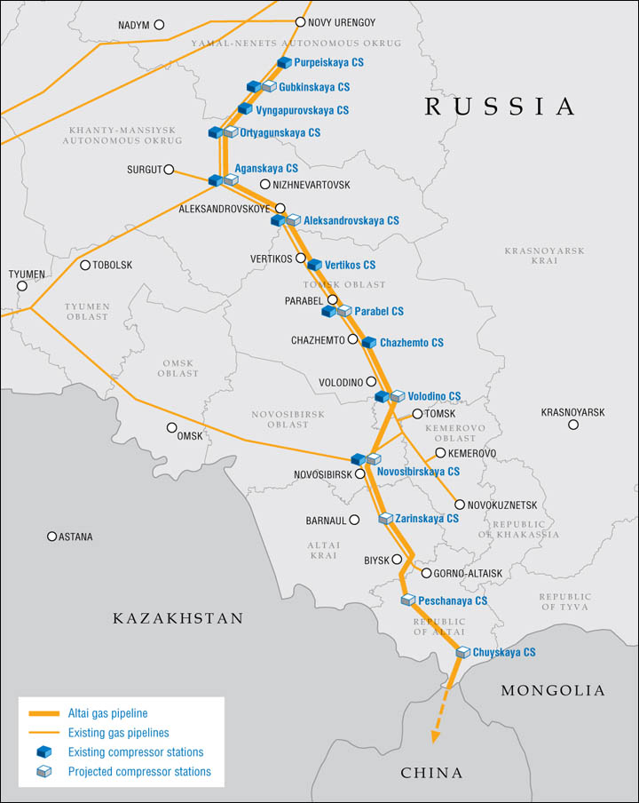
China and BRICS (Russia)
Russia = offering raw materials and some investitions on modernization of industry, but…
1) Power of Siberia - 2014 plans on pipeline and electrification, but crises in Russia and concern of the Chense investor – investitions postponed:
= Gazprom – Power of Siberia/Sila Sibiri known as China Russia East-Route Natural gas pipeline (planned finish postponed until to 2018)
10/2019 - pipeline filled with gas
Gas to China from 12/2019.
2) Power of Siberia 2 - The Altai gas pipeline = natural gas pipeline from Russia's Western Siberia to North-Western China. Postponed. Planned to be finished in 2030.

Slide 12
China and BRICS (Russia)
China-Russia:
rising partnership not disrupted by Russian annexation of Crimea (2014)
China remained neutral (or abstain of voting in GA UN) to Russian occupation of Crimea
However, Russian invasion to Ukraine (2022) ceased natural development of mutual cooperation

Slide 13
China and employment at home
Strong working mobility in China (roughly 280 mil. of people live over half of year out of own city)
Raising wage (labour) costs in China
Decease or stagnation of working possibilities:
= if the GDP rise is less than 8 % annually, than the problem is how to absorb 15 mil. of workforce annually

Slide 14
China and democracy
Officially socialism not changed and the cult of Mao Ce Tung still exists
Absence of political pluralism, freedom, democracy, human rights
strongly ties between partyism and economic rise
Question of territorial integrity:
struggle against „terrorism“ of Uighurs
„Tibet is ours!“
fight against any sign of diplomatic relations with TaiWan

Slide 15
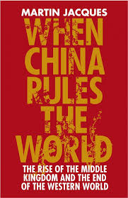
China and the question of democracy
Democratization of China? It is possible but the impact of Confucianism
China is not for for accepting rules of the West
Tradition:
= collectivism
= state and state order
= civic society and revolt

Slide 16
China and expansion
Chinese tradition – „the middle kingdom “
idea of foreign policy for 2 tsnd years:
„the World is coming to China“
foreing policy is extended hand of domestic policy

Slide 17
Martin Jacques and expansion of China
Why is China not expanding?
= China is covered by strong and densely populated countries
= relative poverty rate is high
= „manufactory“, dependency on the prosperity of others
= the question of getting energetic raw materials, which is not possible by conquering other territories

Slide 18
China and shadowy sides of development
high energetic demands (16 % of world production in 2009)
import
construction of heat power plant (2/3 of most poluted cities are chinese)
= most of the emmission of carbon and from economic reasons absence of will for more stricter measures

Slide 19
China and shadowy parts of development
In China there are large territories with
lack of drinking water
erosion of soil
dirty rivers
Now investment into wind chargers and great ambitions to become TOP world power to green energy.

Slide 20
China and shadowy parts of development
Unequal economic development in regions:
over 700 mil. of population in countryside
roughly 200 mil. of population under poverty level
rise of inequalities in salaries in cities and countryside (2001 = 2,79:1; 2009: 5:1)

Slide 21
China and shadowy part of development
Corruption
Social unrest
Autocratic management
One child policy (many exceptions, now totally abandoned but concern about retirement: working population ration in the near future)

Slide 22
Conclusion, discussion

