Slide 1




ESF II project of the University of West Bohemia in Pilsen
reg. number: CZ.02.2.69/0.0/0.0/18_056/0013239

Slide 2

Russia as a global superpower?
Přemysl Rosůlek
University of West Bohemia in Pilsen, the Czech Republic

Slide 3
Definition of global (super)power?
What does it mean to be superpower?
Definition of superpower (by Alice Lyman Miller):
Real superpower must behave four key pillars:
military
economic
political
cultural
See: Ashely Widerhold: Russia: Not The Super Power It Once Was (World Policy Blog).

Slide 4
Russia as a global superpower?
Russia has
territory
sources
large nuclear potential.
All of it is of great importance.
Nevertheless, It laks real economic growth.
Dmitri Trenin, Russia´s Great Power Problem (National Interest)

Slide 5
Russia
Winner of the Second World War
Permanent member of SC UN (GA)
Superpower during the Cold War (USSR during the bipolar world)
member of BRICS
Euroasian power
SNS (CIS)

Slide 6
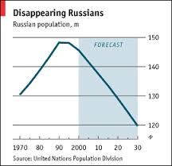
Russia after the break-up of Soviet Union (USSR)
Decline of the Russian population
declining tendency in Russia
very low birth rate (in Europe): 1,1-1,3
low figure of live expectancy:
men: 63 years
women: 75 years (100 mužů na 116 žen)
Huge gap in live expectancy between men and women (up to 15 years)
alcoholism
addiction on drugs
over 80 % of population are ethnic Russians (mainly orthodox religion)
V. I. Putin policy for increase of natality

Slide 7
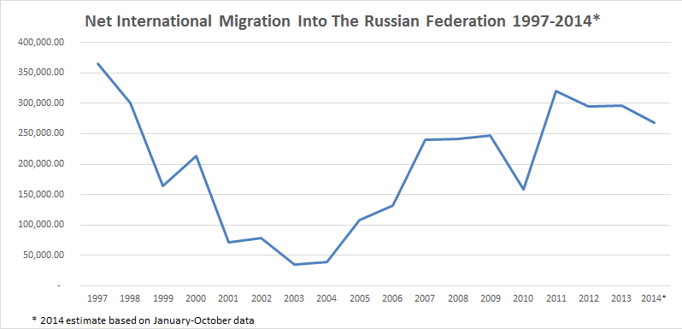
Russsia after the fall of Soviet Union
2) Emmigration and Immigration
immigration of rich (oligarch) and skilled (e.g. in IT communication) Russians
Strong internal immigration
from Ukraine
from other countries of former USSR (often Muslims from the Central Asian republics)
not prestigeous jobs
chechenophobia, caucasophobia, islamophobia (DPNI)
strenghtening legislative

Slide 8
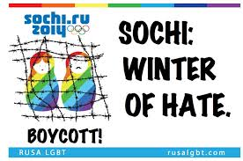
Rusko jako globální mocnost?
In 2014, three factors behind debates about rising role of Russia as a power:
role of Russia in Crisis in Syria
Winter Olympic games in Sochi (Russia) as soft power diplomacy
Annection of Crimea, crisis in Ukraine and Russian involvement/engagement in it (incl. Donbas and Luhansk).

Slide 9
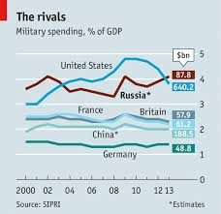
Russia – army (and nuclear) arsenal
expanditure on army around 4% of GDP (USA 3,5 %, in Europe less than 2 %)
Russia secret about how many and where they do have nuclear weapons
estimates: up to 6 tsnds. and less than tsnds ready to use:
land
air planes
submarines
Russian doctrine to use military weapons as a first country.
Debate on Crimea with nuclear weapons.
Armament of flotile in Calinigrad
Incidents in Europe (submarines) and flight zones in Europe (planes).

Slide 10
Russia and economic sources
The most sources in the world (mainly gas and petrol)
20% of world production of gas and oil
Prominent exporter to Central and Western Europe
Russia is „virtually“ economically self-sustainable
GAZPROM – state company, monopoly in Russia
Nevertheless:
Strong economic dependency on export of gas and oil / and import of food products
Lack of rise of middle class after 1989 (worse than India and China)
68 % of economic gains is from export (mainly to Europe)
dependency on Europe / Dependency on world market prices of oil and gas / dependency on rate of Russian Rubel to USD
Three crisis: 1989-1991 (Break-up of USSR), Financial Crisis (1998, 2014)

Slide 11
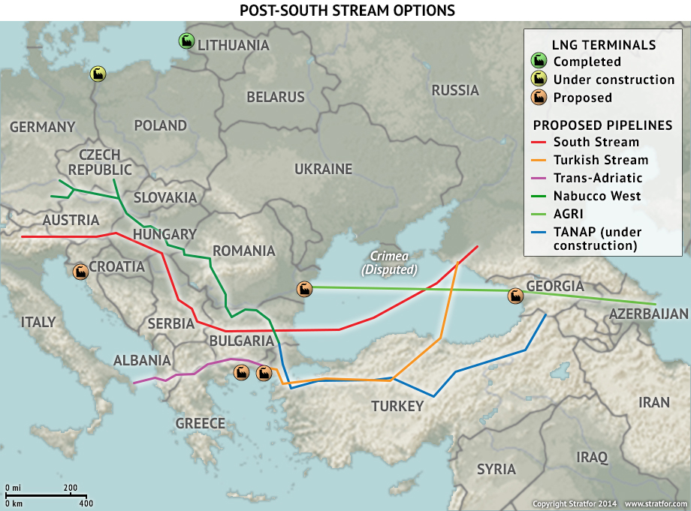
Russia and export of gas – strategy and complications
(in 2014 GAZPROM 1 third export to Europe)
Power of Siberia (Síla Sibiře)
= planned gas line to China strated to be bulit but complications
South Stream
= Russia – Europe (over Bulgaria) cancelled gas line, which shall be taken to Europe and bypass Ukraine (pressure of the EU on Bulgaria because of annexion of Crimea)
Turkish stream
= replacement of South Stream by the Turkish stream
North Stream I, North Stream II (planned, before start) = finished in 20222

Slide 12
Russia after the break-up of Soviet Union
Eurasia „Heartland“
„Break-up of USSR was a mistake“!
territorial integrity saved: Tatarstn, Baschortistan, Chechenia
active policy in „close neighbourhood“:
= Transnistria (from early 1990s incl. Russian soldiers)
= South Ossetia / Abkhazia (after Kosovo independence, against Georgia in NATO)
= Tajikistan
= „Ukrainian question“ – Crimea, Lugansk, Donbas (from 2014), invasion to Ukraine in 2022 = incl. Kherson etc.
= against expansion of NATO eastwards

Slide 13
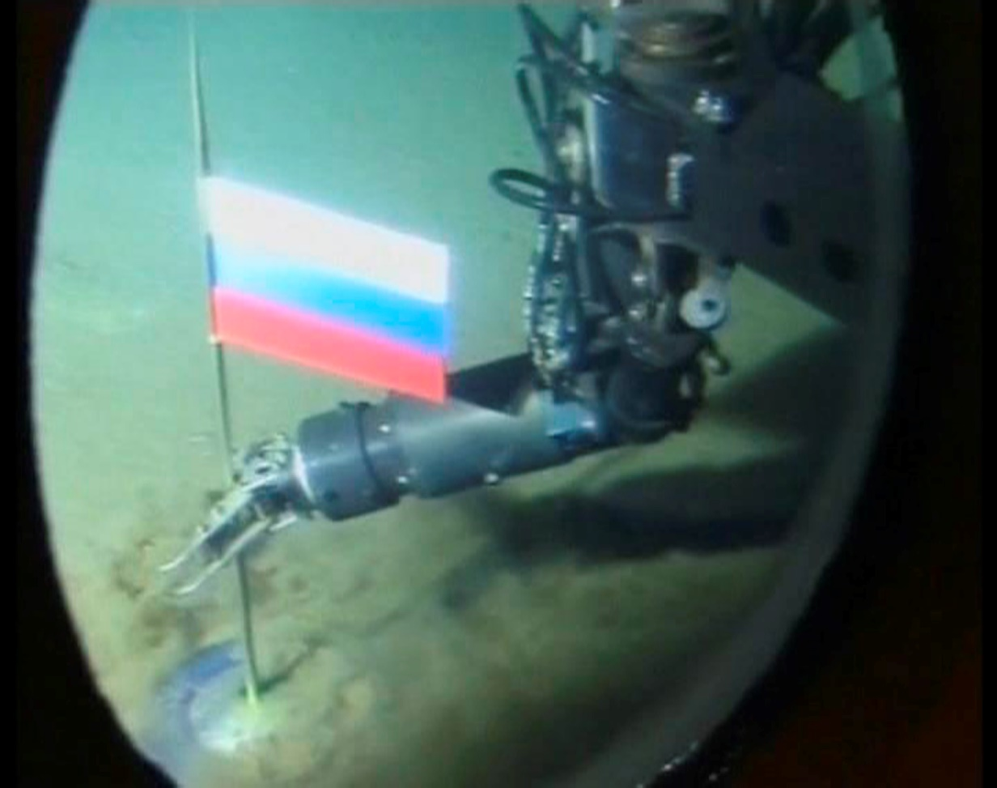
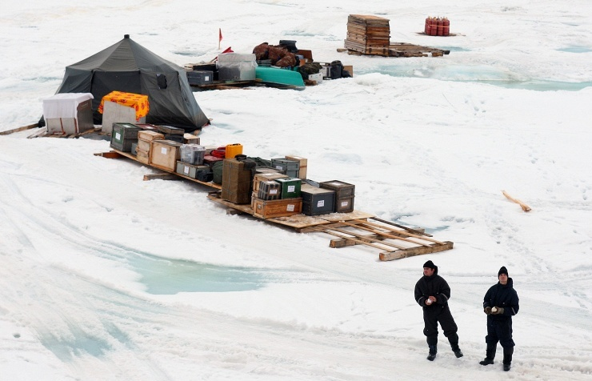
Irational policies: strategy of (territorial) expansion
- Russian flag on the North Pole
- polar station North Pole openede in 2015

Slide 14
Russia and Gerassimov´s doctrine towards „hybrid warfare“
General Gerassimov (2013):
Russia can not win with conventional means
combination of warfare and non-conventional means
Hybrid warfare
war with conventional means (conscripts, heavy guns)
war with unconventional means (role of secret services and special unidentified units, soldiers on vacation and without proper uniform etc.
economic sanctions and boycott
using power of related ethnic minority among enemies
creating opinion makers and „usefull idiots“ among enemies
widening gap in enemies´ society
internal and external propaganda (fake news industry) against democracy and legitimacy of elections etc.

Slide 15

Russia and propaganda / public diplomacy
„Pervij Kanal“
RT (former Russia Today)
TASS (former ITAR-TASS)
Disinformation network (Sputnik, Aeronet etc.)
Trolls
Russian politicians (speeches, social network accounts)

Slide 16
Russia and propaganda
(public diplomacy)
losely associated websites
(e.g. aeronet.cz but many more)
phenomenon of paid trolls (factory in St. Petersburg)
Pro-Russian politicians (Viktor Orbán)
Pro-Russian opinion makers (Roger Waters, E. Kusturica)
„usefull idiots“

Slide 17
Russian propaganda and „public diplomacy“
Ukrainian crisis
Labelling enemies from Kremlin: „Nazi “, „banders“, „upheavel“
Shooting down of Malaisian air plain
„Ukrainians shooted it“
Referendum in Crimea
sided with international law - “Scottish did the same“
Creating pro-Russian and anti-Ukrainian atmosphere

Slide 18
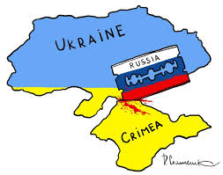
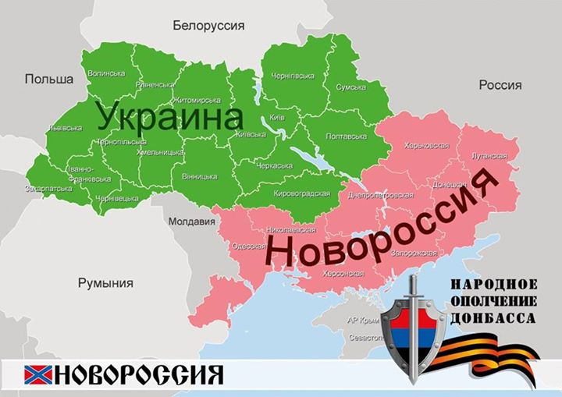
Russia and „territorial“ policies = anomaly
Territorial expansion: Crimea eastern part of Ukraine : Donbas/ Lugansk / Kherson / Mariupol

Slide 19
Russia:
Crimea and Novorossija
Planned project of bridge between Russia and Crimea (built)
Economy (food) and dependenc on import from internal part of Russia
Energetic crisis
Turism in crisis
Poor traficc incl. air traffic
Initiating irredentism – not recognized by international community
Project Novorossija not sucesfull
Strong defence of Ukrainians
fighters supported losely from RF
new identity construction in Donbas and Luhansk (neither Russian, nor Ukrainian)
sanctions damaging Russian economy

Slide 20
The end of presentation and discussion

