Slide 1




ESF II project of the University of West Bohemia in Pilsen
reg. number: CZ.02.2.69/0.0/0.0/18_056/0013239

Slide 2
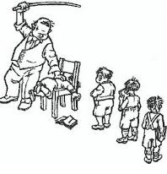
"Lazy, careless, fails"
Psychological aspects of stereotyping in school assessment

Slide 3
Objectivity of school assessment… ???
The teacher's idea of ​​the student may not be a real reflection of the student's abilities and qualities. It does not even have to be the result of the pupil's specific manifests, but rather the interpretation of these manifests by the teacher. "

Slide 4
The emergence of perceptual stereotypes
General laws of perception:
Selectivity
Wholeness
Emotion
Experience
Expectation

Slide 5
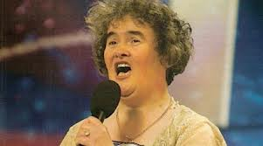
Perceptual stereotypes
Error of succumbing to first impressions
Evaluation mainly on the basis of non-verbal signals. Relatively permanent.

Slide 6
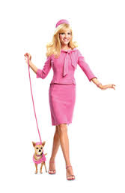
Perceptual stereotypes
Hello effect
Positive impression leads to another positive evaluation and vice versa.

Slide 7
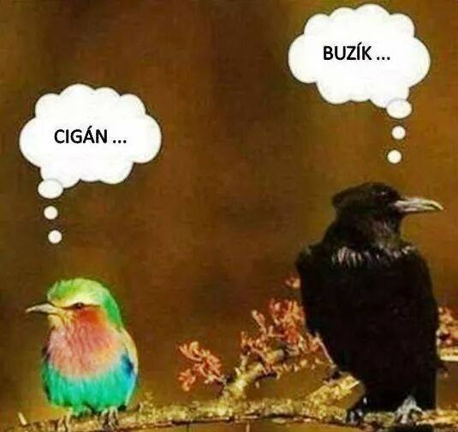
Perceptual stereotypes
Prejudices
Stereotypes

Slide 8
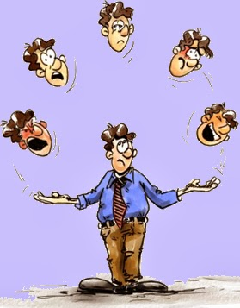
Perceptual stereotypes
Projection
Attributing own characteristics and behaviors to the perceived person.

Slide 9
Projection
I'm cheating, so I think everyone is cheating.
If we think that every Jew will "take us on a stick" and every Arab will lie, there really is no point in trying to communicate.
If your business partner is extremely suspicious and sees fraud behind everything, it may be due to his or her own pattern of behavior.

Slide 10
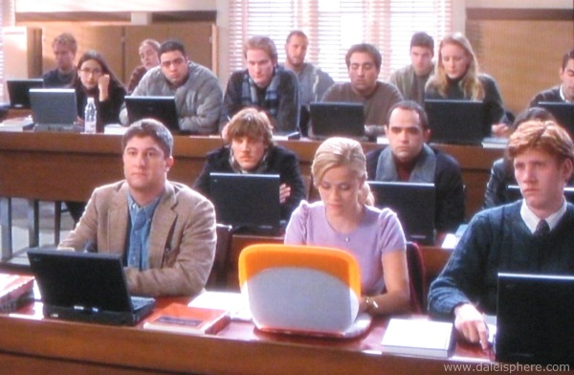
Perceptual stereotypes
Figure and background
An important factor in this stereotype is whether the background is perceived positively or negatively.
Family, class.

Slide 11
Perceptual stereotypes
Series and contrast effect
A number of poor performances lead to an overestimation of better performances.
A series of consecutive excellent performances leads to a worse evaluation of average performances. An individual's performance is evaluated incorrectly because it is evaluated in contrast to others.

Slide 12
Perceptual stereotypes
Self-fulfilling prediction
Golem effect
Pygmalion effect
The effect of expectations leads to the creation of situations that indirectly affect the development of personality.

Slide 13
Key stimuli of perceptual stereotypes
children's appearance
glasses
characteristics of speech
polite behavior
strengthening the child's behavior - admiration, respect for the teacher
performing tasks,
carrying aids,
modified exercise books,
diligence clothes
belonging to a certain social class
belonging to the majority population

Slide 14
Teachers preferential attitudes
Stereotypes are unconscious and unconscious tendencies in the approach to other people and their evaluation.
On this basis, so-called preferential attitudes arise.

Slide 15
Preferential attitudes
Significantly positive attitude towards certain students.
Slightly positive attitude towards certain students.
Neutral attitude towards certain students.
Negative attitude towards certain students

Slide 16
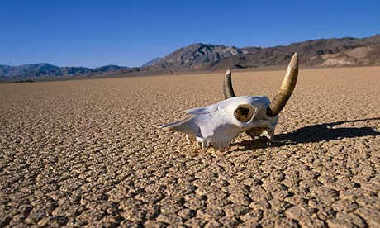
Finally…
Based on the teacher's evaluation, the student's self-confidence, self-confidence and sense of competence are strengthened or weakened.

Slide 17
Finally…
„…but I being poor, have only my dreams, I have spread my dreams under your feet, tread softly because you tread on my dreams" (W. B. Yates)“

Slide 18

Finally…

