Slide 1

Motivation Basics
What is Motivation?
Why are you at college?

Slide 2
Academic scale
What type of motivation do you have for this class?
  Why are you taking this class?
    List 3-5 reasons that you are in this class today.
  Label the reasons as I (intrinsic) or E (extrinsic)
  What do the results tell you about yourself and how you are likely to perform or behave in this class?
Fill the questionaire

Slide 3
How Does Motivation Affect Learning and Behavior?
Directs behavior toward goals
Increases effort and energy expended
Commencement in activities is sooner
Increases persistence in activities
Enhances thought processes
Determines what consequences are reinforcing
Leads to improved performance

Slide 4
Types of motivation

Slide 5

Intrinsic Motivation
Associated with seeking out and conquering challenges in pursuit of personal interests and the exercise of capabilities
Associated with activities that are their own reward
Enjoyment of a task or the sense of accomplishment that it brings

Slide 6

Extrinsic Motivation
Motivation created by external factors like rewards and punishments
Not interested in the activity for its own sake, but instead for possible gains

Slide 7
Try It Yourself
Put an E next to the examples of extrinsic motivation | Put an I next to the examples of intrinsic motivation:
A teacher assigns points for good behavior that can be exchanged for better grades at the end of each week.
A student goes to the library after school to find more information about an especially interesting topic that was introduced in class.
A student crams hard for an upcoming exam in order to get the best mark (A)

Slide 8
Effects of I vs. E Motivation on Student Learning
Intrinsic
  Eager to learn
  Enjoy learning
  Welcome challenges
  Process information effectively
Extrinsic
  Reluctant to engage in learning tasks
  Dislike learning
  Avoid challenges
  Process information superficially

Slide 9
Achievement motivation
“Very little is yet known about how achievement motives (or situationally activated states of achievement motivation) influence the acquisition of knowledge and skills. Achievement motivation research has, for decades, focused on performance criteria and neglected to clarify the relationship between motivation and learning.

Slide 10
Achievement motivation
Rather, motivational phenomena must be studied during the learning process itself, and analyzed in the context of the cognitive and emotional processes occurring during task execution.

Slide 11
Basic questions
Our motivation to succeed in school or in other parts of life is affected by how we think.
What consequences have an influence on feelings of success or failure?

Slide 12
Time perspective and motivation
Heckahausen extended cognite model of motivation
The model maps out the general structure of goal-directed behavior. A given situation presents an individual with various action alternatives, temptations, and potential threats. Any action taken in this situation may bring about a specific outcome, which may in turn have certain consequences

Slide 13
Do cognitive factors affect motivation?
Heckhausen assumed intrinsic motivation to ensue when the action, the desired outcome of the action, and the anticipated consequences of that outcome are thematically congruent.
fEx.:A student reads an article carefully (= action) because she wants to understand a certain topic (= outcome). She wants to understand the topic because she hopes it will help her solve a difficult problem (= consequences).

Slide 14
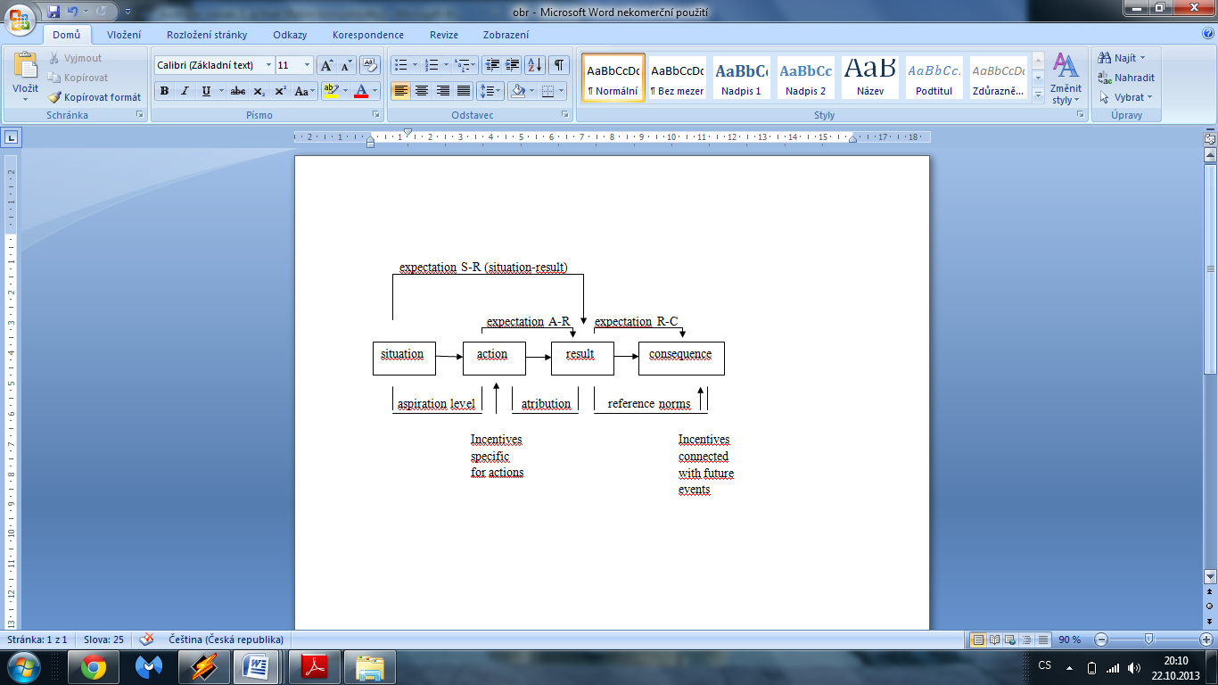

Slide 15
Four types of expectancies, as well as on the incentives in place:
1. Situation-outcome expectancies (How likely is it that the desired outcome will ensue without intervention on my part?),
2.Action-outcome expectancies (How likely is it that my action will lead to the desired outcome?)

Slide 16
Four types of expectancies, as well as on the incentives in place:
3. Outcome-consequence expectancies (How likely is it that the outcome will have the desired consequences?).
4. Incentives of anticipated consequences: The incentive value of the anticipated consequences is a further factor in the equation.

Slide 17
When you will prepare to exam?
All four of the following conditions must be met if a student is to do sufficient preparation for an exam. The student must be confident that:
1. she will not get the desired grade unless she prepares for the exam,
2. she can influence the grade attained by preparing for the exam,
3. the grade is certain to have consequences, and that
4. these consequences are sufficiently important to her.

Slide 18
When you weren´t prepare to exam?
The student will not prepare properly for the exam unless all four of these conditions are met.
1. it seems unnecessary to study for the exam,
2. it seems pointless to study for the exam, 3. the exam grade is not certain to have consequences, or
4. the possible consequences seem unimportant.

Slide 19
Time perspective and achievement
Watch this video.
https://www.youtube.com/watch?v=x3S0xS2hdi4
https://www.youtube.com/watch?v=Yo4WF3cSd9Q
Try to discuss with partner about this research.
Try to describe term „time perspective“.

Slide 20
Time perspective and motivation
Watch this video
http://www.ted.com/talks/philip_zimbardo_prescribes_a_healthy_take_on_time
Think about it a discuss with your partner – What is your main time conception?
Fill the test.

